Slide 1
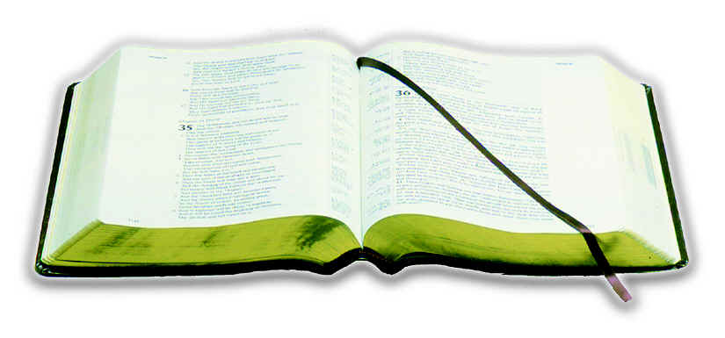
God’s Plan
Elders in every church
(Acts 14:23)

Slide 2
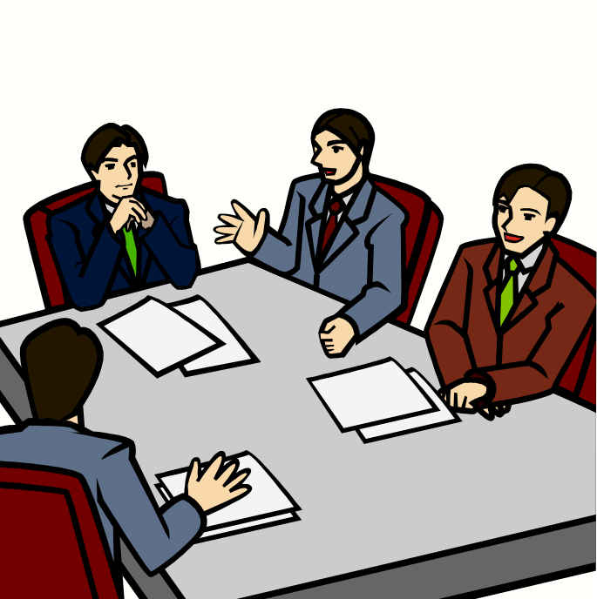
Without Elders – Something is Lacking
Titus 1:5
For this reason I left you in Crete, that you should set in order the things that are lacking, and appoint elders in every city as I commanded you-

Slide 3
A Challenge
Men (even to teens) – think seriously about working toward being qualified to be an elder (cf. 1 Tim. 3:1)
Take a look at life – ask:
  How would I be as an elder?
  Would my family life be a hindrance?
  Would something I do hinder my influence?
  If my name can up – would there be objections?
Work hard – make changes – listen to advice – set your goals – so when time comes – will be no objections!

Slide 4

The Term “Church”
Universal
Local
Matt. 16:18
Eph. 4:4
No Organization
No Work
No Treasury
1 Cor. 1:2
Rom. 16:16
Elders & Deacons
Phil. 1:1
Acts 14:23

Slide 5
Organization
Defined
“The act of organizing; the act or process of arranging and getting into proper order…the state of being organized; an organized body.”
-Webster
Organization
Essential To
Any Task
Two or more….
Lack = hindrance
To watch for souls
Deal with problems
Without it – no oversight
There Will Be
Some Sort of Organization
May be scriptural – wrong
May be strong / weak

Slide 6
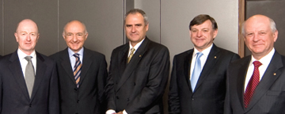

A Safeguard:
Plurality of elders (Titus 1:5)

Slide 7

The Work
of Elders

Slide 8

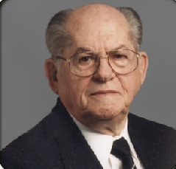
Scriptural Elders
And Deacons
H. E. Phillips
www.onestone.com
&
CEI Bookstore

Slide 9
The Work of Elders
Terms That Refer to Elders
The Work of Elders

Slide 10
Terms
That
Refer
To
The
Elders
Presbuterion
Means:
1. Eldership; elderhood, etc.
2. One older - “bearded one”
3. Suggests maturity in judgment/
experience / wisdom
Translated
1. Elder (Acts 14:23; 1 Tim. 5:1, 17)
2. Presbyter (1 Tim. 4:14)

Slide 11
Terms
That
Refer
To
The
Elders
Presbuterion
Episcopos
Means
1. Overseer, superintendant
2. One charged with duty of seeing
that things are done by others
(Thayer)
3. Epi = over; skep = to look at
Translated
1. Overseer (Acts 20:28)
2. Bishop (1 Tim. 3:1)

Slide 12
Terms
That
Refer
To
The
Elders
Presbuterion
Episcopos
Poiman
Means
1. One who keeps, guards sheep.
2. To feed flock.
3. Work of shepherd: feed, guard,
guide & protect
Translated
1. Shepherd - feed (Acts 20:28)
2. Pastor (Eph. 4:11)

Slide 13
Terms
That
Refer
To
The
Elders
Elder / Presbyter
Maturity
Overseer / Bishop
Administrative Role
Shepherd / Pastor
Teaching Role

Slide 14
Terms
That
Refer
To
The
Elders
All Three Terms
In Acts 20
Elders (v. 17)
Overseers (v. 28)
Feed (v. 28)

Slide 15
The Work of Elders
Terms That Refer to Elders
The Work of Elders

Slide 16
The Work of Elders
Take heed to himself (Acts 20:28)

Slide 17
Take heed to himself (Acts 20:28)
Important since they watch for souls (Heb. 13:17)
Must first inspect himself (2 Cor. 13:5)
  To see if he is right with God
  Hypocrisy renders a leader ineffective (Matt. 7:1-5; Rom. 2:23-24)
  Ask:
    Am I able to keep this church on right path?
    Can I be impartial in dealing with others?
    Am I doing what is expected of me?
Makes a difference in how he approaches people (Gal. 6:1)

Slide 18
The Work of Elders
Take heed to himself (Acts 20:28)
Be example to the flock (1 Pet. 5:3)

Slide 19
Be example to the flock (1 Pet. 5:3)
Cannot “lord” it over the church as a “boss”
Goes before them and leads – rather than drives
  Sheep follow a voice they know (John 10:4)
  He doesn’t bark out commands as a dictator
Constantly think that others are following (Heb. 13:7)
Needs to be a good example of:
  A Husband (good marriage – respect of his wife)
  A Father (children respect him and are faithful)
  A Good Neighbor (good report from those without)
  Faithfulness (can’t expect people to do what you don’t)
  Peacemaker (Rom. 12:18)

Slide 20
The Work of Elders
Take heed to himself (Acts 20:28)
Be example to the flock (1 Pet. 5:3)
Take the oversight (1 Pet. 5:2)

Slide 21
Take the oversight (1 Pet. 5:2)
“Take” oversight willingly – not having to be compelled to
Elders are overseers (Acts 20:28)
Suggests authority – but more responsibility than “boss”
  Like a husband
  Like a father
  Like a child left in charge

Slide 22
Take the oversight (1 Pet. 5:2)
“Take” oversight willingly – not having to be compelled to
Elders are overseers (Acts 20:28)
Suggests authority – but more responsibility than “boss”
Oversight over ALL of the church & its activities
  Worship (who leads – what is sung, order, etc.)
  Bible classes (teachers – literature, etc.)
  Preaching (who – what is taught – pay)
  Benevolence (who is helped – when – how much)
  Material & spiritual (Acts 11:27-30)

Slide 23
Take the oversight (1 Pet. 5:2)
“Take” oversight willingly – not having to be compelled to
Elders are overseers (Acts 20:28)
Suggests authority – but more responsibility than “boss”
Oversight over ALL of the church & its activities
Oversight – doesn’t mean they micromanage (Acts 6:1-6)
Not to “Lord” over them (1 Pet. 5:1-3)
  Acting as masters over servants
  Depriving them of liberties they have
  Yet when we don’t like a decision – cry being “Lords…”
  Effective communication can eliminate that charge

Slide 24
Take the oversight (1 Pet. 5:2)
“Take” oversight willingly – not having to be compelled to
Elders are overseers (Acts 20:28)
Suggests authority – but more responsibility than “boss”
Oversight over ALL of the church & its activities
Oversight – doesn’t mean thy micromanage (Acts 6:1-6)
Not to “Lord” over them (1 Pet. 5:1-3)
Is their oversight only within the activities of the building?
  Concern / business – about where I work, my entertainment, social activities – ONLY as it affects my soul (Heb. 13:17)
  Otherwise – none of their business!

Slide 25
The Work of Elders
Take heed to himself (Acts 20:28)
Be example to the flock (1 Pet. 5:3)
Take the oversight (1 Pet. 5:2)
Take heed to the flock (Acts 20:28)

Slide 26
Take heed to the flock (Acts 20:28)
Requires a skillful eye watching for slightest danger
Woe is pronounced upon shepherds who neglect their sheep
  Ezek. 34
  Jer. 23:1-4
Must first know the flock – acquainted with each member
  Know the needs of each
  Know how to handle / approach each one
  Know their tendency
Watch for dangers – parties / factions – what is be taught or read…

Slide 27
The Work of Elders
Take heed to himself (Acts 20:28)
Be example to the flock (1 Pet. 5:3)
Take the oversight (1 Pet. 5:2)
Take heed to the flock (Acts 20:28)
Rule well (1 Tim. 5:17)

Slide 28
Rule well (1 Tim. 5:17)
Elders are to RULE
  Rule well (1 Tim. 5:17)
  Know how to rule (1 Tim. 3:5)
  Remember those who rule over you (Heb. 13:7)
  Obey those who rule over you (Heb. 13:17)

Slide 29
Rule well (1 Tim. 5:17)
Elders are to RULE
Elders are to rule WELL
  Difference in ruling and ruling well
  Must not rule as Lord’s over the flock (1 Pet. 5:1-3)
  Must not rule as a Diotrephes (3 Jno. 9)
  Must not rule as a legislative body (Jas. 4:12)
  Rule must be in harmony with God’s word (Tit. 1:9)

Slide 30
Rule well (1 Tim. 5:17)
Elders are to RULE
Elders are to rule WELL
Elders must have the respect of the congregation in order to rule well
  Like a father – rules with love and patience (cf. 1 Tim. 3:5)
  Do not provoke (cf. Eph. 6:4)
  Gain respect through communication

Slide 31
The Work of Elders
Take heed to himself (Acts 20:28)
Be example to the flock (1 Pet. 5:3)
Take the oversight (1 Pet. 5:2)
Take heed to the flock (Acts 20:28)
Rule well (1 Tim. 5:17)
Feed the flock (Acts 20:28; 1 Pet. 5:1-2)

Slide 32
Feed the flock (Acts 20:28; 1 Pet. 5:1-2)
Make sure flock is feed proper diet
  Truth (2 Tim. 4:2; 1 Pet. 4:11)
  Balance (2 Tim. 4:2-5)
  Whole counsel (Acts 20:27)
Warn the members of dangerous food (Acts 20:29-30)
Watch – who and how word is taught
When teaching in the pulpit or classroom is not what it should be – responsibility falls upon the elders

Slide 33
The Work of Elders
Take heed to himself (Acts 20:28)
Be example to the flock (1 Pet. 5:3)
Take the oversight (1 Pet. 5:2)
Take heed to the flock (Acts 20:28)
Rule well (1 Tim. 5:17)
Feed the flock (Acts 20:28; 1 Pet. 5:1-2)
Stop mouths of vain talkers (Tit. 1:10-11)

Slide 34
Stop mouths of vain talkers (Tit. 1:10-11)
May involve:
  False teachers (without and within)
  Those who rebel / divisive spirit
  Those who fight disciplinary action
Why? Draw away disciples after them (Acts 20:30)
How?
  By sound doctrine (Titus 1:9-11)
  Mark or identify them (Rom. 16:17-18)
  Minimize their influence

Slide 35
The Work of Elders
Take heed to himself (Acts 20:28)
Be example to the flock (1 Pet. 5:3)
Take the oversight (1 Pet. 5:2)
Take heed to the flock (Acts 20:28)
Rule well (1 Tim. 5:17)
Feed the flock (Acts 20:28; 1 Pet. 5:1-2)
Stop mouths of vain talkers (Tit. 1:10-11)
Watch for souls (Heb. 13:17)

Slide 36
Watch for souls (Heb. 13:17)
Your soul is the most precious possession you have (Matt. 16:26; 10:28)
Guard against apostasy
  Watch for error (Acts 20:29-32)
  Watch for sin in the individual
  Watch for signs of changing – drifting
  Watch for dangers that might lead astray
Tremendous responsibility

Slide 37
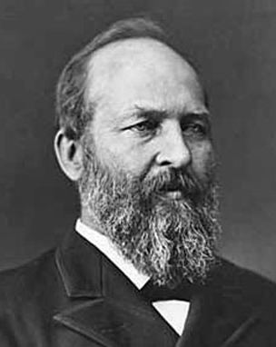
Resigned as an Elder
“I resign the highest office in the land to become President of the United States.”
James A. Garfield
http://churchofchrist-cg-az.com/files/article-famous-Garfield.htm

Slide 38
Titus
“Sound in
the Faith”
1 Peter
“Be Holy”
Elders are
to guard and
protect
sound faith
Titus 1:5-9
Elders are
to guide us
in living
holy
1 Peter 5:1-4

Slide 39
The Work of Elders
Take heed to himself (Acts 20:28)
Be example to the flock (1 Pet. 5:3)
Take the oversight (1 Pet. 5:2)
Take heed to the flock (Acts 20:28)
Rule well (1 Tim. 5:17)
Feed the flock (Acts 20:28; 1 Pet. 5:1-2)
Stop mouths of vain talkers (Tit. 1:10-11)
Watch for souls (Heb. 13:17)

Slide 40
The Work of Elders
Terms That Refer to Elders
The Work of Elders

