Slide 1
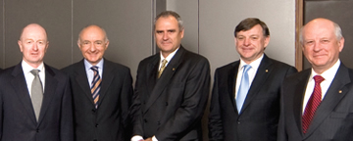
The Eldership

Slide 2
A Challenge
Men (even to teens) – think seriously about working toward being qualified to be an elder (cf. 1 Tim. 3:1)
Take a look at life – ask:
  How would I be as an elder?
  Would my family life be a hindrance?
  Would something I do hinder my influence?
  If my name can up – would there be objections?
Work hard – make changes – listen to advice – set your goals – so when time comes – will be no objections!

Slide 3
Review
The Work of Elders
Terms That Refer to Elders
The Work of Elders

Slide 4
Terms
That
Refer
To
The
Elders
Review
Elder / Presbyter
Maturity
Overseer / Bishop
Administrative Role
Shepherd / Pastor
Teaching Role

Slide 5
Review
The Work of Elders
Take heed to himself (Acts 20:28)
Be example to the flock (1 Pet. 5:3)
Take the oversight (1 Pet. 5:2)
Take heed to the flock (Acts 20:28)
Rule well (1 Tim. 5:17)
Feed the flock (Acts 20:28; 1 Pet. 5:1-2)
Stop mouths of vain talkers (Tit. 1:10-11)
Watch for souls (Heb. 13:17)

Slide 6
What Can I do to
Prepare for the
Eldership?

Slide 7
The office of an elder is one that men should desire
1 Tim 3:1
This is a faithful saying: If a man desires the position of a bishop, he desires a good work.
Women, too, should desire their husbands to be elders
Picture one who has the potential
to be an elder in the future
What Advice, Encouragement, Instruction, Direction
could we give?

Slide 8
What Can I do to Prepare
for the Eldership?
Be Faithful

Slide 9
Be Faithful
Required to be a Christian (Rev. 2:10)
Get priorities straight (Matt. 6:33)

Slide 10
Matt. 6:33
Context: Worrying about daily needs
Seek: “strive after…covet earnestly”
Kingdom: God’s rule in our hearts
Place we give it: First (top priority)
Point: First and Foremost
Strive to let God rule in your life!

Slide 11
Matthew 16:24
Context: Peter thinking of self
To be a disciple – Must say no to self
Then, bear a cross & follow!
Point: Self & Own Desires
Must Be Pushed Back

Slide 12
Matthew 8:22
Context: Following Christ, but first….
Plea was see to another (his father)
Jesus didn’t think much of his plan!
Point: Nothing should stand
in the way of service to God!

Slide 13
Be Faithful
Required to be a Christian (Rev. 2:10)
Get priorities straight (Matt. 6:33)
Elders must be examples (1 Pet. 5:1-3)
Diligent – Steadfast (1 Cor. 15:58; 2 Pet. 1:5-10)
Many men will never be elders
simply because they didn’t make
spiritual matters a priority!

Slide 14
What Can I do to Prepare
for the Eldership?
Be Faithful
Work Toward a Family That Fears God

Slide 15
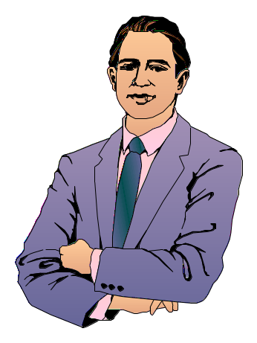
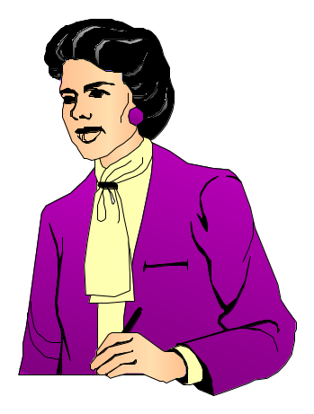

An Elder’s Family
Is Very Important
Both his wife and his children are
mentioned in the qualifications
His family reflects his influence
and leadership

Slide 16
Work Toward a Family That Fears God
Careful who you marry

Slide 17
Who One Marries Makes A Difference
Exo. 34:11-16 - Don’t marry people of land
Deut. 7:3-4 - Don’t marry people of land
Neh. 13:25-26 - Solomon’s wives caused him to sin

Slide 18
Work Toward a Family That Fears God
Careful who you marry
Wife of an elder must be faithful

Slide 19
1 Tim. 3:11
“Even so must their wives be grave, not slanderers, sober, faithful in all things.”

Slide 20

To Whom Does 1 Tim. 3:11 Refer?
Three
Possibilities
Women in general
Wives of deacons only
Wives of elders & deacons
Doesn’t make sense to refer to all women in
the middle of qual of elders / deacons.
If deacons only - God requires more of
deacon’s wife than elder’s wife.
This is in the middle of a discussion of both

Slide 21
1. Grave
Translation:
“Worthy of respect”
(NIV)
“Dignified” (NASV)
“Reverent” (NKJV)
Lexicon:
“gravity, dignity,
serious - what
inspires reverence
and awe” (Vines)
Means:
Take’s life serious
Not indifferent
Sound judgment

Slide 22
1. Grave
2. Not Slanderers
Translations:
“Not malicious talkers” (NIV)
“Not malicious gossips” (NASV)
“Not false accusers” (YLT)
Lexicon:
“False accusers”
(Thayer)
Means:
Control Tongue (Jas. 1:19, 26)
Not a Busybody (1 Tim. 5:13)
Keep Things Confidential

Slide 23
1. Grave
2. Not Slanderers
3. Sober
Translations:
“Temperate”
(NASV, NIV, ASV)
“Vigilant”
(YLT)
Means:
Sound in thinking
Temperate - Self Control
Control Temper / Tongue
Level Headed

Slide 24
1. Grave
2. Not Slanderers
3. Sober
4. Faithful in all Things
In All Areas - Faithful:
In her marriage relationship
In rearing her children / Keeper at home
Submission to her husband / In her role
Personal godliness / Example to others
Control her tongue

Slide 25
1. So much of his example before others depends on her
2. A wife can make or break a man
3. She will be in a position that could easily be misused
4. She will be scrutinized by other members
Importance of Her Qual.

Slide 26
Work Toward a Family That Fears God
Careful who you marry
Wife of an elder must be faithful
Children must be faithful
  Faithful children (Tit. 1:6)
  Rule household well (1 Tim. 3:4-5)
  Think about what you teach your children

Slide 27
What Can I do to Prepare
for the Eldership?
Be Faithful
Work Toward a Family That Fears God
Study the Word

Slide 28
Study the Word
The Need to Study
  Elders must feed the flock (Acts 20:28)
  Must be ready to rebuke gainsayer (Tit. 1:9)
  Prepared to talk to members about souls – thus well versed (Heb. 13:17)

Slide 29
Study the Word
The Need to Study
What Should Study
  Text in context (2 Pet. 3:16-18; 2 Tim. 2:15)
  Wisdom literature
    Know wise approach
    Know human nature – how people act
    i.e. Prov. 18:13, 17
  Issues of the day
    Example: about circum. Gal. 3-4; Acts 15
    Know of dangers flock faces (Acts 20:29-30)

Slide 30
What Can I do to Prepare
for the Eldership?
Be Faithful
Work Toward a Family That Fears God
Study the Word
Work on Communication Skills

Slide 31
Work on Communication Skills
Must have ability to teach (1 Tim. 3:2)
Learn to be careful

Slide 32

Careful
What I Say
To & About
Others
Prov. 10:19
Prov. 11:13
How I
Choose
My Words
Prov. 12:18
Prov. 15:1
Lest I Say
Something
Detrimental
Prov. 11:9
Timing
Prov. 15:23

Slide 33
Work on Communication Skills
Must have ability to teach (1 Tim. 3:2)
Learn to be careful
Learn to think before speak

Slide 34

Think Before Speak
Prov 15:28
The heart of the righteous studies how to answer,
But the mouth of the wicked pours forth evil.
Speak to be
Understood
Speak so Not
Misunderstood
Do Not
Be Vague

Slide 35
Work on Communication Skills
Must have ability to teach (1 Tim. 3:2)
Learn to be careful
Learn to think before speak
Use tact & caution as approach people

Slide 36
Tact & Approach
Prov 15:1-2
1 A soft answer turns away wrath,
But a harsh word stirs up anger.
2 The tongue of the wise uses knowledge rightly,
But the mouth of fools pours forth foolishness.
Prov 25:11
A word fitly spoken is like apples of gold
In settings of silver.

Slide 37
Tact & Approach
How we approach people / situations makes a difference
Our approach to people can prevent problems or create them
How we speak is as important as what we speak

Slide 38
Work on Communication Skills
Must have ability to teach (1 Tim. 3:2)
Learn to be careful
Learn to think before speak
Use tact & caution as approach people
Listen & try to understand others

Slide 39

Listen to
Understand
James 1:19
So then, my beloved brethren, let every man be swift to hear, slow to speak, slow to wrath;
Must know what other says – to know how to respond.
Difference in listening so I can answer & listening to see where coming from.

Slide 40
See the Other Side
Matt. 7:12
Therefore, whatever you want men to do to you, do also to them, for this is the Law and the Prophets.
Phil. 2:4
Let each of you look out not only for his own interests, but also for the interests of others.

Slide 41
What Can I do to Prepare
for the Eldership?
Be Faithful
Work Toward a Family That Fears God
Study the Word
Work on Communication Skills
Seek Wisdom

Slide 42
Seek Wisdom
The need for wisdom
  Know more than right from wrong – good judgment.

Slide 43
Colossians 1:9
For this reason we also, since the day we heard it, do not cease to pray for you, and to ask that you may be filled with the knowledge of His will in all wisdom and spiritual understanding;

Slide 44
Sin
Bad
Better
Best
Decision /
Action
Though not sinful – may not be good at all!

Slide 45
Seek Wisdom
The need for wisdom
  Know more than right from wrong – good judgment.
  Know how to use knowledge

Slide 46
Knowledge
Wisdom
Know what Word Teaches | How much at one time How to approach
Value of Something | Whether to comment or what to say
How to do something Better than another | How I handle that Knowledge / comment

Slide 47
Seek Wisdom
The need for wisdom
  Know more than right from wrong – good judgment.
  Know how to use knowledge
  To see beyond the present

Slide 48
James 1:1-6
1 James, a bondservant of God and of the Lord Jesus Christ, To the twelve tribes which are scattered abroad: Greetings.
2 My brethren, count it all joy when you fall into various trials,
3 knowing that the testing of your faith produces patience.
4 But let patience have its perfect work, that you may be perfect and complete, lacking nothing.
5 If any of you lacks wisdom, let him ask of God, who gives to all liberally and without reproach, and it will be given to him.
6 But let him ask in faith, with no doubting, for he who doubts is like a wave of the sea driven and tossed by the wind.
Wisdom to see the good in the suffering of the moment

Slide 49
Seek Wisdom
The need for wisdom
Sources of wisdom
  Word of God (Prov. 4)
  Multitude of counselors (Prov. 11:14; 15:22)
  Experience (1 Tim. 3:5)
  Watch & talk to other elders (1 Pet. 5:1-3)

Slide 50
What Can I do to Prepare
for the Eldership?
Be Faithful
Work Toward a Family That Fears God
Study the Word
Work on Communication Skills
Seek Wisdom
Pray

Slide 51
Pray
Prayer is powerful (Jas. 5:16-18)
Pray for:
  Self
  Family
  Wisdom
  Attitude (right purpose & motive)
  Opportunity to help people

Slide 52
What Can I do to Prepare
for the Eldership?
Be Faithful
Work Toward a Family That Fears God
Study the Word
Work on Communication Skills
Seek Wisdom
Pray

