Slide 1
2 Kings 20
Isaiah 38-39
1. Hezekiah’s life was extended (vv. 1-11)
a. Sick - was told he would die (v.1)
b. Prayed & wept bitterly (vv. 2-3)
c. Lord heard - and granted him 15 yrs (vv. 4-11)

Slide 2
2 Kings 20
Isaiah 38-39
1. Hezekiah’s life was extended (vv. 1-11)
2. Envoy from Babylon (vv. 12-19)
a. Brought presents from the king because Hezekiah had been sick (v. 12)
b. Hezekiah showed them all his treasures (v. 13)
c. Isaiah rebuked him (vv. 14-19)

Slide 3
“What Have They Seen In Your House?”
2 Kings 20:15
Isaiah 39:4
Saw what he wanted them to see – treasures
Saw his pride
Did not see how God worked & healed him
He was not bothered by what they saw
Saw:
Things should
not have
Not See:
Things should
have

Slide 4

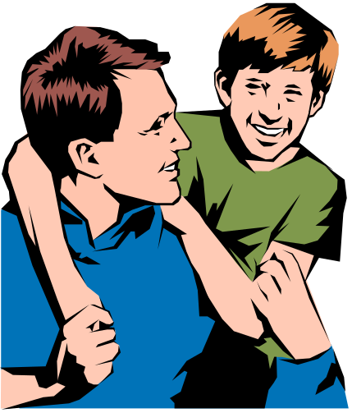

If we could see in someone’s house
Learn a lot about them & who they are
Text – Speaking of - Dwelling
If we could see into one’s family
may be surprised
Use Same Question
Apply it to the Family

Slide 5
What Would They See In Your…..
Family?
House?
See:
Things should
not see?
Not See:
Things should
see?

Slide 6
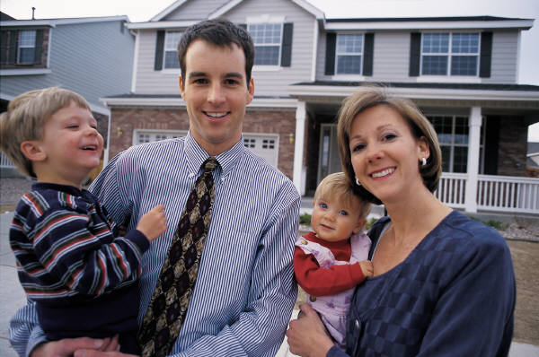
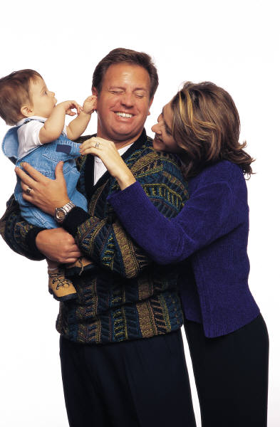
The Home / Family Is In Trouble
Many families have problems
Marriages come apart (50% +)
Those that stay together – not always pleasant
Children – turn to the world
“The highest happiness on earth is in marriage. Every man who is happily married is a successful man even if he has failed in everything else. And every man whose marriage is a failure is not a successful man even if he has succeeded in everything else.” - (William Lynn Phelps)

Slide 7
What Have They Seen In Your House?
2 Kings 20:15 Isaiah 39:4

Slide 8
What Have They Seen In Your House?
I. Who Sees?

Slide 9
I. Who Sees?
A. God
1. God sees all (Heb. 4:13)
2. He knows our secrets (Rom. 2:16)
3. God is involved in the marriage
- Prov. 2:17
- Rom. 7:2-3

Slide 10
I. Who Sees?
A. God
B. Your Children
1. Timothy saw what was his mother & grandmother really were (2 Tim. 1:5; 3:15)
2. Four daughters saw what Philip’s family really was (cf. Acts 21:8-9; 6:3)
3. Jehoshaphat saw Asa’s family (1 Kings 22:42-43)
4. Ahaziah saw Ahab’s ways and learned them (1 Kings 22:51-53)

Slide 11
I. Who Sees?
A. God
B. Your Children
C. Brethren & Neighbors
1. People see our example
a. Matt. 5:16
b. Phil. 2:15
c. 1 Tim. 4:12
2. Possible – others notice more than we think (often there are little indicators)

Slide 12
What Have They Seen In Your House?
I. Who Sees?
II. What Do They See?

Slide 13
II. What Do They See?
A. True dedication & devotion?
  Put spiritual things first (Matt. 6:33)
  Fear of God (Deut. 4:9-10)
  Governed by / decisions based upon the word (Phil. 1:27)
  Hear talk about spiritual matters?
  See Bible study materials?
  See plans for worship that emphasize the importance?

Slide 14
II. What Do They See?
A. True dedication & devotion?
B. Love & care for one another?
1. Loves wife – give his life for her (Eph. 5:25ff)
2. Reverence / respect her husband (Eph. 5:33)
3. See keeping the romance alive /well or weak?
4. See genuine care, concern for others in family?
5. See each are trying to meet the other’s needs?
6. See trying to please your mate (1 Cor. 7)?
7. See people who try to know the needs of mates?

Slide 15
II. What Do They See?
A. True dedication & devotion?
B. Love & care for one another?
C. Family first (Time)?
1. Deut. 6:6-7
2. Eunice & Lois spent time with Timothy (2 Tim 1:15)
3. One of ways to prevent provoking (Eph 6:1-4)

Slide 16
1500 children surveyed were asked:
“What do you think makes a happy family?”
Answer: “Doing things together.”
Graduate students at the University of Chicago,
when asked where they got their major ideas in
morals and religion, replied,
“Through conversation in our family at mealtime.”
- Dr. W. T. Thompson

Slide 17
II. What Do They See?
A. True dedication & devotion?
B. Love & care for one another?
C. Family first (Time)?
D. Who really leads?
1. See a man who is the leader (Eph. 5:23)?
2. See a wife who willing submits (1 Pet. 3:1-6)?
3. See a wife who is the real leader – in charge?
4. See a man who can’t lead very well? Weak?

Slide 18
II. What Do They See?
A. True dedication & devotion?
B. Love & care for one another?
C. Family first (Time)?
D. Who really leads?
E. Successful Communication?
1. One flesh (Matt. 19:6)
2. Dwell with understanding (1 Pet. 3:7)

Slide 19
Successful Communication
Talk & share feelings and ideas?
Listen to each other with intent to understand?
Calm when they disagree (Prov. 29:22)?
Fair and reasonable in what they say (Matt. 7:12)?
Kind (Eph. 4:32)?
Give each other benefit of doubt (1 Cor. 13:7)?
Practice “reflection”?

Slide 20
II. What Do They See?
A. True dedication & devotion?
B. Love & care for one another?
C. Family first (Time)?
D. Who really leads?
E. Successful Communication?
F. Discipline & restraint?

Slide 21
Correct - Punishment
The Punishment Should:
Change the behavior (Prov. 22:15)
Firm - put some teeth in the rules.
Balanced with love / encouragement / praise
Done with future in mind (Heb. 12:11; Prov. 23:13-14)

Slide 22
Control / Restraint
Prov. 29:15
“The rod and rebuke give wisdom, But a child left to himself brings shame to his mother.”
Children do not have wisdom - comes later
Need guidance & restrictions
Controlled by parents (cf. 1 Tim. 3:4-5)
Parents need to very watchful…
Eli did not restrain his sons (1 Sam. 3:11-14)

Slide 23
See Watchful & Careful Parents?
Concerned about who with?
Restrict where they go?
Careful about what movies they see?
Strict about the dress they wear?

Slide 24
II. What Do They See?
A. True dedication & devotion?
B. Love & care for one another?
C. Family first (Time)?
D. Who really leads?
E. Successful Communication?
F. Discipline & restraint?
G. Keeper at home?

Slide 25
Titus 2:3-5
3 the older women likewise, that they be reverent in behavior, not slanderers, not given to much wine, teachers of good things-
4 that they admonish the young women to love their husbands, to love their children,
5 to be discreet, chaste, homemakers, good, obedient to their own husbands, that the word of God may not be blasphemed.
See one who is a keeper of the home?
See one whose job is anything but that?
See one who is a “worker” at home (ASV)?

Slide 26
What Have They Seen In Your House?
I. Who Sees?
II. What Do They See?
III. Why Be Concerned?

Slide 27
III. Why Be Concerned?
A. Give an account to God
1. Sin – lose soul (John 8:21)
2. Hinders service to God (1 Pet. 3:7)
3. God is not mocked (Gal. 6:7-9)

Slide 28
III. Why Be Concerned?
A. Give an account to God
B. Teaching our children
1. Children will learn what they see
2. Often become just like we trained them
a. Ezek. 16:44 –
b. No need to wonder what happened if they are just like what they saw

Slide 29
III. Why Be Concerned?
A. Give an account to God
B. Teaching our children
C. Our example –teaches others
1. Your family life is a book – will be read (2 Cor. 3:2-3)
2. Your example says that what you do is okay!
3. Thus, they do the same and justify it by pointing to you

Slide 30
What Have They Seen In Your House?
I. Who Sees?
II. What Do They See?
III. Why Be Concerned?

Slide 31
What Have They Seen In Your House?

