Slide 1
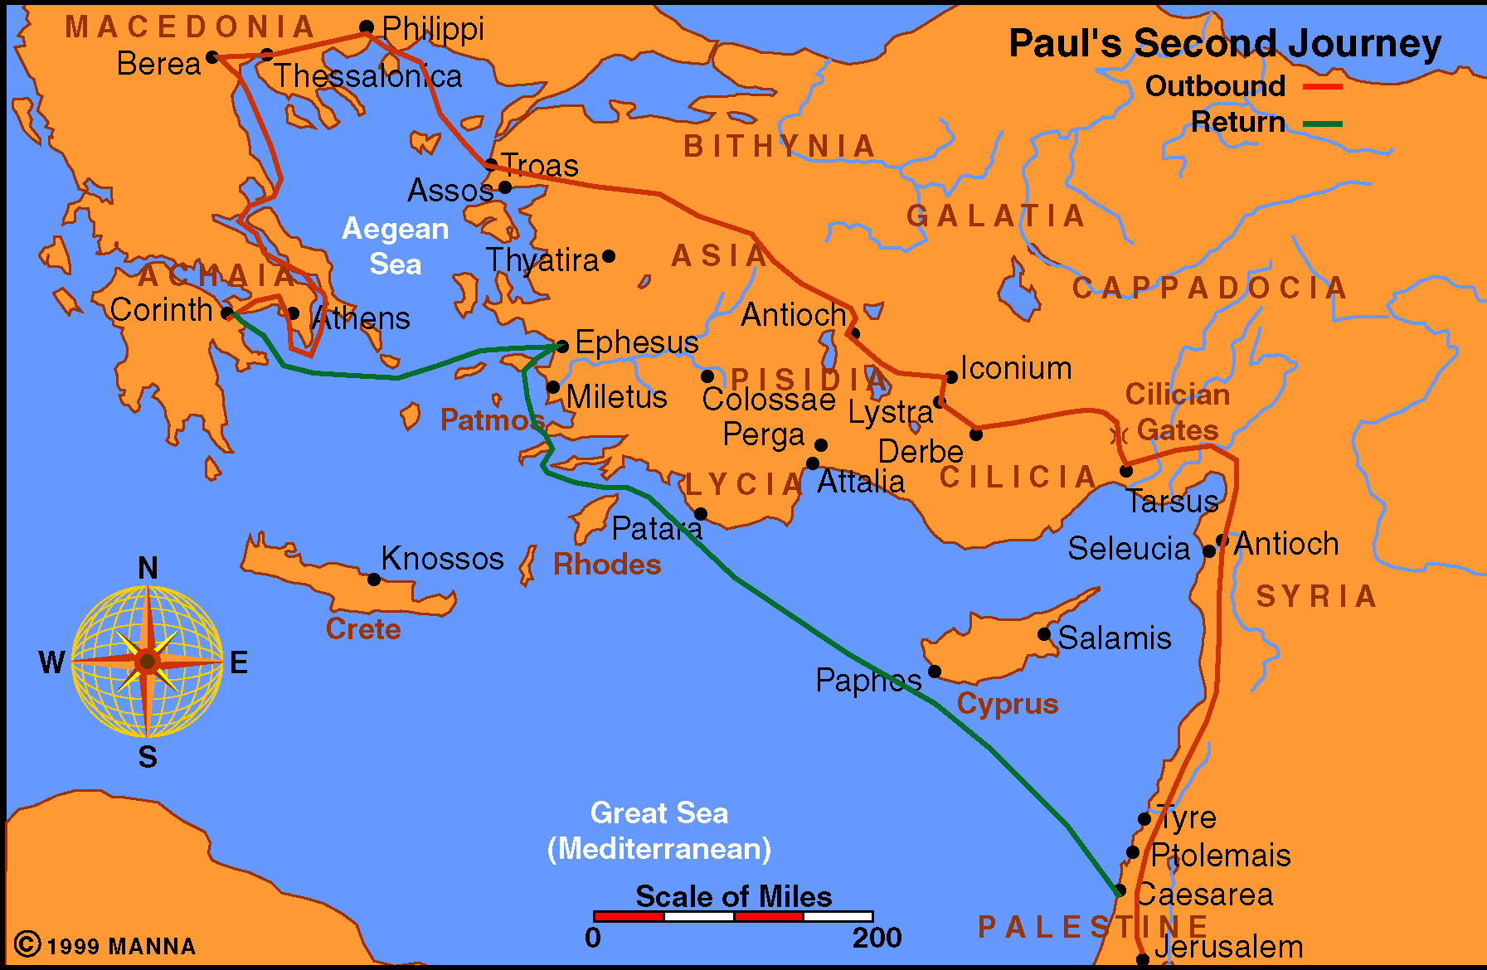
Paul Journey 2
Acts 16-18

Slide 2
Acts 18
At Corinth (vv. 1-17)
  Paul begins his preaching (vv. 1-4)
  His work continues with help and opposition (vv. 5-11)
  Paul before Gallio (vv. 12-17)
Return Trip To Antioch (vv. 18-22)
  From Corinth to Ephesus (vv. 18-21)
  From Ephesus to Jerusalem and on to Antioch (v. 22)
Beginning The Third Journey (vv. 23-28)
  Paul strengthened the disciples of Galatia and Phyrgia (v. 23)
  Apollos in Ephesus (vv. 24-28)

Slide 3
Two Preachers
Two Cities
Acts 18

Slide 4
Two Preachers
Two Cities
Paul at Corinth (vv. 1-17)
Apollos at Ephesus (vv. 24-28)
Acts 18

Slide 5
Two Preachers
Two Cities
Paul at Corinth (vv. 1-17)
Apollos at Ephesus (vv. 24-28)
Acts 18

Slide 6
Paul at Corinth (vv. 1-17)
Paul begins his work in Corinth (vv. 1-4)
Work continues with help and opposition (vv. 5-11)
Paul before Gallio (vv. 12-17)
The Text

Slide 7
Paul at Corinth (vv. 1-17)
Gave himself to the work (v. 5)
  Translations:
    “Constrained in the Spirit” (NKJV)
    “Pressed in Spirit” (KJV/ YLT)
    “Pressed in respect to the word” (Darby)
    “Occupied in the word” (ESV)
    “Constrained by the word” (ASV)
    “Paul began devoting himself completely to the Word” (NASV)
    “Devoted himself exclusively to preaching” (NIV)
The Lessons

Slide 8
Paul at Corinth (vv. 1-17)
Gave himself to the work (v. 5)
  Translations:
  Spent all this time – spreading the word
  Context:
    Timothy & Silas came from Macedonia
    Brought support (2 Cor. 11:6-8)
    May have reference to devoting his full time – vs – having to make tents
  Point: perhaps might reach more – if we devoted more time to trying to reach others
The Lessons

Slide 9
Paul at Corinth (vv. 1-17)
Gave himself to the work (v. 5)
Don’t cast pearls before swine (v. 6)
Times best candidate may be most unlikely (vv. 8-10)
Don’t keep silent (v. 9)
Teach the word (v. 11)
The gospel will cause opposition (vv. 6, 12-17)
Strengthening disciples is just as import as evangelism (vv. 23, 27)
The Lessons

Slide 10
Two Preachers
Two Cities
Paul at Corinth (vv. 1-17)
Apollos at Ephesus (vv. 24-28)
Acts 18

Slide 11
Apollos at Ephesus (vv. 24-28)
Apollos came to Ephesus (vv. 24-25a)
  Great speaker (v. 24)
  Well verses in Scripture (vv. 24-25a)
Taught well – but lacking in one area (v. 25b)
Aquilla & Pricilla corrected him (v. 26)
Went to Achaia (vv. 27-28)
  With recommendation of Ephesians (v. 27)
  Helped those who believe (v. 27)
  Publicly refuted the Jews (v. 28)
The Text

Slide 12
Apollos at Ephesus (vv. 24-28)
Eloquence (v. 24)
Mighty / Instructed in Scripture (vv. 24-25)
Fervent in spirit (v. 25)
Spoke boldly (v. 26)
Willing to learn and stand corrected (v. 26)
Appealed to Scripture (v. 28)
The Lessons

Slide 13
Two Preachers
Two Cities
Paul at Corinth (vv. 1-17)
Apollos at Ephesus (vv. 24-28)
Acts 18

