Slide 1
Some meetings are notable meetings
Ever been a part of a meeting of people (gathering small or large) that was remembered for years and years?
Been in a meeting – that stands out more than any other meeting of that kind?
Is there one assembly of saints – just stands out?
Ever meet with some elders – a meeting never forget?
Two Notable Meetings
A
Sunday
Worship Service
A
Meeting
With
Elders
Acts 20

Slide 2
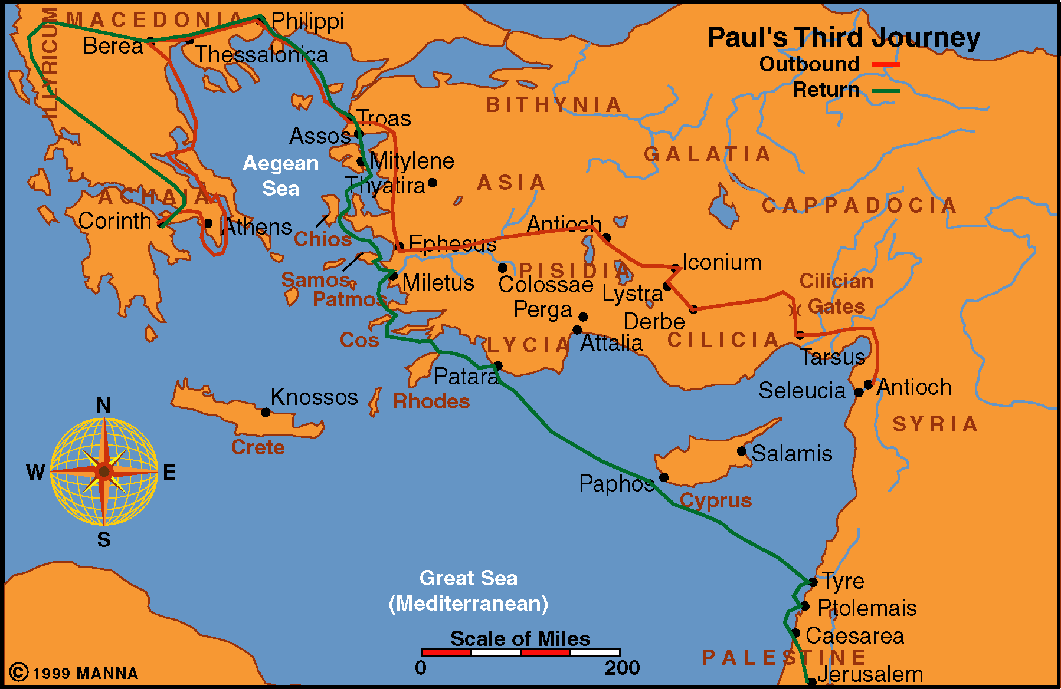
Acts 20
Acts 18-21

Slide 3


Two Notable Meetings
Meeting of the Disciples at Troas (vv. 6-12)
Acts 20
Meeting with the Elders at Ephesus (vv. 17-38)

Slide 4
Two Notable Meetings
Meeting of the Disciples at Troas (vv. 6-12)
Acts 20

Slide 5


Meeting of the Disciples at Troas (vv. 6-12)
Waited for days to worship with the saints (v. 6)
  Says something of the importance of worship
  Planned ahead – where they would be for worship
  Contrast to today:
    Some don’t have time to stop and worship on road
    Don’t plan where we be with saints on Sunday
    Not bother to see if is a church where will be
    “If had to wait 2-3 hours to be able to assemble – ridiculous – I have plans”

Slide 6
Meeting of the Disciples at Troas (vv. 6-12)
Waited for days to worship with the saints (v. 6)
Assembled on the first day of week (v. 7)
  Significance of 1st day
    Lord was raised on first day (Mt. 28:1; Mk. 16:9)
    Jesus appeared to disciples (Jno. 20:19, 26)
    Church established (Acts 2:47)
    First gospel sermon preached (Acts 2)

Slide 7
Meeting of the Disciples at Troas (vv. 6-12)
Waited for days to worship with the saints (v. 6)
Assembled on the first day of week (v. 7)
  Significance of 1st day
  Lord’s Day (Rev. 1:10)
    Holy day – holiday
    Day of devotion, homage to the Lord
    Lord’s day – not the Lord’s hour

Slide 8
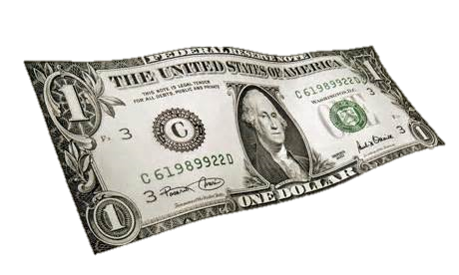

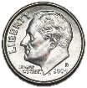
Sunday | Monday | Tuesday | Wednesday | Thursday | Friday | Saturday
Lord’s
Day

Slide 9
Meeting of the Disciples at Troas (vv. 6-12)
Waited for days to worship with the saints (v. 6)
Assembled on the first day of week (v. 7)
  Significance of 1st day
  Lord’s Day (Rev. 1:10)
  Often treat it as any other day
    Just an ordinary work day
    Just an normal family day
    If we can manage it – will try to go to worship

Slide 10
Meeting of the Disciples at Troas (vv. 6-12)
Waited for days to worship with the saints (v. 6)
Assembled on the first day of week (v. 7)
Lord’s Supper (v. 7)
  “Break bread” = Lord’s supper

Slide 11
“Break Bread” (Acts 20:7) = Lord’s Supper
Used To Refer To
Lord’s Supper
Matt. 26:26
Mark 14:22
Luke 22:19
Acts 2:42
1 Cor. 10:16
1 Cor. 11:23-24
Used To Refer To
Common Meal
Acts 2:46
Acts 20:7 is a worship
Assembly. No common
meal in assembly (1 Cor. 11)

Slide 12
Meeting of the Disciples at Troas (vv. 6-12)
Waited for days to worship with the saints (v. 6)
Assembled on the first day of week (v. 7)
Lord’s Supper (v. 7)
  “Break bread” = Lord’s supper
  Only passage on day for Lord’s supper
  Every first day
    If not –why not?
    Parallel to Sabbath

Slide 13

These
Come
Around
Every
Week!
“Remember the
Sabbath day,
to keep it holy”
(Exo. 20:8)
“And upon the
first day of the
week, when the
disciples came
together to
break bread”
(Acts 20:7)
Every Time
Sabbath Day
Occurs
Every Time
First Day
Occurs

Slide 14
Meeting of the Disciples at Troas (vv. 6-12)
Waited for days to worship with the saints (v. 6)
Assembled on the first day of week (v. 7)
Lord’s Supper (v. 7)
Paul Preached (v. 7)
  During the worship
  To strengthen / build faith (cf. 20:32)
  Not a short pep talk – gives ample instruction and admonition – because:
    Intends to leave the next day (v. 7)
    Never expected to see disciples again (v. 38)

Slide 15
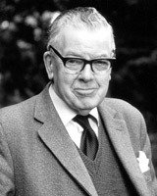
F. F. Bruce:
“Church meetings were not regulated by the clock in those days, and the opportunity of listening to Paul was not one to be cut short; what did it matter if he went on conversing with them until midnight?”
Acts, 408
Notes:
Cf. McGarvey, New Commentary on Acts, 180

Slide 16
Meeting of the Disciples at Troas (vv. 6-12)
Waited for days to worship with the saints (v. 6)
Assembled on the first day of week (v. 7)
Lord’s Supper (v. 7)
Paul Preached (v. 7)

Slide 17
Two Notable Meetings
Meeting of the Disciples at Troas (vv. 6-12)
Acts 20
Meeting with the Elders at Ephesus (vv. 17-38)

Slide 18
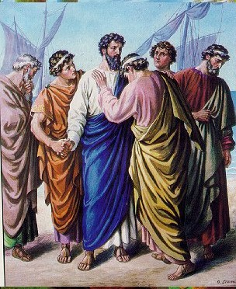
Meeting with the Elders at Ephesus (vv. 17-38)
Paul’s Message To Ephesian Elders
Encouragement & Warning
Only recorded speech to Christians
Does so in form of personal testimony
“Perfect photograph of his own spiritual character as a servant of Christ.”
Picture of what every servant of Christ should be

Slide 19
Meeting with the Elders at Ephesus (vv. 17-38)
The Past (vv. 17-21) – Consistency in his service
  Led a consistent life (v. 18)
  He was a consecrated servant (v. 19)
    Humility
    Compassion
  Preached a complete gospel (vv. 20-21)

Slide 20
Meeting with the Elders at Ephesus (vv. 17-38)
The Past (vv. 17-21) – Consistency in his service
The Present (vv. 22-27) – Consecration in his service
  Concerning Paul (vv. 22-24):
    The Uncertainty about going to Jerusalem (v. 22)
    The Certainty about going to Jerusalem (v. 23)
    The determination about going to Jerusalem (v. 24)
  Concerning the Ephesians (vv. 25-27):
    Their expectation (v. 25)
    Their responsibility (vv. 26-27)

Slide 21
Meeting with the Elders at Ephesus (vv. 17-38)
The Past (vv. 17-21) – Consistency in his service
The Present (vv. 22-27) – Consecration in his service
The Future (vv. 28-38) – Concerns in his service
  Exhortation (v. 28)
  Explanation (vv. 29-30)
  Encouragement (vv. 31-32)
  Example (vv. 33-35)
  Expression (vv. 36-38)

Slide 22
Two Notable Meetings
Meeting of the Disciples at Troas (vv. 6-12)
Acts 20
Meeting with the Elders at Ephesus (vv. 17-38)

