Slide 2
Opposites
Possible to have both among people alike in many ways
Like to think of self as:
Humility
Self Righteousness
Yet, may be - we are:
Do you view self as more righteous?
Do you view others with disdain?
Do view self in class by yourself?

Slide 3
Luke 18:9-14
9 Also He spoke this parable to some who trusted in themselves that they were righteous, and despised others: 10 Two men went up to the temple to pray, one a Pharisee and the other a tax collector. 11 The Pharisee stood and prayed thus with himself, 'God, I thank You that I am not like other men--extortioners, unjust, adulterers, or even as this tax collector. 12 I fast twice a week; I give tithes of all that I possess.' 13 And the tax collector, standing afar off, would not so much as raise his eyes to heaven, but beat his breast, saying, 'God, be merciful to me a sinner!' 14 I tell you, this man went down to his house justified rather than the other; for everyone who exalts himself will be humbled, and he who humbles himself will be exalted."

Slide 4
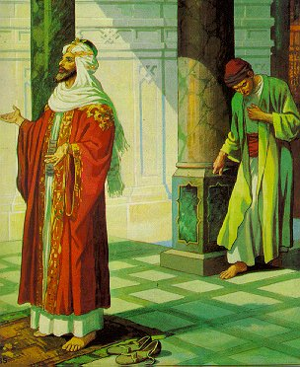
Two Men Who Prayed
A Pharisee &
A Tax Collector
Luke 18:9-14

Slide 5
Two Men Who Prayed
I. The Setting (v. 9)

Slide 6
Luke 18:9-14
9 Also He spoke this parable to some who trusted in themselves that they were righteous, and despised others: 10 Two men went up to the temple to pray, one a Pharisee and the other a tax collector. 11 The Pharisee stood and prayed thus with himself, 'God, I thank You that I am not like other men--extortioners, unjust, adulterers, or even as this tax collector. 12 I fast twice a week; I give tithes of all that I possess.' 13 And the tax collector, standing afar off, would not so much as raise his eyes to heaven, but beat his breast, saying, 'God, be merciful to me a sinner!' 14 I tell you, this man went down to his house justified rather than the other; for everyone who exalts himself will be humbled, and he who humbles himself will be exalted."

Slide 7
I. The Setting (v. 9)
Spoke to those:
  Trusted in self - are righteous
  Despised others (as nothing)
Who was in audience?
Two groups represented
  Pharisees: formality - outward - self righteous - hypocrisy
  Publicans: Outcast - unworthy

Slide 8
Pharisee:
“Belonged” to temple
Face show fasting
Righteous “air”
Scriptures - wore
Religious!
Publican:
Didn’t “Belong” there
No show
Reputation bad
No display
Unworthy!

Slide 9
Two Men Who Prayed
I. The Setting (v. 9)
II. The Parable (vv. 10-13)

Slide 10
Luke 18:9-14
9 Also He spoke this parable to some who trusted in themselves that they were righteous, and despised others: 10 Two men went up to the temple to pray, one a Pharisee and the other a tax collector. 11 The Pharisee stood and prayed thus with himself, 'God, I thank You that I am not like other men--extortioners, unjust, adulterers, or even as this tax collector. 12 I fast twice a week; I give tithes of all that I possess.' 13 And the tax collector, standing afar off, would not so much as raise his eyes to heaven, but beat his breast, saying, 'God, be merciful to me a sinner!' 14 I tell you, this man went down to his house justified rather than the other; for everyone who exalts himself will be humbled, and he who humbles himself will be exalted."

Slide 11

II. The Parable (vv. 10-13)
A. Two Men Similar / Alike
Pharisee
Jew
Religious
Covenant Rel.
Temple Priv.
Prayed
Publican
Jew
Religious
Covenant Rel.
Temple Priv.
Prayed

Slide 12
II. The Parable (vv. 10-13)
A. Two Men Similar / Alike
B. Two Men Different

Slide 13
Pharisee:
'God, I thank You
that I am not
like other men-
-extortioners, unjust,
adulterers, or even
as this tax collector.
I fast twice a week;
I give tithes of
all that I possess.'
Publican:
'God, be merciful
to me a sinner.’

Slide 14
Pharisee
Publican
Arrogant
View self as righteous
Too good to associate
No need for mercy
Singles self out as R.
Humble
View self as a sinner
Too bad to associate
Great need for mercy
Singles self out as S.

Slide 15
Two Men Who Prayed
I. The Setting (v. 9)
II. The Parable (vv. 10-13)
III. The Lessons Learned (v. 14)

Slide 16
Luke 18:9-14
9 Also He spoke this parable to some who trusted in themselves that they were righteous, and despised others: 10 Two men went up to the temple to pray, one a Pharisee and the other a tax collector. 11 The Pharisee stood and prayed thus with himself, 'God, I thank You that I am not like other men--extortioners, unjust, adulterers, or even as this tax collector. 12 I fast twice a week; I give tithes of all that I possess.' 13 And the tax collector, standing afar off, would not so much as raise his eyes to heaven, but beat his breast, saying, 'God, be merciful to me a sinner!' 14 I tell you, this man went down to his house justified rather than the other; for everyone who exalts himself will be humbled, and he who humbles himself will be exalted."

Slide 17
III. The Lessons Learned (v. 14)
A. The Sin of Self-Righteousness
Ignore their weakness - gloat in own righteousness
Seek praises of men (Mt. 23:23-30; Jn 12:42-43)
Focus on weaknesses of others
Places self in one class - all others in another class
Thanks God (not for what God has done) but what he has done for God
Focus on the outward - not on attitudes
No wants, needs, or acknowledgements

Slide 18

Self
God

Slide 19
Luke 18:9-14
9 Also He spoke this parable to some who trusted in themselves that they were righteous, and despised others: 10 Two men went up to the temple to pray, one a Pharisee and the other a tax collector. 11 The Pharisee stood and prayed thus with himself, 'God, I thank You that I am not like other men--extortioners, unjust, adulterers, or even as this tax collector. 12 I fast twice a week; I give tithes of all that I possess.' 13 And the tax collector, standing afar off, would not so much as raise his eyes to heaven, but beat his breast, saying, 'God, be merciful to me a sinner!' 14 I tell you, this man went down to his house justified rather than the other; for everyone who exalts himself will be humbled, and he who humbles himself will be exalted."

Slide 20
Luke 18:9-14
9 Also He spoke this parable to some who trusted in themselves that they were righteous, and despised others: 10 Two men went up to the temple to pray, one a Pharisee and the other a tax collector. 11 The Pharisee stood and prayed thus with himself, 'God, I thank You that I am not like other men--extortioners, unjust, adulterers, or even as this tax collector. 12 I fast twice a week; I give tithes of all that I possess.' 13 And the tax collector, standing afar off, would not so much as raise his eyes to heaven, but beat his breast, saying, 'God, be merciful to me a sinner!' 14 I tell you, this man went down to his house justified rather than the other; for everyone who exalts himself will be humbled, and he who humbles himself will be exalted."

Slide 21
Self-Righteousness Is Sin Because:
Doesn’t love his neighbor as self (Matt. 22:39)
Doesn’t treat others way want to be treated (Matt. 7:12)
Doesn’t look upon things of others (Phil. 4:2)
Makes others the standard - always better (2 Cor. 10:12)
Trust is in SELF - not God (Lk. 18:9-14)
Proud - Arrogant (Prov. 6:17; 16:5; 21:4)
Doesn’t see that he could fall (1 Cor. 10:12: Gal. 6:1)
Binds more than God has (fasting twice a week, etc.)
Sin

Slide 22
III. The Lessons Learned (v. 14)
A. The Sin of Self-Righteousness
B. The Blessing of Humility

Slide 23
Blessing of Humility:
See need / dependence upon God (cry for mercy)
Reverence (“stood afar off” - not presuming to draw near)
No effort to justify, excuse or ignore his wrong.
Have wisdom (Prov. 11:2)
Has honor (Prov. 29:23)
Grace & exaltation from God (Jas. 4:6, 10; 1 Pet. 5:5)

Slide 24
III. The Lessons Learned (v. 14)
A. The Sin of Self-Righteousness
B. The Blessing of Humility
C. Strong, Religious, & Devoted People Can Be Lost

Slide 25
Strong, Religious, & Devoted People Can Be Lost
The Pharisee - had many good characteristics
  Devoutly religious (at temple praying)
  May have been sincere
  Nothing is said against his morality
  Faithful to his marriage vows
  Not an extortioner
  Not unjust (not unfair)
  Liberal with his money
Yet - not justified
  Attitude problems
  Lacking in other areas
  Being religious, devoted, etc. not enough

Slide 26
III. The Lessons Learned (v. 14)
A. The Sin of Self-Righteousness
B. The Blessing of Humility
C. Strong, Religious, & Devoted People Can Be Lost
D. If Mercy Shown to Publican - Me Too!

Slide 27
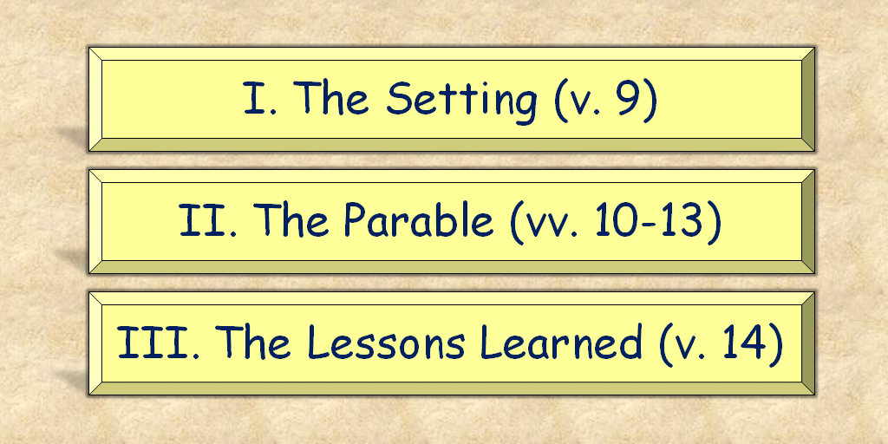
Two Men Who Prayed
Luke 18:9-14

