Slide 1
Acts 15
The
Jerusalem
Discourse

Slide 2
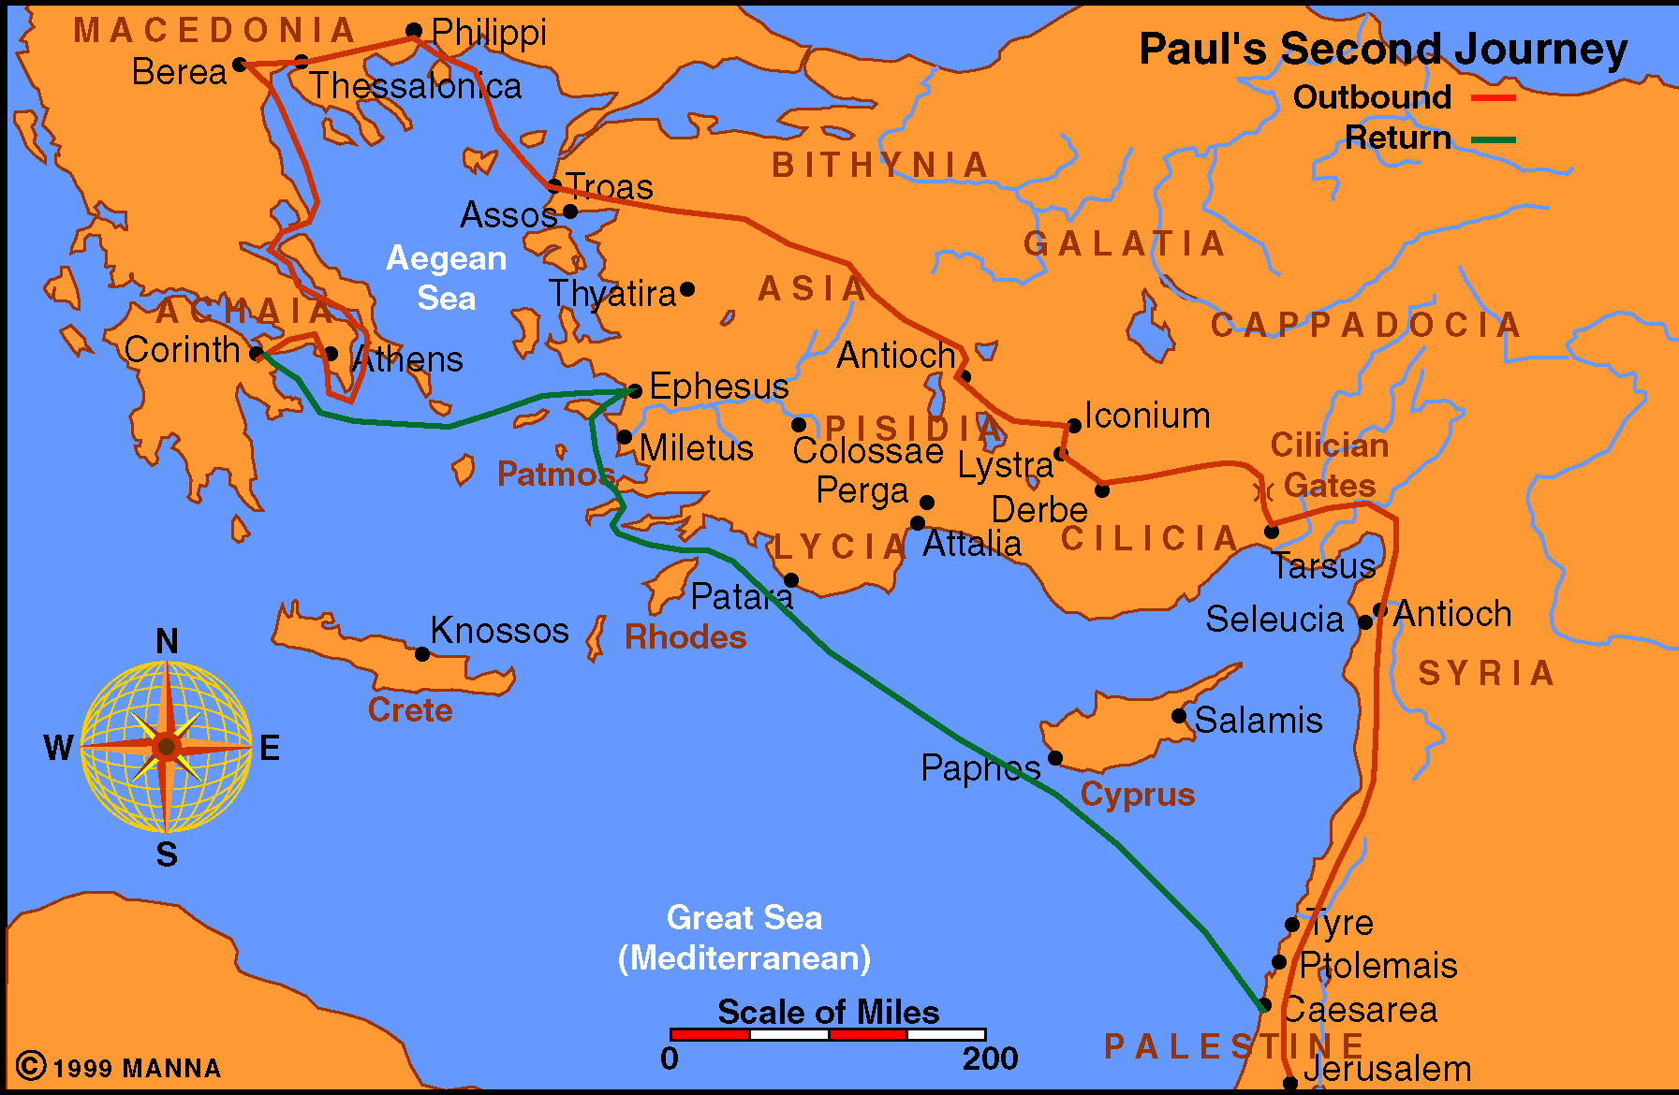

Slide 3
Circumstance
Question about circumcision
About 50 AD
Not a conference in which voting (majority rule)
Effort to see the Divine will on the subject
Not a matter of going to Jer. to learn the truth – they knew it before
Important to see that the apostles said

Slide 4
Circumstance
Possible that some were questioning Paul – Thus the Jerusalem “conference” reinforces Paul’s teachings (cf. Gal. 2)
Since this was “by revelation” (Gal. 2:2) must be the intent of God to settle the question once and for all

Slide 5
An Outline
I. The Discussion in Jerusalem (vv. 1-29)
A. The problem Explained (vv. 1-5)
B. The Speeches (vv. 6-21)
C. A Letter is sent from apostles and elders (vv. 22-29)
II. The Church At Antioch Received The Letter (vv. 30-35)
A. Rejoiced over its encouragement (vv. 30-32)
B. The brethren depart (vv. 33-35)

Slide 6
The Problem Explained (vv. 1-5)
Some teaching must be circumcised (v. 1)
Question: Can Gentiles be saved without becoming Jews?
Great discussion (v. 2)
So decided to go to Jerusalem (vv. 3-5)

Slide 7
Public & Private Meetings
Public meeting (v. 4)
Another public meeting (vv. 6-22)
Private meeting (Gal. 2:2)
  Either prior to or between the public meetings
  Private decision (Gal. 2:9) – accept Paul
  Only men present

Slide 8
An Outline
I. The Discussion in Jerusalem (vv. 1-29)
A. The problem Explained (vv. 1-5)
B. The Speeches (vv. 6-21)
C. A Letter is sent from apostles and elders (vv. 22-29)
II. The Church At Antioch Received The Letter (vv. 30-35)
A. Rejoiced over its encouragement (vv. 30-32)
B. The brethren depart (vv. 33-35)

Slide 9
The
Jerusalem
Discourse
Acts 15

Slide 10
The Jerusalem Discourse
Acts 15
Dissension & Dispute (vv. 1-5)

Slide 11
Dissension & Dispute (vv. 1-5)
Acts 15
What Prompted It (vv. 1, 5)
  Judaizing teachers – teaching Gentiles much become like Jews
  From Judea – giving the impression that “Jerusalem” was in agreement

Slide 12
Dissension & Dispute (vv. 1-5)
Acts 15
What Prompted It (vv. 1, 5)
Reaction of Paul & Barnabas (v. 2)
  Dissension
    “Argued” (LBP)
    Discord – Not harmony
    From Stasis – lit. “a standing” (Strong's) – Stood against
    Translated “uproar” / “insurrection”

Slide 13
Dissension & Dispute (vv. 1-5)
Acts 15
What Prompted It (vv. 1, 5)
Reaction of Paul & Barnabas (v. 2)
  Dissension
  Dispute
    “Debate” (NIV)
    Lit. “questioning” (cf. ASV)

Slide 14
Dissension & Dispute (vv. 1-5)
Acts 15
What Prompted It (vv. 1, 5)
Reaction of Paul & Barnabas (v. 2)
  Dissension
  Dispute
  No small
    A big discussion – serious debate
    Because the doctrine was false:
      Fundamental violation of gospel
      Denied the sufficiency of gospel

Slide 15
Dissension & Dispute (vv. 1-5)
Acts 15
What Prompted It (vv. 1, 5)
Reaction of Paul & Barnabas (v. 2)
  Dissension
  Dispute
  No small
  Did not ignore it / or agree to disagree

Slide 16
Dissension & Dispute (vv. 1-5)
Acts 15
What Prompted It (vv. 1, 5)
Reaction of Paul & Barnabas (v. 2)
Learn:
  Debate can do good (Jude 3)
  Should be willing and ready to defend the truth (Phil.1:17)
    Preachers (2 Tim. 4:1-5)
    Elders (Tit. 1:9)
    Every Christian (1 Pet. 3:15)

Slide 17
The Jerusalem Discourse
Acts 15
Dissension & Dispute (vv. 1-5)
Discussion (vv. 6-21)

Slide 18
Discussion (vv. 6-21)
Acts 15
Why go to apostles & elders (vv. 2, 6)?
  Not to learn the truth – Paul already knew that (cf. v. 12)
  Not to establish policy
  So those at Antioch can see – where Jerusalem church (with its elders) & apostles stand

Slide 19
Discussion (vv. 6-21)
Acts 15
Why go to apostles & elders (vv. 2, 6)?
The speeches (vv. 7-21)
  Peter (vv. 7-11)
  Paul & Barnabas (v. 12)
  James (vv. 13-21)

Slide 20
Discussion (vv. 6-21)
Acts 15
Why go to apostles & elders (vv. 2, 6)?
The speeches (vv. 7-21)
How to determine answers / Establish Auth.
  Command / direct statement (vv. 13-21)
  Approved example (v. 12)
  Necessary inference (vv. 7-11)
  Answer provided by Holy Spirit (v. 28)

Slide 21
Discussion (vv. 6-21)
Acts 15
Why go to apostles & elders (vv. 2, 6)?
The speeches (vv. 7-21)
How to determine answers / Establish Auth.
Learn:
  How to establish authority
  How to settle questions & issues
  How to determine doctrine & practice

Slide 22
The Jerusalem Discourse
Acts 15
Dissension & Dispute (vv. 1-5)
Discussion (vv. 6-21)
Decree (vv. 22-35)

Slide 23
Decree (vv. 22-35)
Acts 15
Sent the letter with chosen men (v. 22)
The letter (vv. 23-29)
  Hear that some unsettle you (vv. 23-24)
  We gave no such command (v. 24)
  We are united on this (v. 25)
  Men we send will tell the same (vv. 26-27)
  Answer given by the Holy Spirit (v. 28)
  Add no greater burden (v. 28)
  Abstain from… (v. 29)

Slide 24
Decree (vv. 22-35)
Acts 15
Sent the letter with chosen men (v. 22)
The letter (vv. 23-29)
The letter received (vv. 30-35)
  Rejoiced & encouraged (vv. 30-32)
  Some went back & some stayed (vv. 33-35)

Slide 25
Decree (vv. 22-35)
Acts 15
Sent the letter with chosen men (v. 22)
The letter (vv. 23-29)
The letter received (vv. 30-35)
Learn:
  How united (v. 25) – appeal to revelation (command, example & Nec. Inference)
  Strengthened by the word
  Confirmation of what we believe is an encouragement

Slide 26
The Jerusalem Discourse
Acts 15
Dissension & Dispute (vv. 1-5)
Discussion (vv. 6-21)
Decree (vv. 22-35)
Disagreement (vv. 36-41)

Slide 27
Disagreement (vv. 36-41)
Acts 15
Brethren can differ in judgment
  Not a matter of right vs wrong
  Not an issue God spoke about

Slide 28
Disagreement (vv. 36-41)
Acts 15
Brethren can differ in judgment
Confidence in people
  Paul thought displayed weakness – not reliable
  Barnabas thought should give him a second chance (perhaps affected by kinship – Col. 4:10)
  Perhaps both attitudes helped John
    Paul’s: impressed him with seriousness of the weakness he had displayed
    Barnabas’ confidence: encouraged him to make good on second chance
  Paul later regained confidence (2 Tim. 4:11; Philemom 24; Col. 4:10-11)

Slide 29
Disagreement (vv. 36-41)
Acts 15
Brethren can differ in judgment
Confidence in people
Time to part ways
  Feelings were strong
  Not animosity or hostility
  Each one could take the course that his judgment deemed appropriate

Slide 30
The Jerusalem Discourse
Acts 15
Dissension & Dispute (vv. 1-5)
Discussion (vv. 6-21)
Decree (vv. 22-35)
Disagreement (vv. 36-41)

