Slide 1
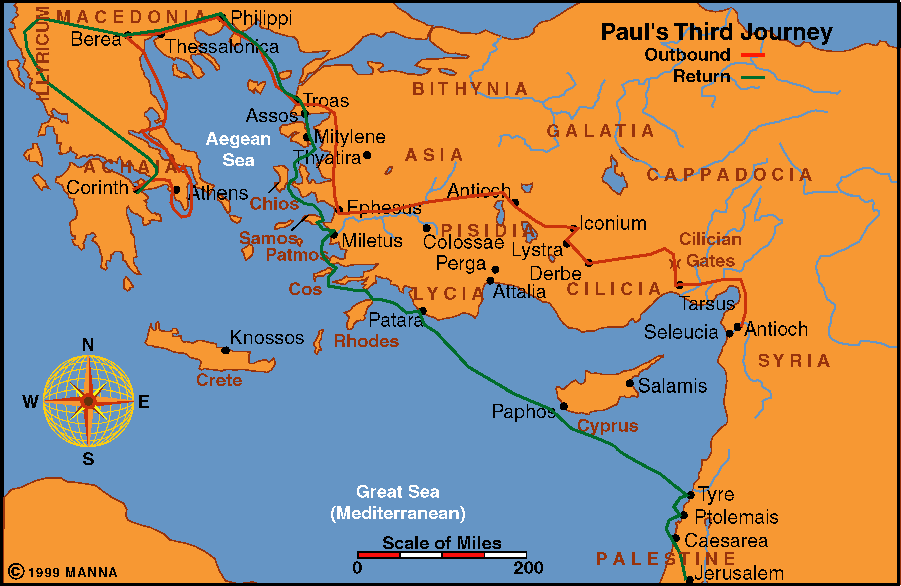
Paul Journey 3
Acts 19
Acts 18-21

Slide 2
Acts 19
Twelve Disciples Are Baptized And Receive The Holy Spirit (vv. 1-7)
Paul Preached And Disputed With The Jews (vv. 8-10)
Miracles And Exorcist (vv. 11-20)
Paul’s Plans For A Future Journey (vv. 21-22)
Uproar Over Idolatry (vv. 23-41)

Slide 3
Acts 19
Paul’s Work at Ephesus
Made a Difference
Established a Difference
Twelve learned what didn’t know
Twelve received Holy Spirit
Many heard instruction
Many obeyed gospel
Teaching caused a riot
In baptisms (vv. 1-7)
In beliefs (vv. 8-10)
In evidence (vv. 11-17)
In responses (vv. 18-41)

Slide 4
The
Difference
At
Ephesus

Slide 5
The Difference
at Ephesus
Baptisms Are Not All The Same (vv. 1-7)
Baptisms Are Not All The Same (vv. 1-7)

Slide 6
Baptisms Are Not All The Same (vv. 1-7)
Twelve did not know about baptism of great commission (vv. 1-7)
Difference in John’s baptism and great commission

Slide 7
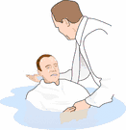

John’s Baptism
Baptism of Great Comm.
Immersion (John 3:23)
In Water (Matt. 3:11)
For Remission (Mark 1:4)
Confess sins (Matt. 3:6)
Baptized – Believe (Acts 19:4)
Didn’t put in kingdom (Mt. 3:1-2)
Immersion (Acts 8:38)
In Water (Acts 10:48)
For Remission (Acts 2:38)
Confess faith (Acts 8:37)
Believe – Baptized (Mk. 16:16)
Puts one in kingdom (Jno. 3:5)
Same

Slide 8
Baptisms Are Not All The Same (vv. 1-7)
Twelve did not know about baptism of great commission (vv. 1-7)
Difference in John’s baptism and great commission
Just because one is baptized – not mean it is baptism of great commission
  Some contend: “If baptism is necessary – I’m okay since I was baptized in _________ church.”
  Baptism of the great commission must be fit pattern

Slide 9

The Right Baptism
The Right Authority – Christ (Acts 19:5)
The Right Person – Penitent Believer (Acts 2:38)
The Right Purpose – Rem. of Sins (Acts 2:38)
The Right Element- Water (Acts 10:47-48)
The Right Action – Immersion (Rom. 6:3-4)
The Right Direction – Into One Body (1 Cor. 12:13)

Slide 10
The Difference
at Ephesus
Baptisms Are Not All The Same (vv. 1-7)
Doctrines Are Not All The Same (vv. 8-10)
Doctrines Are Not All The Same (vv. 8-10)

Slide 11
Doctrines Are Not All The Same (vv. 8-10)
Paul’s teaching was different than what Jews & Greeks believed and taught
  Paul’s teaching in synagogue – 3 months (v. 8)
    Reasoned and persuaded – shows a contrast
    Taught about kingdom (v. 8) – not Jewish thought
      Jesus is the Messiah
      Raised to set on his throne – ruling now
      Kingdom has been established
    Rejected and spoke evil of Way (v. 9)
    Had to pull disciples away (v. 9)
  Paul’s teaching in school of Tyrannas – 2 yrs (vv. 9-10)
    Reasoning (v. 9)
    Taught word of the Lord (v. 10)

Slide 12
Doctrines Are Not All The Same (vv. 8-10)
Paul’s teaching was different than what Jews & Greeks believed and taught
Difference in doctrines today
  Difference in truth and error (1 Jno. 4:6; 2 Pet. 2:1)
  Common thought: “We all believe same book – God”
  Denominational world “Christianity” – not same
    Deity of Christ
    Conditions of salvation
    How / what do in worship
    Nature of the kingdom
    What the church is
    Nature of hell

Slide 13
Doctrines Are Not All The Same (vv. 8-10)
Paul’s teaching was different than what Jews & Greeks believed and taught
Difference in doctrines today
  Difference in truth and error (1 Jno. 4:6; 2 Pet. 2:1)
  Common thought: “We all believe same book – God”
  Denominational world “Christianity” – not same
  Among churches of Christ – not same
    Organization of the church
    Work of the church
    Fellowship
    Who can divorce & remarry
    What is involved in worldliness?

Slide 14
The Difference
at Ephesus
Baptisms Are Not All The Same (vv. 1-7)
Doctrines Are Not All The Same (vv. 8-10)
Evidence is Not All The Same (vv. 11-17)
Evidence is Not All The Same (vv. 11-17)

Slide 15
Evidence is Not All The Same (vv. 11-17)
Paul worked miracles (vv. 11-12)
  Evidence of message preached (Mark 16:17-20; Heb. 2:3-4)
  Unusual miracles - without personal contact [show a greater contrast to demonic “miracles”]
  Thus – clear evidence of message.

Slide 16
Evidence is Not All The Same (vv. 11-17)
Paul worked miracles (vv. 11-12)
Exorcist tried the same (vv. 13-16)
  Tried to call out evil spirits by Jesus (v. 13)
  Seven sons of Sceva tried (v. 14)
  Utterly failed (vv. 15-16)

Slide 17
Evidence is Not All The Same (vv. 11-17)
Paul worked miracles (vv. 11-12)
Exorcist tried the same (vv. 13-16)
People saw the difference (v. 17)
  Fear came upon all
  Concluded that Paul’s teaching was correct!

Slide 18
Evidence is Not All The Same (vv. 11-17)
Paul worked miracles (vv. 11-12)
Exorcist tried the same (vv. 13-16)
People saw the difference (v. 17)
Evidence cited needs careful attention (cf. Acts 17:11)
  Positions taught – theories advanced – evidence cited
    Passage cited (Matt. 4:6)
    Scientific study referenced
    Scholars – quoted
    “Finds” - revealed

Slide 19
Evidence is Not All The Same (vv. 11-17)
Paul worked miracles (vv. 11-12)
Exorcist tried the same (vv. 13-16)
People saw the difference (v. 17)
Evidence cited needs careful attention (cf. Acts 17:11)
  Positions taught – theories advanced – evidence cited
  Examine carefully -
    Does the “evidence” support the claim?
    Does the “evidence” actually say what is claimed?
    What is being assumed?
    Does the evidence say one thing – and the theorist jump to another conclusion?

Slide 20
The Difference
at Ephesus
Baptisms Are Not All The Same (vv. 1-7)
Doctrines Are Not All The Same (vv. 8-10)
Evidence is Not All The Same (vv. 11-17)
Responses Are Not All The Same (vv. 18-41)
Responses Are Not All The Same (vv. 18-41)

Slide 21
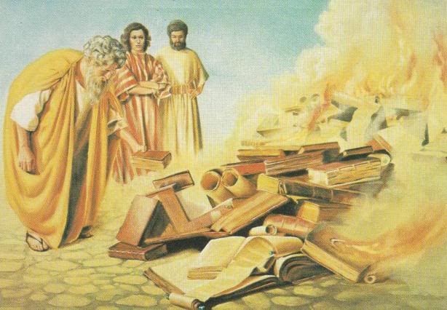
Responses Are Not All The Same (vv. 18-41)
Some: willing to sacrifice & submit (vv. 18-20)
  Believed [obeyed] (v. 18)
  Confessed & told deeds [acknowledged frauds] (v. 18)
  Gave up magic & burned books (v. 19)

Slide 22
Responses Are Not All The Same (vv. 18-41)
Some: willing to sacrifice & submit (vv. 18-20)
Some: unwilling to sacrifice & rebelled (vv. 23-34)
  Upset at what the truth might cost (vv. 23-27)
  Rebelled (vv. 28-34)
    Not what they wanted
    Driven by emotion

Slide 23
Responses Are Not All The Same (vv. 18-41)
Some: willing to sacrifice & submit (vv. 18-20)
Some: unwilling to sacrifice & rebelled (vv. 23-34)
Have same responses today
  Some willing to sacrifice any and all (Matt. 13:44; 19:29)
  Some unwilling to sacrifice – don’t want Christianity to cost them anything (Matt. 19:16-22; Acts 24:25)

Slide 24
The Difference
at Ephesus
Baptisms Are Not All The Same (vv. 1-7)
Doctrines Are Not All The Same (vv. 8-10)
Evidence is Not All The Same (vv. 11-17)
Responses Are Not All The Same (vv. 18-41)

