Slide 1
Luke 22:31-32
31 And the Lord said, "Simon, Simon! Indeed, Satan has asked for you, that he may sift you as wheat.
32 But I have prayed for you, that your faith should not fail; and when you have returned to Me, strengthen your brethren."

Slide 2
Luke 22:31-32
31 And the Lord said, "Simon, Simon! Indeed, Satan has asked for you, that he may sift you as wheat.
32 But I have prayed for you, that your faith should not fail; and when you have returned to Me, strengthen your brethren."
The Context:
Jesus institutes L.S. (vv.14-23)
Dispute over who is greatest (vv. 24-30)
Predicts Peter’s denial (vv. 31-34)

Slide 3
Luke 22:31-32
31 And the Lord said, "Simon, Simon! Indeed, Satan has asked for you, that he may sift you as wheat.
32 But I have prayed for you, that your faith should not fail; and when you have returned to Me, strengthen your brethren."
The Lord Knew
Three Things About
Peter
He Would be Tempted
He Would Yield
He Would be Restored

Slide 4
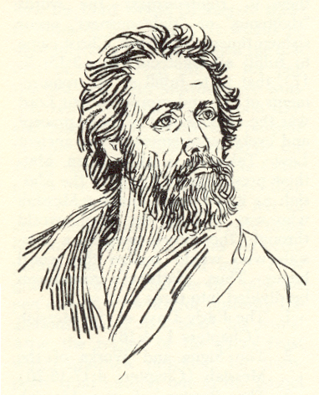
Peter
Was a Likely
Candidate
For
Temptation
Occupied a distinguished place
among disciples
Rash – eager to speak & answer
(Matt. 15:15; 16:13-18, 22-23; Jno. 13:8-9)
Overconfident: “I will never”
(Matt. 26:33; Luke 22:33)

Slide 5
Luke 22:31-32
31 And the Lord said, "Simon, Simon! Indeed, Satan has asked for you, that he may sift you as wheat.
32 But I have prayed for you, that your faith should not fail; and when you have returned to Me, strengthen your brethren."
Temptation &
The Tempter
What Is To Be
Done About It

Slide 6
Temptation of Peter
I. The Tempter

Slide 7
Identified as Satan (v. 31)
A. Is Real
  Not imaginary or a myth
  Just as real & alive as when
    Tempted Eve (Gen. 3:1-6)
    Tempted Jesus (Matt. 4)
  Peter learned this well (cf. 1 Pet. 5:8)
I. The Tempter

Slide 8
Identified as Satan (v. 31)
A. Is Real
B. Character
  Subtle (2 Cor. 11:3)
  Hates righteousness (1 Pet. 5:8)
  Murderer (John 8:44)
  Liar (John 8:44)
  Persevering (John 8:44)
  Successful (Matt. 7:13-14)
I. The Tempter

Slide 9
Identified as Satan (v. 31)
A. Is Real
B. Character
C. Purpose
  Have you (v. 31)
  Sift you (v. 31)
I. The Tempter

Slide 10
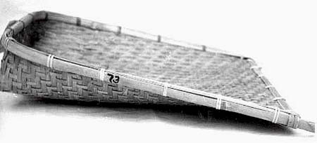
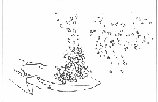
“Sift You”
“to sift, shake in a sieve” (Thayer)
“Grain was agitated or shaken in a kind of fan or sieve. The grain remained in the fan, and the chaff and dust were thrown off. So Christ says that Satan desired to try Peter; to place trials and temptations before him; "to agitate him" to see whether anything of faith would remain, or whether all would not be found to be chaff-mere natural ordor and false professions.”
(Barnes)

Slide 11
“‘He has challenged you’, has undertaken to prove you a company of hypocrites, and Peter especially, the forwardest of you." Some suggest that Satan demanded leave to sift them as their punishment for striving who should be greatest, in which contest Peter perhaps was very warm: ‘Leave them to me, to sift them for it.’"
(Matthew Henry)

Slide 12
Identified as Satan (v. 31)
A. Is Real
B. Character
C. Purpose
  Have you (v. 31)
  Sift you (v. 31)
  Devour (1 Pet. 5:8)
I. The Tempter

Slide 13
Temptation of Peter
I. The Tempter
II. Intercession of Christ

Slide 14
Prayed For Peter & Told Him So
A. That Peter’s Faith Fail Not
B. Prayer / Intercession Worked
C. Intercedes For Us (Heb. 7:25)
II. Intercession of Christ

Slide 15
Temptation of Peter
I. The Tempter
II. Intercession of Christ
III. Subsequent Duty

Slide 16
Strengthen Brethren
“To make stable…make firm” (Thayer)
By Example
  Acts 2
  1 Pet. 5:1-2
B. By Words / Warning
  1 Pet. 1:6-9; 5:8
  2 Pet. 3:17
C. By Words / Exhortation
  1 Peter 1:5-10
D. By Prayer (1 Pet. 3:12; 4:7)
III. Subsequent Duty

Slide 17
Temptation of Peter
I. The Tempter
II. Intercession of Christ
III. Subsequent Duty

