Slide 1

Struggle With Discouragement
It is not uncommon for Christians to be discouraged from time to time
  Some – occasionally / Others – Stay in it
  Some – “blahs” or “blues” / Some – Depression

Slide 2
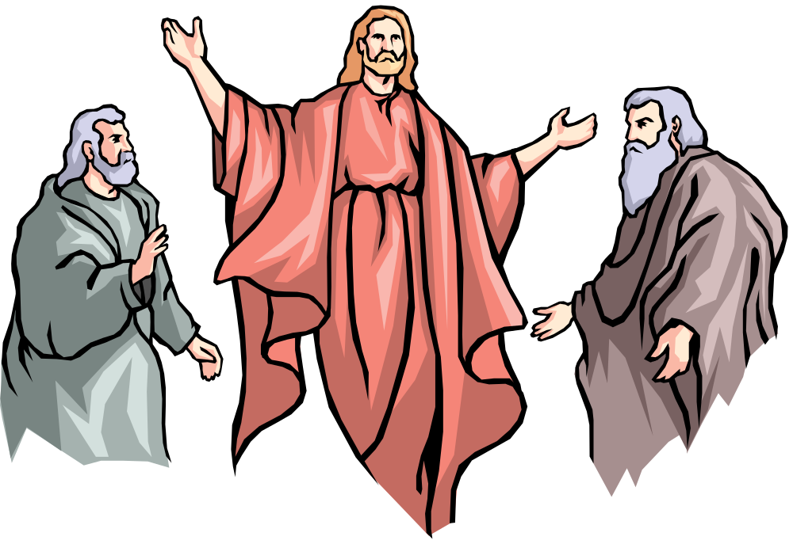
Elijah
Reached a Point Where He Was Pretty Low
Perhaps we think the great prophets are people of steel – unreal temperament
Jas. 5:17 – “nature like ours”
1 Kings 19:1-10 Reached a point – “burnout”
  Afraid (v. 3)
  Doubted ability to continue (v. 4)
  Exhausted (vv. 5-8)
  Felt frustrated & all alone (v. 10)
Elijah Struggled – So Do We!

Slide 3
Struggle With Discouragement
I. What Is Discouragement?

Slide 4
A. Dictionary: “To deprive of courage, hope, confidence” (Webster)
B. Opposite of: Encouraged
C. Synonyms: disappointed, down, disheartened, troubled, blues, depression, gloomy, etc.
D. There is legitimate discouragement
  Possible to be discouraged (Heb. 12:3, 5)
  The need for encouragement (Rom. 1:12)
E. Broad term:
  Includes feelings hurt – heartache – clinical depression
  Some “Depression” is merely discouragement
I. What Is Discouragement?

Slide 5
Struggle With Discouragement
I. What Is Discouragement?
II. What Causes Discouragement?

Slide 6
A. Disappointment at Sin of Others
B. Physical Problems / Sickness
C. Material / Financial Difficulties
D. Own Sin
E. Death of a Stronghold
II. What Causes Discouragement?

Slide 7
Struggle With Discouragement
I. What Is Discouragement?
II. What Causes Discouragement?
III. How Does It Create A Struggle?

Slide 8
A. Feel Like You Are Alone (1 Kings 19:10)
B. Sees A Dark Future
C. Think Nothing Can Do
D. Exaggerate The Trouble
E. Forget The Good Of The Past
III. How Does It Create
A Struggle?

Slide 9
Struggle With Discouragement
I. What Is Discouragement?
II. What Causes Discouragement?
III. How Does It Create A Struggle?
IV. How Can One Deal With It?

Slide 10
A. Things That Don’t Help
1. Running to escape (Psa. 55:6, 16-23)
2. Self pity (1 Sam. 30:1-6)
3. Alcohol (1 Pet. 4:3)
IV. How Can One Deal With It?

Slide 11
A. Things That Don’t Help
B. Elijah’s Case
1. Prayed (1 Kings 19:4; 1 Pet. 5:7)
2. Remember the power of God (1 Kings 19:11- 13)
3. Get busy doing Lord’s will (vv. 15-ff)
4. Not as bad as you think (v. 18)
5. Are others who will help (vv. 17-18)
IV. How Can One Deal With It?

Slide 12
A. Things That Don’t Help
B. Elijah’s Case
C. Hebrews’ Encouragement
1. Know you are on right track (chapters 1-9)
2. Consider danger if stay discouraged (6:4-8)
3. You’ve done it in the past (6:9-12)
4. Remember God’s promises (6:13-20)
5. Consider how Jesus endured (12:3)
6. Could be worse (12:4)
7. Bad circumstances make us better (12:5-11)
8. Take respon. self & be determined (12:12)
IV. How Can One Deal With It?

Slide 13
A. Things That Don’t Help
B. Elijah’s Case
C. Hebrews’ Encouragement
D. Instructions to Encourage the Fainthearted
IV. How Can One Deal With It?

Slide 14
1 Thess 5:14
Now we exhort you, brethren, warn those who are unruly, comfort the fainthearted, uphold the weak, be patient with all.
[ASV: “encourage”]
Remind them what the word says (4:18; 5:11; Acts 20:2; 1 Cor. 14:31)
Be positive – not negative (Num. 13:33 – 14:1; 21:4; 32:7, 9)
Tell them to not give up (1 Thess. 3:2; Acts 11:23)
Let know care – are loved (Col. 2:2)
Remind them of cycles of life (Psa. 30:5)
Remind them of temporary –vs- spiritual (2 Cor. 4:16-18)

Slide 15
A. Things That Don’t Help
B. Elijah’s Case
C. Hebrews’ Encouragement
D. Instructions to Encourage the Fainthearted
E. Put trust in God
IV. How Can One Deal With It?
Psa. 11
Friends advice David to flee – for nothing can do (vv. 1-3)
David declares his confidence in the Lord (vv. 4-7)
  God in on his throne in control (v. 4)
  God will punish wicked (vv. 5-6)
  God will remember the righteous (v. 7)

Slide 16
Struggle With Discouragement
I. What Is Discouragement?
II. What Causes Discouragement?
III. How Does It Create A Struggle?
IV. How Can One Deal With It?

