Slide 1
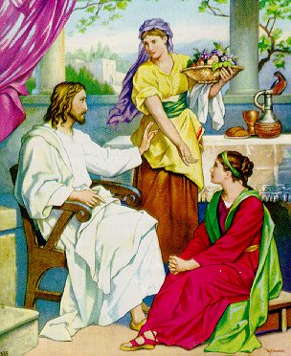
Good People Are Often
Troubled
Luke 10:38-42
“Martha, Martha, you are worried and troubled about many things” (v. 41)
Not a bad person
Not immoral
Not lacking in love for the Lord
Bothered (NASV) – many things
Distracted – thus struggled
We, like Martha, struggle with many things!

Slide 2
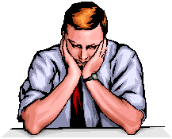
Struggle With Discouragement
It is not uncommon for Christians to be discouraged from time to time
  Some – occasionally / Others – Stay in it
  Some – “blahs” or “blues” / Some – Depression

Slide 3
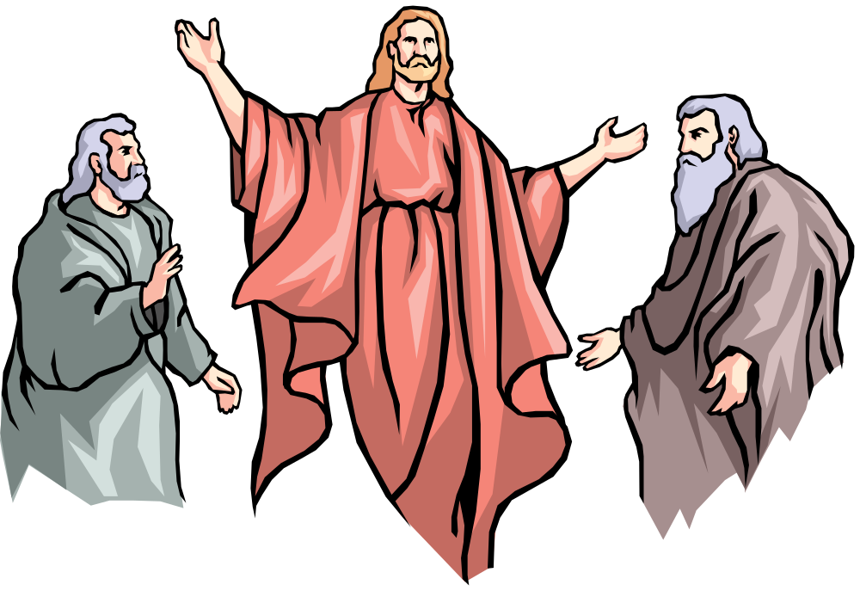
Elijah
Reached a Point Where He Was Pretty Low
Perhaps we think the great prophets are people of steel – unreal temperament
Jas. 5:17 – “nature like ours”
1 Kings 19:1-10 Reached a point – “burnout”
  Afraid (v. 3)
  Doubted ability to continue (v. 4)
  Exhausted (vv. 5-8)
  Felt frustrated & all alone (v. 10)
Elijah Struggled – So Do We!

Slide 4
Struggle With Discouragement
I. What Is Discouragement?

Slide 5
A. Dictionary: “To deprive of courage, hope, confidence” (Webster)
B. Opposite of: Encouraged
C. Synonyms: disappointed, down, disheartened, troubled, blues, depression, gloomy, etc.
D. There is legitimate discouragement
  Possible to be discouraged (Heb. 12:3, 5)
  The need for encouragement (Rom. 1:12)
E. Broad term:
  Includes feelings hurt – heartache – clinical depression
  Some “Depression” is merely discouragement
I. What Is Discouragement?

Slide 6
Struggle With Discouragement
I. What Is Discouragement?
II. What Causes Discouragement?

Slide 7
Disappointment at Sin of Others
  1 Kings 19:10
  Brethren
    Psa. 119:136
    Sin – worldliness
    Toleration of error
    Church troubles
  Family
    Never obey gospel
    Turn astray – life of sin
    Believe or practice religious error
II. What Causes Discouragement?

Slide 8
A. Disappointment at Sin of Others
B. Physical Problems / Sickness
1. Elijah was exhausted
    Ran from Ahab, Mt Carmel to Jezreel – 30 miles (18:46)
    Ran from Jezebel, to Beersheba – 60 miles (19:1-3)
    Ran another days journey (19:4)
    Then felt despair (19:10)
  2. Prolonged sickness, stress on the body, extreme exhaustion – may discourage one
II. What Causes Discouragement?

Slide 9
A. Disappointment at Sin of Others
B. Physical Problems / Sickness
C. Material / Financial Difficulties
1. Financial strain – causes stress
2. Matt. 6:24-33 – worry, anxiety about material things
II. What Causes Discouragement?

Slide 10
A. Disappointment at Sin of Others
B. Physical Problems / Sickness
C. Material / Financial Difficulties
D. Own Sin
1. Often “depression” is merely of problem of guilt (1 Jno. 3:20)
2. “I’m discouraged” – used as an excuse!
    Not all that interested in spiritual matters
    Doing things questionable – maybe sinful
    Blame others – for being discouraged!
  3. Rom. 1:12 – Encouraged by mutual faith [Discouraged because not same faith]
II. What Causes Discouragement?

Slide 11
A. Disappointment at Sin of Others
B. Physical Problems / Sickness
C. Material / Financial Difficulties
D. Own Sin
E. Death of a Stronghold
1. Moses’ death (Josh. 1:1, 7, 9)
2. Jesus’ death (John 14:1)
3. Parent, mentor, leader, etc.
4. Wonder how can we do it without them
II. What Causes Discouragement?

Slide 12
Struggle With Discouragement
I. What Is Discouragement?
II. What Causes Discouragement?
III. How Does It Create A Struggle?

Slide 13
A. Feel Like You Are Alone (1 Kings 19:10)
1. No one to help
2. No one cares
3. No one understands
III. How Does It Create
A Struggle?

Slide 14
A. Feel Like You Are Alone (1 Kings 19:10)
B. Sees A Dark Future
1. 1 Kings 19 - just as soon not live – no reason to keep going
2. Heb. 12:12 – “hands which hang down”
3. Can’t see past the dark cloud
4. Tendency to want to just give up
III. How Does It Create
A Struggle?

Slide 15
A. Feel Like You Are Alone (1 Kings 19:10)
B. Sees A Dark Future
C. Think Nothing Can Do
1. 1 Kings 19 - Elijah wanted to die
2. Col. 3:21 – feel can’t do anything right
3. Psa. 11:3 – “What can the righteous do?”
3. So, what’s the use?
III. How Does It Create
A Struggle?

Slide 16
A. Feel Like You Are Alone (1 Kings 19:10)
B. Sees A Dark Future
C. Think Nothing Can Do
D. Exaggerate The Trouble
1. 1 Kings 19 - “I alone am left” [Yet 7,000]
2. Make the problem bigger – in our mind
3. Reason: see the darker side
    Sick – think dying
    One done wrong – does nothing right
    Difference – becomes a rift
    Financial reverse – ready for bankruptcy
    Feeling down – “I’m depressed”
    Problem – becomes hopeless
III. How Does It Create
A Struggle?

Slide 17
A. Feel Like You Are Alone (1 Kings 19:10)
B. Sees A Dark Future
C. Think Nothing Can Do
D. Exaggerate The Trouble
E. Forget The Good Of The Past
1. Elijah seems to have forgotten:
    God’s answer to prayer (1 Ki. 17:1-7)
    Widow’s flour & oil (1 Ki. 17:8-16)
    Raising of widow’s son (1 Ki. 17:17-24)
    Victory at Mt. Carmel (1 Ki. 18:20-40)
  2. We Forget:
    How been blessed – good of days gone by
    God answered prayers
    Overcome in the past
III. How Does It Create
A Struggle?

Slide 18
Struggle With Discouragement
I. What Is Discouragement?
II. What Causes Discouragement?
III. How Does It Create A Struggle?
IV. How Can One Deal With It?

