Slide 1
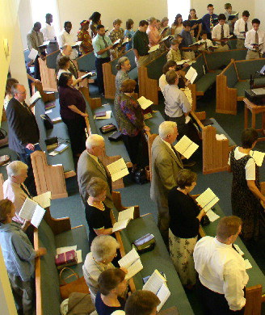
Congregational Singing
Its Place & Purpose

Slide 2
Review
Congregational Singing
Its Place & Purpose
I. Singing Is Worship

Slide 3
Singing Is Worship
Review
What Worship Is

Slide 4
Review
Worship Defined
Strong’s # 4352: proskuneo “(meaning to kiss, like a dog licking his master's hand); to fawn or crouch to, i.e. (literally or figuratively) prostrate oneself in homage (do reverence to, adore)”
Vines: “to make obeisance, do reverence to" (from pros, "towards," and kuneo, "to kiss"), is the most frequent word rendered "to worship." It is used of an act of homage or reverence (a) to God…”

Slide 5
Singing Is Worship
Review
What Worship Is
Who We Worship

Slide 6
Who We Worship
Review
Creator (Psa. 33:6-9; Gen. 1:1; Rev. 4:11)
Almighty (Rev. 4:8, 11)
Great & Awesome (Neh. 1:5; 4:14)
Holds world in hands (Isa. 40:12-17)
Eternal (Exo. 3:14)
Knows all & sees all (Heb. 4:13)
With whom all things are possible (Jer. 32:17)
Saved us from torment by his grace (Eph. 2:4)

Slide 7
Singing Is Worship
Review
What Worship Is
Who We Worship
How We Are To Worship

Slide 8
Review
Must Be From Heart
John 4:24
Must Have Proper Thoughts
1 Cor. 11:27-29
Must Be Show Reverence
Psa. 111:9; 95
Must Be Decently & in Order
1 Cor. 14:40

Slide 9
Singing Is Worship
Review
What Worship Is
Who We Worship
How We Are To Worship
Singing Praises To God

Slide 10
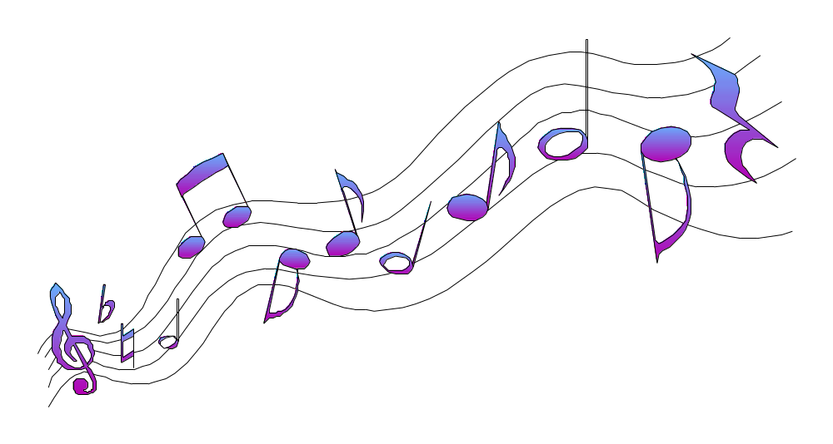
Singing
Singing
Review
Eph. 5:19
Col. 3:16

Slide 11

What Are We To Sing?
Review

Slide 12
Review
Psalms
Hymns
Spiritual Songs
Scriptural Songs
Songs - Praise & Edify
Not Merely Enjoy

Slide 13
The Purpose Of Singing
Review

Slide 14

Review
Purpose For Singing
Purpose For Singing
N
O
T
Pass Time
Entertainment

Slide 15
Review
Purpose For Singing
Purpose For Singing
I
S
Praise God
Teach
Admonish

Slide 16
Congregational Singing
Its Place & Purpose
I. Singing Is Worship
II. The Importance Of Singing

Slide 17
Singing Always Been Part of Service To God
Moses & Israel - released from Egypt (Exo. 15:1-19)
Deborah & Barak (Jud. 5:1-31)
David - Ark returned (1 Chron. 16:7-36)
House of Jacob when left Babylon (Isa. 48:20)
Ezra & Nehemiah wrote about singers (Ezra 2:41, 70; Neh. 12:42-47)
Jesus & Disciples (Matt. 26:30)
Paul & Silas (Acts 16:25)

Slide 18
Singing Always Been Part of Service To God
Music Has Influence
Used to soothe, excite & set moods
Used for dances, parties, movies, TV, etc.
  Indicate danger
  Suggest calmness
  Build tension
Messages come through songs
God uses it to teach & edify (Eph. 5:19)

Slide 19
Singing Always Been Part of Service To God
Music Has Influence
Singing Does Good
Unites us together
Inspires us to greater zeal
Sets mood for worship

Slide 20
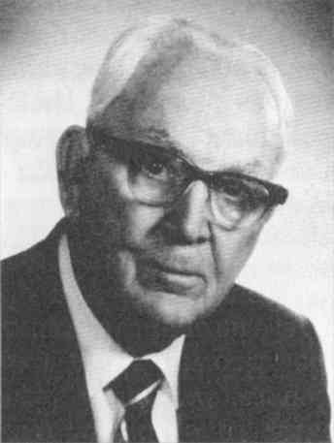
Value of Singing
Tillit S. Teddlie
“It is almost impossible to overestimate the value of a good congregational song service. It stimulates and animates the church to its highest degree of spiritual devotion and worship. It affords an opportunity to every member of the church to express the praise and thanksgiving of his heart unto the Lord. It fills the heart with the sweetest and tenderest emotions, and prepares it for the reception of God’s eternal truth. It enriches, broadens, and sweetens life. It strengthens the faint and discouraged soul with a new faith and a new hope. It pours the oil of gladness into the wounded and sorrowing hearts and revives the drooping spirit of life. It turns the thought of weary pilgrims from the conflicts and crosses of this life to the eternal existence where no shadows ever fall - to the house not made with hands, eternal in the heavens”

Slide 21
Singing Always Been Part of Service To God
Music Has Influence
Singing Does Good
Only Part of Our Worship - In Heaven
Rev. 5:9; 14:3
Not: Preaching, Lord’s Supper, Giving or Prayer
One thing - do for all eternity

Slide 22
Congregational Singing
Its Place & Purpose
I. Singing Is Worship
II. The Importance Of Singing
III. How We Serve God (Sing)

Slide 23
Colossians 3:23
“And whatever you do, do it heartily, as to the Lord and not to men.”
“heartily”
With life
With enthusiasm
With excitement
“as to Lord”
Do our best

Slide 24
Be The Best You Can Be:
Preacher
Plumber
Line Worker
Secretary
House cleaner
Salesman
Carpenter
Sales Clerk
Teacher

Slide 25
“Music (Pitch, Beat, Tone, Rhythm, etc.) is Not Important”

Slide 26
Singing
“To utter a series of words or sounds in musical tones.” (AHD)
Mere words & focus thereon – is not singing!

Slide 27
Holy, Holy, Holy, Lord God Almighty!
Early in the morning our son shall rise to Thee;
Holy, Holy, Holy! Merciful and Mighty!
God over all, and blest eternally.

Slide 28
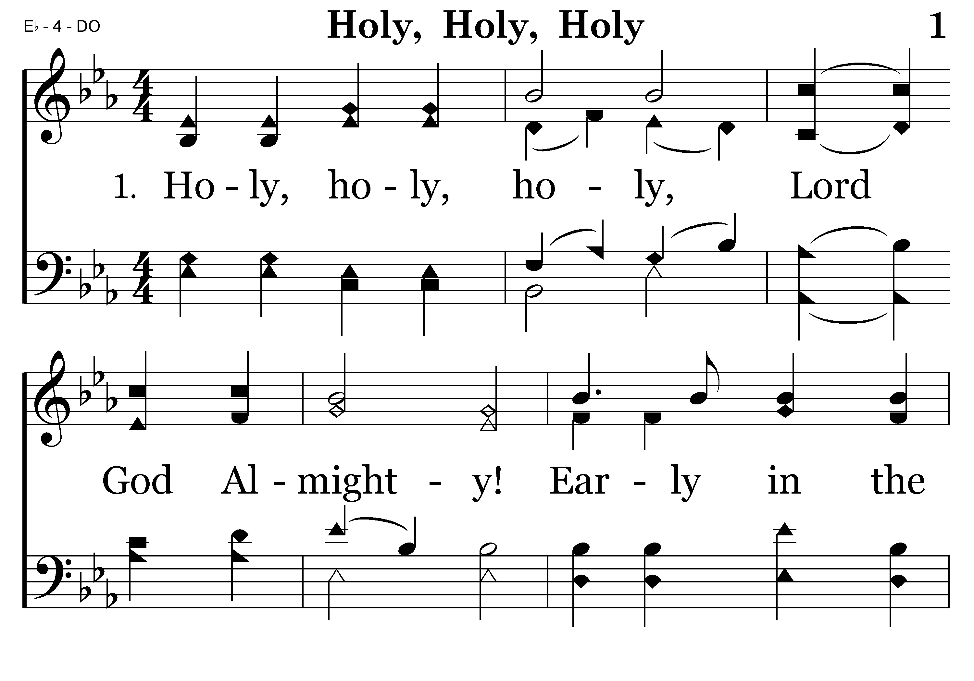
001 - Holy, Holy, Holy - 1.1

Slide 29
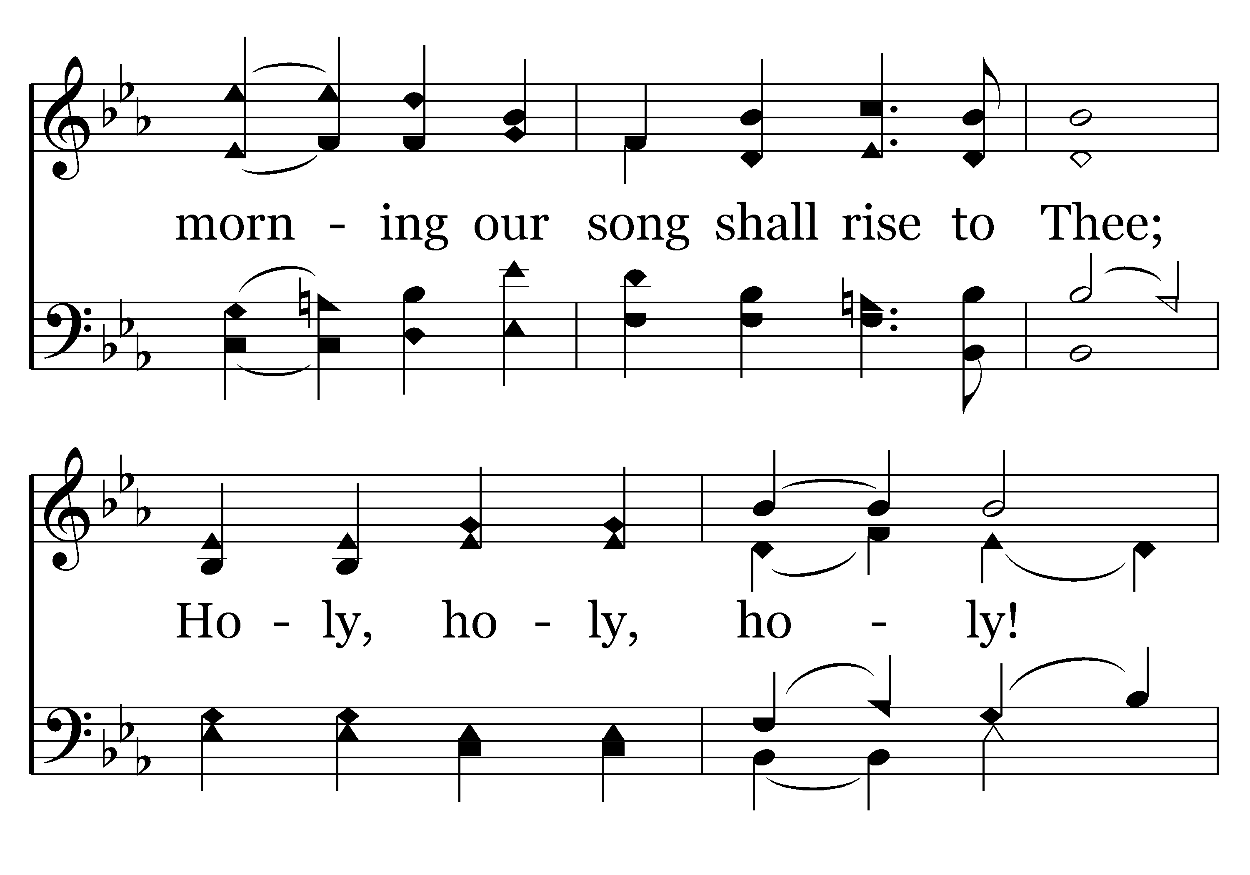
001 - Holy, Holy, Holy - 1.2

Slide 30
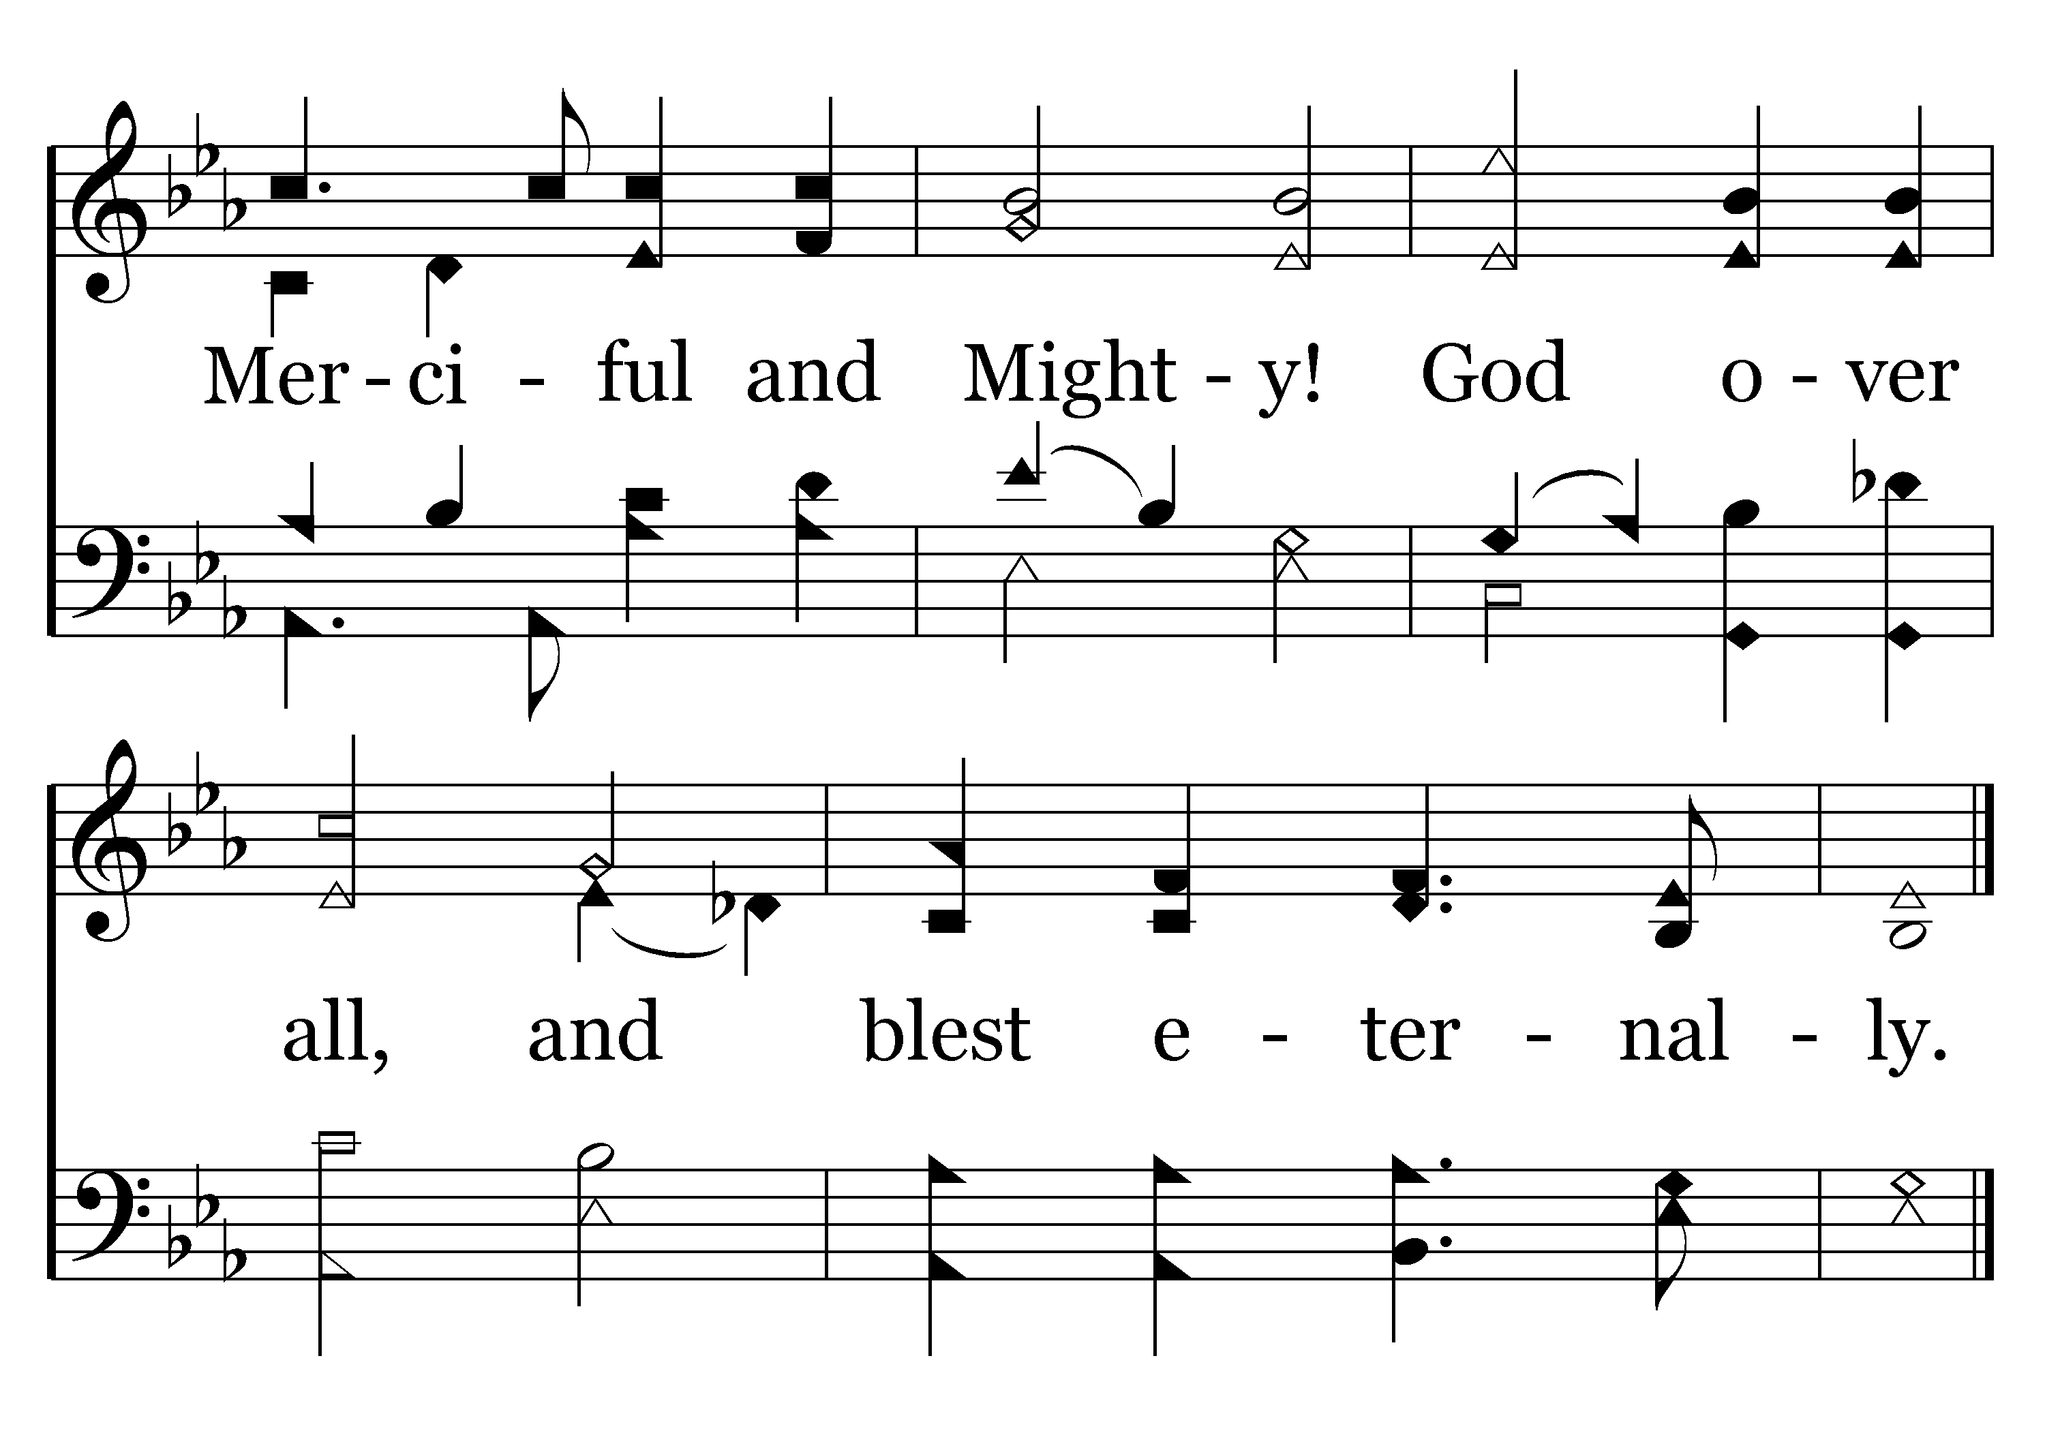
001 - Holy, Holy, Holy - 1.3
End of Verse 1

Slide 31
Congregational Singing
Its Place & Purpose
I. Singing Is Worship
II. The Importance Of Singing
III. How We Serve God (Sing)
IV. Extremes

Slide 32
Extremes
“In Spirit”
but
not
“In Truth”
“In Truth”
but
not
“In Spirit”

Slide 33
Extremes
Focused
More
on the
“Mechanics”
of
Pitch, Tone &
Rhythm
Focused
Merely
on the
“Words”
and
Does Not
Try to
Do Their
Best

Slide 34
Extremes
“Reverent”
to the point
that we
have lost
enthusiasm
&
excitement
“Enthusiasm”
to the point
that we
have lost
reverence
&
dignity

Slide 35
Congregational Singing
Its Place & Purpose
I. Singing Is Worship
II. The Importance Of Singing
III. How We Serve God (Sing)
IV. Extremes

