Slide 1
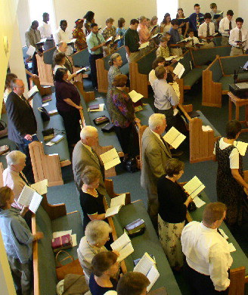
Congregational Singing
Its Place & Purpose

Slide 2
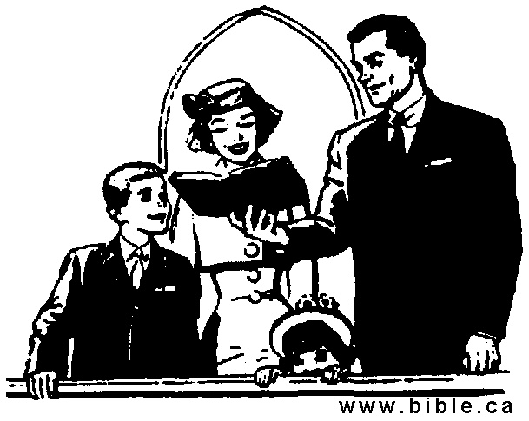
Missing From
Worship Services:
Excitement
Joy
Enthusiasm
Hearty participation

Slide 3
Worship Attitude Affected by
Present-Day Culture
  Get it, and get it quick approach to life
  More comfort and convenience
  Change the service rather than my attitude
  Shorten the worship service
  Drive-in sermons and drive-through communion
  Want to be entertained
  If I’m not enjoying it – others need to act

Slide 4
Wrong
Attitudes
Worship
of Its Joy
Rob
Joy
X

Slide 5
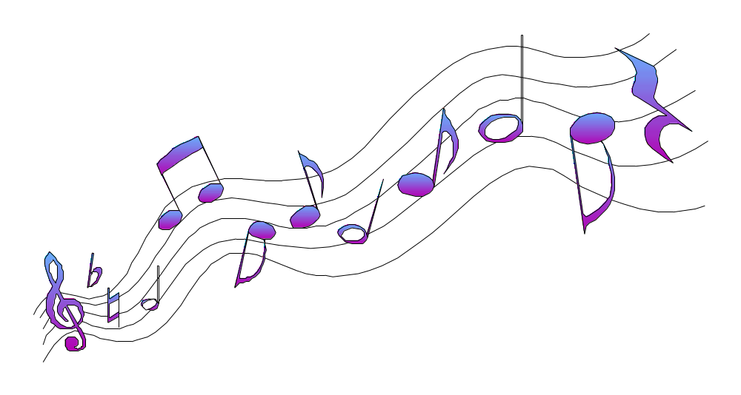
We are more against instrumental music
than we are for singing
- R. J. Stevens

Slide 6
Congregational Singing
Its Place & Purpose
I. Singing Is Worship

Slide 7
Singing Is Worship
What Worship Is

Slide 8
Worship Defined
Strong’s # 4352: proskuneo “(meaning to kiss, like a dog licking his master's hand); to fawn or crouch to, i.e. (literally or figuratively) prostrate oneself in homage (do reverence to, adore)”
Vines: “to make obeisance, do reverence to" (from pros, "towards," and kuneo, "to kiss"), is the most frequent word rendered "to worship." It is used of an act of homage or reverence (a) to God…”

Slide 9
Expression of
Spirituality
Psalm 95:1-7

Slide 10
Psalm 95:1-7
1 Oh come, let us sing to the LORD! Let us shout joyfully to the Rock of our salvation.
2 Let us come before His presence with thanksgiving; Let us shout joyfully to Him with psalms.
3 For the LORD is the great God, And the great King above all gods.
4 In His hand are the deep places of the earth; The heights of the hills are His also.
5 The sea is His, for He made it; And His hands formed the dry land.
6 Oh come, let us worship and bow down; Let us kneel before the LORD our Maker.
7 For He is our God, And we are the people of His pasture, And the sheep of His hand. Today, if you will hear His voice:

Slide 11
Expression of
Spirituality
Worship is a verb
Something you do!
Time to pour out our adoration
Difference in a religion of excitement &
excitement of religion

Slide 12
Singing Is Worship
What Worship Is
Who We Worship

Slide 13
Who We Worship
Creator (Psa. 33:6-9; Gen. 1:1; Rev. 4:11)
Almighty (Rev. 4:8, 11)

Slide 14
Rev 4:8, 11
8 The four living creatures, each having six wings, were full of eyes around and within. And they do not rest day or night, saying: "Holy, holy, holy, Lord God Almighty, Who was and is and is to come!"
11 "You are worthy, O Lord, To receive glory and honor and power; For You created all things, And by Your will they exist and were created."

Slide 15
Who We Worship
Creator (Psa. 33:6-9; Gen. 1:1; Rev. 4:11)
Almighty (Rev. 4:8, 11)
Great & Awesome (Neh. 1:5; 4:14)
Holds world in hands (Isa. 40:12-17)
Eternal (Exo. 3:14)
Knows all & sees all (Heb. 4:13)
With whom all things are possible (Jer. 32:17)
Saved us from torment by his grace (Eph. 2:4)

Slide 16
Singing Is Worship
What Worship Is
Who We Worship
How We Are To Worship

Slide 17
Must Be From Heart
John 4:24
Must Have Proper Thoughts
1 Cor. 11:27-29
Must Be Show Reverence
Psa. 111:9; 95
Must Be Decently & in Order
1 Cor. 14:40

Slide 18

Decently & In Order
(1 Cor. 14:40)
Decently:
denotes "gracefully, becomingly, in a seemly manner"
(eu, "well," schema, "a form, figure")
- “of good external appearance”
Order:
regular arrangement, i.e. (in time) fixed succession
(of rank or character), official dignity:
“of due ‘order,’ in contrast to confusion,
in the gatherings of a local church”

Slide 19
Decently & In Order
(1 Cor. 14:40)
“Let all things be done in an ‘appropriate’ and ‘becoming’ manner; ‘decorously,’ as becomes the worship of God.”
Albert Barnes

Slide 20
Singing Is Worship
What Worship Is
Who We Worship
How We Are To Worship
Singing Praises To God

Slide 21
Singing
Singing
Eph. 5:19
Col. 3:16

Slide 22
Eph. 5:19
“Speaking to one another in psalms and hymns and spiritual songs, singing and making melody in your heart to the Lord”

Slide 23
Col. 3:16
“Let the word of Christ dwell in you richly in all wisdom, teaching and admonishing one another in psalms and hymns and spiritual songs, singing with grace in your hearts to the Lord.”

Slide 24

What Are We To Sing?

Slide 25
Psalms
“In all probability the Psalmoi of Eph. v. 19, Col. iii. 16 are the inspired psalms of the Hebrew Canon” - (Trench 296)
Book of Psalms - 150 such psalms of praise, thanksgiving and request.
Many of those Psalms in our book:
  Hall. Praise Jehovah - Psa. 148
  The Lord is my Shepherd - Psa. 23
  The Law of the Lord - Psa. 19

Slide 26
Psalms
Hymns
Thayer: “a song in praise of gods, heroes, conquerors”
Song of praise
  Main thrust is Praise
  Might be a Psalm or otherwise
Examples:
  “Praise the Lord”
  “Holy, Holy, Holy”

Slide 27
Psalms
Hymns
Spiritual Songs
Contrasted to secular
Content is spiritual matters:
  Might include Praise
  Might include Thanksgiving
  Might include Instruction
Most of our songs fit this category

Slide 28
Psalms
Hymns
Spiritual Songs
Scriptural Songs
Could be “spiritual” - not “Scriptural”
Can’t sing error - like teaching error
Yet recognize “poetic license”
Some songs are unscriptural!

Slide 29
Psalms
Hymns
Spiritual Songs
Scriptural Songs
Songs - Praise & Edify
Not Merely Enjoy
Some of the:
Stamps-Baxter Songs
Camp Songs

Slide 30
The Purpose Of Singing

Slide 31

Purpose For Singing
Purpose For Singing
N
O
T
Pass Time
Entertainment

Slide 32
Purpose For Singing
Purpose For Singing
I
S
Praise God
Teach
Admonish

Slide 33
Congregational Singing
Its Place & Purpose
I. Singing Is Worship
II. The Importance Of Singing
III. How We Serve God (Sing)
IV. Extremes

Slide 35
Congregational Singing
Its Place & Purpose
I. Singing Is Worship
II. The Importance Of Singing

Slide 36
Singing Always Been Part of Service To God
Moses & Israel - released from Egypt (Exo. 15:1-9)
Deborah & Balak (Jud. 5:1-31)
David - Ark returned (1 Chron. 16)
House of Jacob when left Babylon (Isa. 48:20)
Ezra & Nehemiah wrote about singers (Ezra 2:41, 70; Neh. 12:42-47)
Jesus & Disciples (Matt. 26:30)
Paul & Silas (Acts 16:25)

Slide 37
Singing Always Been Part of Service To God
Music Has Influence
Used to soothe, excite & set moods
Used for dances, parties, movies, TV, etc.
  Indicate danger
  Suggest calmness
  Build tension
Messages Come through songs
God uses it to teach & edify (Eph. 5:19)

Slide 38
Singing Always Been Part of Service To God
Music Has Influence
Singing Does Good
Unites us together
Inspires us to greater zeal
Sets mood for worship

Slide 39
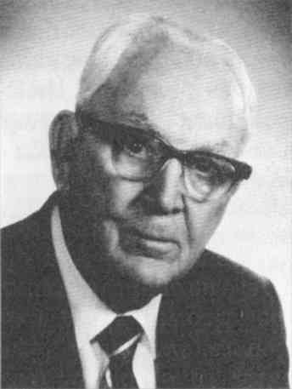
Value of Singing
Tillit S. Teddlie
“It is almost impossible to overestimate the value of a good congregational song service. It stimulates and animates the church to its highest degree of spiritual devotion and worship. It affords an opportunity to every member of the church to express the praise and thanksgiving of his heart unto the Lord. It fills the heart with the sweetest and tenderest emotions, and prepares it for the reception of God’s eternal truth. It enriches, broadens, and sweetens life. It strengthens the faint and discouraged soul with a new faith and a new hope. It pours the oil of gladness into the wounded and sorrowing hearts and revives the drooping spirit of life. It turns the thought of weary pilgrims from the conflicts and crosses of this life to the eternal existence where no shadows ever fall - to the house not made with hands, eternal in the heavens”

Slide 40
Singing Always Been Part of Service To God
Music Has Influence
Singing Does Good
Only Part of Our Worship - In Heaven
Rev. 5:9; 14:3
Not: Preaching, Lord’s Supper, Giving or Prayer
One thing - do for all eternity

Slide 41
Congregational Singing
Its Place & Purpose
I. Singing Is Worship
II. The Importance Of Singing
III. How We Serve God (Sing)

Slide 42
Colossians 3:23
“And whatever you do, do it heartily, as to the Lord and not to men.”
“heartily”
With life
With enthusiasm
With excitement
“as to Lord”
Do our best

Slide 43
Be The Best You Can Be:
Preacher
Plumber
Line Worker
Secretary
House cleaner
Salesman
Carpenter
Sales Clerk
Teacher

Slide 44
Music – Pitch, Beat, Tone, Rhythm, etc. is Not Important

Slide 45
Singing
“To utter a series of words or sounds in musical tones.” (AHD)
Mere words & focus thereon – is not singing!

Slide 46
Congregational Singing
Its Place & Purpose
I. Singing Is Worship
II. The Importance Of Singing
III. How We Serve God (Sing)
IV. Extremes

Slide 47
Extremes
“In Spirit”
but
not
“In Truth”
“In Truth”
but
not
“In Spirit”

Slide 48
Extremes
Focused
More
on the
“Mechanics”
of
Pitch, Tone &
Rhythm
Focused
Merely
on the
“Words”
and
Does Not
Try to
Do Their
Best

Slide 49
Extremes
“Reverent”
to the point
that we
have lost
enthusiasm
&
excitement
“Enthusiasm”
to the point
that we
have lost
reverence
&
dignity

Slide 50
Congregational Singing
Its Place & Purpose
I. Singing Is Worship
II. The Importance Of Singing
III. How We Serve God (Sing)
IV. Extremes

