Slide 1
Acts 28

Slide 2
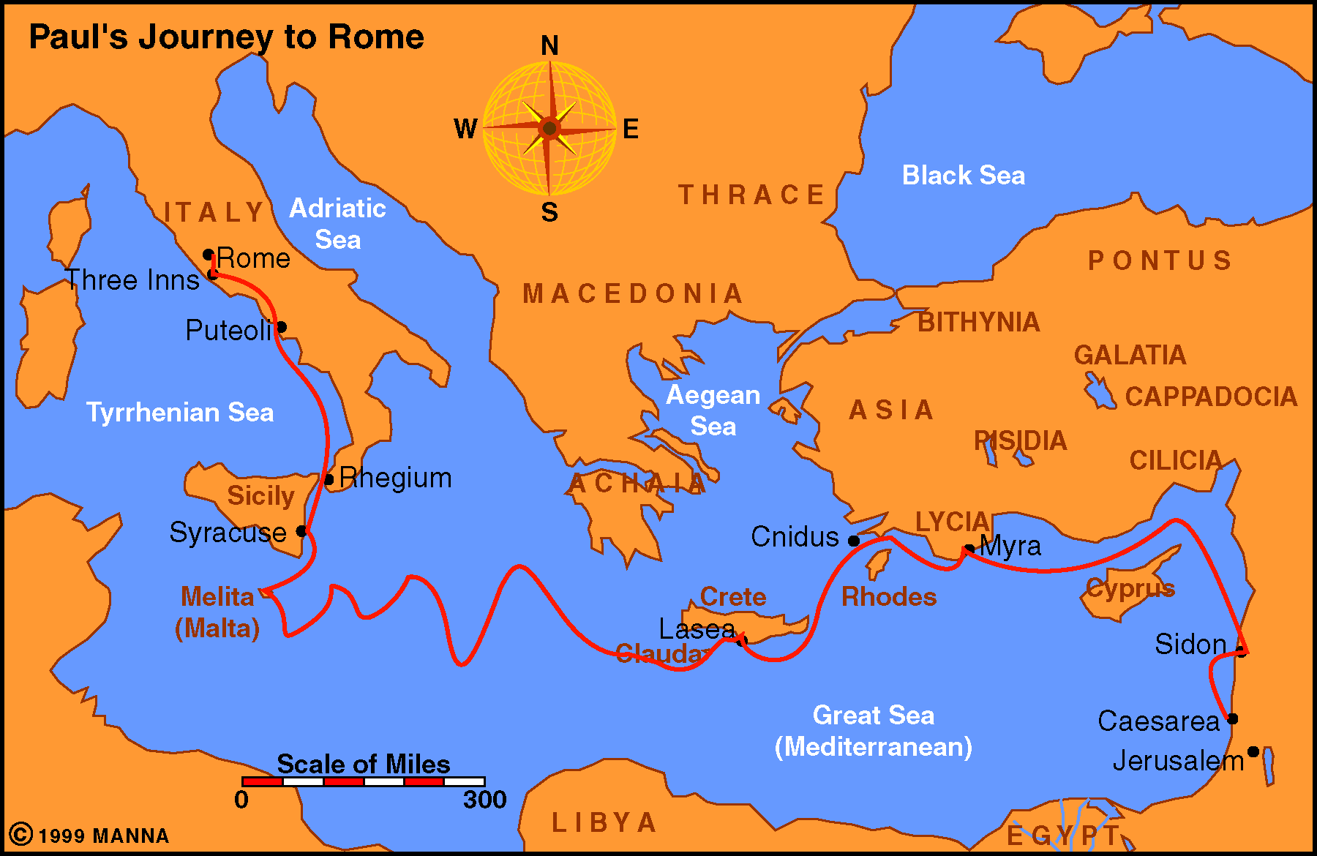
Paul Journey 4

Slide 3
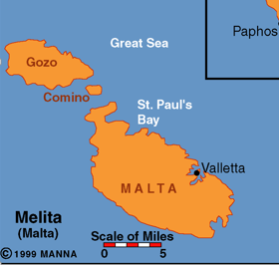
8 Miles x 15 Miles

Slide 4
Paul Had Planned to Go to Rome
Rom. 1:10-15 (written from Corinth on 3rd journey)
Rom. 15:22-24
Acts 19:21 (after trip to Jerusalem – plan to go to Rome)
He went, but not as he planned!
God had promised he would go (Acts 23:11; 27:23-24)
He made it to Rome at last
It took years & unexpected twist and turns – but God’s providence led him to Rome
Notes:
Ought to encourage us not to lose faith but trust in God’s providence to accomplish his purpose no matter what happens along the way!

Slide 5
Acts 28
Rome
at Last

Slide 6
Acts 28
Rome
at Last
Kindness among Pagans (vv. 1-10)

Slide 7
Kindness among Pagans
(vv. 1-10)
Kindness on the beach (vv. 1-6)
  Unusual – great – “extraordinary” (NASV)
  From natives – barbarians – not speak Greek - strangers
  Kindness – “love of mankind” (A. T. Robertson)
  Welcomed them with a fire (showed they cared)
  Paul bitten by snake (confirmed his message – Mk. 16:17-20)
  People, though kind, were fickle (v. 6)
Acts 28
Notes:
Kindness used only twice – here and Titus. 3:4 – Love toward man

Slide 8
Kindness among Pagans
(vv. 1-10)
Kindness on the beach (vv. 1-6)
Kindness at the estate (vv. 7-9)
  Showed them hospitality for 3 days (v. 7)
  Opportunity for Paul to heal his father (v. 8)
  Lead to healing many on island (v. 9)
Acts 28

Slide 9
Kindness among Pagans
(vv. 1-10)
Kindness on the beach (vv. 1-6)
Kindness at the estate (vv. 7-9)
Kindness when they left (v. 10)
  Honored them in many ways (show love & appreciation)
  Provided what they needed (necessities for travel)
Acts 28

Slide 10
Kindness among Pagans
(vv. 1-10)
Kindness on the beach (vv. 1-6)
Kindness at the estate (vv. 7-9)
Kindness when they left (v. 10)
If Pagans can – lesson for us
  Kindness toward brethren (Eph. 4:32)
  Everyone understands kindness (Prov. 19:22)
  Love neighbor (Matt. 22:39)
  Show we care – concerned
Acts 28

Slide 11
Acts 28
Rome
at Last
Kindness among Pagans (vv. 1-10)
Encouragement among Brethren (vv. 11-16)

Slide 12
Encouragement
among Brethren
(vv. 11-16)
At Puteoli (vv. 13-14)
  Sought brethren out
  Brethren invited Paul, Luke & Aristarchus stay
  Stayed for week (opportunity to worship)
Acts 28

Slide 13
Encouragement
among Brethren
(vv. 11-16)
At Puteoli (vv. 13-14)
At Appii Forum & Three Inns (v. 15)
  Brethren from Rome came
    43 miles to Appii Forum
    33 miles to Three Inns
  Not ashamed to be identified with Paul the prisoner
  Encouraged by time with them
    Thankful
    Took courage
Acts 28

Slide 14
Encouragement
among Brethren
(vv. 11-16)
At Puteoli (vv. 13-14)
At Appii Forum & Three Inns (v. 15)
Take Encouragement from our Brethren
  Encouraged by their presence
  Encouraged by their words
  Encouraged when we worship together
  Encouraged to see others strive to serve God
Acts 28

Slide 15
Acts 28
Rome
at Last
Kindness among Pagans (vv. 1-10)
Encouragement among Brethren (vv. 11-16)
Rejection among Jews (vv. 17-29)

Slide 16
Rejection among Jews
(vv. 17-29)
First Meeting (vv. 17-22)
  Paul called for Jewish leaders (v. 17)
  Inform them of why he was a prisoner (vv. 17-20)
  Reaction (vv. 21-22)
    Not been told about Paul (v. 21)
    Wanted to learn more about “sect” (v. 22)
Acts 28

Slide 17
Rejection among Jews
(vv. 17-29)
First Meeting (vv. 17-22)
Second Meeting (vv. 23-29)
  Came to Paul’s lodging (v. 23a)
  Preached about Christ (v. 23b)
  Reaction (vv. 24-29)
    Some believed (v. 24)
    Some disbelieved (v. 24)
    Left (vv. 25-29a)
    Great dispute (v. 29b)
Acts 28

Slide 18
Rejection among Jews
(vv. 17-29)
First Meeting (vv. 17-22)
Second Meeting (vv. 23-29)
There will Always be Some to Reject Gospel
  Even after abundant evidence (v. 23)
  The message doesn’t fit what they want
Acts 28

Slide 19
Acts 28
Rome
at Last
Kindness among Pagans (vv. 1-10)
Encouragement among Brethren (vv. 11-16)
Rejection among Jews (vv. 17-29)
Freedom in Prison (vv. 30-31)

Slide 20
Freedom in Prison
(vv. 30-31)
Paul was Given Freedom in Prison (vv. 16, 30)
  Dwelt by himself (v. 16)
  Had a guard (v. 16)
  For two years – 61-63 AD (v. 30)
  Allowed visitors (v. 30)
Acts 28

Slide 21
Paul’s Visitors
Timothy (Philemon 1; Col. 1:1; Phil. 1:1)
Epaphras (Col. 1:3-8; 4:12-13; Philemon 23)
Osneimus (Philemon 1:10-21)
Tychicus (Col. 4:7-9)
Epaphroditus (Phil. 4:18; 2:25-30)
John Mark (Col. 4:10)
Aristarchus (Col. 4:10)
Demas (Col. 4:14)
Luke (Philemon 24)
Justus (Col. 4:11)

Slide 22
Freedom in Prison
(vv. 30-31)
Paul was Given Freedom in Prison (vv. 16, 30)
Preached (v. 31)
  Continued to preach despite his chains (Col. 1:23-29)
  Converted Onesimus (Philemon 10)
  Preached to the Palace guard (Phil. 1:12-20)
  Had some success with Ceasar’s household (Phil. 4:22)
Acts 28

Slide 23
Freedom in Prison
(vv. 30-31)
Paul was Given Freedom in Prison (vv. 16, 30)
Preached (v. 31)
Wrote Epistles
  Colossians
  Philippians
  Ephesians
  Philemon
  Hebrews
Acts 28

Slide 24
Freedom in Prison
(vv. 30-31)
Paul was Given Freedom in Prison (vv. 16, 30)
Preached (v. 31)
Wrote Epistles
So – What Happened to Paul?
  Did he go before Caesar? God said he would (27:24)
  Paul planned on being released (Phil. 1:23-27; 2:24; Philemon 22)
Acts 28

Slide 25
Freedom in Prison
(vv. 30-31)
Paul was Given Freedom in Prison (vv. 16, 30)
Preached (v. 31)
Wrote Epistles
So – What Happened to Paul?
Good can Come from Trouble (Phil. 1:12-14)
Acts 28

Slide 26
Acts 28
Rome
at Last
Kindness among Pagans (vv. 1-10)
Encouragement among Brethren (vv. 11-16)
Rejection among Jews (vv. 17-29)
Freedom in Prison (vv. 30-31)

