Slide 1

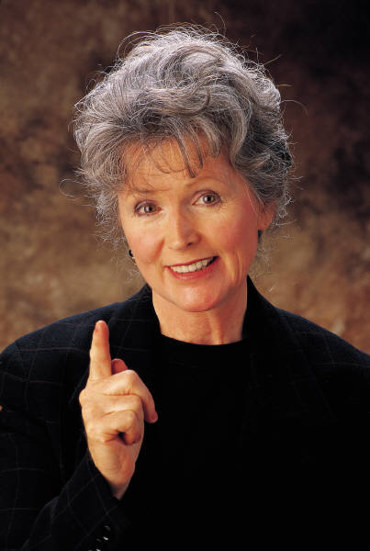
The Role of Women
What is their role in the church?
What can they do?
What limitations are placed upon them?
Notes:
12/16/2003
04/01/2012
01/04/2015

Slide 2


Women Are Equal
To Men
Gal 3:28
There is neither Jew nor Greek, there is neither slave nor free, there is neither male nor female; for you are all one in Christ Jesus.

Slide 3
Women Are Equal
To Men
1 Peter 3:7
Husbands, likewise, dwell with them with understanding, giving honor to the wife, as to the weaker vessel, and as being heirs together of the grace of life, that your prayers may not be hindered.

Slide 4
Women Are Equal
To Men
1 Cor. 11:11-12
Nevertheless, neither is man independent of woman, nor woman independent of man, in the Lord. For as woman came from man, even so man also comes through woman; but all things are from God.

Slide 5
Equality Does Not
Mean Sameness or
Identical
Different Physically
(1 Pet. 3:7)
Different Emotionally
(1 Pet. 3:7)
Different Roles
(1 Pet. 3:1-7)

Slide 6
What Is Going On In Some
Churches of Christ?
Waiting on the Lord’s Supper table
Leading in prayer
Teaching classes with men present
Preaching
Serving as deacons
Serving as elders

Slide 7

Trusting Women : The Way of Women in Churches of Christ
Author: Billie Silvey
Tells of the first women preachers among Churches of Christ
Katie Hayes – Preached at Cahaba Valley Church of Christ (Birmingham) – and West Islip Church of Christ (Long Island, NY)
Amy Henegar – Hospital chaplain preaches Sunday sermons
D’Esta Love (Chaplain of Pepperdine):
2002
“We are finding tools for the analysis of scripture which allow us to view the role of women in the larger context of the biblical witness, rather than allow two heavily disputed passages to relegate women to a silent role” (p. 130).

Slide 8
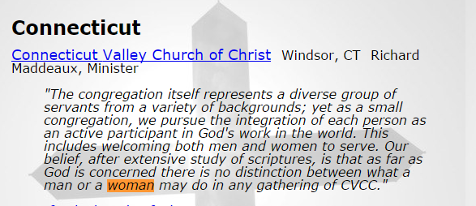
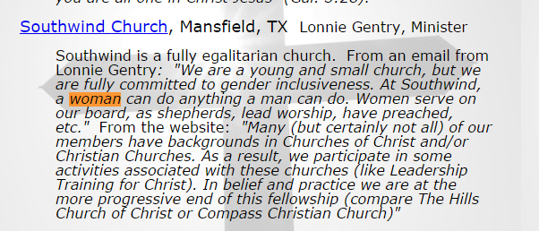
http://www.wherethespiritleads.org/gender_inclusive_churches.htm
Notes:
http://www.wherethespiritleads.org/gender_inclusive_churches.htm

Slide 9
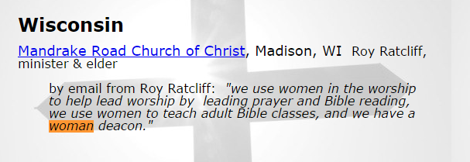
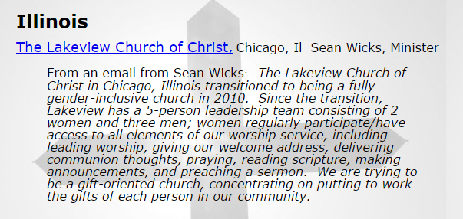

Slide 10
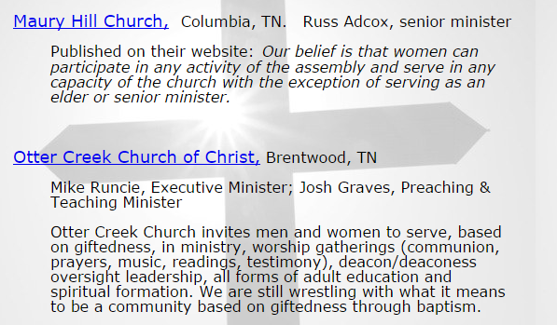

Slide 11
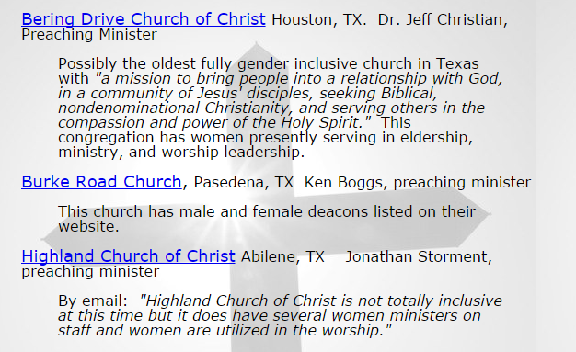

Slide 12



Fourth Ave. Church of Christ
Franklin, TN
Added a woman preacher (intern)
Dec. 2014
From Lipscomb University

Slide 13
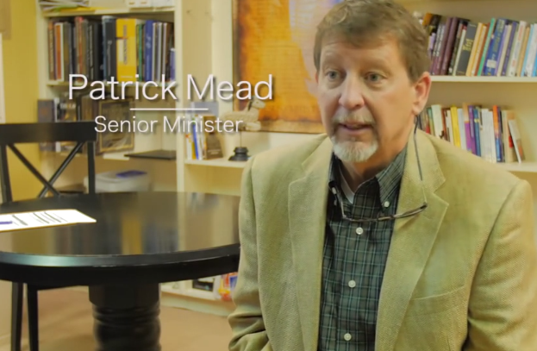
Argues that we do study Christ through Paul
We study Paul through Christ
Two passages were cultural.

Slide 14
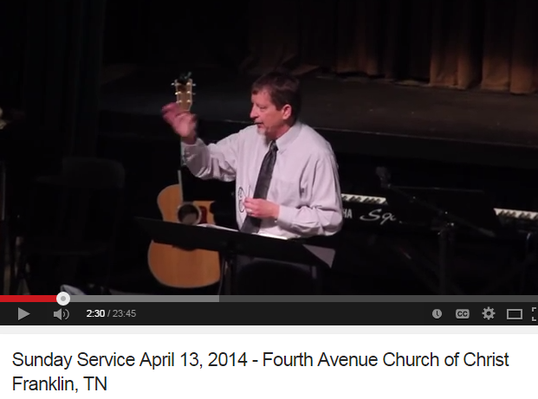

Slide 15
The Role of Women
God Placed Man (Not Woman) In Leadership

Slide 16


I. God Placed Man (Not Woman) In Leadership
A. Generally – 1 Cor. 11:1-3
1 Cor 11:1-3
1 Imitate me, just as I also imitate Christ.
2 Now I praise you, brethren, that you remember me in all things and keep the traditions just as I delivered them to you.
3 But I want you to know that the head of every man is Christ, the head of woman is man, and the head of Christ is God.
God
Christ
Man
Women

Slide 17
I. God Placed Man (Not Woman) In Leadership
A. Generally – 1 Cor. 11:1-3
B. In the Home – Eph. 5:22-24; 1 Pet. 3:1-7
Husband is head of the wife
Wife is to submit to husband

Slide 18
I. God Placed Man (Not Woman) In Leadership
A. Generally – 1 Cor. 11:1-3
B. In the Home – Eph. 5:22-24; 1 Pet. 3:1-7
C. In the Church - Men are to lead
Elders are men (1 Tim. 3:1-7; Tit. 1:5-9)
Deacons are men (1 Tim. 3:8-13)
Preachers are men
  Peter & apostles (Acts 2, 3)
  Paul (Acts 13, 17)
  Stephen (Acts 6)
  Philip (Acts 8)

Slide 19

It Is Not Because
We don’t like women
We think women cannot do as well as men
We think women are inferior
We think women don’t know the Bible
We want to hold to old traditions

Slide 20
The Role of Women
God Placed Man (Not Woman) In Leadership
II. Women Are Not To Teach Over A Man

Slide 21
II. Women Are Not To Teach Over A Man
1 Tim. 2:11-14
11 Let a woman learn in silence with all submission.
12 And I do not permit a woman to teach or to have authority over a man, but to be in silence.
13 For Adam was formed first, then Eve.
14 And Adam was not deceived, but the woman being deceived, fell into transgression.

Slide 22
II. Women Are Not To Teach Over A Man
A. Context:
Roles of men & women
Men (v. 8)
Pray Everywhere
Women (v. 9-14)
Subjection

Slide 23
II. Women Are Not To Teach Over A Man
A. Context:
B. Restrictions: (v. 12)
}
Not To Teach
Over a man
Not To Have Auth.

Slide 24
II. Women Are Not To Teach Over A Man
A. Context:
B. Restrictions:
C. Reasons: (vv. 13-14)
Order of creation (Gen. 2:22-24)
Transgression (Gen. 3:1-6; 16)

Slide 25
Submission Is Not Inferiority
Christ submitted to the Father (1 Cor.11:1-3)
Children submit to parents (Eph. 6:1-4)
Christians submit to elders (Heb. 13:7,17)
Men submit to other men (Heb. 13:7, 17)

Slide 26
The Role of Women
God Placed Man (Not Woman) In Leadership
II. Women Are Not To Teach Over A Man
III. Women Are Not To Address The Assembly

Slide 27
III. Women Are Not To Address The Assembly
1 Cor. 14:34-35
34 Let your women keep silent in the churches, for they are not permitted to speak; but they are to be submissive, as the law also says.
35 And if they want to learn something, let them ask their own husbands at home; for it is shameful for women to speak in church.

Slide 28
III. Women Are Not To Address The Assembly
A. Context: Church = Assembly (v. 23)
1 Cor 14:23
Therefore if the whole church comes together in one place, and all speak with tongues, and there come in those who are uninformed or unbelievers, will they not say that you are out of your mind?

Slide 29
23 Therefore if the whole church comes together in one place, and all speak with tongues, and there come in those who are uninformed or unbelievers, will they not say that you are out of your mind?
24 But if all prophesy, and an unbeliever or an uninformed person comes in, he is convinced by all, he is convicted by all.
25 And thus the secrets of his heart are revealed; and so, falling down on his face, he will worship God and report that God is truly among you.
26 How is it then, brethren? Whenever you come together, each of you has a psalm, has a teaching, has a tongue, has a revelation, has an interpretation. Let all things be done for edification.
27 If anyone speaks in a tongue, let there be two or at the most three, each in turn, and let one interpret.
28 But if there is no interpreter, let him keep silent in church, and let him speak to himself and to God.
29 Let two or three prophets speak, and let the others judge.
30 But if anything is revealed to another who sits by, let the first keep silent.
31 For you can all prophesy one by one, that all may learn and all may be encouraged.
32 And the spirits of the prophets are subject to the prophets.
33 For God is not the author of confusion but of peace, as in all the churches of the saints.
34 Let your women keep silent in the churches, for they are not permitted to speak; but they are to be submissive, as the law also says.
35 And if they want to learn something, let them ask their own husbands at home; for it is shameful for women to speak in church.

Slide 30
III. Women Are Not To Address The Assembly
A. Context: Church = Assembly (v. 23)
B. Silent: (v. 34)
  Must sing (Eph. 5:19; Col. 3:16)
  Silent – i.e. submissive / not over man
  Silent = not address the assembly

Slide 31
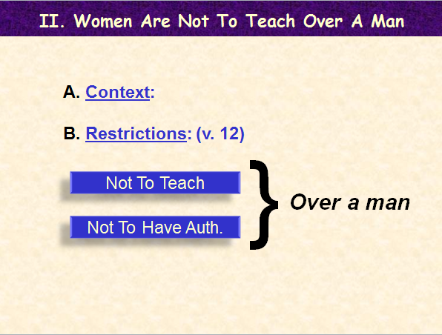
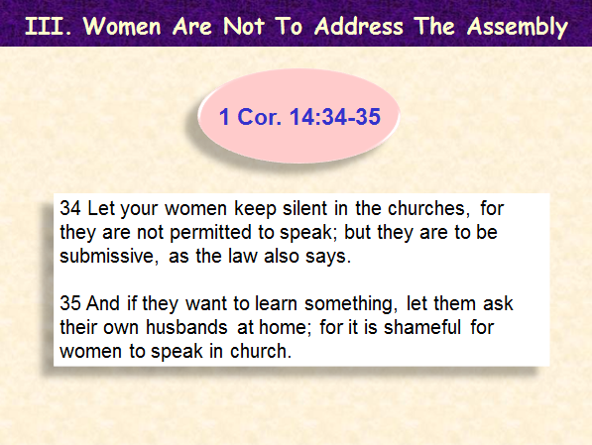
Have Learned Why A Woman Can’t Preach
Restrictions
Cannot teach over a man (1 Tim. 2:11-12)
Cannot address the assembly (1 Cor. 14:34-35)

Slide 32
The Role of Women
God Placed Man (Not Woman) In Leadership
II. Women Are Not To Teach Over A Man
III. Women Are Not To Address The Assembly
IV. Women Are to Submit To Their Husbands

Slide 33
IV. Women Are To Submit To Their Husbands
Submit to Husband as to Lord (v. 22)
Submit in everything (v. 24)
Respect (reverence) husband (v. 33)
Eph. 5:22-33
Submit to Husband (v. 1)
Reason – Fear of God (vv. 2, 5)
Even if he is a non-Christian (v. 1)
1 Pet. 3:1-7

Slide 34
IV. Women Are To Submit To Their Husbands
But This Does Not Mean:
Col 3:18
Wives, submit to your own husbands, as is fitting in the Lord.
Submit to just anything he says (Acts 5:29)
Master – Slave relationship
Cannot disagree, reason & suggest
She has to violate her conscience (Rom. 14:23)

Slide 35
The Role of Women
God Placed Man (Not Woman) In Leadership
II. Women Are Not To Teach Over A Man
III. Women Are Not To Address The Assembly
IV. Women Are to Submit To Their Husbands
V. Women Can Teach

Slide 36
V. Women Can Teach
Older women teaching younger women
Titus 2:3-4
“Men” (anthropos) = mankind
Thayer: “with reference to sex (contextually)”
2 Tim. 2:2

Slide 37
What Can A Woman Do?
Restrictions
Teach women & children (Tit. 2:3-4; 2 Tim. 2:2)
Serve in some special way (Rom. 16:1)
Humble correct a man (Acts 18:24-28)
Ask / answer a question in class
Do anything does not violate her limitations.

Slide 38
Assembly
Bible Classes
P.S | 1-3 | 4-6
7-8 | H.S. | Y.A.
Adult
Church come together in one place
(v. 23)
Regulated by 1 Cor. 14
Divine arrangement (v. 37)
One speak at time (vv 27-31)
Others keep silent (vv. 28, 30)
All may learn (v. 31)
Unrestricted attendance (v. 24)
Women keep silence (vv. 34-35)
Not Regulated by 1 Cor. 14
Human arrangement
Seven speak at time
No teacher keeps silent
Seven different lessons
Restricted attendance
Women keep silence?

Slide 39
Some Women Feel
Uncomfortable
In Class Participation
Don’t Ask / Answer
For Varied Reasons:
Rather Not (some men)
Men are present
Others might feel trying to teach
Not comfortable in a group
How Handle It:
Respect her feelings
Don’t call on her / ask
Don’t put her on spot
Let her abide by her conscience!

Slide 40
The Role of Women
God Placed Man (Not Woman) In Leadership
II. Women Are Not To Teach Over A Man
III. Women Are Not To Address The Assembly
IV. Women Are to Submit To Their Husbands
V. Women Can Teach

