Slide 1
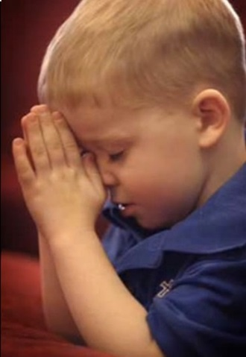
“Dear God,
Thank you for letting us go to church today.
I had a good class. I liked to sing when we the whole church sings.
It was so much fun.
I wish you had been there.
Amen.”
Notes:
Little boy – been the church on Sunday – went to bed he prayed:

Slide 2
Mother: “Oh, honey, what makes you think God wasn’t there today?”
Boy: “Nobody looked like they thought God was there!”
Mother: “Son, God is always with us when we go to worship Him.”
Boy: “If God was there, why wasn’t everybody excited about Him being there?”
Mother: “Good question!”

Slide 3
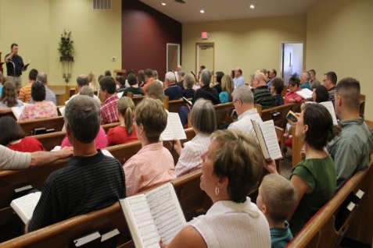
What Would Those Little One’s Watching You
Say To God Tonight About Worship?
Think God was here?
See excitement?
See enthusiasm?

Slide 4

1570-80
Enthusiasm
< Late Latin enthūsiasmus < Greek enthousiasmós, … (a) possession by a god… equivalent to en- en-²+ -thous, -theos god-possessing + -ia y³) + -asmos, variant, after vowel stems, of -ismos -ism
Could any one conclude from our services that we are possessed by God?
Notes:
Dictionary.com

Slide 5
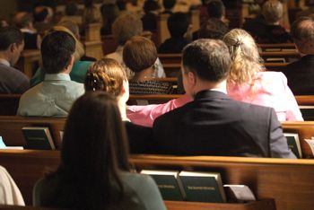
Easy to Merely
“Sit Through Worship”
Enthusiasm
Routine
Ritualistic
No excitement
No enthusiasm
No effort put into it

Slide 6
Restoring Our Passion For Worship
Restoring
Suggests That Something Has Been Lost

Slide 7
Restoring Our Passion For Worship
When We Focus on Whom We Worship

Slide 8
When We Focus on Whom We Worship
The God We Worship
Creator (Psa. 33:6-9; Gen. 1:1; Rev. 4:11)
Almighty (Rev. 4:8, 11)
Notes:
Ps 33:6-9
6 By the word of the LORD the heavens were made, And all the host of them by the breath of His mouth.
7 He gathers the waters of the sea together as a heap; He lays up the deep in storehouses.
8 Let all the earth fear the LORD; Let all the inhabitants of the world stand in awe of Him.
9 For He spoke, and it was done; He commanded, and it stood fast.
Rev 4:11
11 "You are worthy, O Lord, To receive glory and honor and power; For You created all things, And by Your will they exist and were created."

Slide 9
8 The four living creatures, each having six wings, were full of eyes around and within. And they do not rest day or night, saying: "Holy, holy, holy, Lord God Almighty, Who was and is and is to come!"
11 "You are worthy, O Lord, To receive glory and honor and power; For You created all things, And by Your will they exist and were created."
Rev.
4:8, 11

Slide 10
When We Focus on Whom We Worship
The God We Worship
Creator (Psa. 33:6-9; Gen. 1:1; Rev. 4:11)
Almighty (Rev. 4:8, 11)
Great & Awesome (Neh. 1:5; 4:14)
Holds world in hands (Isa. 40:12-17)
Eternal (Exo. 3:14)
Knows all & sees all (Heb. 4:13)
With whom all things are possible (Jer. 32:17)
Saved us from torment by his grace (Eph. 2:4)
Notes:
Isa 40:12-17
12 Who has measured the waters in the hollow of His hand, Measured heaven with a span And calculated the dust of the earth in a measure? Weighed the mountains in scales And the hills in a balance?
13 Who has directed the Spirit of the LORD, Or as His counselor has taught Him?
14 With whom did He take counsel, and who instructed Him, And taught Him in the path of justice? Who taught Him knowledge, And showed Him the way of understanding?
15 Behold, the nations are as a drop in a bucket, And are counted as the small dust on the scales; Look, He lifts up the isles as a very little thing.
16 And Lebanon is not sufficient to burn, Nor its beasts sufficient for a burnt offering.
17 All nations before Him are as nothing, And they are counted by Him less than nothing and worthless.

Slide 11
When We Focus on Whom We Worship
The God We Worship
The Purpose We Have
Matt. 4:10
Rev. 22:9
1 Cor. 10:31
More than a duty – it is a grand privilege!
Mindset should be – we are here to glorify God!
Notes:
1 Cor 10:31
31 Therefore, whether you eat or drink, or whatever you do, do all to the glory of God.

Slide 12

When We Focus on Whom We Worship
The God We Worship
The Purpose We Have
The Focus of the Service
God
Others
Self

Slide 13
1 Oh come, let us sing to the LORD! Let us shout joyfully to the Rock of our salvation.
2 Let us come before His presence with thanksgiving; Let us shout joyfully to Him with psalms.
3 For the LORD is the great God, And the great King above all gods.
4 In His hand are the deep places of the earth; The heights of the hills are His also.
5 The sea is His, for He made it; And His hands formed the dry land.
6 Oh come, let us worship and bow down; Let us kneel before the LORD our Maker.
7 For He is our God, And we are the people of His pasture, And the sheep of His hand. Today, if you will hear His voice:
Psalm
95:1-7

Slide 14
When We Focus on Whom We Worship
The God We Worship
The Purpose We Have
The Focus of the Service
The Day is God’s
Rev. 1:10 – This is the Lord’s day
Why then:
  Treat it like any other day?
  Treat it like it is merely the Lord’s hour?
  Treat it like we are making great sacrifice to worship?
How would you feel about a day that is your day? – Yet little focus is on you?

Slide 15
When We Focus on Whom We Worship
The God We Worship
The Purpose We Have
The Focus of the Service
The Day is God’s
The Effort He Deserves
The best we can offer – this is GOD we are worshipping!
Abel gave of the firstborn of his flock (Gen. 4:4)
Inferior animals were not acceptable (Mal. 1:7-8)
Our effort & participation should be our best!
Approach should not be casual (attitude, attire, attention)
Deserves more than a quick hit & rush!
Notes:
Mal 1:7-8
7 "You offer defiled food on My altar. But say, 'In what way have we defiled You?' By saying, 'The table of the LORD is contemptible.'
8 And when you offer the blind as a sacrifice, Is it not evil? And when you offer the lame and sick, Is it not evil? Offer it then to your governor! Would he be pleased with you? Would he accept you favorably?" Says the LORD of hosts.

Slide 16
Restoring Our Passion For Worship
When We Focus on Whom We Worship
When We Devote Time to Worship

Slide 17

When We Devote Time to Worship
Length of Time is Proportional to Level of Interest
We spend
more time
on things we are
most interested in
Notes:
Hobbies – Sports –
Hunting – Fishing – Golfing – Gardening – Woodworking – Horseback riding, etc.
Music – Watching sports / going to games

Slide 18
When We Devote Time to Worship
Length of Time is Proportional to Level of Interest
Do you spend a long time at sporting events, or school functions?
Do you spend a long time going hunting, fishing, boating, golfing etc.?
Do you spend a long time playing video games or board games, cards, etc.?
Do you spend a long time watching T.V. or movies?
What about your time spent worshipping God?

Slide 19
When We Devote Time to Worship
Length of Time is Proportional to Level of Interest
Time Spent in Worship is Time Well Spent
Deuteronomy 31:9-13 – “thou shalt read this law before Israel in their hearing…”
Nehemiah 8:3,18 – “And he read … from early morning until midday … Also day by day … he read in the book of the law…”
Mark 6:34-35 – “And he began to teach them many things. And when the day was now far spent…”
Acts 2:41,46 – “And with many other words he testified and exhorted them saying … And day by day … with one accord in the temple…”
Acts 20:7-11 – “and continued his message until midnight … Paul continued speaking … talked a long while…”
Notes:
Servants of God in OT and NT devoted TIME to worship!!

Slide 20
Restoring Our Passion For Worship
When We Focus on Whom We Worship
When We Devote Time to Worship
When We Pour Our Hearts into Worship

Slide 21
When We Pour Our Hearts into Worship
Worship is Not a Ritual – But Comes From the Heart
John 4:24 – in spirit

Slide 22
John 4:24
In Truth
Every Act
is Authorized
Do all God says
Nothing more
Nothing less
In Spirit
From the heart
Focus
With Joy
With Life
Easy
Hard
Notes:
Rom 2:28-29
28 For he is not a Jew who is one outwardly, nor is circumcision that which is outward in the flesh;
29 but he is a Jew who is one inwardly; and circumcision is that of the heart, in the Spirit, not in the letter; whose praise is not from men but from God.

Slide 23

When We Pour Our Hearts into Worship
Worship is Not a Ritual – But Comes From the Heart
John 4:24 – in spirit
Careful thinking while we worship
Lord’s Supper (1 Cor. 11:24-29)
Giving (2 Cor. 9:6-7)
Singing (Eph. 5:19)
Prayer (Jas. 5:16)
Study of Word (Acts 20:7)
?

Slide 24
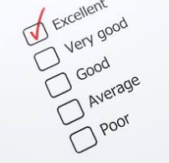
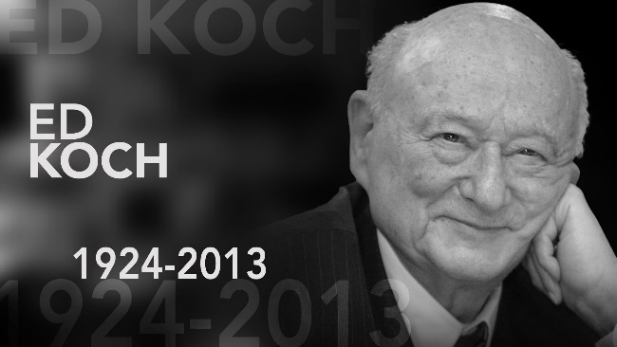
“How’m I Doin’?”
Did I concentrate?
Did think on words of the prayer?
Did I follow the thoughts of the songs?
Did I listen to the sermon?
Did I focus on the sacrifice of Christ in Lord’s Supper?
Was I diligent in my participation?
Notes:
Was Mayor of New York City

Slide 25
When We Pour Our Hearts into Worship
Worship is Not a Ritual – But Comes From the Heart
First Century Disciples – Poured Their Hearts into Worship in Spite of Persecution & Death
Being persecuted didn’t stop some (Heb. 10:25)

Slide 26
not forsaking the assembling of ourselves together, as is the manner of some, but exhorting one another, and so much the more as you see the Day approaching. NKJV
Heb. 10:25
not forsaking our own assembling together, as is the habit of some, but encouraging one another; and all the more, as you see the day drawing near. NAS

Slide 27
Persecutions
  Heb. 12:4 - resistance
  Heb. 12:1-6 - Chastening = Suffering
  Heb. 12:12 - discouraged
  Heb. 10:33 - made spectacles
  Heb. 10:34 - loss of possessions / prison
Context of Heb. 10:25

Slide 28
“As manner of some is”
“Some may have been deterred by the fear of persecution, as those who were thus assembled would be more exposed to danger than others” (Barnes).
Something - causing the problem:
  Whatever it was - not a legitimate excuse.
  Whatever it was - should have assembled.
  Either not specifically address - or persecution implied

Slide 29
How Do These Compare?
Forsake
Because of
Persecution
Forsake
Because of
(Your Reason)
Notes:
But most others – worshipped and assembled in spite of persecution!

Slide 30
When We Pour Our Hearts into Worship
Worship is Not a Ritual – But Comes From the Heart
First Century Disciples – Poured Their Hearts into Worship in Spite of Persecution & Death
Being persecuted didn’t stop some (Heb. 10:25)
Threat of death didn’t stop some (Rev. 2:10)

Slide 31
Restoring Our Passion For Worship
When We Focus on Whom We Worship
When We Devote Time to Worship
When We Pour Our Hearts into Worship
When We Are Excited about Worship

Slide 32
When We Are Excited about Worship
Possible to Overreact & Lose All Enthusiasm
Overreact to Emotionalism or Pentecostalism
Easy to go to the other extreme

Slide 33
Extremes
“In Spirit”
but
not
“In Truth”
“In Truth”
but
not
“In Spirit”

Slide 34
Extremes
Focused
More
on the
“Mechanics”
of
Pitch, Tone &
Rhythm
Focused
Merely
on the
“Words”
and
Does Not
Try to
Do Their
Best

Slide 35
Extremes
“Reverent”
to the point
that we
have lost
enthusiasm
&
excitement
“Enthusiasm”
to the point
that we
have lost
reverence
&
dignity

Slide 36
Between Extremes
Emotionalism
Uncontrolled
Emotion
Excited
Enthus.
Control
No Emotion
Stiff
Stale
Stoic
Dead

Slide 37
When We Are Excited about Worship
Possible to Overreact & Lose All Enthusiasm
Words that Indicate Excitement

Slide 38
Glad
Psalm 122:1
I was glad when they said to me,
"Let us go into the house of the LORD."
To be gleeful
Literally, “to brighten up”
Translated: Cheer, Rejoice, Merry
Be glad and rejoice (Rev. 19:7)
Notes:
Rev 19:7
Let us be glad and rejoice and give Him glory, for the marriage of the Lamb has come, and His wife has made herself ready."

Slide 39
Fervent
Rom 12:11
not lagging in diligence, fervent in spirit, serving the Lord;
To be hot, boil
Use of Liquids (boil) – Solids (glow)

Slide 40
Zealous
Titus 2:14-15
who gave Himself for us, that He might redeem us from every lawless deed and purify for Himself His own special people, zealous for good works.
Same root as fervent: To be hot, boil
To have warm feelings

Slide 41
Burn
Luke 24:32
And they said to one another, "Did not our heart burn within us while He talked with us on the road, and while He opened the Scriptures to us?"
Set on fire
Light

Slide 42
Heartily
Col 3:23
And whatever you do, do it heartily, as to the Lord and not to men
Literally, from the soul
With life & vitality
Translated, Spirit, Life

Slide 43
Might
Eccl 9:10
Whatever your hand finds to do, do it with your might; for there is no work or device or knowledge or wisdom in the grave where you are going.
Vigor
Force & Power
Ability, Strength

Slide 44
Restoring Our Passion For Worship
When We Focus on Whom We Worship
When We Devote Time to Worship
When We Pour Our Hearts into Worship
When We Are Excited about Worship
Notes:
We will have invitation song at the end of our service – now focus on making our worship to God best….

