Slide 1

Mark Your Bible
For Today’s Reading
Psalm 69:1-18

Slide 2
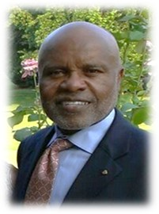
Our Next
Gospel Meeting
Joseph Casimier
Houston, TX
October 14-16

Slide 3



July 17, 2016
Elders Meeting
With All Men
4:00 PM

Slide 4


Slide 6
The Importance of Fellowship
Refuse to fellowship those we should
Extend fellowship to those we should not
(3 John 9-11)
(2 John 9-11)

Slide 7
What Is
Biblical Fellowship?
Review
The Meaning of Fellowship
The Direction of Fellowship
The Use of Fellowship
The Conclusions about Fellowship

Slide 8
2 Corinthians 6:14–17
¹⁴ Do not be unequally yoked together with unbelievers. For what fellowship has righteousness with lawlessness? And what communion has light with darkness?
¹⁵ And what accord has Christ with Belial? Or what part has a believer with an unbeliever?
¹⁶ And what agreement has the temple of God with idols? For you are the temple of the living God. As God has said: “I will dwell in them And walk among them. I will be their God, And they shall be My people.”
¹⁷ Therefore “Come out from among them And be separate, says the Lord. Do not touch what is unclean, And I will receive you.”
Review
Common Work
Share in Action
koinonia
Harmony of thought
A part together with
others
A union of purpose
Thus:
Agreement in principle
leading to joint or common action in spiritual work

Slide 9
Review
Fellowship
In The Truth
The Basis
The Objections
The Application

Slide 10
Review
The Basis
Truth is the basis for unity
Truth is the basis for fellowship
Truth is the basis for rejecting
Truth includes the whole revelation
Unity & Fellowship is Dear & Precious
But Should Not be Maintained at the Expense of Truth!

Slide 11
Receive Him
(Rom. 14)
In the midst of controversy – question of fellowship is raised
Does Romans 14 apply?
  Instrumental music?
  Missionary society?
  Premillennialism?
  Institutionalism?
  Social gospel?
  Divorce & remarriage?

Slide 12
Receive Him
(Rom. 14)
The Context

Slide 13
The Context
The book

Slide 14
Romans
(Outline of the Book)
I. Justification By Faith Apart From Law (1-8)
II. Rejection of the Jews & Accepting Gentiles (9-11)
III. The Christian’s Relationships (12-16)

Slide 15
III. The Christian’s Relationships (12-16)
A. Relationship to God, Christians, all men and our enemies (12)
B. Relationship to civil government (13)
C. Relationship to the weak brother (14-15)
* Salutations (16)

Slide 16
The Context
The book
The weak brother

Slide 17
Weak Brother
Not weak in faith in God / service
Not weak in spiritual strength
Weak in Conscience
V. 1 - “scruples” (ASV) / “opinion” (RSV)

Slide 18
The Context
The book
The weak brother
Two issues

Slide 19

Two Questions / Issues
Eating Meats
Observing Days

Slide 20

Eating of Meat
Jews – Still bothered by the OT restrictions on meat
(Clean & Unclean)
Gentiles – Still associated meat with sacrifice to idol

Slide 21

Observing of Days
“Paul never tolerated the binding of Jewish holy days on Gentile Christians (Col. 2:16; Gal. 4:10-11); however, he permitted the observance of such practices by Jewish Christians so long as they did not bind them on others. Some Jewish Christians could not bring themselves to abandon the observance of sabbaths and holy days after they were baptized into Christ; not to rest on the sabbath would have violated their consciences.”
- Melvin Curry
Notes:
The Just Shall Live By Faith, Edited by Mike Willis. pp. 68-69

Slide 22
The Context
The book
The weak brother
Two issues
The care & love for brother

Slide 23
Romans 13: 8-10
Love
Owe debt of Love
Love fulfills law
Romans 14
Receive Weak Brother
Care about his soul
Care about his Consc.
“Would you like to imbibe the wonderful spirit encouraged in chapter fourteen of Romans? Then concentrate on learning the meaning of Romans 13:8-10. This passage prepares one for the message of the chapter.”
- Irven Lee

Slide 24
Receive Him
(Rom. 14)
The Context
The Point

Slide 25

The Point
Continue in Fellowship
In Spite of Differences
Receive him (v. 1)
Don’t dispute (v. 1)
Pursue things that make for peace (v. 19)
Don’t bind your opinion on others (v. 22)

Slide 26
Receive Him
(Rom. 14)
The Context
The Point
The Chapter

Slide 27
The Chapter
Relationship To The Weak Brother
I. Receive The Weak Brother (vv. 1-12)
II. Don’t Put A Stumbling Block In Brother’s
way (vv. 13-23)

Slide 28
I. Receive The Weak Brother (vv. 1-12)
A. Not to disputes over doubtful things (v. 1)
B. The weak who cannot eat all things (vv. 2-4)
C. The weak who observes a special day (v. 5)
D. Each is accountable to the Lord (vv. 6-12)

Slide 29
D. Each is accountable to the Lord (vv. 6-12)
In the matters of days and eating (v. 6)
No one lives or dies to himself (vv. 7-8)
Christ is Lord of all – thus we all give account to him (vv. 9-12)

Slide 30
I. Receive The Weak Brother (vv. 1-12)
How
A. Not to disputes over doubtful things (v. 1)
B. The weak who cannot eat all things (vv. 2-4)
C. The weak who observes a special day (v. 5)
D. Each is accountable to the Lord (vv. 6-12)
Who
Why

Slide 31
The Chapter
Relationship To The Weak Brother
I. Receive The Weak Brother (vv. 1-12)
II. Don’t Put A Stumbling Block In Brother’s
way (vv. 13-23)

Slide 32
II. Don’t Put A Stumbling Block In Brother’s
way (vv. 13-23)
A. Beware of causing your brother to stumble (v. 13)
B. Nothing is unclean of itself (v. 14)
C. Don’t destroy thy brother with meat (v. 15)
D. Don’t allow good to be evil spoken of (vv. 16-18)
E. Pursue after things that make for peace (vv. 19-21)
F. Don’t bind your opinion on others (v. 22)
G. If a thing is not of faith (conscience) it is sin (v. 23).

Slide 33
The Chapter
Relationship To The Weak Brother
I. Receive The Weak Brother (vv. 1-12)
II. Don’t Put A Stumbling Block In Brother’s
way (vv. 13-23)

Slide 34
Receive Him
(Rom. 14)
The Context
The Point
The Chapter
The Abuse

Slide 35
The Abuse
Some apply it to matters of faith, doctrine & morals

Slide 36
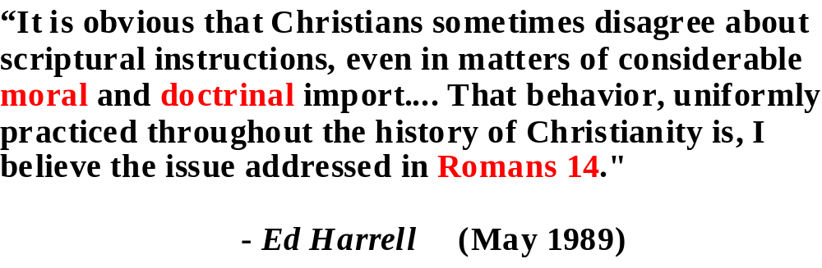
Christianity
Magazine

Slide 37
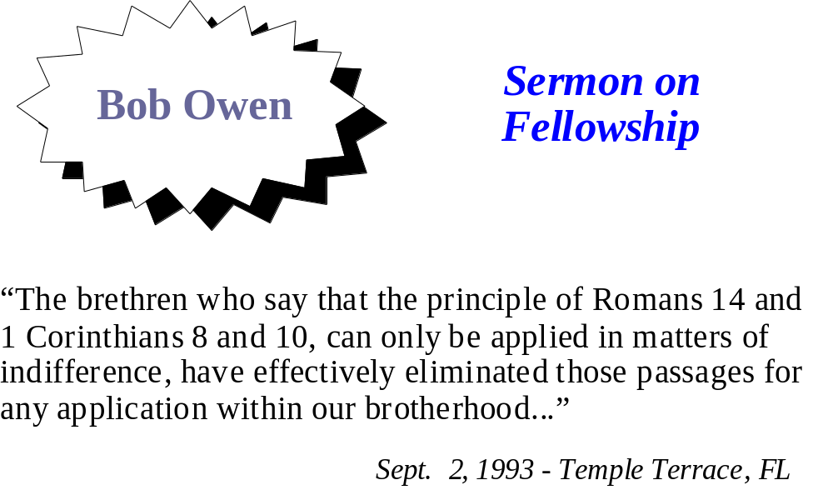

Slide 38
The Abuse
Some apply it to matters of faith, doctrine & morals
Rom. 14 deals with matter of liberties /indifference

Slide 39
Romans 14
Doctrine
Faith
Morals
Indifference
Liberty
?
God received him (v. 3)
To the Lord (v. 6)
Not to judge (condemn) him (v. 13)
Not wrong within itself (v. 14)
Keep it to self (v. 22)

Slide 40
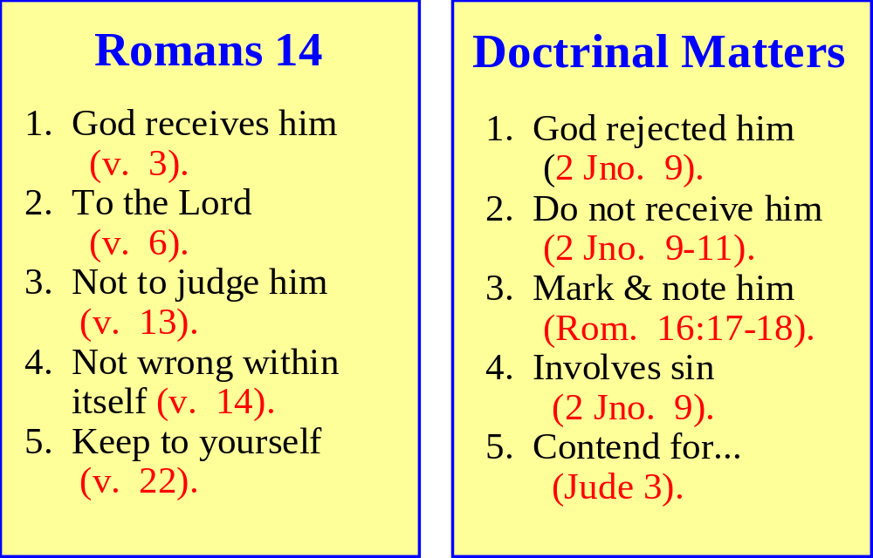
There Is A Difference

Slide 41
Morals and Doctrine Condemned Before and After Romans 14
Before
After
Rom. 13:12-14
Moral Issues
Condemned
Rom. 14
How could this chapter approve fellowship?
Rom. 16:17-18
Doctrinal Issues
Condemned

Slide 42
Test of What Fits in Romans 14
Must neither be REQUIRED or FORBIDDEN
A liberty must first be authorized (1 Cor. 6:12)
If one matter of morals, faith & doctrine – why not all?
Substitute _____?_____ for “meat”:
  Does God receive one who ________ (v. 3)?
  Can one ___________ to the Lord (v. 4)?
  Is ________ clean (v. 14)?
  Is it sinful to condemn one who _______ (v. 13)?
  Does God allow one to participate in ______ as long as he doesn’t put a stumbling block… (v. 13)?
  Is _________ good?

Slide 43
If Romans 14 Includes Matters of Faith
Need to know if it includes ALL matters of faith, morals & doctrine.
If not, need a list of which matters of faith are included & which are not!
Need the criteria of how to determine

Slide 44
The Abuse
Some apply it to matters of faith, doctrine & morals
Rom. 14 deals with matter of liberties /indifference
Dangers of the abuse

Slide 45

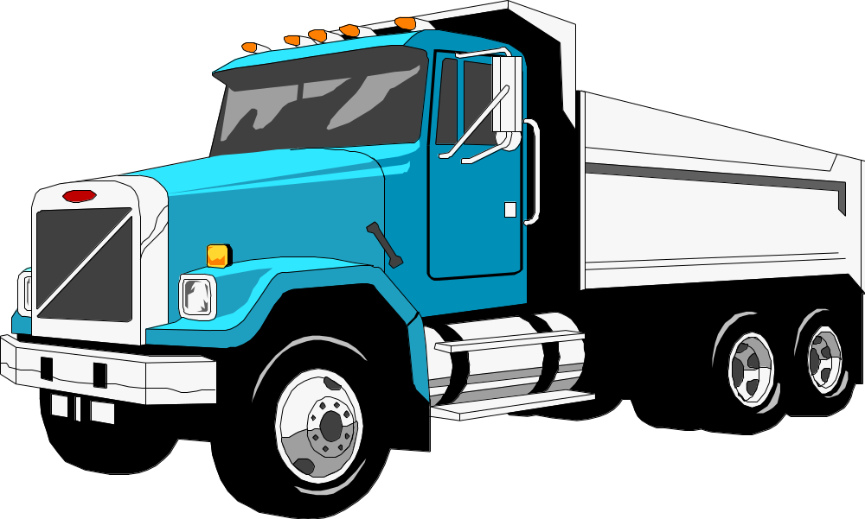
What’s The Big Deal About Romans 14?
Error!
Abuse Of
Romans 14

Slide 46
What’s The Big Deal About Romans 14?
Sin!
Abuse Of
Romans 14
The Next Generation Will Make Logical Application of the Principles!

Slide 47



Loose Thinking On
Romans 14 Leads To:
Broader “Grey” Areas
Fellowship with Various Errors
Softer Preaching

Slide 48
Receive Him
(Rom. 14)
The Context
The Point
The Chapter
The Abuse
The Application

Slide 49
The Application
The Kind Of Issues That Fit
The Criteria
Matter of indifference
(Rom. 14:14)
Yet – Matter of Conscience (14:1, 23)
Issues Today
Circumcision
Non-Rel. Christmas
Playing Cards
Playing Dice
Eat at rest. with bar
No Movies
Etc.

Slide 50
Receive Him
(Rom. 14)
The Context
The Point
The Chapter
The Abuse
The Application

