Slide 1
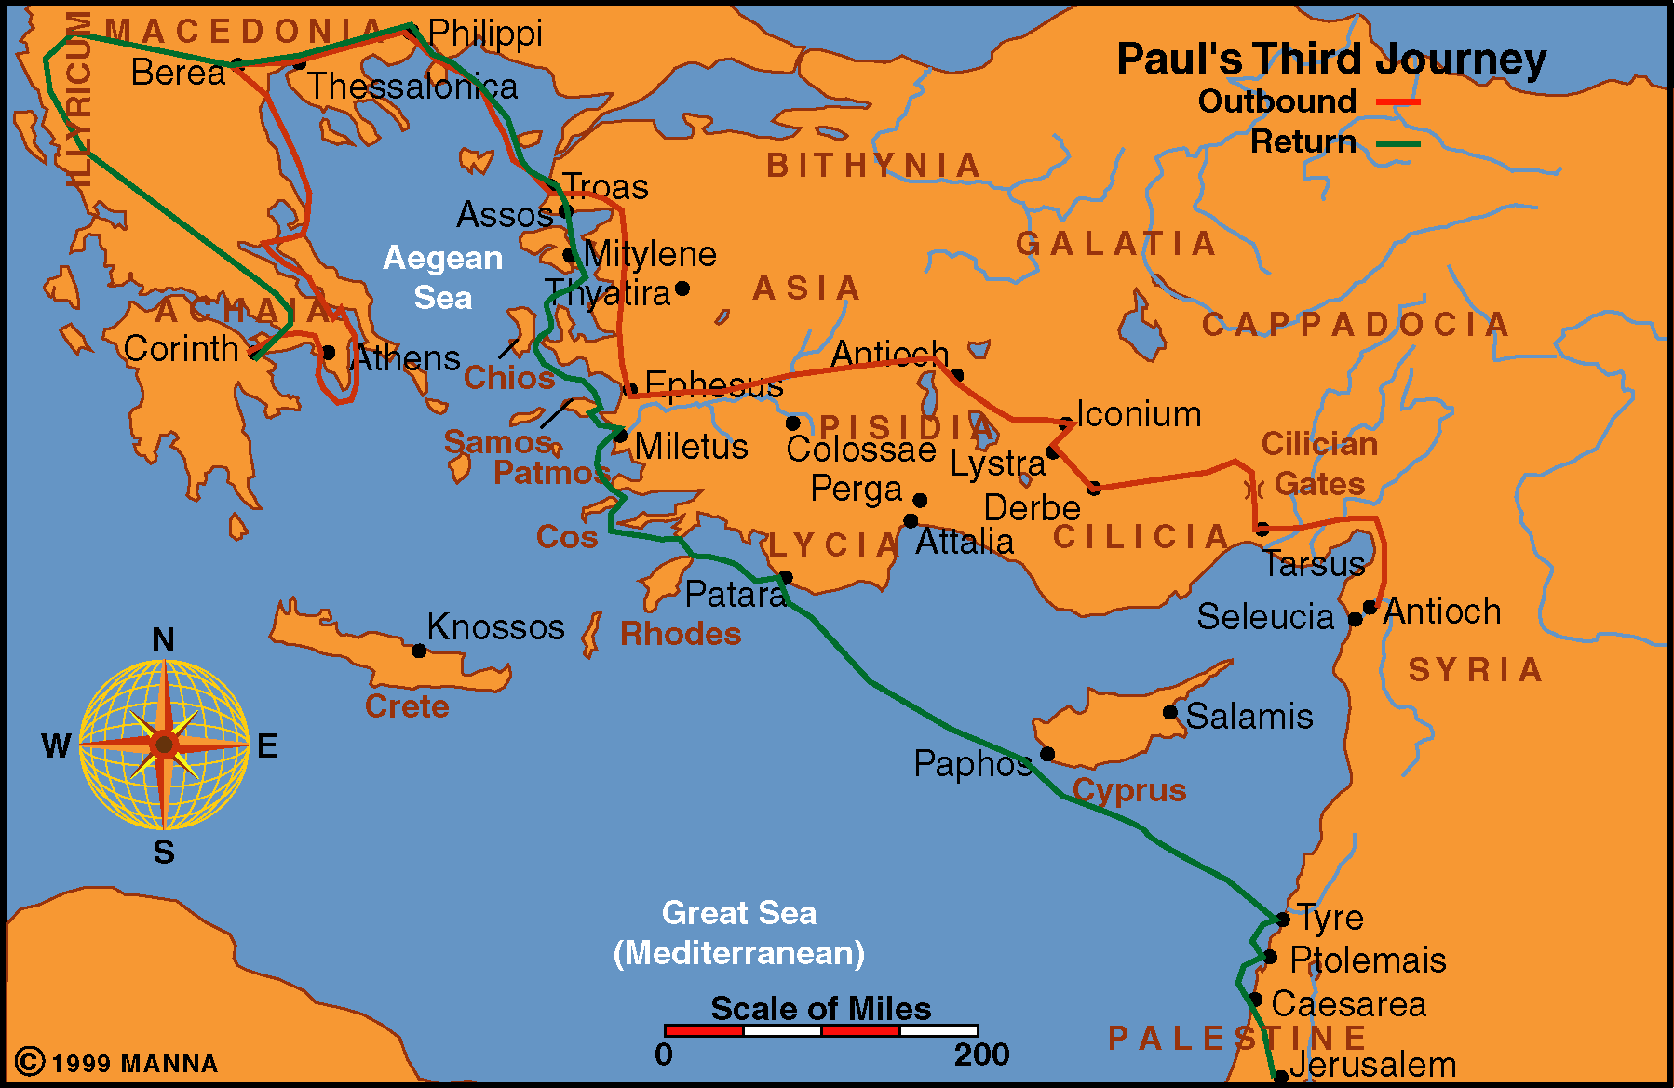
Acts 21
Acts 18-21

Slide 2
Ending the Third Journey &
Paul Arrested at Jerusalem
From Miletus To Jerusalem (vv. 1-17)
  Sailing from Miletus to Tyre (vv. 1-3)
  Stayed seven days in Tyre with the disciples (vv. 4-6)
  Came to Caesarea and stayed with Philip (vv. 7-9)
  The prophet Agabus foretold of Paul’s arrest and imprisonment (vv. 10-11)
  Paul was determined to go to Jerusalem anyway (vv. 12-14)
  Paul went to Jerusalem (vv. 15-17)
Paul Arrested In Jerusalem (vv. 18-40)
  Paul went before James and the elders (vv. 18-25)
  Paul went into the temple (v. 26)
  The uproar (vv. 27-32)
  Paul’s arrest (vv. 33-36)
  Paul given permission to speak (vv. 37-40)
Acts 21

Slide 3
Acts 21
Most of this chapter is historical – (no sermon or teaching recorded)
Several characters in the story:
  Paul
  Philip
  Philips four daughters
  Agabus
  Mnason
  James & elders
  Four unnamed men (vow)
  Trophimus
  Commander (Claudias Lysias)
These are people who made a difference in the history

Slide 4
People
Who
Make A
Difference

Slide 5
People Who Make A Difference
Man Whose Children Spoke Volumes (vv. 8-9)

Slide 6
Man Whose Children Spoke Volumes (vv. 8-9)
Philip wore many hats (last saw him 20 years earlier 8:40)
  Evangelist (Samaria [8:5-12]; Eunuch [8:26-39])
  Servant - One of seven (6:1-5)
  Host (Hospitable – kept Paul & companions)
  Father of four daughters

Slide 7
Man Whose Children Spoke Volumes (vv. 8-9)
Philip wore many hats (last saw him 20 years earlier 8:40)
Did well in rearing his daughters
  Virgins – Morally pure
  Prophesied – faithful, trained and taught well
  What they were – speaks volumes about Philip!
    Says something about his example
    Says something about his rules
    Says something about what he permitted
    Says something about how strict he was
    Says something about his priorities

Slide 8
Man Whose Children Spoke Volumes (vv. 8-9)
Philip wore many hats (last saw him 20 years earlier 8:40)
Did well in rearing his daughters
You make a difference when you train your children well
  Focused on them maintaining moral purity (1 Cor. 6:18)
  Lead them to faithful (Ezek. 16:44)
  See your priorities (Matt. 6:33; 1 Pet. 3:15)
  Show them how to be active in service (Titus 2:14)
  Instruct them in way (Eph. 6:1-4)

Slide 9
People Who Make A Difference
Man Whose Children Spoke Volumes (vv. 8-9)
Man Whose Heart Was Breaking (vv. 12-14)

Slide 10
Man Whose Heart Was Breaking (vv. 12-14)
Agabus prophesied – Paul bound in Jerusalem (vv. 10-11)
Companions & brethren plead with Paul & wept (v. 12)
Broke Paul’s heart (v. 13)
  Break – to crush together – dispirit
  Because he was determined to go anyway
    In spite of the danger
    Their emotional pleas – pounding at his heart
    “Weakening his determination to go on with his duty” (A. T. Robertson)
    Wanted to do right thing – others are begging him not to!

Slide 11
Man Whose Heart Was Breaking (vv. 12-14)
Agabus prophesied – Paul bound in Jerusalem (vv. 10-11)
Companions & brethren plead with Paul & wept (v. 12)
Broke Paul’s heart (v. 13)
  Break – to crush together – dispirit
  Because he was determined to go anyway
  Paul displayed total commitment & complete sacrifice!
Brethren saw his determination (v. 14)
  Stopped (weeping and pleading)
  “Will of the Lord be done”

Slide 12
Man Whose Heart Was Breaking (vv. 12-14)
Today – There are those who want to do right thing
Yet others may be breaking their heart!
Want to go to church – family says “better stay in today”
Children want to go to class – parents won’t take them
Parent who wants to discipline children – mate says no
One who wants to follow their conscience – friends ridicule

Slide 13
People Who Make A Difference
Man Whose Children Spoke Volumes (vv. 8-9)
Man Whose Heart Was Breaking (vv. 12-14)
People Who Were Misinformed (vv. 20-21)

Slide 14
People Who Were Misinformed (vv. 20-21)
Jewish Christians had been misinformed
  Who? – new converts who were zealous for law
  How many? Myriads (thousands) – shows how serious
  Who responsible?
    Not the new converts – they have been told this
    Could be Jewish teachers – who knew better
    Could be those that didn’t listen carefully
  What were they told?
    Forsake Moses
    Not circumcise children
    Not walk in customs of Jews

Slide 15
People Who Were Misinformed (vv. 20-21)
Jewish Christians had been misinformed
The Truth
  Law of Moses – regulated their civil, social & spiritual life
    When the law ceased – still kept some of customs
    Could still abstain from certain foods (Rom. 14)
    Could still circumcise children (Gal. 5:6)
  What Paul taught:
    Law of Moses ended (Col. 2:14; Gal. 3:24-25)
    Means not saved by means of obeying the law (Rom. 3:20)
    Not teach – no one could circumcised (i.e. Acts 16:3)
    Not teach – no one could keep customs of Jews

Slide 16
People Who Were Misinformed (vv. 20-21)
Jewish Christians had been misinformed
The Truth
Lot of misinformation circulates today
  On what we teach & practice:
    “Don’t have music in worship”
    “Don’t believe instruments can be used – even secular songs”
    “Don’t believe in taking care of orphans”
    “Don’t believe in church cooperation”
    “Believe water saves”
    “Don’t believe should study or read the OT”

Slide 17
People Who Were Misinformed (vv. 20-21)
Jewish Christians had been misinformed
The Truth
Lot of misinformation circulates today
  On what we teach & practice:
  About what motives were / reactions meant, etc.
  Learn:
    Don’t believe everything you hear about someone
    Be open to the correction given
    Be prepared to correct misinformation

Slide 18
People Who Make A Difference
Man Whose Children Spoke Volumes (vv. 8-9)
Man Whose Heart Was Breaking (vv. 12-14)
People Who Were Misinformed (vv. 20-21)
The Man Who Demonstrated His Convictions (vv. 22-27)

Slide 19
The Man Who Demonstrated His Convictions (vv. 22-27)
Elders gave advice (vv. 22-24)
  These many Christians – will know you are here (v. 22)
  Four men who have taken vow (vv. 23-24)
    Likely the Nazarite vow (Numbers 6)
    One could associate self with them – by going to temple with them and paying expense
    May got the idea from previous actions (Acts 18:18)
  Would show (v. 24):
    What is rumored is wrong
    You keep the law - customs of it (v. 24)

Slide 20
The Man Who Demonstrated His Convictions (vv. 22-27)
Elders gave advice (vv. 22-24)
Elders want to be clear (v. 25)
  This action is not against conclusions of Jerusalem meeting (Acts 15)
  Our position has not changed!
  Law was not to be bound upon Gentiles

Slide 21
The Man Who Demonstrated His Convictions (vv. 22-27)
Elders gave advice (vv. 22-24)
Elders want to be clear (v. 25)
Paul followed their advice (vv. 26-27)
  Didn’t just tell – but showed his belief
  Actions speak louder than words
  Practicing principle of 1 Cor. 9:20-21

Slide 22
The Man Who Demonstrated His Convictions (vv. 22-27)
Elders gave advise (vv. 22-24)
Elders want to be clear (v. 25)
Paul followed their advice (vv. 26-27)
Case of “Putting your money where mouth is”
  Jeremiah did (Jer. 32)
  Ezra did (Ezra 8:22)
  There will be times – people are watching you to see if you will demonstrate your convictions!

Slide 23
People Who Make A Difference
Man Whose Children Spoke Volumes (vv. 8-9)
Man Whose Heart Was Breaking (vv. 12-14)
People Who Were Misinformed (vv. 20-21)
The Man Who Demonstrated His Convictions (vv. 22-27)
People Caught Up in a Mob (vv. 28-36)

Slide 24
People Caught Up in a Mob (vv. 28-36)
How the mob operated
  A few stir the rest (v. 27)
  Operate on untrue reports & supposition (vv. 28-29)
  Got a lot of people upset (vv. 30, 31, 34, 35)
  Confusion (v. 34)
  Acted rash (vv. 31, 32, 26)

Slide 25
People Caught Up in a Mob (vv. 28-36)
How the mob operated
Often see same “Herd mentality” / “Bandwagon effect”
  “Everyone is doing it”
  “Most people believe…”
  When easily swayed by the group / majority
  Peer pressure (Prov. 1:10-ff)

Slide 26
People Who Make A Difference
Man Whose Children Spoke Volumes (vv. 8-9)
Man Whose Heart Was Breaking (vv. 12-14)
People Who Were Misinformed (vv. 20-21)
The Man Who Demonstrated His Convictions (vv. 22-27)
People Caught Up in a Mob (vv. 28-36)
Man Who Made Assumptions (v. 38)

Slide 27
Man Who Made Assumptions (v. 38)
Commander (Claudias Lysias) made as assumption about Paul
  An Egyptian revolutionary – lead a Jewish rebellion against Roman Rulers.
    Led his followers into the wilderness (4,000)
    Duped them into believing that walls of Jerusalem would fall at his command
    Then overpower the Roman rulers
  Assumed Paul was that leader
  Perhaps basis: Spoke Greek (v. 37) – Egyptians spoke Greek

Slide 28
Man Who Made Assumptions (v. 38)
Commander (Claudias Lysias) made as assumption about Paul
People who make unfounded assumptions today
  Assume what the text does not say
  Assume what is being said – respond without knowing
  Assume motives without evidence
  Assume that one is guilty (cf. vv. 28-29)

Slide 29
People Who Make A Difference
Man Whose Children Spoke Volumes (vv. 8-9)
Man Whose Heart Was Breaking (vv. 12-14)
People Who Were Misinformed (vv. 20-21)
The Man Who Demonstrated His Convictions (vv. 22-27)
People Caught Up in a Mob (vv. 28-36)
Man Who Made Assumptions (v. 38)
Man Who Was Searching for Truth (v. 33)

Slide 30
Man Who Was Searching for Truth (v. 33)
Claudias Lysias seeks to know the facts
  Who was
  What he had done
  Searching for answers
  Willing to give up assumptions & first impressions (vv. 37-39)
  Willing to let Paul speak for himself (v. 40)

Slide 31
Man Who Was Searching for Truth (v. 33)
Claudias Lysias seeks to know the facts
Those seeking the truth (Acts 17:11):
  Know the facts (John 17:17)
  Searching for answer
  Willing to change views – give up preconceived ideas

Slide 32
People Who Make A Difference
Man Whose Children Spoke Volumes (vv. 8-9)
Man Whose Heart Was Breaking (vv. 12-14)
People Who Were Misinformed (vv. 20-21)
The Man Who Demonstrated His Convictions (vv. 22-27)
People Caught Up in a Mob (vv. 28-36)
Man Who Made Assumptions (v. 38)
Man Who Was Searching for Truth (v. 33)

