Slide 1
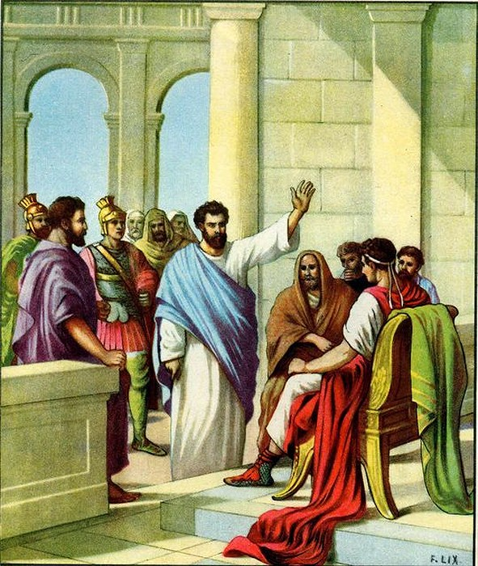
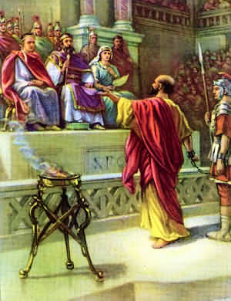
Acts 21 – Paul was arrested
Acts 22 – Paul’s defense
Acts 23 – Taken before Sanhedrin & delivered to Felix
Acts 24 – Paul before Felix the Governor
Acts
25-26
Felix is removed by Rome & Festus takes his place
Acts 25 – Paul stands before Festus
Acts 26 – Paul before King Agrippa
Festus was merely a transition to the King
Agrippa is another notable case of non-conversion

Slide 2
Paul Before
Festus & Agrippa
Acts 25-26

Slide 3
Paul Before Festus
Paul Before Festus (vv. 1-12)
  The Jews inform Festus about Paul (vv. 1-5)
  Paul appeals to Caesar (vv. 6-12)
Festus Informs King Agrippa (vv. 13-22)
  Festus tells of Paul’s appeal to Caesar (vv. 13-21)
  King Agrippa says he will hear Paul himself (v. 22)
Festus Presents Paul to King Agrippa (vv. 23-27)
  All entered the auditorium (v. 23)
  Festus asked King Agrippa to hear Paul so he would have something to write to Caesar (vv. 24-27)
Acts 25

Slide 4
Paul Before Agrippa
Paul’s Defense Before Agrippa (vv. 1-23)
  I am happy to speak – beg you to hear (vv. 1-3)
  My life before my conversion (vv. 4-11)
  My conversion (vv. 12-18)
  I have been fulfilling my mission to preach to the Gentiles (vv. 19-23)
Reaction to Paul’s Defense (vv. 24-32)
  Festus said he was mad (vv. 24-25)
  Agrippa was almost persuaded (vv. 26-29)
  Two conclusions: (vv.30-32)
    Done nothing worthy of death or chains (v. 31)
    Would be set free – except he appealed to Caesar (v. 32)
Acts 26

Slide 5
Paul Before Festus & Agrippa
Acts
25-26
Just Punishment (25:11)

Slide 6
Sought to avoid unfair judgment (vv. 9-10)
  Festus ask if he wanted to go to Jerusalem to be judged (v. 9)
    Take the trail before the Jews – accusers
    Told Paul & us – intent of Festus
  Paul had done no wrong – but he knew the Jews still wanted to kill him (vv. 10-11)
  So appealed to Caesar (v. 10)
    Was his right as a Roman citizen
    Nothing Festus could do
Acts
25-26
Just Punishment (25:11)

Slide 7
Sought to avoid unfair judgment (vv. 9-10)
Willingly would submit to just punishment (v. 11)
  Not seeking to avoid punishment
  Not seeking to avoid the death penalty
  Would not fight to save his life – if worthy of death
Acts
25-26
Just Punishment (25:11)

Slide 8
Sought to avoid unfair judgment (vv. 9-10)
Willingly would submit to just punishment (v. 11)
Capital punishment is God approved (v. 11)
  Gen. 9:6 – because life is in the blood
  Exo. 21:12 – murder put to death (cf. 20:13)
  Deut. 17:4-7 – idolater was to be stoned
  Rom. 13:4 – civil government bears the sword
Acts
25-26
Just Punishment (25:11)

Slide 9
Paul Before Festus & Agrippa
Acts
25-26
Just Punishment (25:11)
Incredible Resurrection (26:8)

Slide 10
Heart of Paul’s preaching – resurrection of Christ
  Preached that in every sermon (13:30-37; 17:18; 22:8)
  Questioned since is arrested (23:6; 24:21; 25:19)
  If so – proves the deity of Christ (Rom. 1:4)
Acts
25-26
Incredible Resurrection (26:8)

Slide 11
Heart of Paul’s preaching – resurrection of Christ
Not unbelievable to think Jesus was raised from dead
  God made the world (Gen. 1:1: Psa. 33:6-9; Acts 17:24)
  The Jews believed in a resurrection (24:15)
  Jews had hope for a Messiah (26:6-7)
  Why then – resurrection of Christ so incredible?
Acts
25-26
Incredible Resurrection (26:8)

Slide 12
Heart of Paul’s preaching – resurrection of Christ
Not unbelievable to think Jesus was raised from dead
Resurrection of Christ – Hub of the Bible
  All that we believe relies upon it (1 Cor. 15:13-19)
  If we firmly believe in it – rest should stand
  If we understand it – enthused (Luke 24:32)
  Where we need to start – point our friends to the resurrection!
Acts
25-26
Incredible Resurrection (26:8)

Slide 13
Paul Before Festus & Agrippa
Acts
25-26
Just Punishment (25:11)
Incredible Resurrection (26:8)
Purposeful Preaching (26:18)

Slide 14
Preaching has a divine purpose
It is not a social message
It is not to feel good about self
It is not to merely get along with others
Gospel is a message of redemption!
Acts
25-26
Purposeful Preaching (26:18)

Slide 15
Preaching is designed to produce a change
  Open eyes
    Enable to hearer to see what has not seen
    See clearly: God, Christ, Salvation, Church, etc.
  Turn from darkness to light
    Darkness = (sin, ignorance, error)
    Now – understanding – walk in light (Eph. 5:3-14)
  Turn from power of Satan to God
    Power – rule of Satan to kingdom (rule) of God
    Col. 1:13 – from darkness to kingdom
    Now serving God – submitting to will of God
Acts
25-26
Purposeful Preaching (26:18)

Slide 16
Preaching is designed to produce a change
The changes bring two results
  Forgiveness of sins
    God releases – turns them loose (remits)
    Remembers them no more (Heb. 8:12)
  Inheritance
    Children are heirs (Rom. 8:16-18)
    We have an inheritance superior (1 Pet. 1:4)
Acts
25-26
Purposeful Preaching (26:18)

Slide 17
Paul Before Festus & Agrippa
Acts
25-26
Just Punishment (25:11)
Incredible Resurrection (26:8)
Purposeful Preaching (26:18)
True Repentance (26:20)

Slide 18
Repent
  Change of mind
  A. T. Robertson said that when John called upon his hearers to repent, “John did not call on people to be sorry, but to change their mental attitudes and conduct” (Word Pictures In The New Testament, I: 24)
  Turn away from sin
    1 Kings 8:47-48
    Ezek. 14:6
    Ezek. 18:30
Acts
25-26
True Repentance (26:20)

Slide 19
Repent
Turn to God
  Reference to baptism
  Parallel passages: Acts 2:38; 3:19
Acts
25-26
True Repentance (26:20)

Slide 20
Acts 2:38 Repent & be baptized
Acts 3:19 Repent & be converted
Acts 26:20 Repent & turn to God
Acts
25-26
True Repentance (26:20)

Slide 21
Repent
Turn to God
  Reference to baptism
  Parallel passages: Acts 2:38; 3:19
  Turn from one thing – turn to something else
Acts
25-26
True Repentance (26:20)

Slide 22
Repent
Turn to God
Do works befitting repentance
  Change of life / behavior (Rom. 6)
  “Live as men who have repented should” (Goodspeed)
  “Prove their repentance by their deeds” (NIV)
  More than stopping sin – doing what is required!
Acts
25-26
True Repentance (26:20)

Slide 23
Paul Before Festus & Agrippa
Acts
25-26
Just Punishment (25:11)
Incredible Resurrection (26:8)
Purposeful Preaching (26:18)
True Repentance (26:20)
Close Persuasion (26:28)

Slide 24
Was Agrippa almost or was he ridiculing the idea?
  Paul said he believed (v. 27)
  Paul followed this with comments about being fully persuaded (v. 29)
  “In short time you would persuade me to be a Christian” (NASV; ESV)
Acts
25-26
Close Persuasion (26:28)

Slide 25
Was Agrippa almost or was he ridiculing the idea?
How was he almost persuaded?
  Knew the message was true
  He believed the prophets – has faith
  Faith he has is not strong enough to obey
  Close (i.e. Rom. 10)
  Something is hindering – something isn’t just right
Acts
25-26
Close Persuasion (26:28)

Slide 26
Was Agrippa almost or was he ridiculing the idea?
How was he almost persuaded?
Why not be fully persuaded?
  Perhaps he thought would have more opportunities
  Maybe it was pride
  Could have been some practice or sin – not willing to give up
  May he was thinking – 2nd coming not really going to happen
Acts
25-26
Close Persuasion (26:28)

Slide 27
Paul Before Festus & Agrippa
Acts
25-26
Just Punishment (25:11)
Incredible Resurrection (26:8)
Purposeful Preaching (26:18)
True Repentance (26:20)
Close Persuasion (26:28)

