Slide 1
Acts 21 – Paul was arrested
Acts 22 – Paul’s defense
Acts 23 – Taken before Sanhedrin & delivered to Felix
Acts 24 – Paul before Felix the Governor
A Notable case of non-Conversion

Slide 2
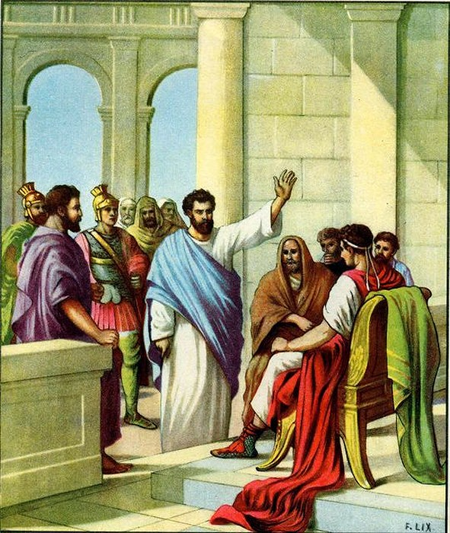
Paul Before Felix
Felix – Governor (procurator) who was appointed by the emperor
Ruler of Judea (A.D. 52-60)
Acts 24

Slide 3

Paul Before Felix
The Charge (vv. 1-9)
Acts 24

Slide 4

The Charge (vv. 1-9)
The Accusers (vv. 1-4)
  High Priest & elders (v. 1)
  Hired an orator (vv. 1-2)
  Used flatter (vv. 2-4)

Slide 5
The Charge (vv. 1-9)
The Accusers (vv. 1-4)
The Accusations (vv. 5-7)
  Plague (pest, danger to the public)
  Creator of dissension (leader in rebellion, troublemaker)
  Ringleader of sect of Nazarenes (leader of a faction)
  Profaned the temple
vv. 6-7
Would have given him a fair trial
But Lysias took him by violence!

Slide 6
The Charge (vv. 1-9)
The Accusers (vv. 1-4)
The Accusations (vv. 5-7)
Evidence (vv. 8-9)
  Your examination
  Jews as witnesses

Slide 7
The Charge (vv. 1-9)
False charges will be made against good people
False charges will be leveled against the truth
Reports are often the opposite of what happened
Facts often get in the way – of what people want

Slide 8
Paul Before Felix
The Charge (vv. 1-9)
The Defense (vv. 10-21)
Acts 24

Slide 9
The Defense (vv. 10-21)
Cannot prove the accusations (vv. 11-13)
  Reason: I didn’t do it – is no evidence (vv. 11-12)
  They can’t prove it (v. 13)

Slide 10
The Defense (vv. 10-21)
Cannot prove the accusations (vv. 11-13)
Confess I am of the Way – called a sect (vv. 14-15)
  Worship according to that way (v. 14a)
  Believe all that is in law & prophets (v. 14b)
  Have hope will be a resurrection (v. 15)

Slide 11
The Defense (vv. 10-21)
Cannot prove the accusations (vv. 11-13)
Confess I am of the Way – called a sect (vv. 14-15)
Have a clear conscience (v. 16)
Where are the witnesses (vv. 17-20)?
  Reason I came to Jerusalem (v. 17)
  They didn’t find me doing wrong (v. 18)
  If done wrong – should be here (v. 19)
  Let those from the council say what I did wrong there (v. 20)

Slide 12
The Defense (vv. 10-21)
Cannot prove the accusations (vv. 11-13)
Confess I am of the Way – called a sect (vv. 14-15)
Have a clear conscience (v. 16)
Where are the witnesses (vv. 17-20)?
Reason I am judged (v. 21)
  Most of Jews agreed in a resurrection
  Not of interest to Rome

Slide 13
The Defense (vv. 10-21)
Accusations
Response
Plague
Creator of dissension
Ringleader of sect of Nazarenes
Profaned the temple
Went quietly about his work (vv. 12-13)
I am of the way that believes in res (vv. 14-15)
I went into temple to prove not against Moses + brought alms to Jews (vv. 17-19)

Slide 14
Paul Before Felix
The Charge (vv. 1-9)
The Defense (vv. 10-21)
The Delay (vv. 22-23)
Acts 24

Slide 15
The Delay (vv. 22-23)
Because of his knowledge (v. 22a)
  Have a better understanding of Christianity than most
  Felix was not deceived by Tertullus

Slide 16
The Delay (vv. 22-23)
Because of his knowledge (v. 22a)
Deferred until Lysias would come (v. 22b)
  Not wanting to get crossways with council
  Not wanting to punish an innocent man
  Wanting a bribe from Paul (v. 26)
  No indication Lysias ever came

Slide 17
The Delay (vv. 22-23)
Because of his knowledge (v. 22a)
Deferred until Lysias would come (v. 22b)
Paul kept in prison – but given liberty (v. 23)
  Not unusual – but must suggest he thought Paul was innocent
  Allowed visitors to come and provide
Felix knows enough to make him miserable
Knows what is right – but lacks courage!

Slide 18
Paul Before Felix
The Charge (vv. 1-9)
The Defense (vv. 10-21)
The Delay (vv. 22-23)
The Sermon (vv. 24-25a)
Acts 24

Slide 19
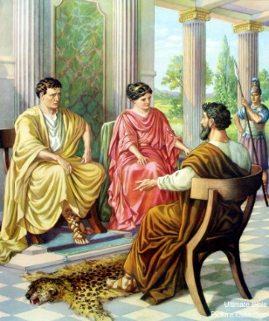
The Sermon (vv. 24-25a)
Requested (v. 24a)
  Why? Wanted to know more about the faith
  Was it genuine interest – thinking of obeying?
  Was it curiosity?

Slide 20
The Sermon (vv. 24-25a)
Requested (v. 24a)
Concerned the faith in Christ (v. 24b)
  The gospel - The faith
  What it means to believe in Christ

Slide 21
The Sermon (vv. 24-25a)
Requested (v. 24a)
Concerned the faith in Christ (v. 24b)
The content (v. 25)
  Righteousness - God’s plan for being righteous
    Revealed in the gospel (Rom.1:16-17)
    By faith in Christ (Rom. 3:21-22)
    Requires submission (Rom. 10:1-3)

Slide 22
The Sermon (vv. 24-25a)
Requested (v. 24a)
Concerned the faith in Christ (v. 24b)
The content (v. 25)
  Righteousness - God’s plan for being righteous
  Self Control – Submission to God’s will
    Suppress of own will – yielding to will of God
    Abstain & cease sin (i.e. their adultery)
    Faith in Christ involves a dramatic change!

Slide 23
The Sermon (vv. 24-25a)
Requested (v. 24a)
Concerned the faith in Christ (v. 24b)
The content (v. 25)
  Righteousness - God’s plan for being righteous
  Self Control – Submission to God’s will
  Judgment to come – Reason need to be right
    Repent in view of judgment (Acts 17:30-31)
    All will be before the judgment (2 Cor. 5:10)

Slide 24
The Sermon (vv. 24-25a)
Requested (v. 24a)
Concerned the faith in Christ (v. 24b)
The content (v. 25)
Boldness of Paul
  Addressing a couple in adultery
  Addressing one who had power to release or execute

Slide 25
Paul Before Felix
The Charge (vv. 1-9)
The Defense (vv. 10-21)
The Delay (vv. 22-23)
The Sermon (vv. 24-25a)
The Wait (vv. 25b-27)
Acts 24

Slide 26
The Wait (vv. 25b-27)
Was afraid (v. 25b)
  “Trembled” (KJV), “Terrified” (ASV)
  Saw the truth and it scared him!

Slide 27
The Wait (vv. 25b-27)
Was afraid (v. 25b)
Waited for convenient time (v. 25b)
  Postponed – put it off – delayed
  “When the time is right”
  No evidence ever found that time

Slide 28
The Wait (vv. 25b-27)
Was afraid (v. 25b)
Waited for convenient time (v. 25b)
While he waited (vv. 26-27)
  Hoped for a bribe (v. 26)
  Talked often with Paul (v. 26)
  Left Paul bound (v. 27)

Slide 29
Paul Before Felix
The Charge (vv. 1-9)
The Defense (vv. 10-21)
The Delay (vv. 22-23)
The Sermon (vv. 24-25a)
The Wait (vv. 25b-27)
Acts 24

