Slide 2
Parables on
The Value of the Lost
Luke 15
Comparison / Contrast
The Lost Sheep (vv. 3-7)
The Lost Coin (vv. 8-10)
The Lost Son (vv. 11-24)

Slide 3
Two Brothers
Luke 15:11-32

Slide 4
A Simple Story
Son left
Sunk to a low
Returned to his father
Many Profound Lessons
Sinner’s: Ambition, Condition, Contrition
Sinner’s view of himself
Father’s role
Reaction of others to his repentance

Slide 5
Two Brothers
Luke 15:11-32
The Younger
(Left – but came to himself)

Slide 6
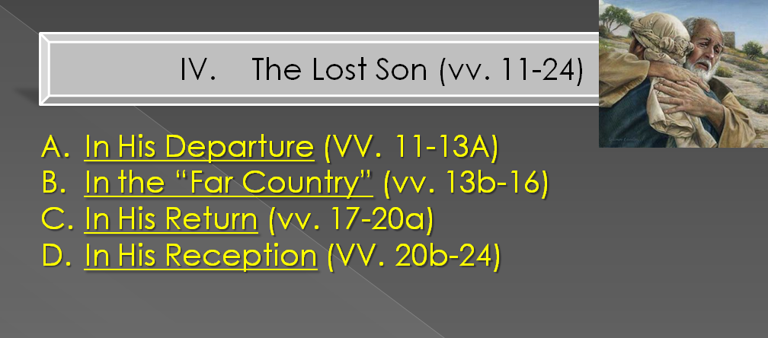
The Younger
(Left – but came to himself)

Slide 7
The Younger
(Left – but came to himself)
He did not immediately leave
“Yet although he had gained his portion, he did not immediately leave his home. St. Bernard sees a force in this, and observes how the apostasy of the heart will often precede the apostasy of the life. The divergence of the sinner’s will and will of the God does not immediately appear. Soon, however, it must, for not many days after, the younger son gathered all together, and took his journey into a far country.”
R. C. Trench, Parables of Our Lord, 142

Slide 8

The Younger
(Left – but came to himself)
He did not immediately leave
Overt Action
Sin
Quitting
Departure
Precedes
Heart

Slide 9
The Younger
(Left – but came to himself)
He did not immediately leave
Humility does not demand forgiveness, but begs
(vv. 18-19, 21)

Slide 10
The Younger
(Left – but came to himself)
Luke 15:17
17 But when he came to himself, he said, 'How many of my father's hired servants have bread enough and to spare, and I perish with hunger!

Slide 11
The Younger
(Left – but came to himself)
A. Before He Came To Himself

Slide 12
A. Before He Came To Himself
What It Means - Not At Himself
  Not mean - not accountable / responsible
  Lost track of who he was & where going
  Alienated from from his real self
  “Contrary to sound judgment and the decisions of a sound mind” (Barnes)
  “As if he had been beside himself” (J,F& B)
  As if he had been far from himself as he was from home. As a matter of fact he had been away, out of his head, and now began to see things as they really were.” (Robertson)

Slide 13
Sober - Sobriety
Strong’s: soundness of mind, i.e. (literally) sanity or (figuratively) self-control:
Vines: denotes "soundness of mind" …. "sound judgment" practically expresses the meaning; "it is that habitual inner self-government, with its constant rein on all the passions and desires, which would hinder the temptation to these from arising, ….
RSV: Sensibly
1 Tim. 2:9, 15

Slide 14
A. Before He Came To Himself
What It Means - Not At Himself
Behavior When He Is Not At Himself
Lost sight of the father
Focus on the now
Lost all sense of himself - who he was
Search for the empty
Wasteful
Selfish
Turned his back on his religion

Slide 15
A. Before He Came To Himself
What It Means - Not At Himself
Behavior When He Is Not At Himself
Evidence - This Was Not Himself
Later “came to himself” (v. 17)
Father was looking for him to return (v. 20)

Slide 16
A. Before He Came To Himself
What It Means - Not At Himself
Behavior When He Is Not At Himself
Evidence - This Was Not Himself
Examples of those - Not themselves
Peter
Matt. 26:69-75
Barnabas
Gal. 2:13

Slide 17
The Younger
(Left – but came to himself)
A. Before He Came To Himself
B. When He Came To Himself

Slide 18
B. When He Came To Himself
What It Means to Come to Himself
“When he came to his senses” (NASV; NIV)
“It is a wonderful stroke of art, to represent the beginning of repentance as the return of a sound consciousness.” (Vincent)
“Restoration to sound sense” (Clarke)
Repent: “1. metanoeo NT:3340, lit., "to perceive afterwards" (meta, "after," implying "change," noeo, "to perceive"; nous, "the mind, the seat of moral reflection"), in contrast to pronoeo, "to perceive beforehand,” (Vines)

Slide 19
B. When He Came To Himself
What It Means to Come to Himself
The Process of Coming to Himself
1. Observation (v. 16) - Sees self as he was / as he is
2. Reflection (v. 17) - What happens if continue
3. Decision (v. 18) - Either remain as are or change
4. Action (v. 20) - Arose and went to father.

Slide 20
The Younger
(Left – but came to himself)
A. Before He Came To Himself
B. When He Came To Himself
C. After He Came To Himself

Slide 21
C. After He Came To Himself
Different Person
Give
Me
(v. 12)
Make
Me
(v. 19)
Changes to
Serve Self -- Serve Father
Focus on now -- Focus on Future

Slide 22
C. After He Came To Himself
Different Person (v. 19)
Father Welcomes Him (vv. 20-22)
Rejoicing (v. 24)
Those Didn’t Welcome -- Have Greater Problem (vv. 25-32)

Slide 23
Two Brothers
Luke 15:11-32
The Younger
(Left – but came to himself)
The Older
(Stayed – but was beside himself)

Slide 24
The Older
(Stayed – but was beside himself)
First image: Obedient, loyal, hardworking (“in the field”)
At last: True character is revealed

Slide 25
The Older
(Stayed – but was beside himself)
The Sin
  Not moral – but in disposition/ attitude
  Anger (v. 28) - over reception of his brother
  Sulkiness (v. 28) refused to go in
  Self-righteousness (v. 29) – “I never..”
  Self-pity (v. 29) – “never gave me…”
  Envy (v. 30) – “killed for him…”
  Contempt (v.30) – “this son of yours”
  Malice – would not forgive

Slide 26
The Older
(Stayed – but was beside himself)
The Sin
The Suffering
  Of the penitent –
    The elder son should have loved him
    The elder son should have welcomed him
    Instead – he made him unhappy
    Brotherly love would have saved him from suffering!

Slide 27
The Older
(Stayed – but was beside himself)
The Sin
The Suffering
  Of the penitent –
  Of the father -
    His joy was interrupted
    His love was wounded
    He must stop and deal with another son

Slide 28
The Older
(Stayed – but was beside himself)
The Sin
The Suffering
  Of the penitent –
  Of the father –
  Of the family -
    Family is made unhappy
    Sound of merrymaking is heard no more!
    Occasion of happiness is turned sour for all

Slide 29
The Older
(Stayed – but was beside himself)
The Sin
The Suffering
  Of the penitent –
  Of the father –
  Of the family –
  Of the older brother himself -
    His attitude estranged him
    He cut himself off from his brother & father
    He separated himself from the fellowship
    His attitude made himself miserable

Slide 30
The Older
(Stayed – but was beside himself)
The Sin
The Suffering
The Entreaty
  His action: Father went to his son – pleaded (v. 28)
  His words: Called him “son” (v. 31)
  His promise (v. 31)
    Perpetual fellowship – “ever with me”
    His treasures – “all that I have is…”
  His appeal: to reason – to unite brothers (v. 32)

Slide 31
Two Brothers
Luke 15:11-32
The Younger
(Left – but came to himself)
The Older
(Stayed – but was beside himself)

