Slide 2
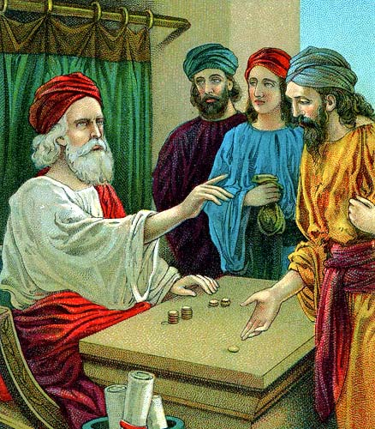
Parable of The Talents
Matthew 25:14-30

Slide 3
Matt 25:14-30
14 "For the kingdom of heaven is like a man traveling to a far country, who called his own servants and delivered his goods to them.
15 And to one he gave five talents, to another two, and to another one, to each according to his own ability; and immediately he went on a journey.
16 Then he who had received the five talents went and traded with them, and made another five talents.
17 And likewise he who had received two gained two more also.
18 But he who had received one went and dug in the ground, and hid his lord's money

Slide 4
19 After a long time the lord of those servants came and settled accounts with them.
20 So he who had received five talents came and brought five other talents, saying, 'Lord, you delivered to me five talents; look, I have gained five more talents besides them.’
21 His lord said to him, 'Well done, good and faithful servant; you were faithful over a few things, I will make you ruler over many things. Enter into the joy of your lord.‘
22 He also who had received two talents came and said, 'Lord, you delivered to me two talents; look, I have gained two more talents besides them.'
23 His lord said to him, 'Well done, good and faithful servant; you have been faithful over a few things, I will make you ruler over many things. Enter into the joy of your lord.’

Slide 5
24 Then he who had received the one talent came and said, 'Lord, I knew you to be a hard man, reaping where you have not sown, and gathering where you have not scattered seed.
25 And I was afraid, and went and hid your talent in the ground. Look, there you have what is yours.'
26 But his lord answered and said to him, 'You wicked and lazy servant, you knew that I reap where I have not sown, and gather where I have not scattered seed.
27 So you ought to have deposited my money with the bankers, and at my coming I would have received back my own with interest.
28 Therefore take the talent from him, and give it to him who has ten talents.

Slide 6
29 For to everyone who has, more will be given, and he will have abundance; but from him who does not have, even what he has will be taken away.
30 And cast the unprofitable servant into the outer darkness. There will be weeping and gnashing of teeth.'

Slide 7
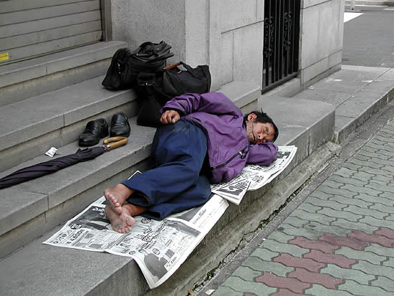
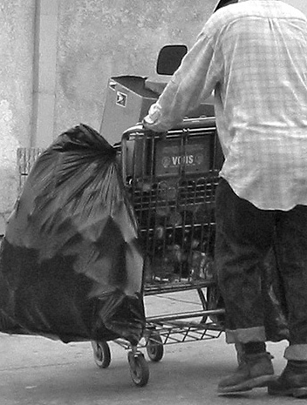
Morris Siegel
A street person in Los Angeles, CA
Roamed about in dark alleys, sleeping out-of-doors, carrying everything he owned in an old shopping cart.
He was found in an alley, dead of natural causes, heart trouble perhaps
Had three bank accounts containing a total of $207,421
In 1979, Morris’ father died and left him the money. When Morris did not claim it, the Division of Unclaimed Property tracked him down, and his family forced him to accept it. He did not show up at the ceremony when the cash was awarded. He took enough of the money to buy an old car, where he slept in bad weather. Relatives rented him an apartment; he never went there.
He died December 14, 1989, with three dollars in his pocket and an untouched fortune in the bank.
What a wasted life!

Slide 8
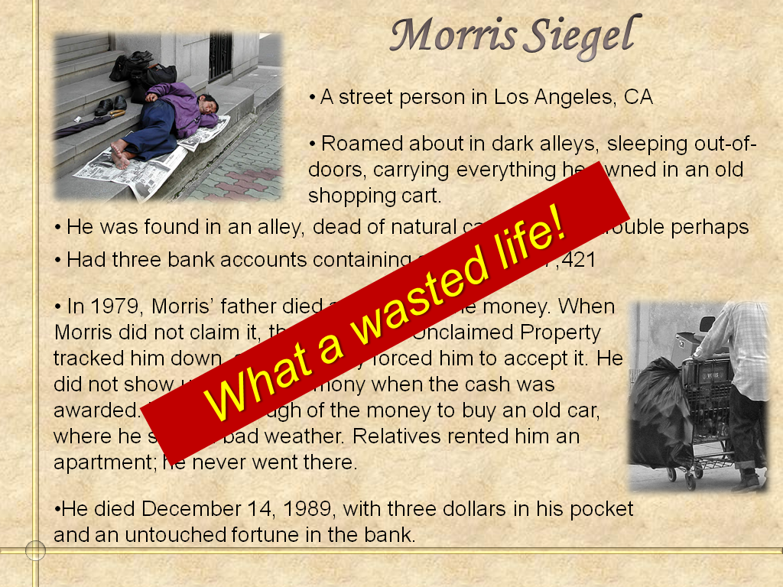
Could It Be That We Do No Better Than Morris Siegel?
Blessings - we waste?
Talents - we bury?
Opportunities - we pass?

Slide 9
Parable of The Talents
Matthew 25:14-30
The Passage (Context)

Slide 10
The Passage (Context)
The Warning to Watch
  Discussion of end of time – second coming (Matt. 24:3, 35-51)
  Don’t know when that will be (Matt. 24:36)
  Therefore watch (Matt. 24:42, 44; 25:13)

Slide 11
The Passage (Context)
The Warning to Watch
Three Parables in Context
  Ten Virgins (25:1-13) – Watchful in waiting
  Talents (25:14-30) – Watchful in working
  Sep. of sheep & goats (25:31-46) – Watchful toward Judgment

Slide 12
The Passage (Context)
The Warning to Watch
Three Parables in Context
The Audience
  Not the Pharisee & chief priests
  Disciples (Matt. 24:1-3)

Slide 13
Parable of The Talents
Matthew 25:14-30
The Passage (Context)
The Parallel (Pounds)

Slide 14
The Parallel (Pounds)
Luke 19:11-27
Pounds (KJV) / Minas (NKJV)
Very Similar Principles
  Master gives money to servants
  Master goes away
  Each are expected to trade and gain
  Some do well (gain) – One fails (gained nothing)
  One who failed accused master of being harsh

Slide 15
The Parallel (Pounds)
Luke 19:11-27
Pounds (KJV) / Minas (NKJV)
Very Similar Principles
Not the Same

Slide 16
Talents
(Matt. 25)
Mt. Olives – After Entry
(24:3)
Disciples (24:1-3)
Householder Leaves
For a time
Unequal Distribution
Reward Same
Severe Punishment
Pounds
(Luke 19)
Near Jer.– Before Entry
(v. 11)
Multitude (19:3)
Nobleman Leaves
To Get Kingdom
Equal Distribution
Reward Proportional
Deprived of Pound

Slide 17
“An estimate of the probabilities on each side seems to be favorable to the view that we have accurate reports of two different parables, and not two reports of the same parable…”
Alfred Plummer, A Critical and Exegetical Commentary on the Gospel According to Luke, 437

Slide 18
Parable of The Talents
Matthew 25:14-30
The Passage (Context)
The Parallel (Pounds)
The Parable (Talents)

Slide 19
The Parable (Talents)
The Talents Given (vv. 14-15)
  Generously – gave them “his goods”
  Universally - gave “to each” – none were overlooked
  Impartially – to each “according to his own ability”
    Recognized inequality of abilities
    Yet, no partiality
  Trustingly – left his money with them while gone
God Gives to Each of Us “Talents”
Work & Use Opportunities We Have For Service

Slide 20
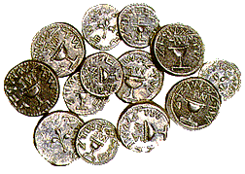
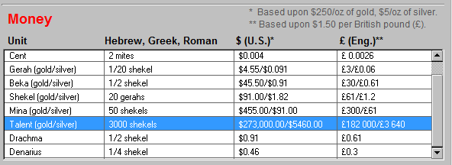
Talent
“One talent represented a considerable amount of money at that time when a denarius was a day's wage. “
(A. T. Robertson, Word Pictures in the New Testament)
$1286 oz (10-22-16) - $1,384,874 (Gold) / $17.58 oz (10-22-16) – $19,197 (Silver)

Slide 21
A ‘talent’ in the old days meant a measure of weight. It was the heaviest weight in the measuring system. It was used in measurements of gold, silver, iron, and bronze. Later on, it meant a measure of money. One talent, for Jews, was equivalent to 3,000 shekels, or ‘as much as a man could carry’. In later times of Jewish history, and in the time of Jesus and Matthew, one talent was equivalent to 6,000 denarii (Roman coins). 6,000 denarii would be about the earnings of an ordinary worker for fifteen to twenty years. It was in ordinary parlance ‘a ton of money’.
http://www.redemptoristspirituality.net/eng2/index.php?option=com_content&task=blogcategory&id=59&Itemid=80
Notes:
91 lbs

Slide 22
Five
Two
One
Notes:
91 lbs

Slide 23
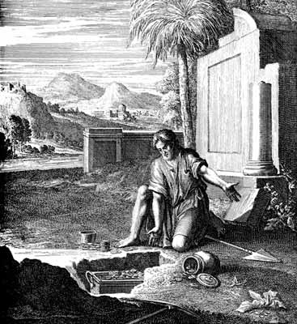
The Parable (Talents)
The Talents Given (vv. 14-15)
Management of the Talents (vv. 16-18)
  Five Talent Man – worked & served promptly & faithfully – gained five more
  Two Talent Man - worked & served promptly & faithfully – gained two more
  One Talent Man – buried his talent

Slide 24
Five
Two
One
Notes:
91 lbs

Slide 25
The Parable (Talents)
The Talents Given (vv. 14-15)
Management of the Talents (vv. 16-18)
  Five Talent Man – worked & served promptly & faithfully – gained five more
  Two Talent Man - worked & served promptly & faithfully – gained two more
  One Talent Man – buried his talent
    Didn’t gamble or waste it
    Didn’t embezzle it
    Didn’t make a poor investment
    Simply failed to use it!

Slide 26
The Parable (Talents)
The Talents Given (vv. 14-15)
Management of the Talents (vv. 16-18)
The Reckoning (vv. 19-30)

Slide 27
The Parable (Talents)
The Talents Given (vv. 14-15)
Management of the Talents (vv. 16-18)
The Reckoning (vv. 19-30)
  Five Talent Man – (vv. 20-21)
    Commended – “good and faithful”
    Promoted –
      Made ruler over many things – more trust
      Allowed to enter pleasures of the palace

Slide 28
The Parable (Talents)
The Talents Given (vv. 14-15)
Management of the Talents (vv. 16-18)
The Reckoning (vv. 19-30)
  Five Talent Man – (vv. 20-21)
  Two Talent Man – (vv. 22-23)
    Commended – “good and faithful”
    Promoted –
      Made ruler over many things – more trust
      Allowed to enter pleasures of the palace
The man with lesser talent
was rewarded the same as the greater!

Slide 29
The Parable (Talents)
The Talents Given (vv. 14-15)
Management of the Talents (vv. 16-18)
The Reckoning (vv. 19-30)
  Five Talent Man – (vv. 20-21)
  Two Talent Man – (vv. 22-23)
  One Talent Man (vv. 24-30)
    Gave a defense (vv. 24-25) – inaction call for many words!

Slide 30
One Talent Man’s Defense
“You are a hard man…”
  Mistaken view of God
  Charge: Demands more than one can do – requires too much – unfair!
  Thinks master is watching for the least failure
  Had no faith in his master’s fairness or goodness (though master had faith in him)
  All sin is rooted in a misconception of God

Slide 31
One Talent Man’s Defense
“You are a hard man…”
“I was afraid”
  So – did nothing!
  Had no faith in himself (though his master did)
  Afraid of failure –
  5 virgins: overconfident; he was under-confident
  Inconsistent:
    Charge: You require more than you should
    Action: Didn’t even do what he could

Slide 32
The Parable (Talents)
The Talents Given (vv. 14-15)
Management of the Talents (vv. 16-18)
The Reckoning (vv. 19-30)
  Five Talent Man – (vv. 20-21)
  Two Talent Man – (vv. 22-23)
  One Talent Man (vv. 24-30)
    Gave a defense (vv. 24-25) – inaction call for many words!
    Master’s reaction (vv. 26-30)

Slide 33
Master’s Reaction
Rebuked (vv. 26-27)
  “Wicked and lazy”
  Task was not that hard – no reason…
Talent Taken Away (vv. 28-29)
Cast Into Outer Darkness (v. 30)

Slide 34
Application Is Obvious
Master
Travels to far country
Servants
Talents
Trading talents
Master returns
Reckoning
Joys of the Lord
Outer Darkness
Christ
Ascends to heaven
Christians
Tasks - opportunities
Working – use opp.
Second coming
Judgment
Heaven
Hell

Slide 35
Parable of The Talents
Matthew 25:14-30
The Passage (Context)
The Parallel (Pounds)
The Parable (Talents)
The Principles (Lessons Learned)

Slide 36
The Principles (Lessons Learned)
We’ve Been Given Talents
  All have talent – not a “no talent man”
  Talent defined
    Not just natural / developed abilities (cf. v. 15)
    Emphasis of parable is work & service
    Point in context: To be working while we wait
    Responsibility, Task given, Opportunities
“But it is evident that the reference here is not to these. It is rather to those opportunities which have been given to men in consequence of their abilities and environment.”
William Taylor, The Parables of our Savior, 184

Slide 37
Talent
Any Task
Any Responsibility
Any Opportunity
Any Ability
Any Work
Any Commandment

Slide 38
The Principles (Lessons Learned)
We’ve Been Given Talents
Trust - Responsibility
  Talent – was a lot of money! (Grave responsibility)
  We are stewards of what belongs to God (1 Cor. 4:2)
  You have been entrusted with great responsibility;
    Your soul (Matt.16:26)
    Your child (Prov. 22:6; Eph. 6:4)
    Gospel (Mark 16:15; Rom. 1:16; 2 Tim. 2:15)
    Money (1 Tim. 6:17-18)
    Brethren (Gal. 6:1; Heb. 10:24)
    Time (Eph. 5:15-16)

Slide 39
The Principles (Lessons Learned)
We’ve Been Given Talents
Trust – Responsibility
Work According to Ability
  God’s expectation is based on our capability (2 Cor. 8:12)
    Does not require more than can do (cf. 1 Cor. 10:13)
    Does require you to do what able to do! (cf. Phil. 4:13)
  Judged individually & independently – not by comparison
  Opportunities vary
    One can personally support a preacher – another only buy a tract or two
    One have many to teach – another have just a few
    One can lead & solve problems – other serve tables

Slide 40
The Principles (Lessons Learned)
We’ve Been Given Talents
Trust – Responsibility
Work According to Ability
  God’s expectation is based on our capability (2 Cor. 8:12)
    Does not require more than can do (cf. 1 Cor. 10:13)
    Does require you to do what able to do! (cf. Phil. 4:13)
  Judged individually & independently – not by comparison
  Opportunities vary
  Avoid extremes:
    Pride – because we have 5 talents
    Discontent – because we only have 1 talent
    Some think: can’t lead or do something big – do nothing!

Slide 41
The Principles (Lessons Learned)
We’ve Been Given Talents
Trust – Responsibility
Work According to Ability
The Sin of Neglect
  God will not hold us accountable for what we do not have – but will hold us accountable for what we do have
  Talent unused is same as if flagrantly abused!
  Not what he did – it is what he didn’t do!
  Many Christian lost because of neglect
    Failure to act is sin (Jas. 4:17)
    In judgment will be asking “when did we…?” (Matt 25)

Slide 42
The Principles (Lessons Learned)
We’ve Been Given Talents
Trust – Responsibility
Work According to Ability
The Sin of Neglect
Servant of God – Can Lose Soul
  “Own servants” (v. 14)
  Yet one became unprofitable – wicked (vv. 26, 30)
  Cast into outer darkness (v. 30)

Slide 43
Parable of The Talents
Matthew 25:14-30
The Passage (Context)
The Parallel (Pounds)
The Parable (Talents)
The Principles (Lessons Learned)

Slide 44
What are you doing while you are waiting?

