Slide 2
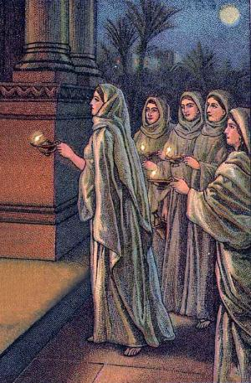
Parable of Ten Virgins
Matt. 25:1-13

Slide 3
Matt. 25:1-13
1 "Then the kingdom of heaven shall be likened to ten virgins who took their lamps and went out to meet the bridegroom.
2 Now five of them were wise, and five were foolish.
3 Those who were foolish took their lamps and took no oil with them,
4 but the wise took oil in their vessels with their lamps.
5 But while the bridegroom was delayed, they all slumbered and slept

Slide 4
6 And at midnight a cry was heard: 'Behold, the bridegroom is coming; go out to meet him!'
7 Then all those virgins arose and trimmed their lamps.
8 And the foolish said to the wise, 'Give us some of your oil, for our lamps are going out.'
9 But the wise answered, saying, 'No, lest there should not be enough for us and you; but go rather to those who sell, and buy for yourselves.'
10 And while they went to buy, the bridegroom came, and those who were ready went in with him to the wedding; and the door was shut.

Slide 5
11 Afterward the other virgins came also, saying, 'Lord, Lord, open to us!'
12 But he answered and said, 'Assuredly, I say to you, I do not know you.'
13 Watch therefore, for you know neither the day nor the hour in which the Son of Man is coming.

Slide 6
Parable of
Ten Virgins
The Context

Slide 7
The Context
Before the parable (Matt. 24)
  Destruction of Jerusalem (vv. 1-34)
  End of time & 2nd Coming (vv. 35-51)
    Don’t know when (vv. 35-41)
      No one knows(vv. 35-36)
      No warning (vv. 37-39)
      Separation of righteous & wicked (vv. 40-41)
    Must be ready (vv. 42-51)
      Watch (vv. 42-43)
      Be ready (v. 44)
      Faithful servant & evil servant (vv. 45-51)

Slide 8
The Context
Before the parable (Matt. 24)
After the parable (Matt. 25)
  Parable of talents (vv. 14-30)
  Judgment scene (vv. 31-46)

Slide 9
The Context
The Lord is returning
When don’t know when
Thus, Watch & Be Ready!

Slide 10
Parable of
Ten Virgins
The Context
The Parable

Slide 11
The Parable
The Customs
  Wedding festivities – Usually at night
  Bridegroom would go to bride’s house – get the bride and bring her to his home
  Followed by a grand procession of those who carried lamps to light the way
    Invited guest allowed to join the procession
    “Without a torch or lamp they couldn’t join the procession, or enter the bridegroom’s house” (Fred Wright, Manners and Customs of Bible Lands, 132)

Slide 12
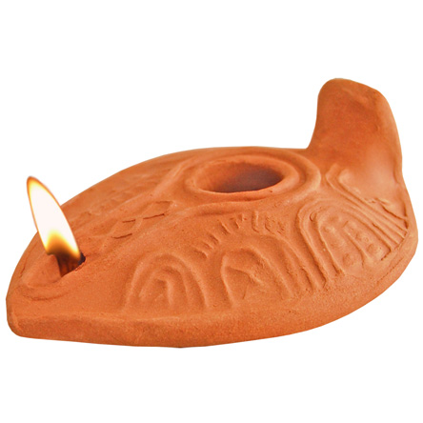
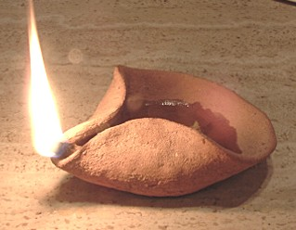
The Virgin’s Lamp
“The lamps consisted of a round receptacle for pitch or oil for the wick. This was placed in the hollow cup or deep saucer,…which was fastened by a pointed end into a long wooden pole, on which it was borne aloft.”
Edersheim – as quoted by Wright

Slide 13
The Parable
The Customs
The Story
  Ten virgins prepare to meet the bridegroom (vv. 1-4)
    Ten wise – took extra oil
    Ten foolish – took no extra oil
  Bridegroom delayed – all slept (v. 5)
  Bridegroom comes all go to meet him (vv. 6-9)
    All went (v. 6)
    All trimmed lamps (v. 7)
    Foolish virgins asked the wise for oil (v. 8)
    Wise virgins refused (v. 9)
  Foolish virgins shut out (vv. 10-12)

Slide 14
The Parable
The Customs
The Story
The Point
13 Watch therefore, for you know neither the day nor the hour in which the Son of Man is coming.
Bridegroom = Christ
Coming of the bridegroom = 2nd coming
Virgins = Christians
Waiting = time for preparation for 2nd coming
Oil = preparation & readiness for 2nd coming

Slide 15
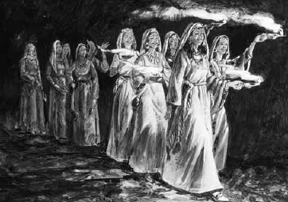
The Parable
Alike In Many Ways
All went out to meet bridegroom
All had lamps
All were expecting the bridegroom to come
None had knowledge of time of his coming
All looked forward to his coming
All expected to be a part of the festivities
All slept while he delayed
All trimmed their lamps
All had lamps that burned (for the moment)
The Customs
The Story
The Point
The Virgins

Slide 16
Difference Was Basic
Five Virgins
Wise
Prepared
Watched
Ready
Five Virgins
Foolish
Unprepared
Did not Watch
Were not Ready

Slide 17
Parable of
Ten Virgins
The Context
The Parable
The Application

Slide 18
The Application
Be Watchful – Vigilant
  Conclusion (v. 13; cf. 24:42)
  This warning is to Christians – who are confident
    Not those who never obey
    Not those who are hypocrites
    Not those who openly turn away

Slide 19
“The purpose of the parable is, to impress upon the members of the Church their need of vigilance. It adds much to the solemnity of the lesson, that by the foolish virgins are meant, not hypocrites, much less the openly ungodly, but the negligent in prayer, the slothful in work. Nor is it that they have no oil at all; they have some, but not enough”
R. C. Trench, Parables of our Lord, 86

Slide 20
The Application
Be Watchful – Vigilant
  Conclusion (v. 13; cf. 24:42)
  This warning is to Christians – who are confident
  Watch by careful obedience at all times (2 Pet. 3:10-11)
    Watch our words (Matt. 12:36-37)
    Watch our time (Eph. 5:15)
    Watch our opportunities (Gal. 6:10; Jas. 4:17)
    Watch our heart (Prov. 4:23)
    What our eyes (Matt. 5:28)
    Watch our actions (Matt. 5:13-16)
    Watch our worship (Matt. 15:9)

Slide 21
The Application
Be Watchful – Vigilant
Don’t Neglect
  Foolish virgins were careless, shortsighted, not forward looking, thoughtless
  Many will lose soul – by what they failed to do
    Jas. 4: 17
    Matt. 25 – when did we…?
  Presumptuous – assume & take for granted that have enough
    Evidence: all are sleeping – Think everything needful is in order

Slide 22
The Application
Be Watchful – Vigilant
Don’t Neglect
Cannot Borrow
  Some things cannot borrow – cannot loan
  Can’t borrow:
    Righteousness
    Faith
    Character
    Service
    Reputation
  Can’t borrow from family, brethren
  Give account for self (2 Cor. 5:10; Rom. 14:12)

Slide 23
The Application
Be Watchful – Vigilant
Don’t Neglect
Cannot Borrow
Cannot Recall

Slide 24
Lost Opportunities Cannot Be Recalled
The foolish virgins:
  Missed their chance
  Didn’t seize the opportunity (Eph. 5:15)
  Tried at last moment - but later found the door shut
Everyday we have opportunities (Gal. 6:10) that may never return
Open doors may soon be shut:
  To obey the gospel (Heb. 3:7)
  Correct our lives (2 Cor. 6:2)
  Teach another (Mk. 16:15)
  Plea to some brother to return (Gal. 6:1)
  Train children (Eph. 6:1-4)
Days – years of possible service – forever gone!

Slide 25
The Application
Be Watchful – Vigilant
Don’t Neglect
Cannot Borrow
Cannot Recall
Cannot Find
Foolish cried for mercy – but it was too late
Day of mercy will turn to the day of judgment
Matt. 7:21-ff

Slide 26
13 Watch therefore, for you know neither the day nor the hour in which the Son of Man is coming.
Why Watch?
Don’t know the day or hour of 2nd coming
Neglect – failure is so easy
Cannot borrow or use another’s preparation
Opportunities will soon be gone
After his coming – preparations cannot be made
Cry for mercy will not help in day of judgment

Slide 27
Parable of
Ten Virgins
The Context
The Parable
The Application

