Slide 2
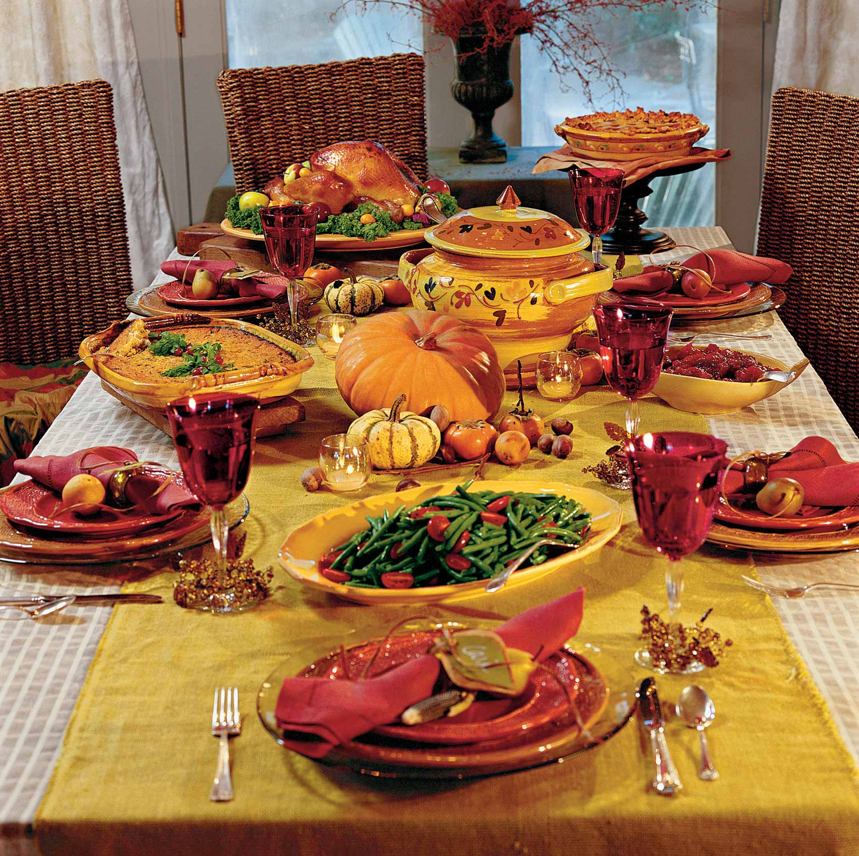
Parable of
The Great Supper
Luke 14:15-24

Slide 3
Luke 14:15-24
15 Now when one of those who sat at the table with Him heard these things, he said to Him, "Blessed is he who shall eat bread in the kingdom of God!"
16 Then He said to him, "A certain man gave a great supper and invited many,
17 and sent his servant at supper time to say to those who were invited, 'Come, for all things are now ready.'
18 But they all with one accord began to make excuses. The first said to him, 'I have bought a piece of ground, and I must go and see it. I ask you to have me excused.'

Slide 4
19 And another said, 'I have bought five yoke of oxen, and I am going to test them. I ask you to have me excused.'
20 Still another said, 'I have married a wife, and therefore I cannot come.'
21 So that servant came and reported these things to his master. Then the master of the house, being angry, said to his servant, 'Go out quickly into the streets and lanes of the city, and bring in here the poor and the maimed and the lame and the blind.'
22 And the servant said, 'Master, it is done as you commanded, and still there is room.’

Slide 5
23 Then the master said to the servant, 'Go out into the highways and hedges, and compel them to come in, that my house may be filled.
24 For I say to you that none of those men who were invited shall taste my supper.' "

Slide 6
Parable of
The Great Supper
Luke 14:15-24
The Passage (Context)

Slide 7
The Passage (Context)
The Chapter
The Cost of Following Christ
Evidence (Healing) [vv. 1-6]
Spirit / Attitude (Humility) [vv. 7-14]
Requires a Change (Parable) [vv. 15-24]
Priority (Sacrifice All) [vv. 25-33]
Hypocrisy is Useless (Salt) [vv. 34-35]

Slide 8
The Passage (Context)
The Chapter
The Setting
  Jesus was invited to eat in house of a chief Pharisee (v. 1)
  Seems to have been expensive entertainment (vv. 7, 12)
  Guests must have been many
  Guests must have included people of consideration (v. 12)
  Attitude: rejected Christ – looking for fault (v. 1)
  Context & parable addresses the problem.

Slide 9
The Passage (Context)
The Chapter
The Setting
The Statement
Lesson on Humility
(vv. 7-11)
------
Lesson on respect of persons
(vv. 12-14)
15 Now when one of those who sat at the table with Him heard these things, he said to Him, "Blessed is he who shall eat bread in the kingdom of God!"

Slide 10
The Passage (Context)
The Chapter
The Setting
The Statement
Suggests the kingdom is material
Thinks Jews (by birth) will be in kingdom
15 Now when one of those who sat at the table with Him heard these things, he said to Him, "Blessed is he who shall eat bread in the kingdom of God!"

Slide 11
What Was His Motive or Design?
To divert the discussion (since Jesus had reproved the guests and the master of house)
To contrast the present degenerate state to blessed state in the future (when what Jesus mentioned would be practiced)
To expand on the reference to the resurrection of the just – i.e. those recompensed shall eat bread….
To commend self (Jews) – assuming be in kingdom

Slide 12
Parable of
The Great Supper
Luke 14:15-24
The Passage (Context)
The Parable (In Response)

Slide 13
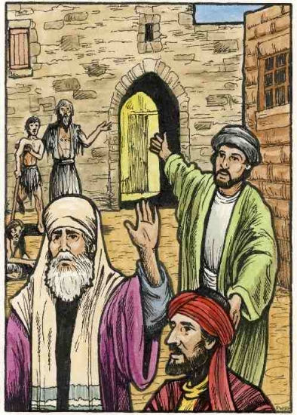
The Parable (In Response)
The Invitation (vv. 16-17)
“Great supper”
  Due to many invited
  A formal feast
Invitation given long before ready
Servant announce is ready – “come”
Application: invitation of gospel to the Jews

Slide 14
The Parable (In Response)
The Invitation (vv. 16-17)
The Excuses (vv. 18-20)
With one consent – one mind or one spirit
First: Bought ground – must see it (v. 18)
Second: Bought oxen – must prove (v. 19)
Third: Married wife (v. 20)
Application: those (the Jews) who refused the gospel invitation

Slide 15
The Parable (In Response)
The Invitation (vv. 16-17)
The Excuses (vv. 18-20)
The Host’s Response (vv. 21-24)
Angry (v. 21)
Sent messenger to streets to bring in poor, maimed, lame, & blind (v. 21)
Still room – so goes to highways & hedges to fill the house (vv. 22-23)
Proclaims: none of those (originally) invited would taste of supper (v. 24)
Application: Jews rejected – turn to Gentiles

Slide 16
Parable Was Both Historic & Prophetic
Historic
At the time uttered
Jews had already
rejected
the Christ &
the invitation
Prophetic
At the time uttered
Gentiles had not already
been
invited

Slide 17
Parable of
The Great Supper
Luke 14:15-24
The Passage (Context)
The Parable (In Response)
The Point (Being Made)

Slide 18
The Point (Being Made)
To Correct Misunderstanding
  Man (v.15) had common concept of Jews: Being a Jews puts one in the privileged number
  To him (and others like him) the parable it directed
To Show Jews that their Rejection – Leaves them Outside the Kingdom
To See The Hindrances (excuses) to Serving God

Slide 19
Parable of
The Great Supper
Luke 14:15-24
The Passage (Context)
The Parable (In Response)
The Point (Being Made)
The Principles (We Learn)

Slide 20
The Principles (We Learn)
Gospel Feast
  Feast: Great preparations long before invitation given (Eph. 1:3-4; 3:10-11)
  Feast: Quality of provisions - forgiveness & hope of eternal life (1 Tim. 4:8)
  Feast: Abundance of supply (Isa. 55:7; Eph. 3:20)
  Feast: Fellowship it affords (1 John 1:3, 7)
  Feast: Joy it gives (1 Pet. 4:13; 1 John 1:4)

Slide 21
The Principles (We Learn)
Gospel Feast
Confidence Assumed
  Jews assumed were always children of God (John 8:31-33; Rom. 9:6)
  Many assume that if moral – okay (Acts 10:2, 22; 11:14)
  Many assume that if religious – okay (Mt. 7:21; 2 Thess. 2:10-12)
  Many assume that if baptized – okay (Acts 8:20-22)
  Many assume that if members of church – okay (Heb. 10:26-28)

Slide 22
The Principles (We Learn)
Gospel Feast
Confidence Assumed
Excuses

Slide 23
1. The Excuses Offered
Bought a piece of ground (v. 18) – Focus on possessions
Bought 5 yoke of oxen (v. 19) – Focus on business
Married a wife (v. 20) – Focus on domestic affairs

Slide 24
2. The Excuses – Not Flimsy
Not just flimsy things made up – but things were really important to them
Lest someone think – my “reason” is not flimsy like theirs

Slide 25
“The three classes of excuses are drawn from the different phases of life; they are not ‘flimsy” excuses, ridiculous excuses, as some have sought to make them; they were the most important excuses that could be given. They were taken from the honorable stations of life in business and social intercourse. Yet, it was considered an insult to refuse to accept the invitation. There reasons assigned could be put aside; they could have been attended to another time; those making them could have attended the supper, and later attended to the business and social affairs.”
H. Leo Boles, Commentary on Luke, 288

Slide 26
Luke 14:18
[I must needs go] I have necessity, or am obliged to go and see it; possibly pleading a contract or an agreement that he would go soon and examine it. However, we may learn from this that sinners sometimes plead that they are under a "necessity" to neglect the affairs of religion. The affairs of the world, they pretend, are so pressing that they cannot find time to attend to their souls. They have no time to pray, or read the Scriptures, or keep up the worship of God. In this way many lose their souls. God cannot regard such an excuse for neglecting religion with approbation. He commands us to seek "first" the kingdom of God and his righteousness, nor can he approve any excuse that people may make for not doing it.
(Albert Barnes)

Slide 27
3. The Excuses = Hindrances
None of the things mentioned – sinful within itself
Become wrong when hinder or interfere with a higher calling
Our Possessions
Should never
Hinder our
Service
Our
Business
Should never
Hinder our
Service
Our Domestic
Relations
(Good or Bad)
Should never
Hinder our
Service (v. 26ff)

Slide 28
4. The Excuses: Didn’t Want To
First (v. 18) – implies would be glad to, but
Second (v. 19) – implies sees no real obligation
Third (v. 20) – simply says can’t come
“One consent” (v. 18) – one attitude: really didn’t want to go
“But you are not willing to come to Me that you may have life” (John 5:40)

Slide 29
Luke 14:20
None give a naked refusal. Each has some reason of his own why he ought to be held excused. Three excuses are given as specimens of all the rest; and it will be observed that they answer to the three things which are said to "choke the word" in the parable of the Sower (Luke 8:14),-"the care of this world," Luke 14:18; "the deceitfulness of riches," Luke 14:19; and "the pleasures of this life," Luke 14:20. Each differs from the other, and each has its own, plausibility; but all arrive at the same result-`We have other things to attend to, more pressing just now.' So far from saying, I decline to come, each represents himself as only hindered by something in the way just now: when these are removed, they will be ready. But, notwithstanding these plausibilities, they are held as refusers; and when at length they call, the Master in turn will refuse them.
(Jamieson, Fausset, and Brown)

Slide 30
The Principles (We Learn)
Gospel Feast
Confidence Assumed
Excuses
The Invitation Is Extended to All (even unlikely)

Slide 31
Parable of
The Great Supper
The Passage (Context)
The Parable (In Response)
The Point (Being Made)
The Principles (We Learn)

