Slide 1
Gospel is powerful and effective (Isa. 55:9-10)
Possible to make it of none effect
  Matt. 15:6
  Mark 7:13
  Rom. 9:6
  Heb. 4:2
Does not mean gospel is not effective – but simply not availing self of its power (i.e. books – tools – med)
Gospel very effective at Thessalonica (2 Thess. 2:13)

Slide 2
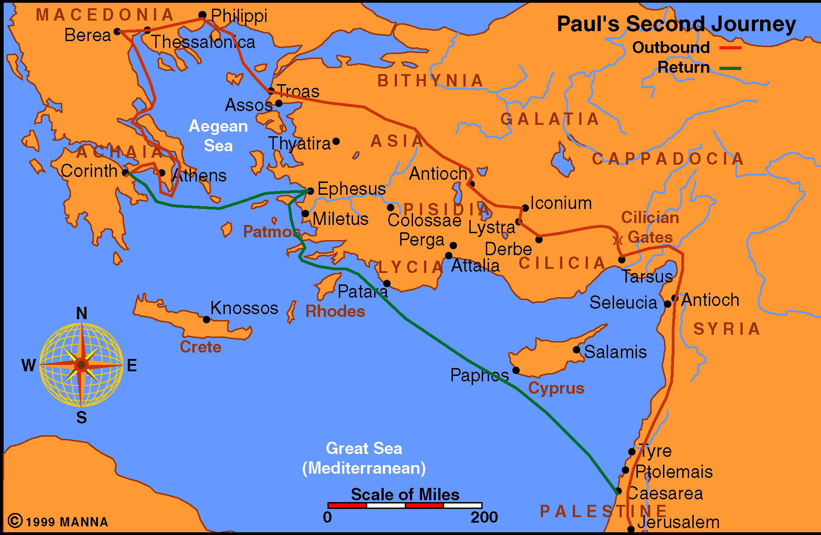
Paul Journey 2
Acts 16-18

Slide 3
Acts 17
At Thessalonica (vv. 1-9)
At Berea (vv. 10-15)
At Athens (vv. 16-34)

Slide 4
Making
The Gospel
Effective
Acts 17

Slide 5
Making The Gospel Effective
Take it to the People (vv. 1-2)

Slide 6
Take it to the People (vv. 1-2)
Gospel is the message that saves (1 Cor. 1:21)
For the gospel to be effective – must be heard & learned (John 6:45)
Times – think people are going to just come to us
Paul went to the where the people were (vv. 1-2)
  At Philippi – went to river (16:13)
  At Berea – went to synagogue (17:10)
  At Athens – went to synagogue (17:17)

Slide 7
Take it to the People (vv. 1-2)
Gospel is the message that saves (1 Cor. 1:21)
For the gospel to be effective – must be heard & learned (John 6:45)
Times – think people are going to just come to us
Paul went to the where the people were (vv. 1-2)
We must take message to those we want to convert
  They likely will not come to hear a sermon
  Take it to their home – or ours, etc.

Slide 8
Making The Gospel Effective
Take it to the People (vv. 1-2)
Explain it and Persuade (vv. 2-4)

Slide 9
Explain it and Persuade (vv. 2-4)
Paul’s use of the Scriptures (vv. 2-4)
  Reasoned from it (v. 2)
  Explained it (v. 3)
  Demonstrated from it (v. 3)
  Persuaded with it (v. 4)
Ezra - & 13 other teachers – explained (Neh. 8:7-8)
For gospel to be effective – Explain it – persuade
  Develop the point – the argument
  Draw conclusions
  Don’t just read it – are give a passage

Slide 10
Making The Gospel Effective
Take it to the People (vv. 1-2)
Explain it and Persuade (vv. 2-4)
Have an Open Mind (v. 11)

Slide 11
Have an Open Mind (v. 11)
Bereans received the word with readiness of mind (v. 11)
  “Readiness of mind” (KJV & ASV)
  “With great eagerness” (NASV)
  “Gladly listened to the message” (LBP)
Gospel is effective – on an open mind
  Willing to learn & be taught
  Admits – lot I don’t know & could be wrong
  Willing to consider the evidence
  Searching for what is true (v. 11)
  Open – but not gullible (2 Tim. 3:6)

Slide 12
Making The Gospel Effective
Take it to the People (vv. 1-2)
Explain it and Persuade (vv. 2-4)
Have an Open Mind (v. 11)
Test What You Hear (v. 11)

Slide 13
Test What You Hear (v. 11)
Bereans tested what they heard (v. 11)
  Searched the Scriptures – to see of teaching was true
  Involved daily study (v. 11)
Gospel is effective – when we test what we hear
  When we don’t – and accept it – the teacher becomes the standard
  When we don’t – and reject it – own feelings are standard
  We are to try to spirits (1 John 4:1, 6)
  That insulates us against error (2 Pet. 3:16-18)

Slide 14
2 Peter 3:16-18
16 as also in all his epistles, speaking in them of these things, in which are some things hard to understand, which untaught and unstable people twist to their own destruction, as they do also the rest of the Scriptures.
17 You therefore, beloved, since you know this beforehand, beware lest you also fall from your own steadfastness, being led away with the error of the wicked;
18 but grow in the grace and knowledge of our Lord and Savior Jesus Christ. To Him be the glory both now and forever. Amen.
Some will pervert Scripture
Danger that you will be misled
Prevent: by knowing the text

Slide 15
Making The Gospel Effective
Take it to the People (vv. 1-2)
Explain it and Persuade (vv. 2-4)
Have an Open Mind (v. 11)
Test What You Hear (v. 11)
Lay Basic Foundation (vv. 16-29)

Slide 16
Lay Basic Foundation (vv. 16-29)
Can’t build where there is no foundation
  Preaching to Jews – already had foundation of OT
  Preaching to Gentiles – pagans don’t know God
  Questions are asked – person is not ready for the answer

Slide 17
Lay Basic Foundation (vv. 16-29)
Can’t build where there is no foundation
Those at Athens – needed a more basic foundation
  They were ignorant of the one true God (vv. 22-23)
  Foundation laid: one true God (vv. 24-29)

Slide 18
Lay Basic Foundation (vv. 16-29)
Can’t build where there is no foundation
Those at Athens – needed a more basic foundation
Gospel will be effective when we lay basic foundation
  Start with evidence of the existence of God
  Bible is inspired of God
  Does it make a difference what one believes
  Purpose and duration of the Old Testament
  Difference in the OT and NT
  Who Jesus is and what it means
  Evidence of resurrection

Slide 19
Lay Basic Foundation (vv. 16-29)
Can’t build where there is no foundation
Those at Athens – needed a more basic foundation
Gospel will be effective when we lay basic foundation
When teaching – always go back to the basics!
  Everything rest on the first principles
  All error is a perversion of the basics
  Basics are like a skeleton on which all things hang

Slide 20
Making The Gospel Effective
Take it to the People (vv. 1-2)
Explain it and Persuade (vv. 2-4)
Have an Open Mind (v. 11)
Test What You Hear (v. 11)
Lay Basic Foundation (vv. 16-29)
Repent (v. 30)

Slide 21
Repent (v. 30)
God demands repentance (v. 30)
  Time God overlooked (i.e. OT polygamy, etc) – but not now
  Demanded of all men everywhere
  Alien sinner (Acts 2:38; 17:30-31)
  Erring child of God (Acts 8:22)

Slide 22
Repent (v. 30)
God demands repentance (v. 30)
What is repentance?
  A change of mind
1. metanoeo NT:3340, lit., "to perceive afterwards" (meta, "after," implying "change," noeo, "to perceive"; nous, "the mind, the seat of moral reflection"), in contrast to pronoeo, "to perceive beforehand," hence signifies "to change one's mind or purpose," always, in the NT, involving a change for the better, an amendment, and always, except in Luke 17:3,4, of "repentance" from sin.
(Vine's Expository Dictionary of Biblical Words)

Slide 23
Repent (v. 30)
God demands repentance (v. 30)
What is repentance?
  A change of mind
  Results in change of life
Nineveh “…repented at the
preaching of Jonah…”
(Matt. 12:41)
“…they turned from their
evil way…”
(Jonah 3:10)

Slide 24
Making The Gospel Effective
Take it to the People (vv. 1-2)
Explain it and Persuade (vv. 2-4)
Have an Open Mind (v. 11)
Test What You Hear (v. 11)
Lay Basic Foundation (vv. 16-29)
Repent (v. 30)
Listen in View of Judgment (v. 31)

Slide 25
Listen in View of Judgment (v. 31)
Judgment day that is coming
  All stand before the judgment (2 Cor. 5:10)
  None escape the judgment of God (Rom. 2:2)
  All preparation is before death (Heb. 9:27)
Gospel is effective when listen in view of judgment
  If is no judgment – what difference would any of it make?
  Should persuade us to change (2 Pet. 3:11-ff)
  The very gospel we hear – will be the standard of judgment (John 12:48)

Slide 26
Making The Gospel Effective
Take it to the People (vv. 1-2)
Explain it and Persuade (vv. 2-4)
Have an Open Mind (v. 11)
Test What You Hear (v. 11)
Lay Basic Foundation (vv. 16-29)
Repent (v. 30)
Listen in View of Judgment (v. 31)

