Slide 1
Acts 7
Stephen’s Defense (vv. 1-53)
(Denies the charge of speaking against Moses)
  A review of the nation of Israel (vv. 1-50)
    The call of Abraham and the promise (vv. 1-8)
    Joseph and the patriarchs in Egypt (vv. 9-16)
    Moses: God’s deliverer (vv. 17-43)
    The tabernacle and the temple (vv. 44-50)
  You resist God like your fathers (vv. 51-53)
Stephen’s Stoning (vv. 54-60)
  The Jews were cut to the heart and gnashed at him (v. 54)
  Stephen saw Jesus (vv. 55-56)
  The Jews cried out with a loud voice, stopped their ears and ran at him (v. 57
  The Jews stoned Stephen (vv. 58-60a)
  Stephen died (v. 60b)

Slide 2
Acts 7
See Many Examples of a Living Faith
Abraham (vv. 1-8)
Joseph (vv. 9-16)
Moses (vv. 17-43)
Joshua (v. 45)
David (v. 45)
Solomon (v. 47)
Stephen (vv. 54-60)

Slide 3
Acts 7

Slide 4
Acts 7
Cheerfully Obeys (vv. 2-4)

Slide 5
2 And he said, "Brethren and fathers, listen: The God of glory appeared to our father Abraham when he was in Mesopotamia, before he dwelt in Haran,
3 and said to him, 'Get out of your country and from your relatives, and come to a land that I will show you.'
4 Then he came out of the land of the Chaldeans and dwelt in Haran. And from there, when his father was dead, He moved him to this land in which you now dwell.

Slide 6
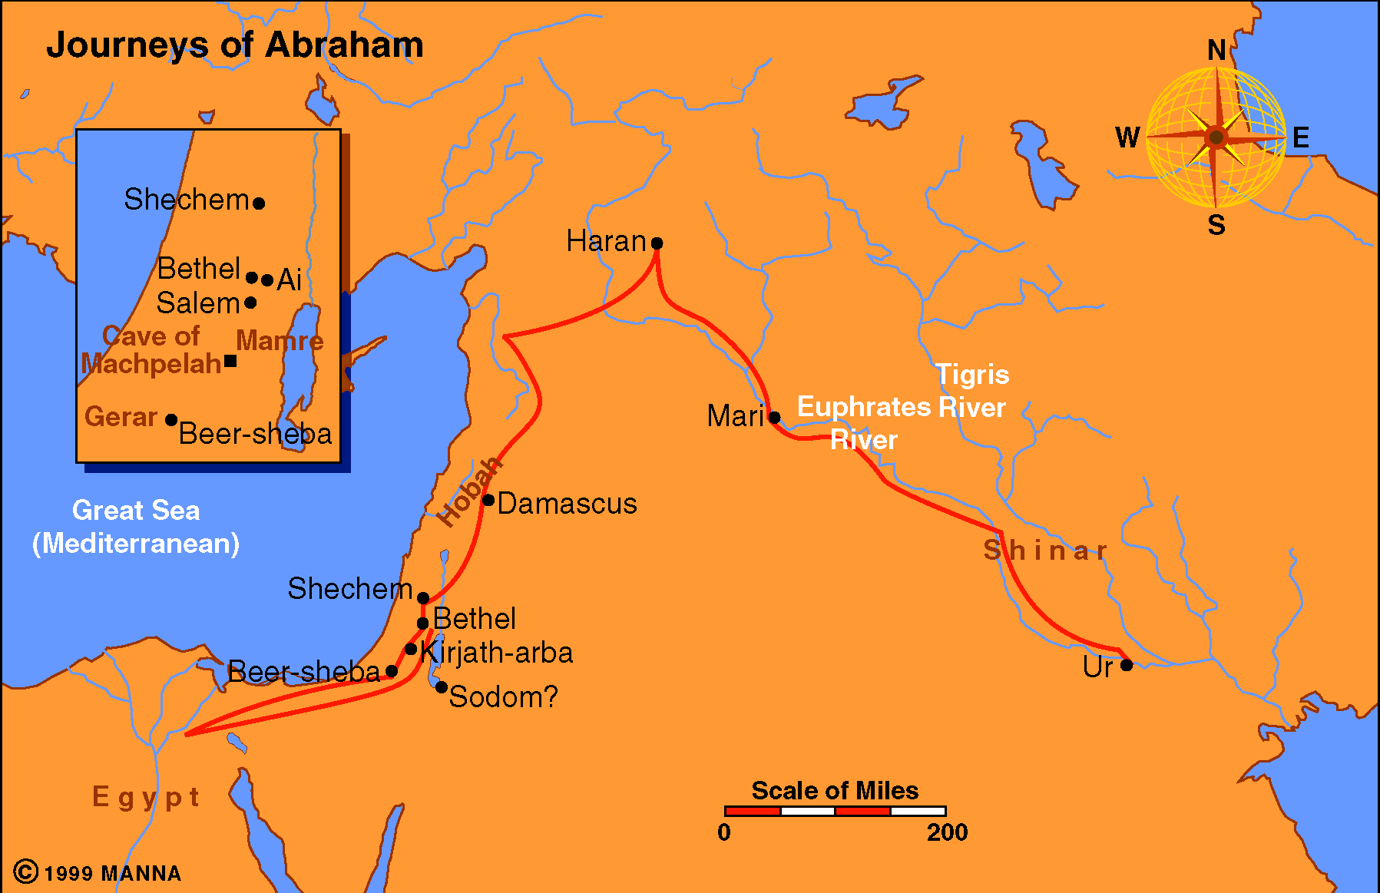
Abraham Journey

Slide 7
Cheerfully Obeys (vv. 2-4)
God told Abram to leave his home and family
  Didn’t know where he was going (Heb. 11:8)
  Reason he left is God’s direction (Gen. 15:7; Neh. 9:7)
  He obeyed promptly and willingly
  That took a living faith to do that
Believers today must comply cheerfully
  Times told to do what is hard, challenging
  Like Matthew – immediately go (Matt. 9:9)
  Do so no matter what we are required to do
  No matter what the cost
  Obey instantly and cheerfully

Slide 8
Acts 7
Cheerfully Obeys (vv. 2-4)
Trust When Can’t See (v. 5)

Slide 9
5 And God gave him no inheritance in it, not even enough to set his foot on. But even when Abraham had no child, He promised to give it to him for a possession, and to his descendants after him.

Slide 10
Trust When Can’t See (v. 5)
Abraham trusted God’s promise of a land for his descendants
  Promise for a land – that he never inherited (Heb. 11:9)
  It was for his descendants
    But at time – had no children
    He was old
  Before promise fulfilled – told to offer up Isaac (Heb. 11:17)
  When the darkness was so thick – couldn’t see – Abraham trusted God!

Slide 11
Trust When Can’t See (v. 5)
Abraham trusted God’s promise of a land for his descendants
Living faith shows itself when we can’t see
  Doesn’t require much faith to trust when all is bright and hopeful
  Faith is when don’t see and yet believe (John 20:29)
  We walk by faith – not by sight (2 Cor. 5:7)
  Will face times that will call for a living faith
    When God says his way is for our good (Deut. 6:24)
    When God says I will provide (Matt. 6:24-33)
    When God says cast your care on me (1 Pet. 5:7)
    When God’s way doesn’t seem right (Prov. 14:12)

Slide 12
Acts 7
Cheerfully Obeys (vv. 2-4)
Trust When Can’t See (v. 5)
Confidence in the Future (vv. 6-7)

Slide 13
6 But God spoke in this way: that his descendants would dwell in a foreign land, and that they would bring them into bondage and oppress them four hundred years.
7 “And the nation to whom they will be in bondage I will judge,” said God, “and after that they shall come out and serve Me in this place.”

Slide 14
Confidence in the Future (vv. 6-7)
God told Abraham the promise would be delayed 400 yrs
  Actually 430 (Exo. 12:40-41; Gal. 3:17); Number rounded
  That’s a long time to wait
  Yet, Abraham trusted in God because he promised…

Slide 15
Confidence in the Future (vv. 6-7)
God told Abraham the promise would be delayed 400 yrs
We must patiently wait – having confidence in the future
  When we pray – God hears and answers (1 Pet. 3:12)
  When promised the second coming (2 Pet. 3:4)
  When he promised a home in heaven (1 John 2:25)
  That the child will turn our like we train them (Prov. 22:6)

Slide 16
Acts 7
Cheerfully Obeys (vv. 2-4)
Trust When Can’t See (v. 5)
Confidence in the Future (vv. 6-7)
Believes in God’s Providence (vv. 9-16)

Slide 17
9 “And the patriarchs, becoming envious, sold Joseph into Egypt. But God was with him
10 and delivered him out of all his troubles, and gave him favor and wisdom in the presence of Pharaoh, king of Egypt; and he made him governor over Egypt and all his house.
11 Now a famine and great trouble came over all the land of Egypt and Canaan, and our fathers found no sustenance.
12 But when Jacob heard that there was grain in Egypt, he sent out our fathers first.

Slide 18
13 And the second time Joseph was made known to his brothers, and Joseph's family became known to the Pharaoh.
14 Then Joseph sent and called his father Jacob and all his relatives to him, seventy-five people.
15 So Jacob went down to Egypt; and he died, he and our fathers.
16 And they were carried back to Shechem and laid in the tomb that Abraham bought for a sum of money from the sons of Hamor, the father of Shechem.

Slide 19
Believes in God’s Providence (vv. 9-16)
Joseph believed in the providence of God
  Was mistreated: sold into strange land (v. 9a)
  Understood – God used it for good (vv. 9b-10; Gen. 50:20)
  Used this and the famine to bring his people to Egypt to preserve a nation (vv. 11-15)

Slide 20
Believes in God’s Providence (vv. 9-16)
Joseph believed in the providence of God
A living faith believes God’s providence is working today
  What is providence?

Slide 21
Providence
“The working of God through His provision in the natural and spiritual realms, and yet it is a control that violates neither the sovereignty of the human will nor the divine natural and spiritual laws.” (H. Hailey)
“Providence” (Acts 24:2) comes from pronoia which means “forethought” (Vines). – God used forethought in creating a universe that he could control and use for his purpose.
See the word “provide” in “providence”
Providence is the non-miraculous use of natural law and circumstance to accomplish his purpose.

Slide 22
Providence
“It is the divine intervention in the affairs of men within the confines of natural law” (Winston Atkinson, Anchor Magazine)
Simply stated: God working through natural means

Slide 23
Believes in God’s Providence (vv. 9-16)
Joseph believed in the providence of God
A living faith believes God’s providence is working today
  What is providence?
  God works in his universe today
    Still rules in the kingdoms of men (Dan. 4:25)
    Preserves the world he made (Neh. 9:6-8)
    “for thy pleasure they are and were created” (Rev. 4:11)
  We don’t have to know HOW or all about specific cases – just the fact that he does…

Slide 24
Acts 7
Cheerfully Obeys (vv. 2-4)
Trust When Can’t See (v. 5)
Confidence in the Future (vv. 6-7)
Believes in God’s Providence (vv. 9-16)
Proper Sense of Values (vv. 22-29)

Slide 25
22 And Moses was learned in all the wisdom of the Egyptians, and was mighty in words and deeds.
23 Now when he was forty years old, it came into his heart to visit his brethren, the children of Israel.
24 And seeing one of them suffer wrong, he defended and avenged him who was oppressed, and struck down the Egyptian.
25 For he supposed that his brethren would have understood that God would deliver them by his hand, but they did not understand.
26 And the next day he appeared to two of them as they were fighting, and tried to reconcile them, saying, 'Men, you are brethren; why do you wrong one another?'

Slide 26
27 "But he who did his neighbor wrong pushed him away, saying, 'Who made you a ruler and a judge over us?
28'Do you want to kill me as you did the Egyptian yesterday?'
29 Then, at this saying, Moses fled and became a dweller in the land of Midian, where he had two sons.

Slide 27
Proper Sense of Values (vv. 22-29)
Moses chose the spiritual over the material
  Had all that Egypt had to offer open to him (v. 22)
  Understood something greater than all the riches of Egypt (Heb. 11:26)
  Because of choosing to be with God’s people:
    Spent the next 40 years (age 40-80) in Midian
    Spent the next 40 years (age 80-120) in the wilderness

Slide 28
Proper Sense of Values (vv. 22-29)
Moses chose the spiritual over the material
Our sense of values
  Spiritual riches are the real riches (1 Tim. 6:6; Phil. 1:19-26)
  Priorities straight (Matt. 6:33)
“The Main thing is to keep the main thing –
the main thing.”

Slide 29
Proper Sense of Values (vv. 22-29)
Moses chose the spiritual over the material
Our sense of values
  Spiritual riches are the real riches (1 Tim. 6:6; Phil. 1:19-26)
  Priorities straight (Matt. 6:33)
  Keep your eye on the goal (Heb. 13:14; Col. 3:2)

Slide 30
Acts 7
Cheerfully Obeys (vv. 2-4)
Trust When Can’t See (v. 5)
Confidence in the Future (vv. 6-7)
Believes in God’s Providence (vv. 9-16)
Proper Sense of Values (vv. 22-29)
Answers the Call of Duty (vv. 30-36)

Slide 31
30 And when forty years had passed, an Angel of the Lord appeared to him in a flame of fire in a bush, in the wilderness of Mount Sinai.
31 When Moses saw it, he marveled at the sight; and as he drew near to observe, the voice of the Lord came to him,
32 saying, 'I am the God of your fathers--the God of Abraham, the God of Isaac, and the God of Jacob.' And Moses trembled and dared not look.
33'Then the LORD said to him, "Take your sandals off your feet, for the place where you stand is holy ground.

Slide 32
34 "I have surely seen the oppression of my people who are in Egypt; I have heard their groaning and have come down to deliver them. And now come, I will send you to Egypt." '
35 This Moses whom they rejected, saying, 'Who made you a ruler and a judge?' is the one God sent to be a ruler and a deliverer by the hand of the Angel who appeared to him in the bush.
36 He brought them out, after he had shown wonders and signs in the land of Egypt, and in the Red Sea, and in the wilderness forty years.

Slide 33
Answers the Call of Duty (vv. 30-36)
God called Moes to deliver his people
  Reluctant at first (Exo. 3:13; 4:1, 10)
  However, chosen by God (v. 35)
  Answered the call and did the job (v. 36)

Slide 34
Answers the Call of Duty (vv. 30-36)
God called Moes to deliver his people
God is calling for duty today
  To follow him (2 Thess. 2:14; Mark 8:34)
  To be an example (1 Tim. 4:12)
  To be an exception (Phil. 2:19-21)
  To teach others (Tit. 2:3-4)
  To be spiritual leader in the family (Eph. 6:1-4)

Slide 35
Acts 7
Cheerfully Obeys (vv. 2-4)
Trust When Can’t See (v. 5)
Confidence in the Future (vv. 6-7)
Believes in God’s Providence (vv. 9-16)
Proper Sense of Values (vv. 22-29)
Answers the Call of Duty (vv. 30-36)
Always looks up (vv. 54-60)

Slide 36
54 When they heard these things they were cut to the heart, and they gnashed at him with their teeth.
55 But he, being full of the Holy Spirit, gazed into heaven and saw the glory of God, and Jesus standing at the right hand of God,
56 and said, "Look! I see the heavens opened and the Son of Man standing at the right hand of God!"
57 Then they cried out with a loud voice, stopped their ears, and ran at him with one accord;
58 and they cast him out of the city and stoned him. And the witnesses laid down their clothes at the feet of a young man named Saul

Slide 37
59 And they stoned Stephen as he was calling on God and saying, "Lord Jesus, receive my spirit."
60 Then he knelt down and cried out with a loud voice, "Lord, do not charge them with this sin." And when he had said this, he fell asleep.

Slide 38
Always looks up (vv. 54-60)
Stephen in midst of a crisis – had his mind focused above
  Proclaimed Christ (v. 37, 52)
  Saw a vision of Christ at right hand of God (vv. 55-56)
  As being stoned – cries out to the Lord (v. 59)
  As dying – ask the Lord to forgive them (v. 60)

Slide 39
Always looks up (vv. 54-60)
Stephen in midst of a crisis – had his mind focused above
Always our affections on things above (Col. 3:2)
  Look to spiritual over the material (Matt. 6:33)
  Look to inward over the outward (1 Pet. 3:3-4)
  Look to God over man (Acts 5:29)
  Look to eternal over the temporal (2 Cor. 4:17)

Slide 40
Acts 7
Cheerfully Obeys (vv. 2-4)
Trust When Can’t See (v. 5)
Confidence in the Future (vv. 6-7)
Believes in God’s Providence (vv. 9-16)
Proper Sense of Values (vv. 22-29)
Answers the Call of Duty (vv. 30-36)
Always looks up (vv. 54-60)

