Slide 1
Acts 3
Healing of the Lame Man And a Sermon on Christ
Healing of the Lame Man (vv. 1-11)
Peter’s Sermon about Jesus (vv. 12-26)

Slide 2
Acts 3
Healing of the Lame Man And a Sermon on Christ
Healing of the Lame Man (vv. 1-11)
  The lame man expected money from Peter and John (vv. 1-5)
  Peter heals the lame man (vv. 6-8)
  The people who saw were amazed (vv. 9-11)

Slide 3
Acts 3
Healing of the Lame Man And a Sermon on Christ
Healing of the Lame Man (vv. 1-11)
Peter’s Sermon about Jesus (vv. 12-26)
  Jesus: The suffering servant (vv. 12-21)
    This miracle was not by his own power (v. 12)
    You killed God’s servant (vv. 1-15a, 17-18)
      You denied the Holy One and released a murderer (vv. 13-14)
      You killed the prince of life (v. 15)
      Through your ignorance (v. 17)
      Foretold by the prophets that he must suffer (v. 18)
    God raised him up (v. 15b)
    Through Christ – this lame man is healed (v. 16)
    Therefore, repent and be converted (vv. 19-21)

Slide 4
Acts 3
Healing of the Lame Man And a Sermon on Christ
Healing of the Lame Man (vv. 1-11)
Peter’s Sermon about Jesus (vv. 12-26)
  Jesus: The suffering servant (vv. 12-21)
  Jesus: The prophet of prophecy (vv. 22-24)
    Moses [Deut 18:15, 18, 19] (vv. 22-23)
      God would raise up a prophet like him
      If don’t hear him – you will be destroyed (v. 24)
    Samuel and others

Slide 5
Acts 3
Healing of the Lame Man And a Sermon on Christ
Healing of the Lame Man (vv. 1-11)
Peter’s Sermon about Jesus (vv. 12-26)
  Jesus: The suffering servant (vv. 12-21)
  Jesus: The prophet of prophecy (vv. 22-24)
  Jesus: The seed of Abraham (vv. 25-26)
    The promise to Abraham (v. 25)
    God raised up Christ to bless you in turning you away from sin (v. 26)

Slide 6
Lessons From Healing of Lame Man
Acts 3

Slide 7

Some Things Worth More Than Silver & Gold (v. 6)

Slide 8
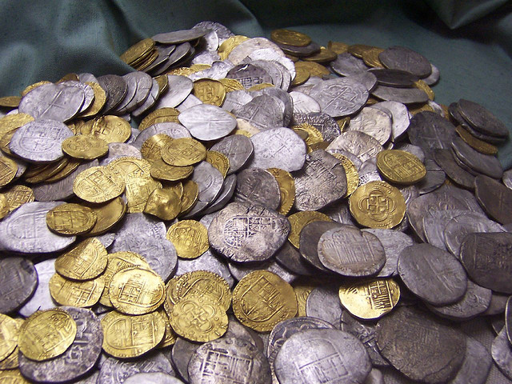
I.
Soul (Matt. 16:26)
Forgiveness (Heb. 8:12)
Hope of heaven (Titus 1:2; 3:7)
Word & knowledge of it (Psa. 19:10; 119:72)
Wisdom (Prov. 8:19; Col. 1:9)
Good name (Prov. 22:1)
Time & attention to children (Prov. 22:6)
Some Things Worth More Than Silver & Gold (v. 6)

Slide 9
Some Things Worth More Than Silver & Gold (v. 6)
Nature of Real Miracles (vv. 7, 9, 16)

Slide 10
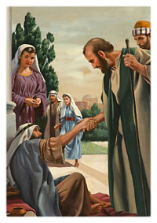
II.
Immediate (v. 7)
Complete (v. 16)
Evident (vv. 9. 16)
Faith of performer (v. 16)
  Lame man – had no basis for faith
  Faith was required for performer not the recipient (Matt. 17:14-21)
Nature of Real Miracles (vv. 7, 9, 16)

Slide 11
Some Things Worth More Than Silver & Gold (v. 6)
Nature of Real Miracles (vv. 7, 9, 16)
Being Channels of Power (vv. 12, 16)

Slide 12

III.
Apostles were not the source of power – but mere channels (vv. 12, 16)
Being Channels of Power (vv. 12, 16)

Slide 13
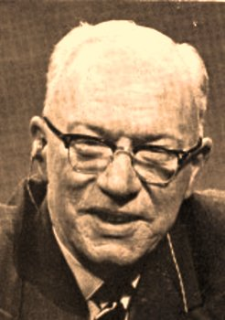
William Barclay
“They never regarded themselves as the sources of power but only as channels of power. They were well aware of the limitations of what they could do. They were also well aware that there was no limitations to what the Risen Christ could do through them and with them. Therein lies the secret of the Christian life.
The Christian knows that so long as he thinks of what I can do and what I can be, there will be nothing but failure and frustration and fear; but when he thinks of ‘not I, but Christ in me’ there can be nothing but peace and power.”
Acts of the Apostles, 30-31

Slide 14
III.
Apostles were not the source of power – but mere channels (vv. 12, 16)
We too are mere channels
  For the gospel (1 Cor. 3:5)
  For understanding (Neh. 8:7-8)
  For sorrow / repentance (2 Cor. 2:2)
  For wisdom (2 Cor. 10:12; Prov. 24:6)
  For encouragement (1 Thess. 4:18; Acts 15:31)
  For joy (Rom. 12:15)
Being Channels of Power (vv. 12, 16)

Slide 15
Some Things Worth More Than Silver & Gold (v. 6)
Nature of Real Miracles (vv. 7, 9, 16)
Being Channels of Power (vv. 12, 16)
Ignorance Does Not Remove Responsibility (v. 17)

Slide 16

IV.
Of what were they ignorant?
  Of who Jesus was – Son of God (Luke 23:34)
  That he was the one OT foretold (Acts 3:12-26)
Ignorance Does Not Remove Responsibility (v. 17)

Slide 17
IV.
Of what were they ignorant?
Should not have been ignorant
  Ample evidence (Acts 2:22)
  Even Gentiles without excuse (Rom. 1:20)
  It is our responsibility to read & know (2 Pet. 3:18)
Ignorance Does Not Remove Responsibility (v. 17)

Slide 18
IV.
Of what were they ignorant?
Should not have been ignorant
Sins of ignorance are still sin (1 Tim. 1:13)
  Violation of law (done ignorantly) still sin (1 Jno. 3:4)
  Commands don’t obey (in ignorance) still sin
  May involve:
    Worldliness: (drink, dance, dress)
    Marriage: (adultery)
    Worship: (instrum. music)
    Church: (denomination)
Ignorance Does Not Remove Responsibility (v. 17)

Slide 19
IV.
Of what were they ignorant?
Should not have been ignorant
Sins of ignorance are still sin (1 Tim. 1:13)
If in ignorance – means when learn will change (1 Tim. 1:13)
Ignorance Does Not Remove Responsibility (v. 17)

Slide 20
Some Things Worth More Than Silver & Gold (v. 6)
Nature of Real Miracles (vv. 7, 9, 16)
Being Channels of Power (vv. 12, 16)
Ignorance Does Not Remove Responsibility (v. 17)
Who Jesus Is & What That Means (vv. 12-26)

Slide 21

V.
Peter’s Sermon about Jesus (vv. 12-26)
  Jesus: The suffering servant (vv. 12-21)
  Jesus: The prophet of prophecy (vv. 22-24)
  Jesus: The seed of Abraham (vv. 25-26)
Who Jesus Is & What That Means (vv. 12-26)

Slide 22
V.
Peter’s Sermon about Jesus (vv. 12-26)
Means:
  Power (v.12, 16)
  Repent & be converted (v. 19)
  Hear him in all things (v. 22)
  Refreshing from the Lord (v. 19)
  Can be forgiven of all iniquities (v. 26)
Who Jesus Is & What That Means (vv. 12-26)

Slide 23
Some Things Worth More Than Silver & Gold (v. 6)
Nature of Real Miracles (vv. 7, 9, 16)
Being Channels of Power (vv. 12, 16)
Ignorance Does Not Remove Responsibility (v. 17)
Who Jesus Is & What That Means (vv. 12-26)

