Slide 1
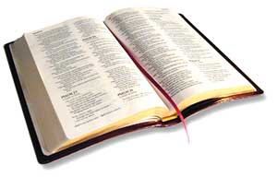
Woman: “‘He that believeth and his baptized shall be saved’ is not in my Bible.’”
Preacher: “Yes it is. In Mark 16:16”
Woman: “No, its not in my Bible.”
Preacher: “Let me have your Bible and I will show you.”
He opened it to find – she had cut it out!
Notes:
Think of the gall – arrogance takes to do such a thing

Slide 2
Preacher in Texas
Began a class by reading a text
Without comment, explanation or application
Matt 19:9
And I say unto you, Whosoever shall put away his wife, except it be for fornication, and shall marry another, committeth adultery: and whoso marrieth her which is put away doth commit adultery.
“That don’t seem like a very good law to me!”
Notes:
Just as bad as woman cutting verse out! – both are judging the law of God!

Slide 3
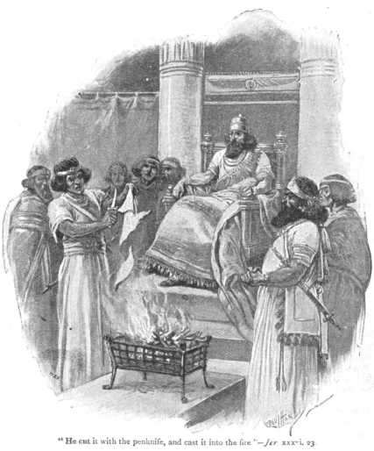
Jehoiakim
Took a penknife and cut the scroll
and burned it in the fire
(Jer. 36:23)
Notes:
Not a new problem
Bold move – not bothered at all – but hardened (v. 24)

Slide 4

A Spoof – Circulated on the Internet
Illustrates How People Approach the Bible

Slide 5

Would You Like to Sit On a Committee / Panel
That Passes Judgment on the Bible?
To Determine What is Good and What is Not?
James gives such a warning
James 4:11-12

Slide 6
James 4:11-12
11 Do not speak evil of one another, brethren. He who speaks evil of a brother and judges his brother, speaks evil of the law and judges the law. But if you judge the law, you are not a doer of the law but a judge.
12 There is one Lawgiver, who is able to save and to destroy. Who are you to judge another?

Slide 7
James 4:11-12
11 Do not speak evil of one another, brethren. He who speaks evil of a brother and judges his brother, speaks evil of the law and judges the law. But if you judge the law, you are not a doer of the law but a judge.
12 There is one Lawgiver, who is able to save and to destroy. Who are you to judge another?

Slide 8
James 4:11-12
Context
11 Do not speak evil of one another, brethren. He who speaks evil of a brother and judges his brother, speaks evil of the law and judges the law. But if you judge the law, you are not a doer of the law but a judge.
12 There is one Lawgiver, who is able to save and to destroy. Who are you to judge another?
Subject: Speaking evil of brother
The law (1:25; 2:8) forbade that
To violate the law:
  Speak evil of the law
  Judge the law
  Not a doer of law (v. 11)
  Sitting in the place of God (v. 12)

Slide 9
Judge of the Law
Assume the office of judging the propriety and fitness of the law
Takes a role of superiority over the law
“To exercise the office of a censor is to play the part of a judge” (Woods).
Usurps God’s position as lawgiver
Saying the word is not a perfect rule
Consider the law unworthy to be kept
Deems the law improper, unimportant, and unjust
Says the law is “a bad one, or at best defective; and may, therefore, be disregarded” (Woods)
“He has sat in judgment on the law, and has made his own will more binding than the law” (Barclay)

Slide 10
James 4:11
Don't criticize and speak evil about each other, dear brothers. If you do, you will be fighting against God's law of loving one another, declaring it is wrong. But your job is not to decide whether this law is right or wrong, but to obey it.
The Living Bible

Slide 11
11 Don't speak evil against each other, dear brothers and sisters.* If you criticize and judge each other, then you are criticizing and judging God's law. But your job is to obey the law, not to judge whether it applies to you.
12 God alone, who gave the law, is the Judge. He alone has the power to save or to destroy. So what right do you have to judge your neighbor? –
The New Living Translation

Slide 12
Serious Matter
To Judge the law is to judge God who gave the law
God
“To seek to judge his laws means that we think we are wiser than he. To seek to replace his laws would mean that we consider ourselves to be greater than God. This is the basis of sin and idolatry”
(Clayton K. Harrop, 119)

Slide 13
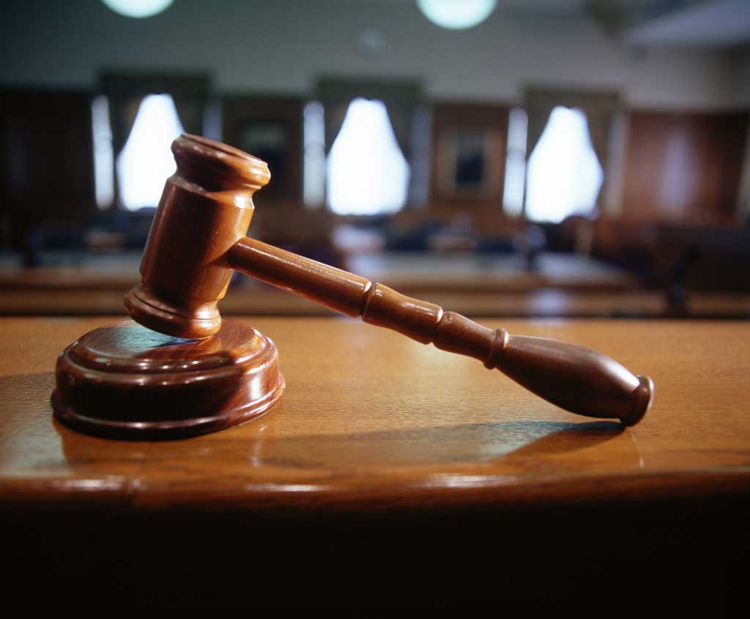
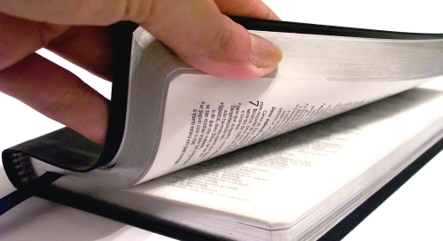
Judges
of the Law
James 4:11-12

Slide 14
Judges
of the Law
Why We Cannot Be Judges of the Law

Slide 15
Why We Cannot Be Judges of the Law
There is one lawgiver (Jas. 4:11-12)
Law is given by inspiration (1 Cor. 2:9-13)
God is infinite in wisdom (Isa. 55:8-9; Rom. 11:34)
We are forbidden to change it at all (Deut. 4:2; Rev. 22:18-19)
We are to be doers of the law (Jas. 4:11-12)
The law of God is complete and perfect (2 Pet. 1:3; Jas. 1:25)

Slide 16
Judges
of the Law
Why We Cannot Be Judges of the Law
How We Become Judges of the Law

Slide 17
How We Become Judges of the Law
Think it will not work
  Analyze God’s law – conclude: it just won’t work
  Examples:
    Moses (Exo. 3:10, 13; 4:1, 10)
    Spies (Num. 13:31-33)
    Habakkuk (Hab. 1:2, 6, 12-13)
    Greeks (1 Cor. 1:18, 21, 23)

Slide 18
How We Become Judges of the Law
Think it will not work
  Analyze God’s law – conclude: it just won’t work
  Examples:
  To human thinking – God’s way looks like not work
    Dipping 7 times in Jordan (2 Kings 5:10-14)
    Looking at a serpent on pole (Num. 21:4-9)
    Marching around city (Josh. 6:1-7)
    Putting clay on eyes (John 9:6-7)

Slide 19
How We Become Judges of the Law
Think it will not work
  Analyze God’s law – conclude: it just won’t work
  Examples:
  To human thinking – God’s way looks like not work
  Way that seems right – but is not (Prov. 16:25)
  Must learn to trust (Prov. 3:5-6)

Slide 20
How We Become Judges of the Law
Think it will not work
Think it is unfair
  “Not fair for God to ask me to….”
  Jews thought God was not fair (Rom. 9:14-24; 11:34)
  Human reasoning says God is unfair
    Required Abraham to sac. his son (Gen. 22)
    Held back all of Israel because of Achan (Josh. 7)
    Demanded the break up of families (Ezra 10:10-11, 44)

Slide 21
How We Become Judges of the Law
Think it will not work
Think it is unfair
Think it is too hard
  Reason: “Just can’t do it.”
  Examples:
    Rich young ruler – too much to give up money (Matt. 19:16-ff)
    Disciples – too much to forgive 7 times in day (Luke 17:4-5)
  God’s law is not too hard
    Not burdensome (1 John 5:3)
    Easy / within reach (Matt. 11:28-30; Rom. 10:8-10)

Slide 22
How We Become Judges of the Law
Think it will not work
Think it is unfair
Think it is too hard
Think it is unnecessary
  Parse law out into categories: (important / unimportant)
  Examples:
    Fails to pray (Jas. 4:2)
    Didn’t dwell in booths (Neh. 8:13-18)
    Didn’t circumcise (Joshua 5)
  How does one determine what is important and what is not?

Slide 23
How We Become Judges of the Law
Think it will not work
Think it is unfair
Think it is too hard
Think it is unnecessary
Think it is out of date
  Applies only to time period – addresses culture….
  Word of God is never out of date
    Psa. 111:8 – “never out of date, never obsolete” (MSG)
    1 Pet. 1:25 – endures forever
Notes:
The Message Translation
“precepts” (v. 7) – “They stand fast forever and ever…” (NKJV)

Slide 24
How We Become Judges of the Law
Think it will not work
Think it is unfair
Think it is too hard
Think it is unnecessary
Think it is out of date
Think we can disregard or ignore
  Admit & know what text says – just ignore it
  Examples:
    Judges 17:6; 21:25 – lived like they wanted
    Jas 4:11-12 – ignore the law about love

Slide 25
How We Become Judges of the Law
Think it will not work
Think it is unfair
Think it is too hard
Think it is unnecessary
Think it is out of date
Think we can disregard or ignore
Notes:
We wouldn’t think about: cutting verses out / saying “not a very good…” / sitting on a committee

Slide 26
Judges
of the Law
Why We Cannot Be Judges of the Law
How We Become Judges of the Law
The Laws We Judge

Slide 27
The Laws We Judge
Baptism
  The Law: Mark 16:16
  Judge: Can’t be for that would mean those not baptized would be lost

Slide 28
The Laws We Judge
Baptism
Speaking evil of a brother
  The Law: Jas. 4:11-12; 2:8
  Judge: Doesn’t apply to me / not a big deal to speak evil

Slide 29
The Laws We Judge
Baptism
Speaking evil of a brother
Regular /consistent worship
  The Law: Heb. 10:25
  Judge: Not necessary / too much to do

Slide 30
The Laws We Judge
Baptism
Speaking evil of a brother
Regular /consistent worship
Daily spiritual exercise
  The Law:
    Pray (1 Thess. 5:17; Psa. 55; Dan. 6:10)
    Bible reading / study (Acts 17:11; 1 Pet. 2:2)
  Judge: Don’t see it necessary / just ignore it

Slide 31
The Laws We Judge
Baptism
Speaking evil of a brother
Regular /consistent worship
Daily spiritual exercise
Divorce and remarriage
  The Law: Matt. 19:9
  Judge:
    Not fair
    Doesn’t make sense
    Means happy families – must break up
    If true, one of my relatives is in adultery – can’t accept it

Slide 32
The Laws We Judge
Baptism
Speaking evil of a brother
Regular /consistent worship
Daily spiritual exercise
Divorce and remarriage
Role of women
  The Law: 1 Tim. 2:11-12; Eph. 5:22-ff
  Judge: Outdated / belittles women / make men superior

Slide 33
The Laws We Judge
Baptism
Speaking evil of a brother
Regular /consistent worship
Daily spiritual exercise
Divorce and remarriage
Role of women
Modesty
  The Law: 1 Tim. 9-10
  Judge: silly / hard to determine what is short or tight

Slide 34
The Laws We Judge
Baptism
Speaking evil of a brother
Regular /consistent worship
Daily spiritual exercise
Divorce and remarriage
Role of women
Modesty
Obeying civil law
  The Law: Rom. 13:1-7
  Judge: don’t have to / man’s laws are not important

Slide 35
The Laws We Judge
Baptism
Speaking evil of a brother
Regular /consistent worship
Daily spiritual exercise
Divorce and remarriage
Role of women
Modesty
Obeying civil law
Withdrawing from disorderly
  The Law: 1 Cor. 5:1-13; 2 Thess. 3:6-15
  Judge: Won’t work / there a better way / too hard
Notes:
Could add more:
Don’t retaliate (Rom. 12:17-21)
Forgive (Eph; 4:32) – Judge: can’t / too hard

Slide 36
Judges
of the Law
Why We Cannot Be Judges of the Law
How We Become Judges of the Law
The Laws We Judge

