Slide 2
Jonah – the Man
  Lived in Galilean city of Gath-hepher (north of Nazareth)

Slide 3
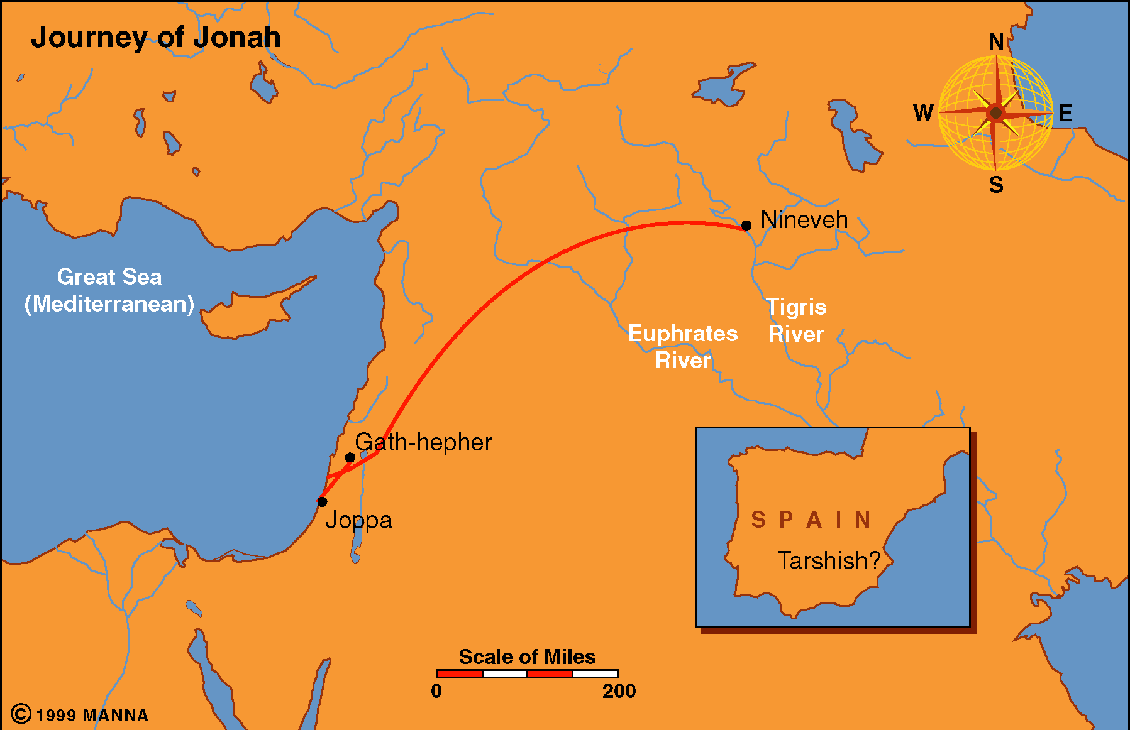

Slide 4
Jonah – the Man
  Lived in Galilean city of Gath-hepher (north of Nazareth)
  During the time of Jeroboam, II [793-753 BC] (2 Kings 14:25)

Slide 5
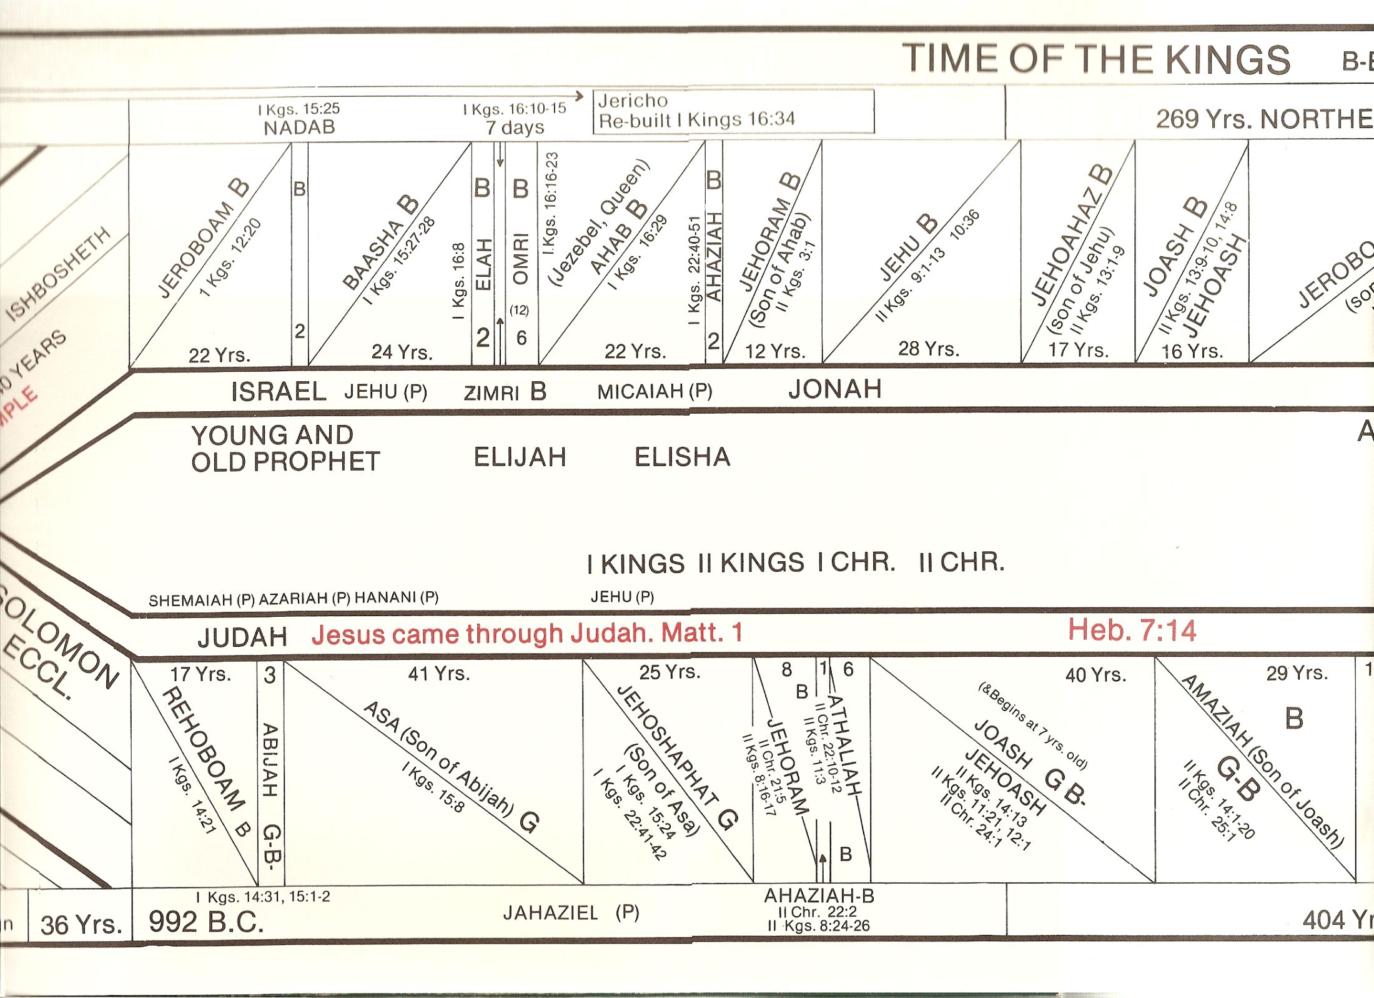

Slide 6
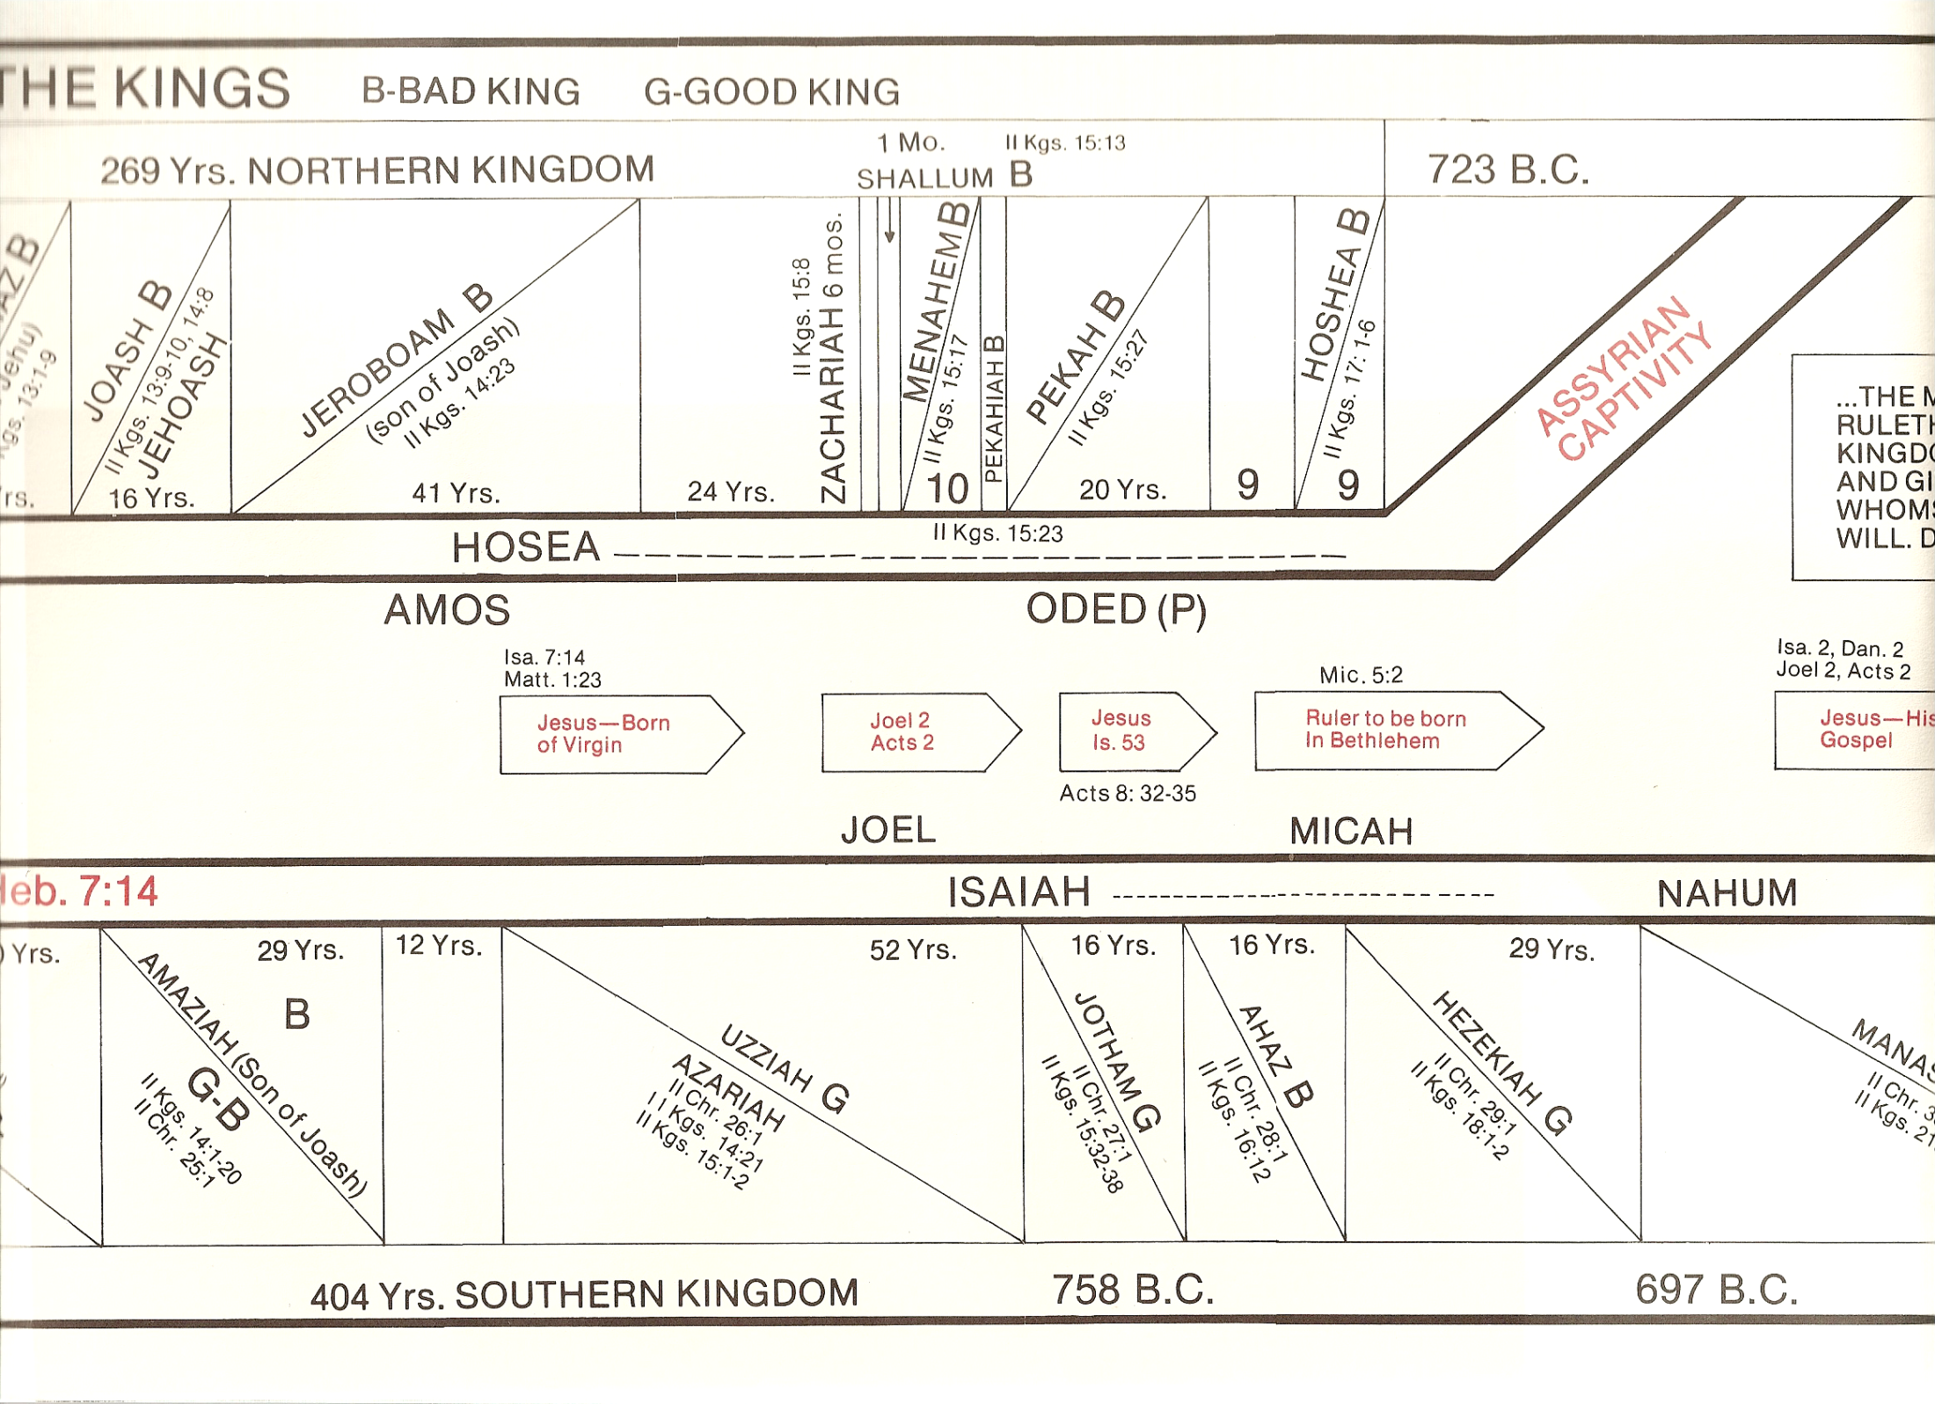
JONAH

Slide 7
Jonah – the Man
  Lived in Galilean city of Gath-hepher (north of Nazareth)
  During the time of Jeroboam, II [793-753 BC] (2 Kings 14:25)
  Had an attitude problem:
    Toward his enemy (Assyria) – didn’t want them to repent and be blessed
    Toward God – didn’t think God was doing right thing

Slide 8
Jonah – the Man
Date of Book
  During the time of Jeroboam, II [793-753 BC] (2 Kings 14:25)
  During the latter years of Amaziah [Judah] (2 Kings 14:23-27)
  This would be toward the beginning of Jeroboam’s reign (790 – 780) BC
  Hailey: 780 BC

Slide 9
Jonah – the Man
Date of Book
Prophet to the North
  Classify prophet by kingdom and before or after exile

Slide 10
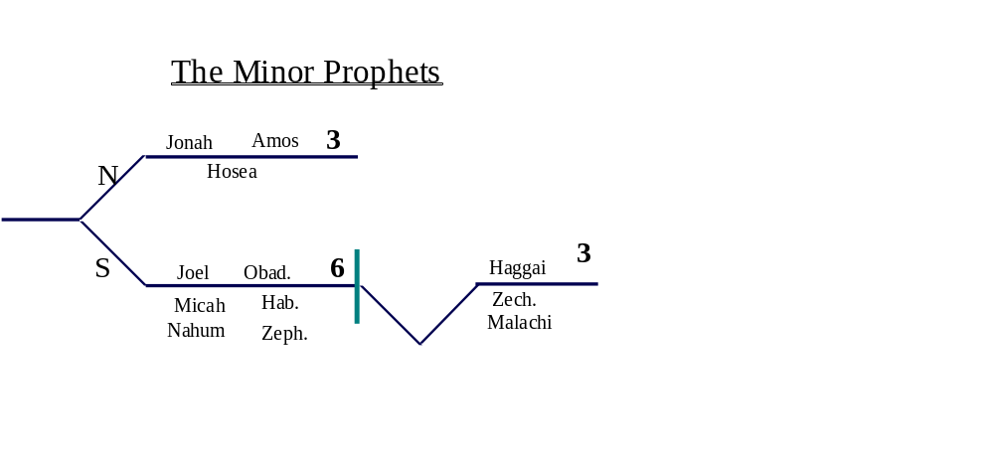

Slide 11
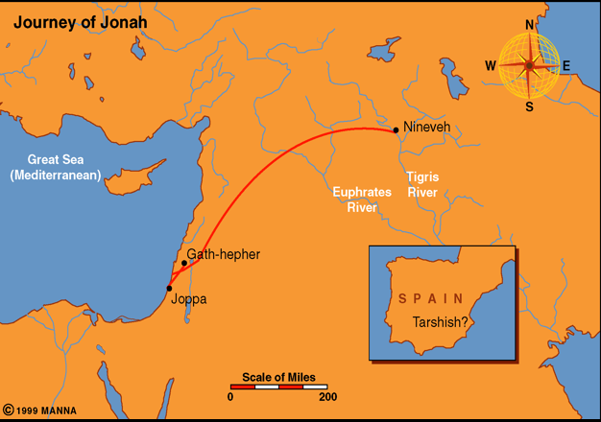
Jonah – the Man
Date of Book
Prophet to the North
  Classify prophet by kingdom and before or after exile
  Prophet to Ninivah (capital of Assyria)

Slide 12
Jonah – the Man
Date of Book
Prophet to the North
Setting / Background
  Under Jeroboam Israel was reviving strength
    Captured Hamath, Damascus, and all territory from Hamath to Dead Sea – as Jonah and prophesied (2 Kings 14:23-27)
    Israel – has bright future – on the incline/ rise
  Assyria is on the decline
  Yet Assyria is still a threat and thorn to enemies (including Israel)

Slide 13
Jonah – the Man
Date of Book
Prophet to the North
Setting / Background
Nature of the Book
  The book is largely about the prophet – instead of a collection of oracles (only 1 line of prophecy 3:4)
  Unique:
    The only later prophet cast in narrative form
    The only minor prophet in whose career the miraculous plays an prominent role
    The only minor prophet who major activity is on foreign soil
    The only OT character represented as taking a trip on the Mediterranean
    The only minor prophet mentioned by Jesus

Slide 14
Jonah – the Man
Date of Book
Prophet to the North
Setting / Background
Nature of the Book
Message of the Book
  “First apostle to the Gentiles” (Dean Stanley)
  A warning to Nineveh (3:4)
    Only 8 words (5 in Hebrew)
    A message of doom – plea for repentance
    Shows that God is a universal God

Slide 15
Jonah – the Man
Date of Book
Prophet to the North
Setting / Background
Nature of the Book
Message of the Book
Methods of Interpretation
  Mythical (Fiction)
  Allegorical (Jonah = Israel; Fish = Captivity)
  Historical: True story
    Jonah was a real man (2 Kings 14:25)
    Jesus endorsed the story (Matt. 12:39-41)
    Those who deny it – deny the miraculous

Slide 16
Jonah – the Man
Date of Book
Prophet to the North
Setting / Background
Nature of the Book
Message of the Book
Methods of Interpretation
Use in the New Testament
  Matt. 12:38-21; 16:4; Luke 11:29-32
  Taught about his resurrection
  Taught about repentance

Slide 17
The Book
Running From God - His Resignation (1)
Running To God - His Repentance (2)
Running With God - His Revival (3)
Running Ahead Of God - His Rebellion (4)

Slide 18
The Book
Running From God - His Resignation (1)

Slide 19
Running From God - His Resignation (1)
  Commissioned (vv. 1-2)
  Fled (v. 3)

Slide 20
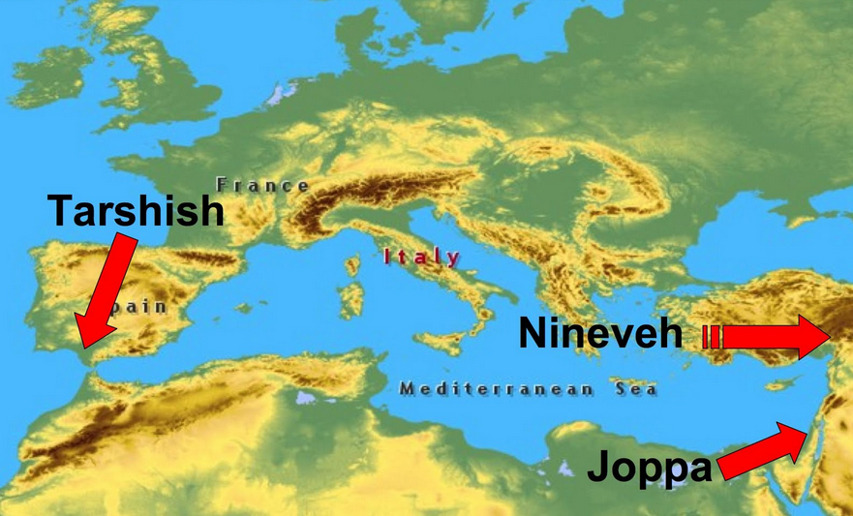

Slide 21
Running From God - His Resignation (1)
  Commissioned (vv. 1-2)
  Fled (v. 3)
  The storm (vv. 4-16)
  The whale (v. 17)

Slide 22
The Book
Running From God - His Resignation (1)
Running To God - His Repentance (2)

Slide 23
Running To God - His Repentance (2)
  Repentance & prayer (vv. 1-9)
    My cry heard (v. 2)
    My affliction (vv. 3-6)
    Result - turn to you (vv. 4, 7-9)
  Whale vomited Jonah up (v. 10)

Slide 24
The Book
Running From God - His Resignation (1)
Running To God - His Repentance (2)
Running With God - His Revival (3)

Slide 25
Running With God - His Revival (3)
  Jonah preached in Nineveh (vv. 1-4)
  Nineveh repents (vv. 5-9)
  God turns away his wrath (v. 10)

Slide 26
The Book
Running From God - His Resignation (1)
Running To God - His Repentance (2)
Running With God - His Revival (3)
Running Ahead Of God - His Rebellion (4)

Slide 27
Running Ahead Of God - His Rebellion (4)
  Angry with the Lord (vv. 1-4)
  God uses a plant to illustrate pity to Jonah (vv. 5-11)

Slide 28
The Book
Running From God - His Resignation (1)
Running To God - His Repentance (2)
Running With God - His Revival (3)
Running Ahead Of God - His Rebellion (4)

Slide 29
Lessons From
Lessons We Learn from Jonah

Slide 30
Lessons We Learn from Jonah
God is a universal God
  “All nations” (Gen. 22:18)
  “Whosoever” (Joel 2:32)

Slide 31
Lessons We Learn from Jonah
God is a universal God
Power of the word
  Jonah knew its power: Knew it could, and afraid it would convert them
  It caused them to repent (Matt. 12:41; Jonah 3:10)

Slide 32
Lessons We Learn from Jonah
God is a universal God
Power of the word
God uses creation for his purpose
  Controlled the weather (1:4, 11, 13, 15; 4:8)
  Made a sea creature, a vine, and worm (1:17; 4:6-7)
  Rev. 4:11

Slide 33
Lessons We Learn from Jonah
God is a universal God
Power of the word
God uses creation for his purpose
Repentance defined
  Turned from their evil way (Jonah 3:10)
  Jesus said they repented (Matt. 12:41)

Slide 34
Lessons We Learn from Jonah
God is a universal God
Power of the word
God uses creation for his purpose
Repentance defined
Conditional character of prophecy
  God threatens doom (3:4)
  But it is always conditional (cf. 3:9)

Slide 35
Lessons We Learn from Jonah
God is a universal God
Power of the word
God uses creation for his purpose
Repentance defined
Conditional character of prophecy
Can’t run from God
  “Jonah learned, and through his experience millions have learned, that when God enjoins a disagreeable duty, it is far easier to go and do it than to run from it” (McGarvey).
  “When one sets out to baffle God, there is bound to be a storm” (George L. Robinson).
  “The path of self-will is always downward” (Kyle Yates)

Slide 36
Lessons We Learn from Jonah
God is a universal God
Power of the word
God uses creation for his purpose
Repentance defined
Conditional character of prophecy
Can’t run from God
Mixed up values
  “He had been angry, at first, because Nineveh was spared; he is now angry because the gourd was not spared” (G.L.Robinson)
  More concerned about the material than people!

Slide 37
Lessons We Learn from Jonah
God is a universal God
Power of the word
God uses creation for his purpose
Repentance defined
Conditional character of prophecy
Can’t run from God
Mixed up values
Conflict of piety and duty
  Jonah feared God (1:9)
  At same time – running from his task (1:3)
  “…a man whose religion resided in the realm of emotion, rather than in the sphere of the will” (G.L. Robinson)

Slide 38
