Slide 1
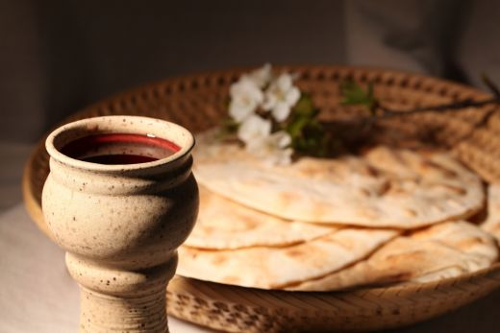
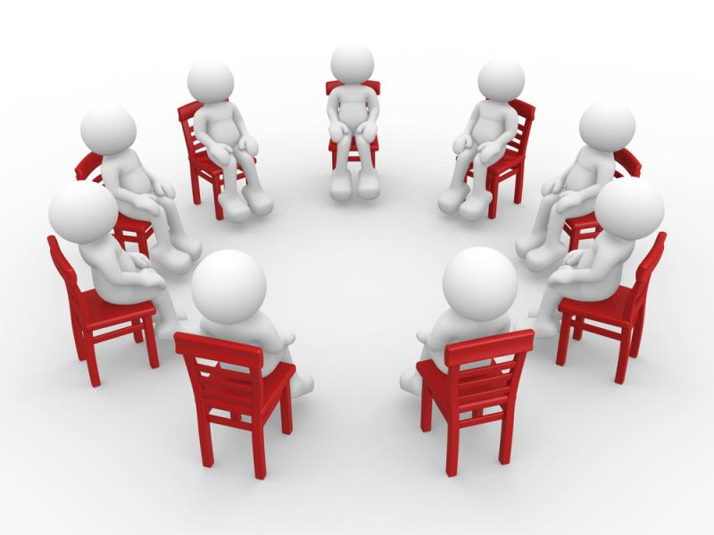
The
House Church
Movement

Slide 2
The House Church
Movement for several years – called the “House Church Movement”
  Started among denominational groups
  Worked among brethren for several years
  Alive and working today
Examples among “us”
  Franklin, TN (Williamson County Church)
  Bowling Green, KY (Church at Bowling Green)
  Florence, KY
  Athens, AL
  Tampa, FL (Christians in Tampa)
  Birmingham, AL (Church at Birmingham)
  Etc. – Kansas City, Huntsville, Denver & St. Louis

Slide 3
The House Church
What is true of one group – not necessarily true of another.
What one practices / believes – another may not
Not an exhaustive study – but an overview

Slide 4
The House Church Movement
And Beyond
Identity of the Movement

Slide 5
Identity of the Movement
Not merely a question of meeting in someone’s house
  Churches did meet in houses at times
    Rom. 16:5
    1 Cor. 16:19
    Col. 4:15
    Philem 2
  Churches met in other places as well
  More about what believe and practice – drive - than where they meet

Slide 6
Identity of the Movement
Not merely a question of meeting in someone’s house
Driven by:
  Dissatisfaction – feeling that churches have lost their spirituality and stuck in rut of traditionalism
  Liberal thinking
    Found among denominational groups
    Found among institutional churches of Christ
    Found among non-institutional churches of Christ
  Two works that had considerable impact at the beginning of this movement:

Slide 7
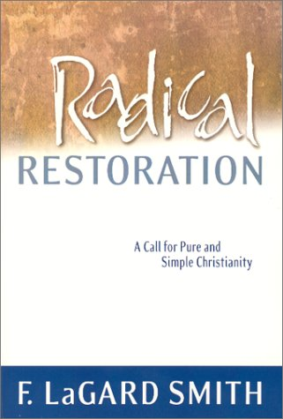
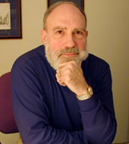
Radical Restoration by LaGard Smith
Promotes Renewed House Church Movement

Slide 8
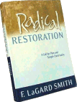
Main Points of Movement
First century church had Lord’s Supper along with common meal -- we should do the same
“House churches” pattern of first century -- we should do the same
No structure & organization
Goal: Setting should be intimate, informal, spontaneous, personal, active, mutually participatory

Slide 9
LaGard Smith on House Churches
“Maybe that’s where it all went wrong in the first place. Maybe the church should never have left home” (143).
Cites Acts 20:20, 1 Cor. 16:19, Rom. 16:3-5, Col. 4:15, Phile. 1-2 & Acts 12:5-12 as house churches
“There seems to be little question but that first-century Christians met together in small groups as house churches” (148).
“The house church... was also a natural setting for edification and exhortation” (150).

Slide 10
Smith on House Churches
“Historically, of course, we know that it was not until the third century that Christians began to erect what we today would recognize as church buildings. Piecing together archeology and history, it appears the primitive church typically met in a room (sufficiently large enough for probably 40-50 people) in the house of a wealthy member” (148).
“In the house church, the role of official clergy virtually vanished in the midst of a simple fellowship meal. As did the structured ritual and liturgy. And sacrosanct tradition” (151).

Slide 11
Smith on Elders & House Churches
“There is nothing to rule out the possibility that the role of elders in the early church might well have encompassed more than one level of involvement -- even simultaneously. Perhaps there were elders shepherding the disciples in each house, depending upon their size and make-up. And perhaps elder oversight may have been exercised throughout a group of house churches which collectively comprised a larger, recognizable ‘congregation.’ More thought-provoking for us, of course, is the third possibility -- that elders in individual house churches might also have come together as a group of city-wide elders to discuss matters of importance to the entire community of believers…. Nothing necessarily precludes ‘Jerusalem’s elders’ from being gathered from among elders in a multiplicity of house churches” (178).

Slide 12
Smith on Youth Ministries
LaGard blames youth ministries for bringing a division of the generations, for replacing the function of the home & for causing an improper shift to youth leadership
“Why are young people so excited when they return home from a weekend retreat? I suggest it’s because they have experienced something very similar to ‘radical restoration.’ While I continue to be concerned about what I believe is too often a lack of biblical depth in study and song, and lament that parents are not playing the primary roles they ought to play -- nevertheless, look what is happening dynamically at those retreats. There is spontaneity, informality, intimacy, and mutual participation of a type which our young people rarely witness in our more structured assemblies… And, of course, there’s all that table fellowship which breaks down so many barriers” (235-6).

Slide 13

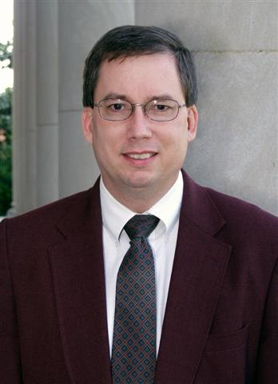
Come To The Table
John Mark Hicks
(of Lipscomb Univ.)
“The church should revision the supper as a meal rather than simply bread and wine” (186)
“Table fellowship is a focal point…” (53)

Slide 14
Identity of the Movement
Not merely a question of meeting in someone’s house
Driven by:
Goals (differ)
  Some: Restore New Testament Christianity
    Get back to way it was in first century
    Steve Atkerson: “apostles…intended for all churches to follow these same apostolic patterns even today” (Apostolic Tradition, 13)
    F. LaGard Smith: attempt to turn back the clock and restore the worship in line with NT

Slide 15
Identity of the Movement
Not merely a question of meeting in someone’s house
Driven by:
Goals (differ)
  Some: Restore New Testament Christianity
  Some: Recapture the spirit of Christianity in our own culture
    “It is not the recreation of the first century church that is the goal. The desire to recapture the spirit and dynamics of early church life in ways that are appropriate to our own culture” (Robert Banks, The House Church Comes, 24)
    This opens the door…

Slide 16
Identity of the Movement
Not merely a question of meeting in someone’s house
Driven by:
Goals (differ)
Overview of the movement

Slide 17
Overview of the
House Church Movement
Great Focus on Lord’s Supper – turn it into a meal
Some: Make a meal of the Lord’s Supper
Some: Have Lord’s Supper in conjunction with a pot luck meal
Emphasis on eating larger pieces / drinking larger portions

Slide 18
Overview of the
House Church Movement
Great Focus on Lord’s Supper – turn it into a meal
Emphasis on seating arrangement
Circle
Face each other
Not sing to back of someone’s head

Slide 19
Overview of the
House Church Movement
Great Focus on Lord’s Supper – turn it into a meal
Emphasis on seating arrangement
Disdain for “church buildings”
Disdain for “full time” or “paid” preachers
Disdain for elders - have “servant leaders”
Camp / devotional / emotional / casual atmosphere
Testimonials – of what Lord means to me
Emphasis on mutual edification (over worship)
Women take greater role – talking in assembly
Hand clapping / Hand waving
Meet in house – keep groups small
No collection - treasury

Slide 20
Identity of the Movement
Not merely a question of meeting in someone’s house
Driven by:
Goals (differ)
Overview of the movement
Against Tradition
  At what point does something become tradition? 2 weeks in row – 3 weeks?
  Is eating larger portions of Lord’s Supper in a circle now a tradition we must be against?
  Is meeting in a house – now a tradition?
  How do these proposals fix the problems of the rut?
  Bottom line: being anti-traditional!

Slide 21
The House Church Movement
And Beyond
Identity of the Movement
Errors of the Movement

Slide 22
Errors of the Movement
Worship in houses
  No one is opposed to churches meeting in houses
  Many churches began that way – small…
  Churches met in various places

Slide 23
Where Did Saints Meet in First Century?
In the temple Acts 2:46
By a river side Acts 16:13
School of Tyrannus Acts 19:9
An upper room Acts 20:8
Government dwelling Acts 28:30-31
Synagogue-type place James 2:2
Place not specified, but is an expedient

Slide 24
Errors of the Movement
Worship in houses
  No one is opposed to churches meeting in houses
  Many churches began that way – small…
  Churches met in various places
  No exclusive pattern of where disciples met
  See function of the assembly hindered by large numbers in church buildings (denies them the informality and spontaneity)
  Some argue from “family” concept - disciples should meet in house – why not all disciples reside in same structure on sustained basis?
  Ironic – some house churches have – moved into rented buildings

Slide 25
Errors of the Movement
Worship in houses
Spontaneous – Informal worship
  Told: best arrangement in a circle – preferably around a table (Robert Banks, 37)
  Come together “completely spontaneous with no one leading from the front” (Beresford Job, What is a church?)
  Hardly the picture of New Testament (1 Cor. 14)
    Some were to keep silent (1 Cor. 14:26-35)
    Done decent and in order (1 Cor. 14:40)
  They ridicule “traditional” worship as a “spectator’s sport”

Slide 26
Errors of the Movement
Worship in houses
Spontaneous – Informal worship
Mutual Ministry
  Smith: “houses don’t have pulpits” (211); “Pulpit ministers may be an invention, but mutual ministry is not” (212)
  Elders should be “teaching pastors” to the church; preachers should be evangelist to the lost (212).
  Each member (in the circle) has
  Sounds like “gospel” –vs- “doctrine” distinction
  Evangelist – taught the church (1 Tim. 1:3; Acts 19:10; 1 Cor. 3:4-9)

Slide 27
Errors of the Movement
Worship in houses
Spontaneous – Informal worship
Mutual Ministry
Rejection of elders
  Smith: city wide eldership – even multi level
  No elders in each of these “house churches”

Slide 28
Extent of Elders’ Rule
“Elders in every city” (Titus 1:5)
“Elders in every church” (Acts 14:23)
“Take heed unto yourselves, and to all the flock, in which the Holy Spirit hath made you bishops...” (Acts 20:28)
“Tend the flock of God which is among you, exercising the oversight thereof...” (1 Pet. 5:2
City-wide eldership is from Catholicism, not the New Testament

Slide 29
Errors of the Movement
Worship in houses
Spontaneous – Informal worship
Mutual Ministry
Rejection of elders
Church treasury
  Smith: get away from the idea of giving as mandated item of worship (7, 245)
  1 Cor. 16:1-2 – Command / order
    True that this is a benevolence passage
    It is also a collection passage

Slide 30
Errors of the Movement
Worship in houses
Spontaneous – Informal worship
Mutual Ministry
Rejection of elders
Church treasury
Lord’s supper
  Two ideas:
    Lord’s Supper as a meal (large portions)
    Lord’s Supper in conjunction with meal
  The amount – not suggested or hinted at in NT
  Only place where common meal and Lord’s supper are mentioned – said don’t do it (1 Cor. 11:17-34)

Slide 31
The Lord’s Supper & Passover
Argued: Lord’s Supper Was Instituted During a Common Meal
Not an ordinary meal (Exo. 12)
If can change the roasted lamb & bitter herbs to beans, corn and chicken – why not the elements of the Lord’s supper?
Lord’s Supper was instituted “after” meal (1 Cor. 11:25)
Jesus didn’t observe the Lord’s Supper – only instituted it (Luke 22)

Slide 32
Errors of the Movement
Worship in houses
Spontaneous – Informal worship
Mutual Ministry
Rejection of elders
Church treasury
Lord’s supper
Role of women
  Women: addressing assembly – giving testimony – open conversation during Lord’s Supper – Leading in chain prayer
  1 Tim. 2:11-12 ; 1 Cor. 14:34-35

Slide 33
New Stuff
Using instrumental music (or question opposition to it)
Denying baptism is essential (or question it)
Claiming direct revelation from God

Slide 34
The House Church Movement
And Beyond
Identity of the Movement
Errors of the Movement
Evolution of the Movement

Slide 35
Evolution of the Movement
What is going on now – hardly what started with F. LaGard Smith’s Radical Restoration
One calls it the “Progressive Movement”
Changing so rapidly – hard to be up to date
Heart: lack of respect for authority & silence
  If respect silence of scripture (Heb. 7:14) – will oppose
  If don’t – door is open that can’t be shut!

Slide 36
The House Church Movement
And Beyond
Identity of the Movement
Errors of the Movement
Evolution of the Movement

