Slide 1
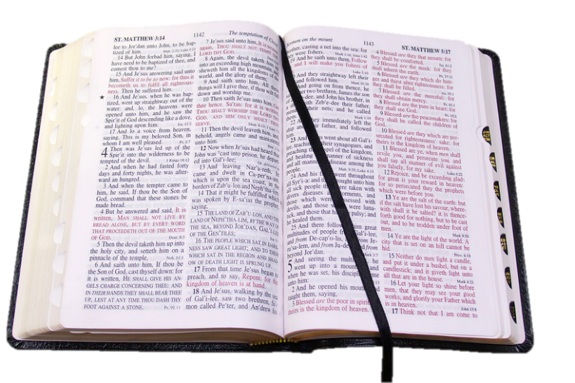
Faith
Man’s Reaction
The Word of God
(2 Tim. 3:16-17)

Slide 2
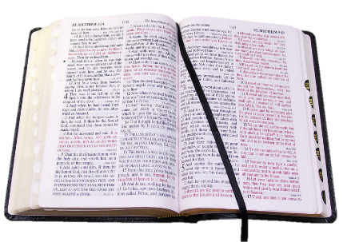
“…from faith to faith…”
(Rom. 1:17)
The Story of
Salvation
by Faith
was
Revealed
Faith
In order to
Produce

Slide 3
We Live By Faith
What We
Do Is
Because of
Faith
Hab. 2:4
Heb. 10:38
Where We
Fail
We Are Lacking
Notes:
“The Just shall live by faith”

Slide 4
Faith

Slide 5

Faith
I. Faith Defined
A. Heb. 11:1

Slide 6
“Now faith is the substance of things hoped for, the evidence of things not seen.”
(Heb. 11:1)
“Now faith is assurance of [things] hoped for, a conviction of things not seen.” (ASV)
“Faith is confidence as to things hoped for;
conviction as to things not seen.” (Robinson)
Notes:
Heb. 11:1 does more to show what faith DOES and HOW it FUNCTIONS than Defining it

Slide 7
Conviction of
Things Not Seen
Confidence of
Things Hoped For
Heb. 11:6
Believe that
He is
Rewarder of
Those - Seek
One Who Has Faith:
Convinced in regard to things not seen
Confidence in things that he hopes for

Slide 8
Faith
I. Faith Defined
A. Heb. 11:1
B. Acceptance of Evidence

Slide 9
Faith is the
Acceptance of Evidence
Based on
Evidence
Faith
Produces
“So then faith comes by hearing,
and hearing by the word of God.”
(Rom. 10:17)

Slide 10
Faith is the
Acceptance of Evidence
Based on
Evidence
Faith
Produces
“And since we have the same spirit of faith, according to what is written, "I believed and therefore I spoke," we also believe and therefore speak,.”
(2 Cor. 4:13)

Slide 11
Faith
I. Faith Defined
A. Heb. 11:1
B. Acceptance of Evidence
C. It is not:

Slide 12
Faith is Not:
Blind leap into the dark
Opinion / Personal feelings
Tradition

Slide 13
Faith
I. Faith Defined
II. Faith’s Source

Slide 14
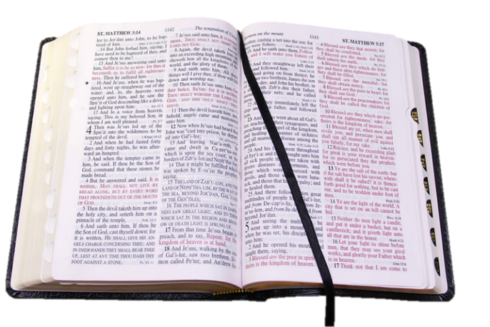
The Source of Faith
Acts 20:32
...word of His grace, which is able to build you up...

Slide 15
The Source of Faith
Rom. 10:17
..faith comes by hearing and hearing by the word of God..
Notes:
Example: - Acts 2 – unbelieving Jews heard evid of res. Then believed (v. 36-37)
Example: Acts 18 – corrupt heathen Corinthians – heard believed (v. 8)

Slide 16
The Source of Faith
Established / Strengthened / Maintained
More time spend with word -- Faith Stronger
Less time spend with word -- Faith Weaker
If what we believe is not in word -– not faith!
Notes:
Faith is not inherited
Faith is not handed down

Slide 17
Faith
I. Faith Defined
II. Faith’s Source
III. Faith To No Avail

Slide 18
Faith to No Avail
Believe the Wrong Thing
(2 Thess. 2:10; 1 John 4:1)
Believe the Right Thing - Not Act
(Jas. 2:19; John 8:31, 44)
Believe Right Thing - Lose Faith
(Luke 8:13; Heb. 3:12-13)

Slide 19
Faith
I. Faith Defined
II. Faith’s Source
III. Faith To No Avail
IV. Faith’s Change

Slide 20
Faith’s Change
Varying Degrees
Little
(Matt. 6:30; 16:8)
Great
(Matt. 8:10)
Weak
(Rom. 4:19)
Increase
Grow
(Luke 17:5
2 Thess. 1:3)
Full of Faith
(Acts 6:8)
Keep It
Work on It
(Heb. 10:39
1 Pet. 1:9)
Notes:
Faith is not concrete – have it & always will

Slide 21
Faith
I. Faith Defined
II. Faith’s Source
III. Faith To No Avail
IV. Faith’s Change
V. Faith Saves

Slide 22
Saved
By
Faith
Faith is essential to salvation
(Rom. 5:1; John 8:24; Luke 8:12)
Faith without works - dead
(Jas. 2:24, 26)
Faith & Obedience
  Go hand in hand (Rom. 1:5; 16:26)
  Disobedience - lack of faith
  (Num. 20:12)
  “Faith”/ “Believe” = obed.
    (Rom. 10:16)

Slide 23
“But they have not all obeyed the gospel. For Isaiah says, "Lord, who has believed our report?”
(Rom. 10:16)
Obey = Believe

Slide 24
Faith
I. Faith Defined
II. Faith’s Source
III. Faith To No Avail
IV. Faith’s Change
V. Faith Saves

