Slide 1

Is there real
evidence for believing?
For Faith
Evidence for God part 1 (11-15)
Evidence for God part 2 (11-22)
The Problem of Evil (11-29)
The Bible and Science (12-06)
Creation (12-13)
Evolution (12-20)
The Genesis Flood (12-27)
Archaeology (01-03)
Historical Jesus (01-10)
The Resurrection of Christ (01-17)
Inspiration of Scripture (01-24)
Canon and the Apocrypha (02-07)
Sunday Evening
Studies
Designed to build and strengthen
real faith

Slide 2
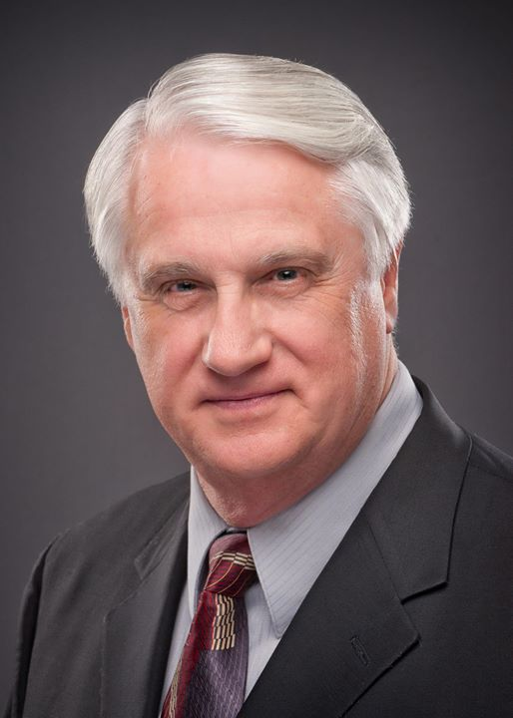
For Faith
February 7, 2015
Daniel H. King, Ph.D.
(Old Testament Studies & Biblical Languages)
9:00 AM: Plenary Inspiration of the Scriptures
9:50 AM: The Canonization of the Scriptures
5:30 PM: The Apocrypha
El Bethel Church of Christ ♦ 1801 Highway 41-A North ♦ Shelbyville, TN 37160

Slide 3
For Faith
Historical Jesus
Was Jesus a real person?
Did he really exist?
Was he a fictional character or myth created by some overly zealous people?

Slide 4
Historical Jesus – A Critical Issue
“Some religions, both ancient and modern, require no historical basis, for they depend upon ideas rather than events. Christianity is not one of these” (Everett F. Harrison, A Short Life of Christ, 11).
The religion of Christ (Christianity) stands or falls upon events in history.
Thus, the historicity of Jesus Christ is a critical issue!
Notes:
https://www.christiancourier.com/articles/26-historicity-of-jesus-christ-the

Slide 5
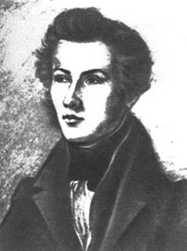

Some Say: No Historical Jesus
Bruno Bauer (1809-1882), German philosopher & historian, said that Jesus was the mental invention of a few second-century Christians under the influence Graeco-Roman philosophy.
“…the New Testament Jesus is a myth” (Dan Barker, Losing Faith in Faith, 378
Some argued that he is the product of Babylonian mythology (The Fundamentals, 2:284)
Notes:
https://www.christiancourier.com/articles/26-historicity-of-jesus-christ-the

Slide 6
How Can We Know If Jesus Is Historical?
Same way we know:
  George Washington
  Thomas Jefferson
  Flavius Josephus
  Aristotle
Were Real People
We Know By Testimony

Slide 7
For Faith
Historical Jesus
New Testament Documents

Slide 8
New Testament Documents
Is this circular reasoning?
  Can / should one use the Bible to prove the Bible?
  Here – using the NT as any other collection of ancient documents
  To reject these as evidence:
    Is to reject the earliest primary sources about Jesus in favor of later sources
    Rejects primary sources for secondary sources
  There is no historically reliable source outside the NT that calls into question the picture of Jesus presented in the gospels.
  Skeptics, wanting to reject the Christ, assume the NT documents are unreliable until proven reliable (guilty until proven innocent)

Slide 9
New Testament Documents
Is this circular reasoning?
Based upon eyewitness accounts
  Luke (Luke & Acts) – wrote history as one who had seen the Lord himself (Luke 1:1-4)
  John was one of apostles of Christ
  Matthew was an apostle of Christ
  James was written by brother of Jesus
  Of 27 books – 10 were written by companions – 14 were written by Paul (was an eyewitness as well)

Slide 10
New Testament Documents
Is this circular reasoning?
Based upon eyewitness accounts
Documents are well established
  All were completed within 65 years of Christ death
  Over 5,000 extant manuscripts
Original
Autograph
MS
MS

Slide 11
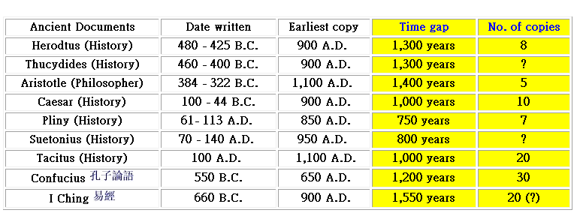
http://www.faithhelper.com/ntrel2.htm
Notes:
http://www.faithhelper.com/ntrel2.htm

Slide 12
New Testament Documents
Is this circular reasoning?
Based upon eyewitness accounts
Documents are well established
Disciples were incapable of creating a myth
  Their thinking was different than Jesus
    About the kingdom (they thought it material – Matt. 20:20-28)
    About his suffering (Matt. 16:21-23)
    About false teaching (Matt. 16:5-12)
  Their courage was different than Jesus (they wanted to fight with a sword then shrank back – Matt 26:51, 56, 58, 74)
  Their concept of love differed (Lk. 9:51-56; 19:1-10; John 4)
  If gospel writers invented Jesus – greatest miracle of all!!
Notes:
Ferrell Jenkins, Introduction to Christian Evidences, 113

Slide 13
New Testament Documents
Is this circular reasoning?
Based upon eyewitness accounts
Documents are well established
Disciples were incapable of creating a myth
Documents are historically accurate
  They do no contradict history
  The names of governments, kings, tetrarchs, and priests are accurately named.
Have Irrefutable Evidence
Of the Existence of Jesus!
Notes:
Ferrell Jenkins, Introduction to Christian Evidences, 113

Slide 14
For Faith
Historical Jesus
New Testament Documents
Jewish Testimony

Slide 15
Jewish Testimony
Josephus
  Jewish historian – lived (37-100 AD)
  Mentions Jesus twice in Antiquities of the Jews
    18.3.3 – Called him the Christ - miracles – death and res.

Slide 16
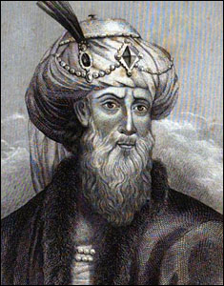
Flavius Josephus
(37-100 AD)
“Now, there was about this time Jesus, a wise man, if it be lawful to call him a man. For he was a doer of surprising feats - a teacher of such men as receive the truth with pleasure. He drew over to him both many of the Jews and many of the Gentiles. He was [the] Christ; and when Pilate, at the suggestion of the principal men amongst us, had condemned him to the cross, those that loved him at the first did not forsake him, for he appeared to them alive again the third day, as the divine prophets had foretold these and ten thousand other wonderful things concerning him; and the tribe of Christians, so named from him, are not extinct to this day.” ( Antiquities of the Jews 18.3.3)
Notes:
http://www.neverthirsty.org/pp/historical-secular-quotes-about-jesus/flavius-josephus.html

Slide 17
Jewish Testimony
Josephus
  Jewish historian – lived (37-100 AD)
  Mentions Jesus twice in Antiquities of the Jews
    18.3.3 – Called him the Christ - miracles – death and res.
    20.9.1 – Trial of James – identified as brother of the so-called Christ

Slide 18
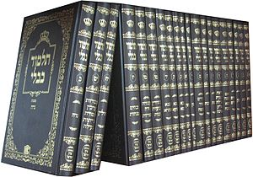
Jewish Testimony
Josephus
Talmud
  Defined: Collection of Jewish law and tradition consisting of the Mishnah and Gemara.
  Two editions: Palestinian (ca 400 AD) & Babylonian (ca 500 AD)
  This is valuable for it is mostly hostile toward Christianity
  Talked about Jesus:
    Tells of his reality – his existence
    Charges that he was born out of wedlock – calls him “Ben Pandera” (a distorted form of the word for “virgin”)
    Talks about his miracles – called “magic”
    Tells of his execution
Notes:
https://www.christiancourier.com/articles/26-historicity-of-jesus-christ-the

Slide 19
For Faith
Historical Jesus
New Testament Documents
Jewish Testimony
Roman Sources

Slide 20
Roman Sources
Pliny
  Governor of Bithynia
  Wrote to Roman Emperor Trajan (ca 112 AD) asked how to deal with Christians who practice of meeting on appointed day and singing hymns “to Christ as if to God” (Epistles X.96)
Notes:
https://www.christiancourier.com/articles/26-historicity-of-jesus-christ-the

Slide 21
Roman Sources
Pliny
Tacitus
  Roman historian (born 59 AD) wrote about Christ ca 115 AD
  Refers to “Christus” being executed at the hands of Pontus Pilate (Annals XV.44)

Slide 22
Roman Sources
Pliny
Tacitus
Suetonius
  Roman writer
  Wrote about 120 AD told of Claudius expelling Jews from Rome for “making disturbances at the instigation of Chrestus” (a corruption of Christos) (Vita Claudi xxv.4)
  Luke refers to this about 49 AD (Acts 18:2)

Slide 23
Roman Sources
Pliny
Tacitus
Suetonius
Thallus
  Gentile writer (ca 52 AD) – Samaritan born historian
  Quoted by Julius Africanus (221 AD) – spoke of the darkness when Christ died (Josh McDowell, Evidence that Demands a Verdict, 84)

Slide 24
For Faith
Historical Jesus
New Testament Documents
Jewish Testimony
Roman Sources
Antagonist to Christianity

Slide 25
Antagonist to Christianity
Celsus
  Pagan philosopher of 2nd century AD
  Wrote the oldest extant literary attack on Christianity, True Discourse (ca 178 AD)
  Was a bitter assault on Christ
    Argued that he was born in low circumstance
    Said he was illegitimate child of a soldier
    As he grew he deceived other that he was God
    Claimed that his own people killed him and faked a res.
  Never questioned the historicity of Jesus Christ!

Slide 26
Antagonist to Christianity
Celsus
Lucian
  Of Samosata (ca 115-200 AD)
  Wrote against Christianity with great contempt and hostility
  Said that Christians worship a well know sophist who was crucified in Palestine because he introduced new mystery – a new cult (Passing Peregrinus)
  Never denied his existence

Slide 27
Antagonist to Christianity
Celsus
Lucian
Porphyry
  Of Tyre – born 233 AD
  Studied philosophy in Greece – lived in Sicily were wrote 15 books against the Christian faith
  In Life of Pythagoras, he contended that magicians of the pagan world had greater powers than Christ.
  This was an inadvertent concession of Jesus’ existence and power!

Slide 28
For Faith
Historical Jesus
New Testament Documents
Jewish Testimony
Roman Sources
Antagonist to Christianity
Patristic Writers

Slide 29
Patristic Writers
Polycarp
  69 – 155 AD
  Lived in Smyrna
  Was a disciple of apostle John (Eusebius v.xx)
  Stated that he has served Christ 86 years – willingly died for him
  Shows that he believed Jesus to be real – believed his friend (John) had really seen him!

Slide 30
Patristic Writers
Polycarp
Tertullian
  Lived in Carthage (160-200 AD) – Jurist theologian
  Pagan and Roman Lawyer – later a convert
  Recognized the 4 gospels – quoted from 24 NT books
  Spoke of the truth of Christ’s divinity, as contended by Tiberius, who decided in favor of Christ (Apology, v.2)

Slide 31
For Faith
Historical Jesus
New Testament Documents
Jewish Testimony
Roman Sources
Antagonist to Christianity
Patristic Writers

Slide 32

In Young Adult Classroom

