Slide 1

Is there real
evidence for believing?
For Faith
Evidence for God part 1 (11-15)
Evidence for God part 2 (11-22)
The Problem of Evil (11-29)
The Bible and Science (12-06)
Creation (12-13)
Evolution (12-20)
The Genesis Flood (12-27)
Archaeology (01-03)
Historical Jesus (01-10)
The Resurrection of Christ (01-17)
Inspiration of Scripture (01-24)
Canon and the Apocrypha (02-07)
Sunday Evening
Studies
Designed to build and strengthen
real faith

Slide 2

For Faith
February 7, 2015
Daniel H. King, Ph.D.
(Old Testament Studies & Biblical Languages)
9:00 AM: Plenary Inspiration of the Scriptures
9:50 AM: The Canonization of the Scriptures
5:30 PM: The Apocrypha
El Bethel Church of Christ ♦ 1801 Highway 41-A North ♦ Shelbyville, TN 37160

Slide 3
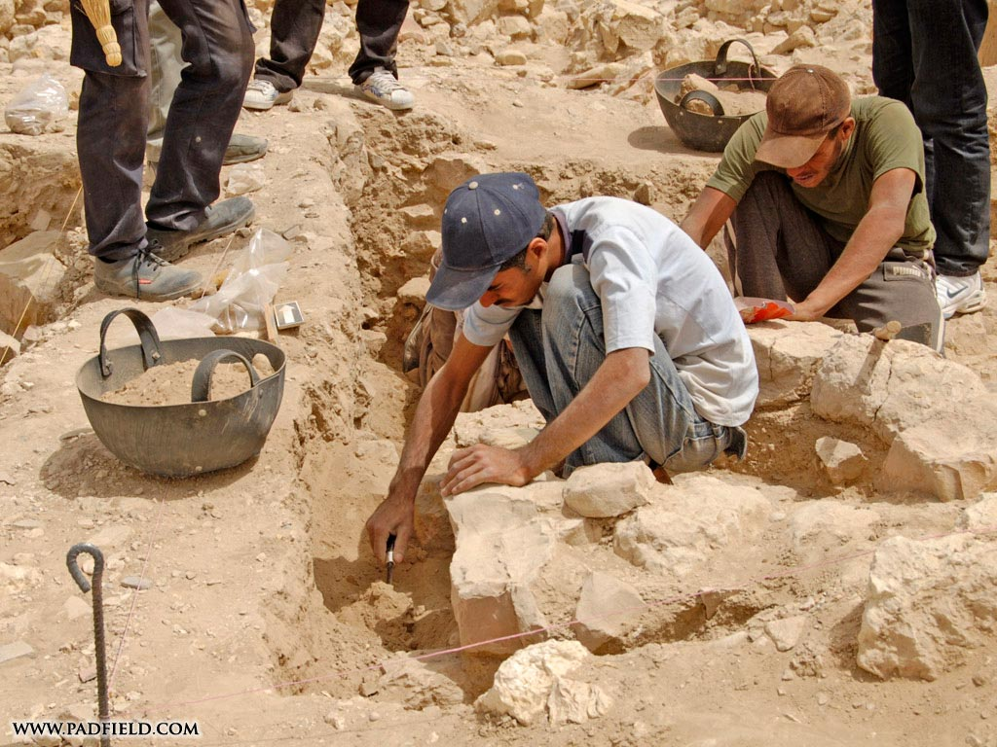
For Faith
Archaeology
“Archaeology is the science which excavates and analyzes ancient human settlements.”
- Henry M. Morris, Ph.D., Many Infallible Proofs, 300

Slide 4
For Faith
Archaeology
The Role of Archaeology

Slide 5
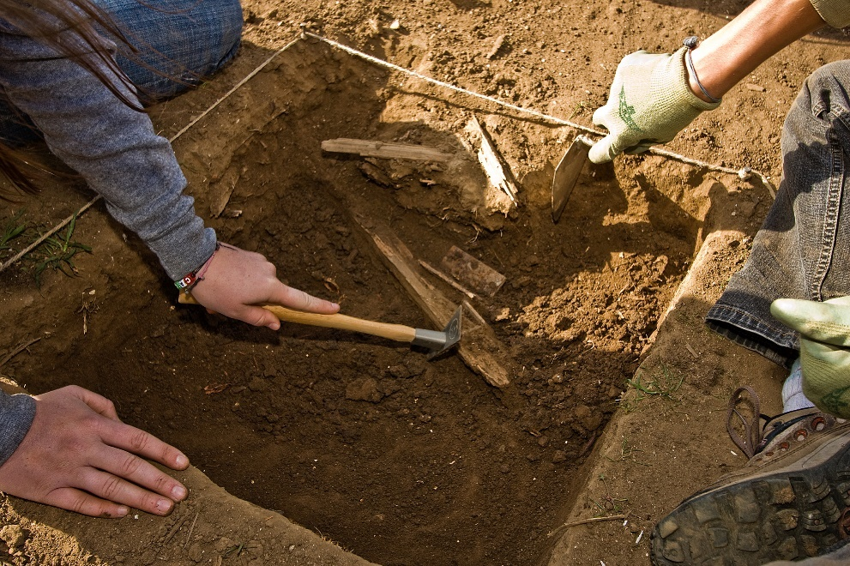
The Role of Archaeology
“In addition to illuminating the Bible, archaeology has confirmed countless passages which have been rejected by critics as unhistorical and contradictory to known facts. This aspect of archaeology forms a valuable part of the defense of the Scriptures, commonly known as apologetics. In summary it may be said that two of the main functions of Bible archaeology are the illumination and confirmation of the Bible.”
- Joseph Free, Archaeology and Bible History, 1

Slide 6
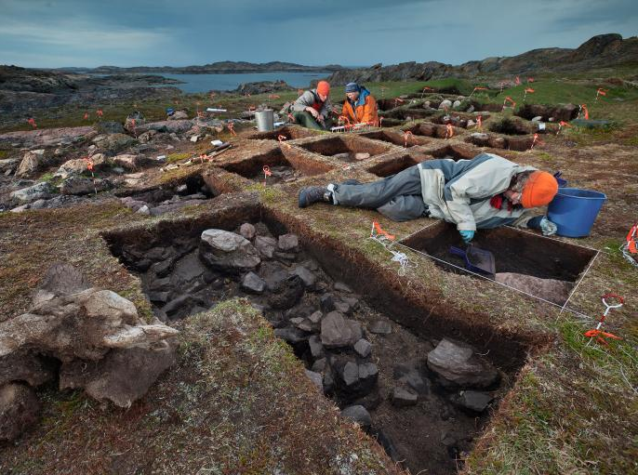
“Our inquiry into Bible archaeology will produce evidences which verify the historicity of the Bible.”
“The historical accuracy of the Bible does not prove the inspiration of the Bible. But for the Bible to be inspired it must be historically accurate.”
- Roger Dickson, The Fall of Unbelief, 339, 358.

Slide 7
For Faith
Archaeology
The Role of Archaeology
The Discoveries of Archaeology

Slide 8
The Discoveries of Archaeology
Moabite Stone

Slide 9
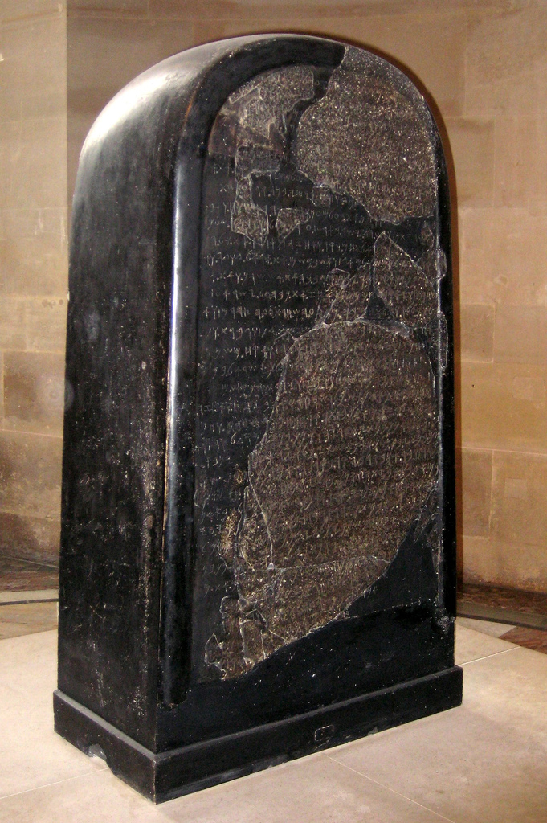
The Moabite Stone
Discovered August 19, 1868 by F. A. Klein (German Missionary) in Dibon, Moab (13 mi S of Dead Sea)
Size: 46” H x 24” W x 10 ½” D
Klein went back to Germany to get $400 to buy it from the Arabs
Meanwhile, Frenchman, Clermont-Ganneau went to see it & made a squeeze (facsimile impression)
Arabs then destroyed it (heat & cold water) – Ganneau later gathered all fragments – put it back together
Now in Paris.

Slide 10
The Moabite Stone
Monument was made when Mesha was king of Moab (850 BC) – 2 Kings 3:4-5
Tells how Moabite deity (Chemosh) allowed Israel to overpower them
Tells of Mesha’s revolt against Ahab (Israel) – Showing were contemporaries
Omri is confirmed as being king of Israel
Use of “Yahweh” referring to the God of Israel.

Slide 11
The Discoveries of Archaeology
Moabite Stone
Black Obelisk of Shalmaneser III

Slide 12
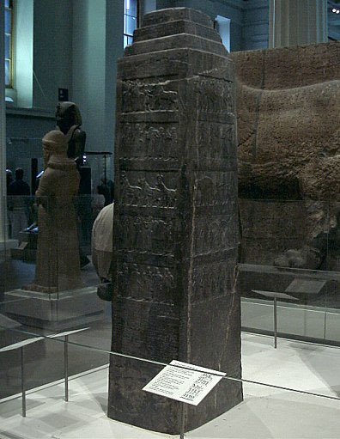
Black Obelisk of Shalmaneser III
Discovered in 1846 by Henry Layard at Nimrod (Mesopotamia)
Made by Shalmaneser, III king of Assyria
Size: 6 ½’ Tall – with four sides – 5 rows of reliefs
Now in British Museum
Tells us victories of Shalmaneser, III (859-824 BC)
Mentions Jehu (King of Israel, 841-814) as bowing before Shalmaneser (2 Kings 9, 10)
Mentions Shalmaneser went against coalition of kings of Damascus & Palestine (Hazael & Ahab) – 2 Kings 8:7-ff

Slide 13
The Discoveries of Archaeology
Moabite Stone
Black Obelisk of Shalmaneser III
Inscriptions of Shishak

Slide 14
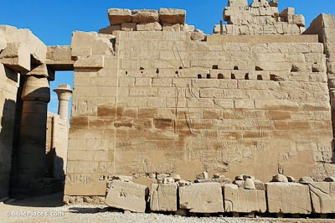
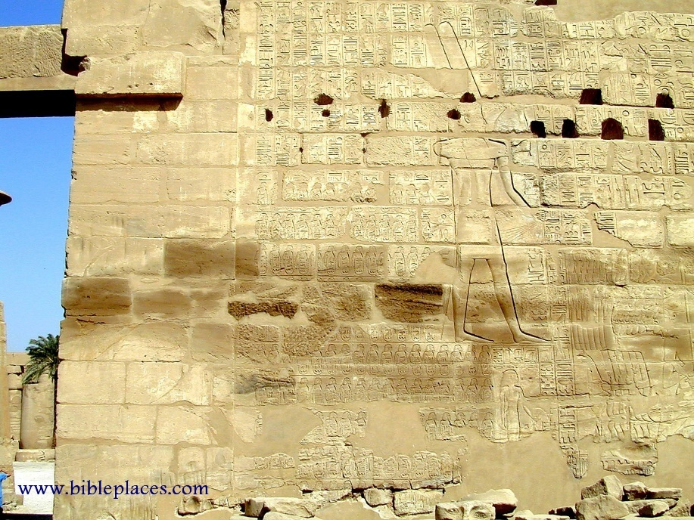
Inscriptions of Shishak
Shishak – King of Egypt (945-924 BC)
His inscription is on wall of the temple of Amun at Karnak in Egypt
Tells of his campaigns into Israelite territory
Shows he was a contemporary with Rehoboam and Jeroboam
Tells of him presenting 156 Palestian prisoners to the god Amun
Mentions 156 cities taken – including Megiddo (where a fragment of a stele of Shishak was found)
1 Kings 14:25-26; 2 Chron.12:2,9
Notes:
Photo: www.bibleplaces.com

Slide 15
The Discoveries of Archaeology
Moabite Stone
Black Obelisk of Shalmaneser III
Inscriptions of Shishak
Annals of Sargon II

Slide 16
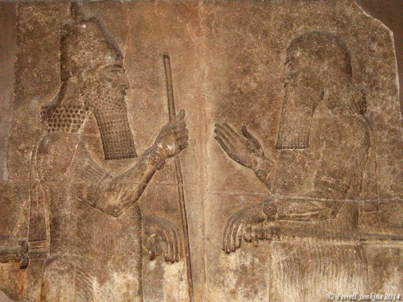
Annals of Sargon II
Sargon II king of Assyria (722-705 BC)
Mentioned in Isaiah 20:1
Critics said name Sargon was not found among Assyrian kings
Paul Emile Botta found his palace in 1843 at Khorsabad (northern end of Tigris River)
Some 22,000 tablets were found
Items are now in British Museum and Iraq Museum (Baghdad)
1963 a victor stele commemorating the capture of Ashdod found at Ashdod.
Sargon (left) receives a minister
Photo by Ferrell Jenkins
British Museum
Notes:
https://ferrelljenkins.wordpress.com/2014/03/03/visualizing-isaiah-20-sargon-the-king-of-assyria/

Slide 17
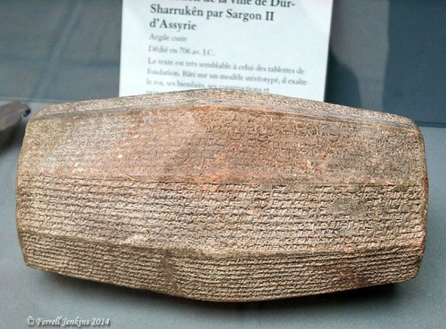
Annals of Sargon II
Inscription tells of building Sargon’s palace
Photo by Ferrell Jenkins
British Museum
Notes:
https://ferrelljenkins.wordpress.com/2014/03/03/visualizing-isaiah-20-sargon-the-king-of-assyria/
https://ferrelljenkins.wordpress.com/2013/08/22/sargon-ii-ashdod-and-isaiah-201/

Slide 18
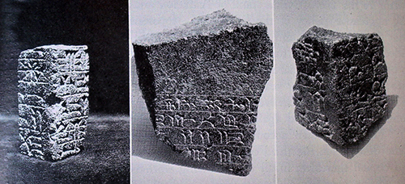
Annals of Sargon II
The photos below were published in an article by Hayam Tadmor (“Philistia Under Assyrian Rule.” Biblical Archaeologist (29:3, 1966). A photo of the piece in the middle below is also published in a BARarticle (Jan-Feb, 2007) by H. Shanks on the “Assyrian Palace Discovered in Ashdod.”
– Ferrell Jenkins
Notes:
https://ferrelljenkins.wordpress.com/2014/03/03/visualizing-isaiah-20-sargon-the-king-of-assyria/
https://ferrelljenkins.wordpress.com/2013/08/22/sargon-ii-ashdod-and-isaiah-201/

Slide 19
Annals of Sargon II
Fragments of another stele, commemorating the victories of Sargon, were found at Ashdod during the current season, thus offering direct confirmation and vivid illustration of the biblical and Assyrian accounts. In all, three pieces of the stele were discovered. Enough can be made of their contents to show that the inscription duplicated in content if not precisely in wording other victory steles of the Assyrian king. By comparing the Ashdod stele with the others it will be possible to reconstruct the missing parts, one of which described the actual conquest of Ashdod. The inscription was carved in cuneiform signs characteristic of Sargon and his period, on all four sides of a slab of basalt which had been imported from a region north of Megiddo. It may have served as a pedestal for an obelisk, or a statue of the emperor. It must have been erected between the year of victory at Ashdod and the death of the king in 705 B.C., perhaps in 707 when a similar stele was set up in Cyprus. With the accession of Sennacherib in 704, most of the vessel countries revolted; Hezekiah of Judah and Sidqa of Ashkelon were the ringleaders in the west. They were able to liberate Ashdod from Assyrian control, and doubtless the event was observed by the destruction of Sargon’s victory stele, symbol of foreign oppression. These fragments of a monumental Assyrian inscription are the first ever found in Palestine.
- David Noel Freedman, Biblical Archaeologist (26:4, 1963)
Notes:
https://ferrelljenkins.wordpress.com/2014/03/03/visualizing-isaiah-20-sargon-the-king-of-assyria/
https://ferrelljenkins.wordpress.com/2013/08/22/sargon-ii-ashdod-and-isaiah-201/

Slide 20
The Discoveries of Archaeology
Moabite Stone
Black Obelisk of Shalmaneser III
Inscriptions of Shishak
Annals of Sargon II
Hezekiah’s Tunnel

Slide 21
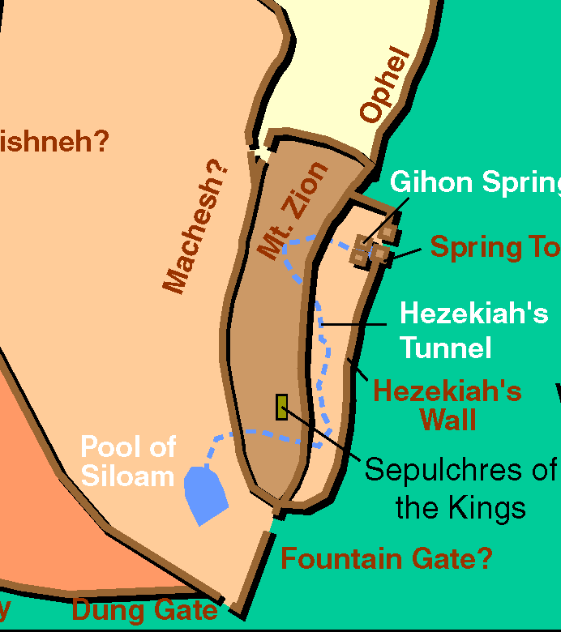
Hezekiah’s Tunnel
After Sargon’s death, Sennacherib reigned in Assyria (705-681 BC)
Then Hezekiah rebelled (2 Kings 18:7)
He fortified the city (2 Chron. 32:2-4)
Cut a tunnel from Gihon Springs to pool of Siloam (2 Chron. 32:30; 2 Kings 20:20)
1880 a boy playing near pool of Siloam fell – while laying he noticed some markings on wall – written in Hebrew (form contemporary with time of Hezekiah)

Slide 22
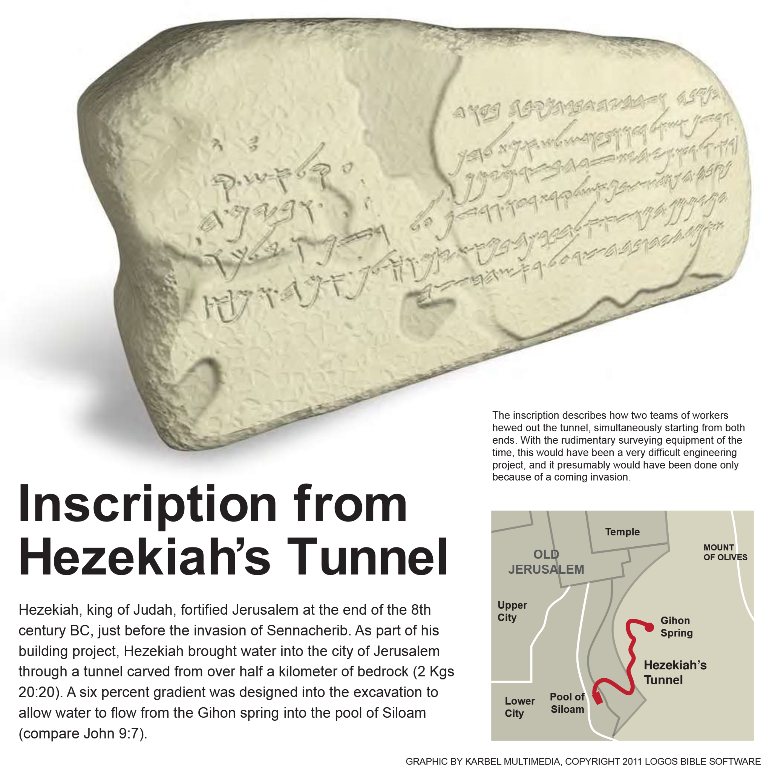
Discovered by a young boy wading in the Pool of Siloam in 1880

Slide 23
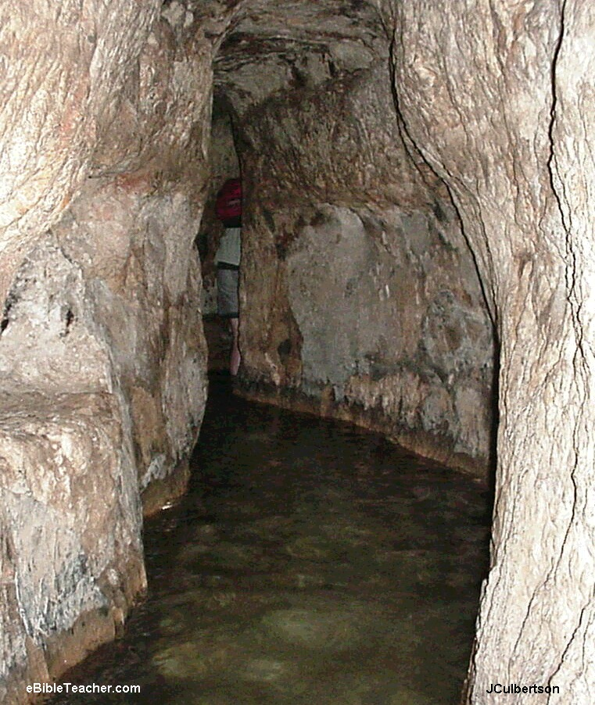
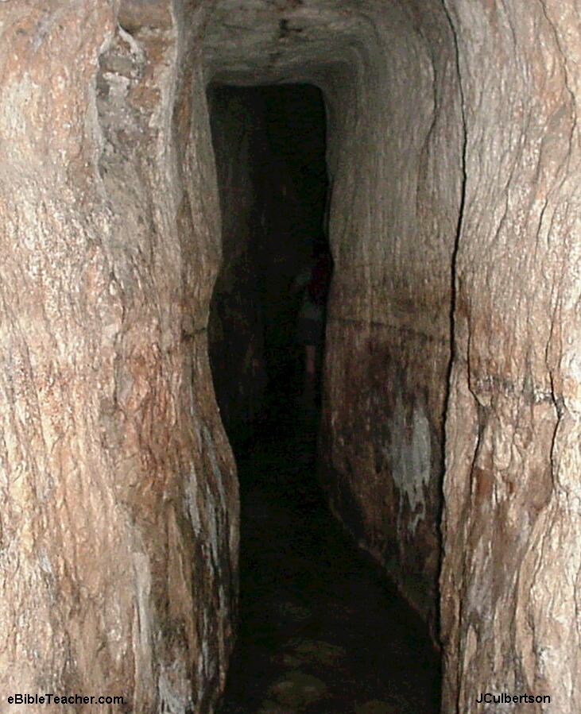
Hezekiah’s Tunnel

Slide 24
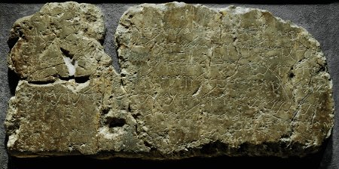
Hezekiah’s Tunnel
The Siloam inscription commemorates the excavation of Hezekiah’s Tunnel. Archaeological Museum, Istanbul, Turkey. Credit: Erich Lessing/Art Resource, NY.
...And this was the account of the breakthrough. While the laborers were still working with their picks, each toward the other, and while there were still three cubits to be broken through, the voice of each was heard calling to the other, because there was a crack (or split or overlap) in the rock from the south to the north. And at the moment of the breakthrough, the laborers struck each toward the other, pick against pick. Then water flowed from the spring to the pool for 1,200 cubits. And the height of the rock above the heads of the laborers was 100 cubits (Price, 1997, p. 267).
Learn “cubit” = 18”
Notes:
https://apologeticspress.org/apcontent.aspx?category=13&article=1347

Slide 25
The Discoveries of Archaeology
Moabite Stone
Black Obelisk of Shalmaneser III
Inscriptions of Shishak
Annals of Sargon II
Hezekiah’s Tunnel
Sennacherib’s Prism

Slide 26
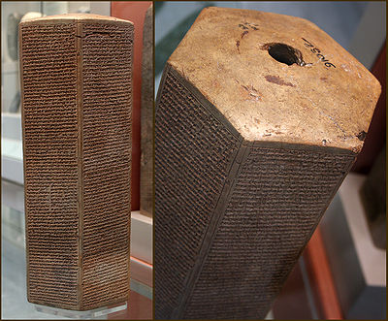
Sennacherib’s Prism
After Hezekiah’s rebellion, Sennacherib took cities of Judah (2 Chron. 32:1; Isa. 36:1)
To buy time, Hezekiah offered tribute to Sennacherib (2 Kings 18:13-16)
1830 a prism make by Sennacherib (691 BC) was found at Nineveh
Tells us Sennacherib’s campaigns in Judah – how he made Hezekiah a prisoner in Jerusalem “like a bird in a cage”
Also called Taylor Prism
British Museum

Slide 27
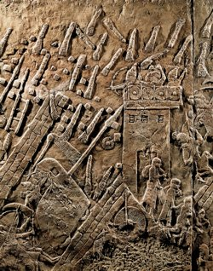
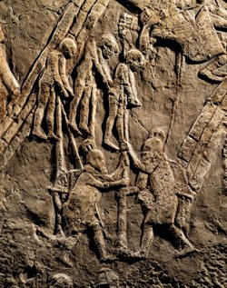
Sennacherib’s Relief
Assyrians attack the Jewish fortified town of Lachish. Part of a relief from the palace of Sennacherib at Nineveh. British Museum, London. Credit: Erich Lessing/Art Resource, NY.
One of the cities Sennacherib took was Lachish (2 Chron. 32:9; Isa. 36:2)
When he returned to Nineveh, left relief about the success (found in 1899)
Nearly 70 ft of wall dedicated to this relief
The epigraph read: “Sennacherib, king of the world, king of Assyria, sat upon a nimedu- throne and passed in review the booty (taken) from Lachish (La-ki-su)”
Assyrian warriors shown impaling Jewish prisoners. Part of a relief from the palace of Sennacherib. British Museum, London. Credit: Erich Lessing/Art Resource, NY.
Notes:
https://apologeticspress.org/apcontent.aspx?category=13&article=1347

Slide 28
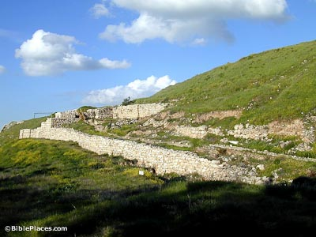
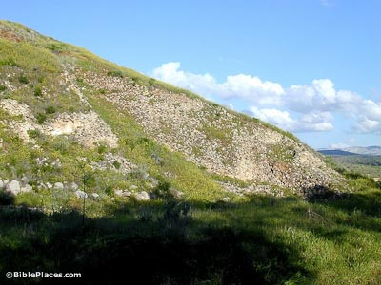
Sennacherib’s Siege Ramp
Approach Ramp
“The evidence of it is all there: the enormous sloping siege ramp thrown up against the city walls south of the gate; the double line of defense walls, upslope and downslope; the iron-shod Assyrian battering rams that breached the city wall at its highest point; the massive destruction within the fallen city.... Virtually all the details of the Assyrian reliefs have been confirmed by archaeology”
- William Dever, Quoted by Apologetics Press
Siege Ramp
Notes:
http://www.bible-architecture.info/Lachish.htm
https://apologeticspress.org/apcontent.aspx?category=13&article=1347
http://www.bibleplaces.com/lachish/

Slide 29
The Discoveries of Archaeology
Moabite Stone
Black Obelisk of Shalmaneser III
Inscriptions of Shishak
Annals of Sargon II
Hezekiah’s Tunnel
Sennacherib’s Prism
Cyrus Cylinder

Slide 30
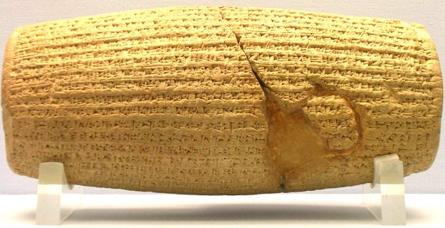
Cyrus Cylinder
Isaiah prophesied that Cyrus would allow captives to return (Isa. 44:28; 45:1)
Bible says Cyrus was the one who allowed them to return (Ezra 1:1ff; 2 Chron. 36:23)
1879 Hormoz Rasam found a cylinder (9” long) in ancient city of Babylon
Tells of Cyrus overtaking Babylon (without warfare) in 539 BC.
Tells of his allowing captive to return (humanitarian approach)

Slide 31
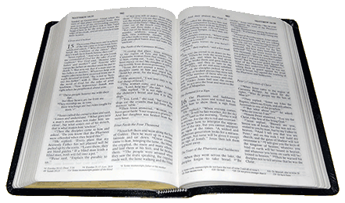
Ezra 1:1–2
1 Now in the first year of Cyrus king of Persia, that the word of the Lord by the mouth of Jeremiah might be fulfilled, the Lord stirred up the spirit of Cyrus king of Persia, so that he made a proclamation throughout all his kingdom, and also put it in writing, saying,
² Thus says Cyrus king of Persia:
All the kingdoms of the earth the Lord God of heaven has given me. And He has commanded me to build Him a house at Jerusalem which is in Judah.
“I am Cyrus, king of all, the great king, the mighty king, king of Babylon, king of Sumer and Akkad, king of the four corners of the earth.”
- Werner Keller, The Bible as History, 310-311 (as quoted by Roger Dickson, Fall of Unbelief, 356).

Slide 32
“I am Cyrus, king of all, the great king, the mighty king, king of Babylon, king of Sumer and Akkad, king of the four corners of the earth.”
- Werner Keller, The Bible as History, 310-311 (as quoted by Roger Dickson, Fall of Unbelief, 356).
2 Chronicles 36:23
Thus says Cyrus king of Persia:
All the kingdoms of the earth the Lord God of heaven has given me. And He has commanded me to build Him a house at Jerusalem which is in Judah. Who is among you of all His people? May the Lord his God be with him, and let him go up!

Slide 33
The Discoveries of Archaeology
Moabite Stone
Black Obelisk of Shalmaneser III
Inscriptions of Shishak
Annals of Sargon II
Hezekiah’s Tunnel
Sennacherib’s Prism
Cyrus Cylinder
Code of Hammurabi

Slide 34
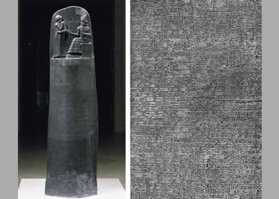
Code of Hammurabi
Critics have argued that the laws that Moses wrote were too advanced for his time & writing skills were not developed.
Dec. 1901 / Jan. 1902 French Archaeologist M. de Morgan found mass of black diorite in Susa (Persia)
8’ H x 6’ Circum. (base) / 5’ (top)
By Hammurabi King of Babylon (thought to be Amraphel of Gen. 14:1)
282 laws – 4,000 lines –
Shows writing & laws hundreds of years before Moses
Notes:
https://apologeticspress.org/apcontent.aspx?category=13&article=860

Slide 35
The Discoveries of Archaeology
Moabite Stone
Black Obelisk of Shalmaneser III
Inscriptions of Shishak
Annals of Sargon II
Hezekiah’s Tunnel
Sennacherib’s Prism
Cyrus Cylinder
Code of Hammurabi
Jericho

Slide 36
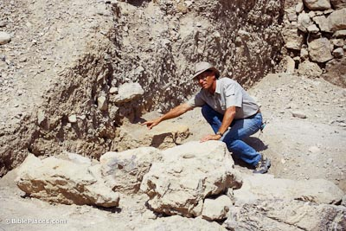
Jericho
Bible story is that walls of Jericho fell down flat – burned with fire (Josh. 6)
John Garstang excavated Jericho (1930, 1936).
Found an inner wall and outer wall – Outer wall suffered the most – fell down completely –burned with fire –houses along the wall burned and roof fallen in on pottery within. – Joseph Free, Archaeology and Bible History, 130)
Garstang’s work questioned by Kathleen Kenyon (1950’s)
Bryant Wood March/April 1990 issue of Biblical Archaeology Review vindicated Garstang’s work. (Jackson, Apologetics Press)
Bryant Wood points to the base of that mudbrick wall. All agree that the wall fell down, but they differ on the date. Wood’s conclusions are the most informed and they date the destruction of the wall to the time of Joshua (1400 BC).
Notes:
https://www.apologeticspress.org/apcontent.aspx?category=11&article=988
http://www.bibleplaces.com/jericho/

Slide 37
Bryant Wood – Archaeological Review
“When we compare the archaeological evidence at Jericho with the Biblical narrative describing the Israelite destruction of Jericho, we find a quite remarkable agreement” (1990, p. 53, emp. added).
-Quoted by Wayne Jackson, Apologetics Press
Wall fell down flat
Walls burned with fire
Houses along the wall
Took no possessions (grain left)
Notes:
https://www.apologeticspress.org/apcontent.aspx?category=11&article=988

Slide 38
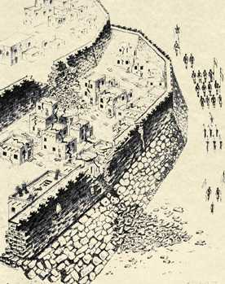
The Walls of Jericho
Artist's reconstruction of the north side of ancient Jericho, based on the German excavations of 1907-1909. Note the houses built against the mud brick city wall, which rests on top of the stone retaining wall
Josh. 2:15 says that Rahab's house was built against the city wall
Large pile of bricks found at base of inner and outer walls indicating sudden collapse of fortifications
Thick layer of soot indicates city was destroyed by fire, Josh. 6:24

Slide 39
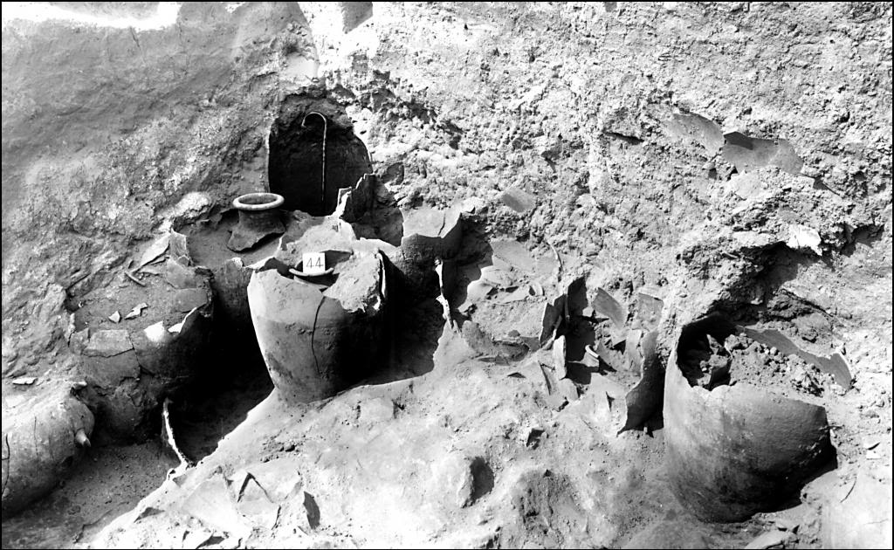
Jericho
Jars full of grain found by John Garstang at Jericho. They were charred in the fire that the Israelites set to destroy the Canaanite city
Notes:
http://www.inerrantword.com/180015375/blog/180004060/220000047/Recent_Archaeological_Discoveries_That_Lend_Credence_To_The_Historicity_of_the_Scriptures

Slide 40
For Faith
Archaeology
The Role of Archaeology
The Discoveries of Archaeology

Slide 41

In Young Adult Classroom

