Slide 1

Is there real
evidence for believing?
For Faith
Evidence for God part 1 (11-15)
Evidence for God part 2 (11-22)
The Problem of Evil (11-29)
The Bible and Science (12-06)
Creation (12-13)
Evolution (12-20)
The Genesis Flood (12-27)
Archeology (01-03)
Historical Jesus (01-10)
The Resurrection of Christ (01-17)
Inspiration of Scripture (01-24)
Canon and the Apocrypha (02-07)
Sunday Evening
Studies
Designed to build and strengthen
real faith

Slide 2

For Faith
February 7, 2015
Daniel H. King, Ph.D.
(Old Testament Studies & Biblical Languages)
9:00 AM: Plenary Inspiration of the Scriptures
9:50 AM: The Canonization of the Scriptures
5:30 PM: The Apocrypha
El Bethel Church of Christ ♦ 1801 Highway 41-A North ♦ Shelbyville, TN 37160

Slide 3
For Faith
The Genesis Flood

Slide 4

The Importance of the Genesis Flood
“The existence of the flood is denied by evolutionist, not so much for lack of evidence, as because of the necessity of keeping to strict uniformitarianism in order to provide more time for evolution.”
Thomas F. Heinze, Creation vs Evolution, 106-107

Slide 5
Two Models for Geological Record
Uniformitarianism
Has been uniformity in all natural, physical & geological events
Gradual changes over billions of years
Catastrophism
World wide flood
Cataclysmic
Sudden burial
Rapid sedimentation

Slide 6
The Flood Is Incompatible with Evolution
“It would be difficult to find an account from any period of biblical history that has been ridiculed more frequently, or with greater derisiveness, than the story of the Flood. Such a response from those who do not believe in God hardly is surprising, since by all accounts the concept of a recent global Flood is incompatible with the naturalistic system of origins espoused by unbelievers. For more than a hundred years the Flood has been under accelerated attack by infidels within the scientific community who have chosen to support such concepts as uniformitarianism and organic evolution. In fact, atheistic writers have admitted that one of the main forces behind the rise of uniformitarianism was the desire to eliminate God as Creator, and as Initiator of the Great Flood (see Gould, 1965, 1987).”
Bert Thompson, Ph.D
Apologetics Press
Notes:
http://apologeticspress.org/apcontent.aspx?category=9&article=130

Slide 7
For Faith
The Genesis Flood
The Bible Story

Slide 8

The Bible Story
Genesis 6-9

Slide 9
The Bible Story
Reason for the flood – wickedness (Gen. 6:5-8)
Instructions & preparation (6:14-22)
Noah’s family & animals enter the ark (7:1-16)
Rained for 40 days and nights (7:4, 12, 17)
Fountains of the deep were broken up (7:11)
Depth of the flood (7:20)
All flesh died (7:21-23)
How long it lasted
  150 days (7:24)
  Waters began to decrease (8:1-5)
  Noah & family came out a year later (8:13-19)

Slide 10


Warrren E. Wiersbe’s Chronology
2-10 – Entered the ark (7:4)
2-17 – Rains (7:11)
3-26 – Rain stops (7:12)
7-17 – Ark rested on Ararat (8:4)
10-1 – See top of mountain (8:5)
11-11 – Sent out Raven & Dove (8:6)
11-18 – Dove returned (8:10-11)
11-25 – Dove did not return (8:12)
1-1 – Noah removed cover (8:13)
2-27 – Left the ark (8:14)
Wiersbe’s Outlines of the Old Testament, 32

Slide 11
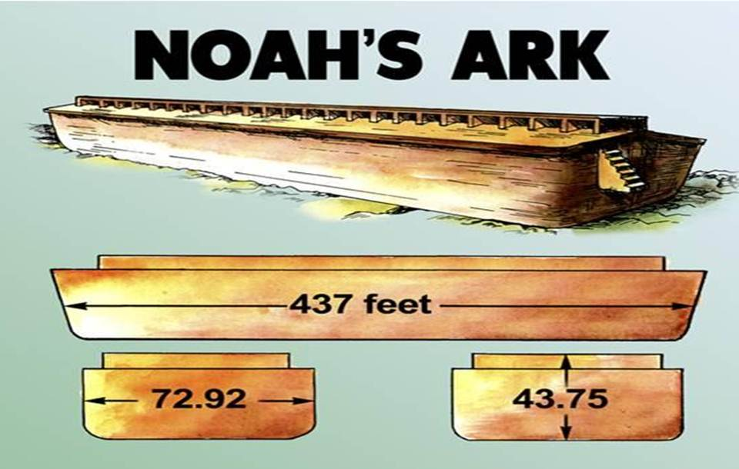
The Size of
Genesis 6:15
450 feet
75 feet
45 feet

Slide 12
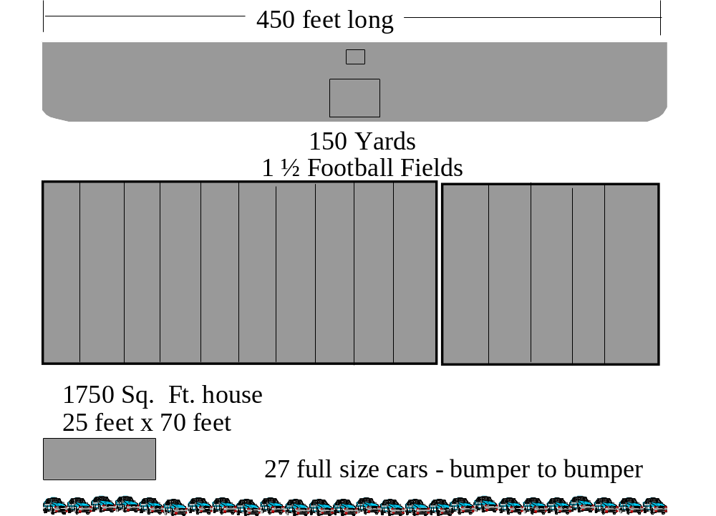

Slide 13
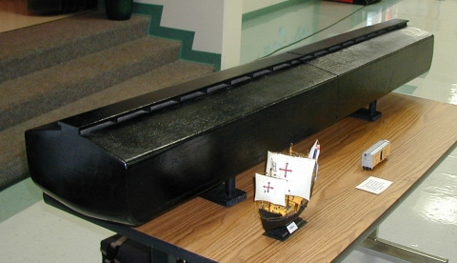
Photo courtesy of Arnold Mendez
The replica of Noah's ark shown above is 1/75 scale. For comparison purposes, both the railroad stockcar and model of the sailing ship Pinta (one of Columbus' ships) are also at the same 1/75 scale model size.
The full-size version of the railroad stockcar model shown in the picture is 44 feet long and has a capacity of 2,670 cubic ft. The ark's volume was 1,518,000 cubic ft., which is equal to 569 railroad stockcars. Strung together these stockcars would make a train five and one-half miles long!

Slide 14
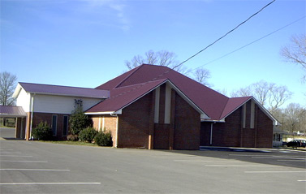
45
Ft

Slide 15

60’
76’

Slide 16


Plenty of Room in the Ark
John C. Whitcomb
“For the sake of realism, imagine waiting at a railroad crossing while ten freight trains, each pulling 52 boxcars, move slowly by, one after another. That is how much space was available in the Ark, for its capacity was equivalent to 520 modern railroad stock cars. A barge of such gigantic size, with its thousands of built-in compartments (Gen. 6:14) would have been sufficiently large to carry two of every species of air-breathing animal in the world today (and doubtless the tendency toward taxonomic splitting has produced more “species” than can be justified in terms of Genesis “kinds”) on only half of its available deck space. The remaining space would have been occupied by Noah’s family, five additional representatives of each of the comparatively few kinds of animals acceptable for sacrifice, two each of the kinds that have become extinct since the Flood, and food for them all (Gen. 6:21)” (The World That Perished, 23)

Slide 17
For Faith
The Genesis Flood
The Bible Story
Was it Universal or Local?

Slide 18
What it Universal or Local?
It is argued that the flood was limited to the Mesopotamian region

Slide 19

The Flood & An Old Earth Concept Cannot Coexist
Henry M. Morris, Ph.D.
“The Biblical Flood in the days of Noah has become a great divide between two watersheds of belief. On the one hand there are those who say it is either a purely mythological event or else possibly a local or regional flood. This group includes practically all evolutionists, but it also includes the ‘old-earth creationists.’ These all accept the so-called geological ages as the approved record of Earth history, recognizing that a global hydraulic cataclysm would have destroyed any evidence for such geological ages. The geological ages concept and a worldwide devastating Flood logically cannot coexist.”
Notes:
http://apologeticspress.org/apcontent.aspx?category=9&article=130
Morris, Henry M. (1998), “Why Christians Should Believe in a Global Flood,” Back to Genesis (El Cajon, CA: Institute for Creation Research), 116:a-c, August.

Slide 20
The Flood & An Old Earth Concept Cannot Coexist
Henry M. Morris, Ph.D.
“On the other hand, ‘young-earth creationists’ accept the Biblical record of the Flood as a literal record of a tremendous cataclysm involving not only a worldwide Flood, but also great tectonic upheavals and volcanic outpourings that completely changed the crust of the earth and its topography in the days of Noah. Those of us who hold this view are commonly ridiculed as unscientific and worse, so it would be more comfortable and financially rewarding if we would just go along with the evolutionist establishment, downgrade the Flood, and accept the geological ages (1998, p. a, emp. Added).”
(1998), “Why Christians Should Believe in a Global Flood,” Back to Genesis (El Cajon, CA: Institute for Creation Research), 116:a-c, August).
Notes:
http://apologeticspress.org/apcontent.aspx?category=9&article=130
Morris, Henry M. (1998), “Why Christians Should Believe in a Global Flood,” Back to Genesis (El Cajon, CA: Institute for Creation Research), 116:a-c, August.

Slide 21
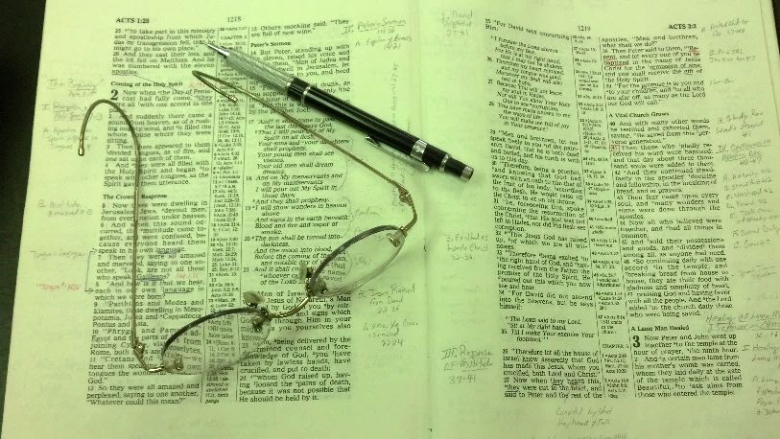
The Text Says
It Was Universal
8:9 – waters on face of whole earth
6:7 – destroy man from earth
6:13 – destroy all flesh with earth
6:17 – every living thing in the earth
7:4 – destroy all from face of earth
7:19 – all high hills under heaven
7:21 – every creeping thing & every man
9 – Rainbow argues for universal flood

Slide 22
A Local Flood?
If so, why build the ark?
If so, why didn’t Noah & animals just migrate?
If so, what promise is in the rainbow?
If so, God’s purpose of destruction of every land creature – not accomplished!

Slide 23
For Faith
The Genesis Flood
The Bible Story
Was it Universal or Local?
Evidence of the Flood

Slide 24
Evidence of the Flood
Jesus endorsed the record of the Genesis flood
  Jesus is proven to be the Son of God by the resurrection (Rom. 1:4)
  Jesus endorsed the creation story (Matt. 19:3-6) – thus endorsing the book of Genesis
  Jesus endorsed the Genesis flood
    Matt. 24:36-39
    Luke 17:26-27

Slide 25
Evidence of the Flood
Jesus endorsed the record of the Genesis flood
Geologic findings

Slide 26
Caution About Scientific Evidence of the Flood
“However, I believe a word of caution is in order. In the past, extremes have been documented from those on both sides of the issue. Some have made indefensible statements like ‘...There is no way geologically of supporting the idea that there was a worldwide flood...’ (Clayton, 1969). On the other hand, some have interpreted almost every shred of evidence as supporting a global Flood, even going so far as to identify a particular layer within the geologic column as the Flood layer—a posture that, in the end, proved extremely inadvisable (as well as embarrassing).
Both extremes should be avoided. Biblical evidence establishes the fact that there was a universal Flood. Knowing that, we then may be alert to evidence from science that possibly provides support for the Flood model. At the same time, however, we must realize that it is not always an easy task to interpret such evidence, for none among us has experienced or witnessed a global Flood. As Austin has warned: ‘The worldwide Flood recounted in Genesis has no parallel in today’s world’ (1994, p. 192).”
- Bert Thompson, Ph.D., Apologetics Press
Notes:
https://www.apologeticspress.org/apcontent.aspx?category=9&article=132

Slide 27
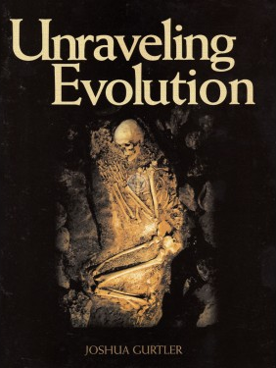

Catastrophic Events Leave Evidence
“These two great events [separation of waters from firmament & the flood, DVR] would have probably involved massive tectonic plate shifts, volcanic activity, and ensuing millions of tons of sedimentary deposition. The consequences would be the rapid layering that is seen in the geologic column, along with the multitudes of fossils, and vast stores of coal from the compression of many cubic miles worth of organic materials such as animals and vegetation” (p. 69)
Joshua Gurtler, Ph.D

Slide 28
Evidence of the Flood
Jesus endorsed the record of the Genesis flood
Geologic findings
  Karoo Supergroup in Africa

Slide 29
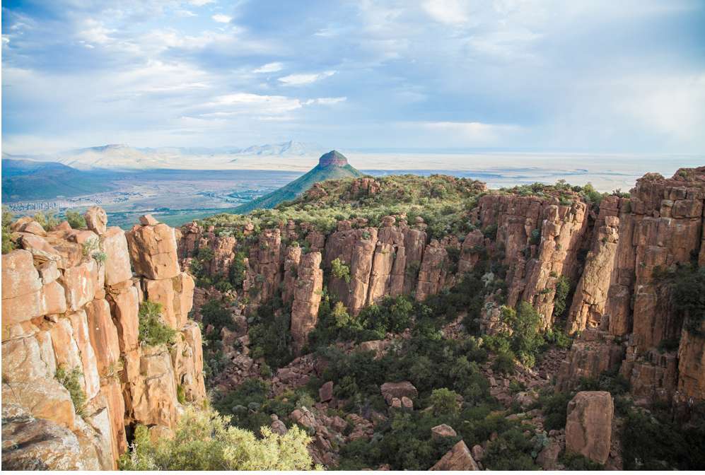
Karoo Valley in South Africa
Located amidst Karoo Supergroup
Contains 800 billion rapidly buried vertebrate animals
A catastrophic occurrence would account for that
Notes:
Cf Unraveling Evolution, Josh Gurtler, 69

Slide 30
Evidence of the Flood
Jesus endorsed the record of the Genesis flood
Geologic findings
  Karoo Supergroup in Africa
  Miocene shales in California

Slide 31
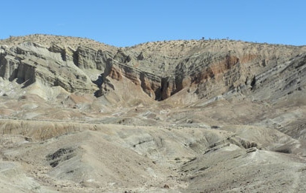
Miocene shales of California
1 billion fish fossilized within four square miles
A catastrophic occurrence would account for that
Notes:
Cf Unraveling Evolution, Josh Gurtler, 69

Slide 32
Evidence of the Flood
Jesus endorsed the record of the Genesis flood
Geologic findings
  Karoo Supergroup in Africa
  Miocene shales in California
  Fossils in top of moutains

Slide 33

Marine fossils on the tops of mountains!
Fossil ammonites (coiled marine cephalopods) like this one are found in limestone beds high in the Himalayas of Nepal. How did marine fossils get thousands of feet above sea level?

Slide 34
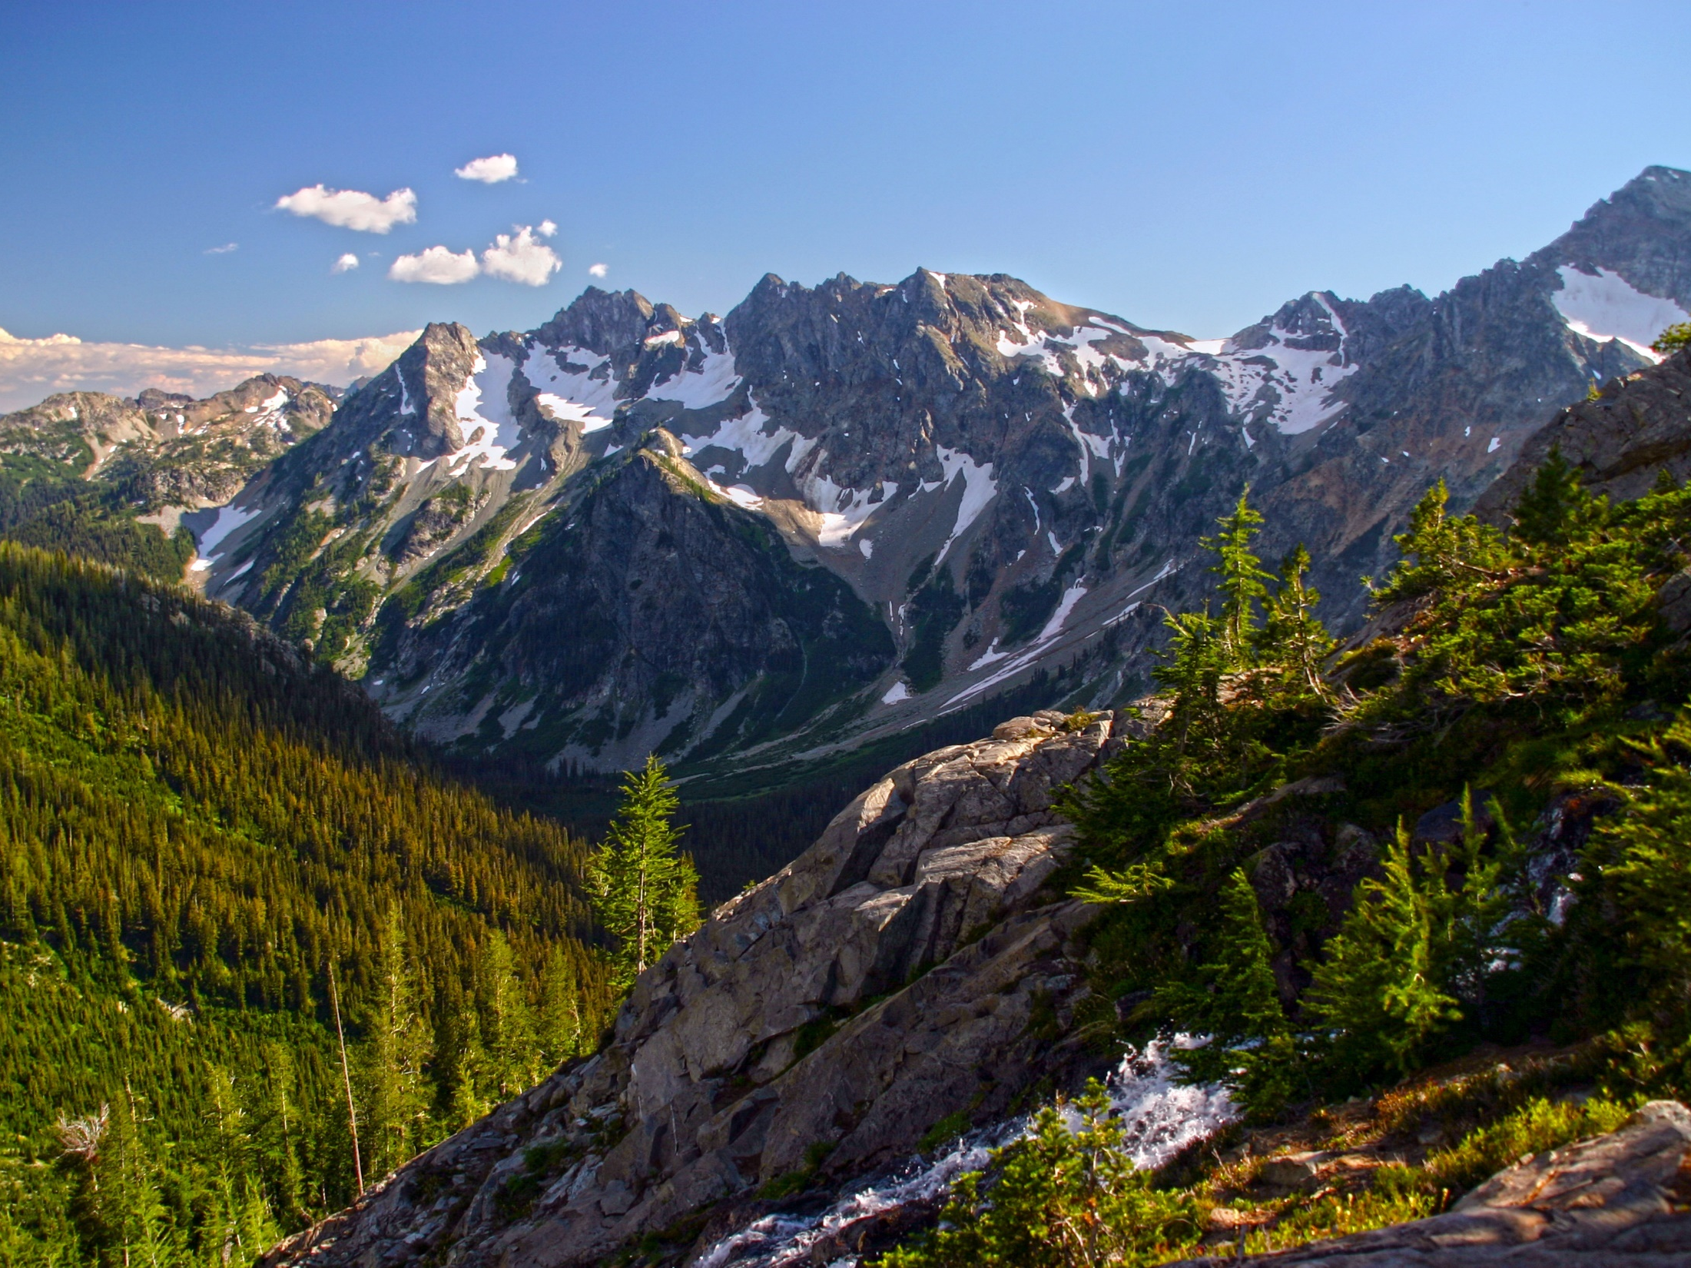

Mountains Have Been Under Water
“Geologic evidence suggests that most, if not all, of the world’s mountains have been under water at some point in the past—a conclusion demanded by the existence of sedimentary deposits and marine fossils at or near their summits. Much of the Earth’s crust is composed of sedimentary rocks (shales, limestones, sandstones, etc.) that generally are known to form under water.”
Bert Thompson, Ph.D.
Apologetics Press
Notes:
https://www.apologeticspress.org/apcontent.aspx?category=9&article=132

Slide 35
Evidence of the Flood
Jesus endorsed the record of the Genesis flood
Geologic findings
  Karoo Supergroup in Africa
  Miocene shales in California
  Fossils in top of mountains
  Rapid sedimentation

Slide 36

Evidence a Catastrophic Event
Contemporary Rapid
Sedimentation
“Some sedimentary layers, that were supposedly created millions of years apart, are often interbedded within one another. One example of this shows Cambrian and Mississippian sedimentary layers interbedded one on top of the other. The only problem with this is that the Cambrian (Mauv limestone) layers were allegedly laid down over 150 million years before the Mississippian (Redwell limestone) layers! How did the Cambrian come out on top?”
Joshua Gurtler, Ph.D, Unraveling Evolution, 70-72

Slide 37
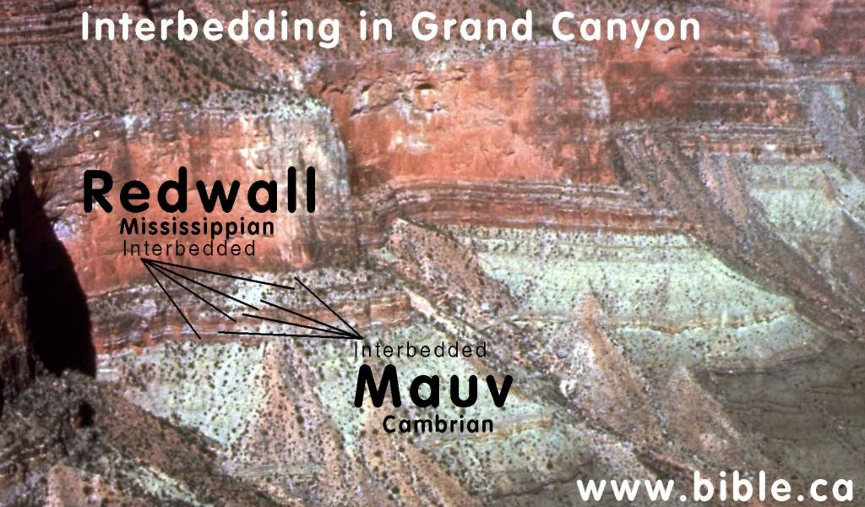
Photo credit: Don Patton & Steve Rudd

Slide 38
Evidence a Catastrophic Event
Rapid Sedimentation
“ Evidence shows that the sedimentary layers in the geologic column were formed rapidly rather than slowly.”(p. 71)
“..rocks hold dinosaur fossils contain only the dinosaurs and not the vegetation necessary to sustain life. But why?...Where is all of their food?! A full grown Apatosaurus would require over three tons of vegetation per day! Why are the dinosaurs buried absent of their surrounding ecosystem? Could this be evidence of a catastrophic burial? Yes.” (p. 71).
Trees set in several layers of sedimentation is evidence of rapid sedimentation
Joshua Gurtler, Ph.D, Unraveling Evolution, 70-72

Slide 39
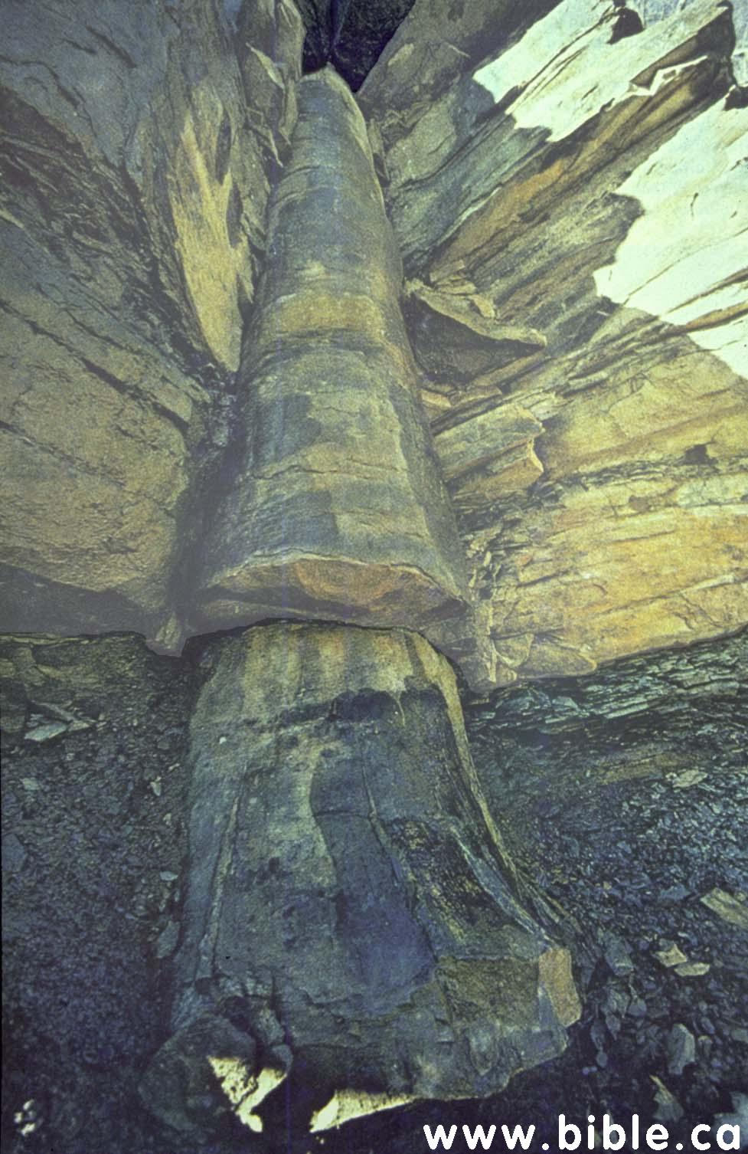
“A polystrate fossilized tree near Cookeville, TN in the Kettles coal mines. This tree was supposedly buried gradually amidst millions of years of sediment. Only a rapid catastrophic burial could create such pristine preservation.”
Joshua Gurtler, Ph.D, Unraveling Evolution, 70-72.
Photo: Don Patton & Steve Rudd
This tree begins in one coal seam, protrudes upward through numerous layers and finally into another layer of coal.

Slide 40

Fossil Evidence of Rapid Burial & Disorder
“Worldwide fossilization has occurred in vast quantities, including fossils of even many modern forms of life. These fossils are found in sedimentary strata, often at great depths and under great pressure. Yet as Morris has observed: ‘Fossils, however, normally require very rapid burial and compaction to be preserved at all. Thus every sedimentary formation appears to have been formed rapidly—even catastrophically—and more and more present-day geologists are returning to this point of view’ (1998, p. b). While it is not creationists’ intention to suggest that every instance of rapid burial and fossilization or mass destruction is attributable directly and specifically to the Great Flood, many may well be.
Sedimentary fossil ‘graveyards’ have been found worldwide in rocks of all ‘ages.’ Various rock types (granite, shale, limestone, etc.) are found in all parts of the geologic column, and there exists a general disorder in the fossil record, which would be expected if a global Flood occurred.”
- Bert Thompson, Ph.D. Apologetics Press
Notes:
https://www.apologeticspress.org/apcontent.aspx?category=9&article=132

Slide 41
Evidence of the Flood
Jesus endorsed the record of the Genesis flood
Geologic findings
Flood legends

Slide 42

“The existence among all races of stories or traditions of a great flood which destroyed all mankind has long been known and regarded by those familiar with them as a remarkable confirmation of the truth of the Deluge account in Genesis” (p. 165).
Byron C. Nelson

Slide 43

“Traditions similar to this record are found among nearly all the nations and tribes of the human race. And this is as one would expect it to be. If that awful world catastrophe, as described in the Bible, actually happened, the existence of the Flood traditions among the widely separated and primitive people is just what is to be expected. It is only natural that the memory of such an event was rehearsed in the ears of the children of the survivors again and again, and possibly made the basis of some religious observances” (1951, pp. 127-128).
Alfred M. Rehwinkel

Slide 44
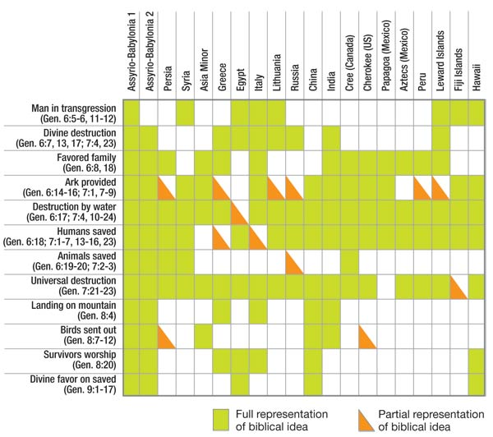
Byron C. Nelson
Notes:
https://answersingenesis.org/the-flood/flood-legends/flood-legends/

Slide 45

Flood Legends
Legends have been reported from nations such as China, Babylon, Mexico, Egypt, Sudan, Syria, Persia, India, Norway, Wales, Ireland, Indonesia, Romania, etc
“In 95 percent of the more than two hundred flood legends, the flood was worldwide; in 88 percent, a certain family was favored; in 70 percent, survival was by means of a boat; in 67 percent, animals were also saved; in 66 percent, the flood was due to the wickedness of man; in 66 percent, the survivors had been forewarned; in 57 percent, they ended up on a mountain; in 35 percent, birds were sent out from the boat; and in 9 percent, exactly eight people were spared.” (James Perioff, Tornado in a Junkyard: The Relentless Myth of Darwinism, 168)

Slide 46
For Faith
The Genesis Flood
The Bible Story
Was it Universal or Local?
Evidence of the Flood
The Flood Explains & Answers

Slide 47
The Flood Explains and Answers
For the geological phenomena
“This writer contends that the Genesis flood of Genesis 6-8 is an adequate answer for the geological phenomena which we observe today. In fact, most paleontological and geological phenomena we see today can be explained only in light of cataclysmal geology; that is, fossils and strata were formed by sudden burial and sedimentation and not by a slow process of natural happenings – uniformitarianism” (Roger E. Dickson, The Fall of Unbelief, 243).

Slide 48
The Flood Explains and Answers
For the geological phenomena
What happened to dinosaurs

Slide 49
What Happened To Dinosaurs?
Evolutionist Explanation
  Sudden climate change – couldn’t survive
  Asteroid (6 mi wide) impacted the earth (caused dust & soot to block sun rays causing plants to die (in turn the herbivores and then the carnivores) (Thompson, Dinosaur Controversy)
  Massive disease
  Volcanic Greenhouse

Slide 50
Response:
Why did the asteroid kill every dinosaur but left many other forms of life unharmed?
Why did the asteroid not kill other reptiles such as turtles and alligators?
Nothing in the fossil record supports the idea that all the dinosaurs died at once.

Slide 51
All Agree
Something Catastrophic
Sudden
(Account for fossil record)

Slide 52
What Happened To Dinosaurs?
Evolutionist Explanation
Creationist Explanation
  Flood (Gen. 6-8)
    Global (7:19)
    Explains the sudden death, massive fossil graveyard

Slide 53
What Happened To Dinosaurs?
Evolutionist Explanation
Creationist Explanation
  Flood (Gen. 6-8)
  In The Ark
    Some must have survived in the ark
    He took two of every kind, not species (Gen. 6:19-20)
    How in the ark?

Slide 54
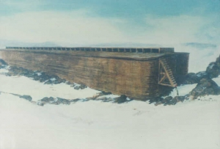
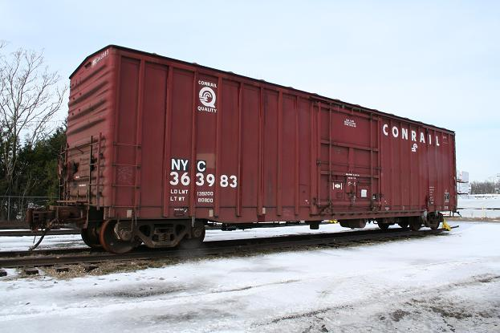
How Was It
Possible In The Ark?
Ark was huge:
  450 ft long, 75 ft wide, 45 ft high
  100,000 sq. ft
  Hold 520 modern railroad boxcars!

Slide 55
How Was It
Possible In The Ark?
Ark was huge:
Not all dinosaurs were massive

Slide 56
“To some, the idea of dinosaurs on the ark seems absurd. However, it is not so hard to accept the idea of dinosaurs on the ark after considering the subject carefully. First, remember that God was the Creator of all animals, and He knew exactly how big the ark needed to be in order to house all different kinds of land-living animals. Second, contrary to popular belief, not all dinosaurs were massive. According to the famous evolutionary dinosaur fossil-hunter John Horner, the average dinosaur was only about the size of a large cow (see Horner and Lessem, 1993, p. 124). Many dinosaurs were only a few feet tall—even as full-grown adults. Some were as small as chickens. Third, God may have allowed Noah to take baby dinosaurs into the ark, instead of those that were full grown. That allowance certainly would have saved space and reduced the amount of necessary food. The largest fossil dinosaur eggs indicate that a 40-foot-long dinosaur laid eggs that were less than a foot in diameter (see “Dinosaur Reproduction,” 2007). As hatchlings, even the largest dinosaurs were no bigger than an average house pet. Young dinosaurs on the ark would have needed no more space than the average dog.”
- Kyle Butts and Eric Lyons, What Happened to Dinosaurs?

Slide 57

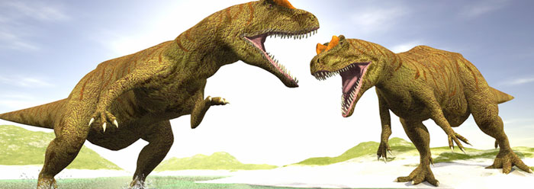
New Study Finds Dinosaur Models Are Too Thick
by Brian Thomas, M.S.
Dinosaur reconstructions in museums worldwide may all be too large, according to new research published in the Journal of Zoology. Researchers revisited the 25-year-old statistical formula used to estimate dinosaur mass, based on fossilized skeletal information. The old formula is “seriously flawed,” according to study author Gary Packard.¹
If the new formula holds up, it strengthens the feasibility of the Noah’s Ark account in Genesis, which has already been thoroughly established.² Not only would Noah have taken on two skinnier-than-previously-thought juvenile representatives of each of the larger dinosaur kinds, but his family would have been less burdened with feeding requirements during the year-long event
Notes:
http://www.icr.org/article/new-study-finds-dinosaur-models-are

Slide 58
New Study Finds Dinosaur Models Are Too Thick
by Brian Thomas, M.S.
The new predictions of dinosaur size may also alleviate a longstanding conundrum over herbivorous dinosaurs. How could the large dinosaurs, such as Stegosaurus and Apatosaurus, have eaten enough food to support their massive bodies when they had such small mouths on their tiny (by comparison) heads? Perhaps they didn’t have to eat quite so much after all, if their bodies were actually substantially less bulky.
How off was the old mass-estimation equation? According to this research, today’s dinosaur models depict dinosaurs being twice as massive as the new estimates say they should be. The fact that such a remarkable difference in mass estimation has gone unchallenged for so long illustrates how tenuous paleontological reconstructions tend to be.
Notes:
http://www.icr.org/article/new-study-finds-dinosaur-models-are

Slide 59
New Study Finds Dinosaur Models Are Too Thick
by Brian Thomas, M.S.
The old formula has had a widespread impact, having dictated perception of dinosaur sizes for the entire Western culture. If something so basic can so easily be misconstrued from the physical evidence, what other misinformation is being spread? Without being able to base depictions of early earth history on the trustworthy information from the biblical record, reconstructions of dinosaurs’ lives and times will forever inhabit a near-fictional realm.
Notes:
http://www.icr.org/article/new-study-finds-dinosaur-models-are

Slide 60
What Happened To Dinosaurs?
Evolutionist Explanation
Creationist Explanation
  Flood (Gen. 6-8)
  In The Ark
  Driven to extinction
    Climate change after the flood (even people died at younger ages after the flood)
    Earth filled with humans (perhaps hunted & killed as happens with other animals)
    Eaten by mammals

Slide 61
Dinosaur Found Inside Mammal
“Villagers digging in China’s rich fossil beds have uncovered the preserved remains of a tiny dinosaur in the belly of a mammal, a startling discovery for scientists who have long believed early mammals couldn’t possibly attack and eat a dinosaur” (Verrengia, 2005).
(AP Report, Nature, Jan. 13, 2005)

Slide 62
For Faith
The Genesis Flood
The Bible Story
Was it Universal or Local?
Evidence of the Flood
The Flood Explains & Answers

