Slide 1

Is there real
evidence for believing?
For Faith
Evidence for God part 1 (11-15)
Evidence for God part 2 (11-22)
The Problem of Evil (11-29)
The Bible and Science (12-06)
Creation & Evolution (12-13)
The Genesis Flood (12-20)
Archeology (01-03)
Historical Jesus (01-10)
The Resurrection of Christ (01-17)
Inspiration of Scripture (01-24)
Canon and the Apocrypha (02-07)
Sunday Evening
Studies
Designed to build and strengthen
real faith

Slide 2

For Faith
Daniel H. King, Ph.D.
(Old Testament Studies & Biblical Languages)
The Canon & The Apocrypha
Three Lessons (9:00 am; 9:50 am; 5:30 pm)
February 7, 2015

Slide 3
For Faith
Creation & Evolution
There are two contrasting views of the origin of life & universe

Slide 4
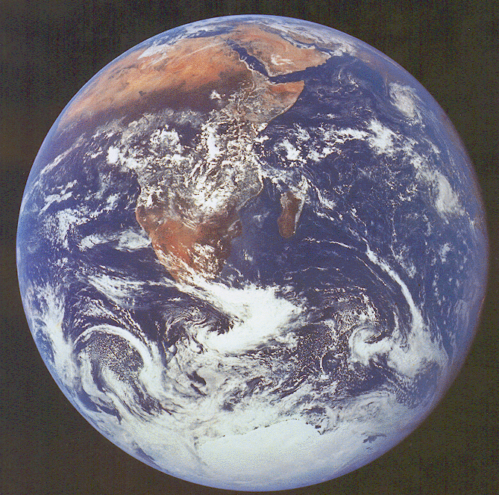
Man Teaches
That It All Began With
From Non-Living Matter
And Evolved Into
Its Present Form
The Bible Teaches
That God Created
The World & All Things In It
In Six Literal Days

Slide 5
The Bible Says:
Man Says:
The Genesis Account
Evolution
Both are matters of FAITH!

Slide 6
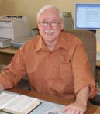
“But as one examines the theory of evolution he is suddenly struck with the thought that it demands more faith than does the creation account of Genesis 1.”
Roger E. Dickson, Ph.D
The Fall of Unbelief, 186

Slide 7
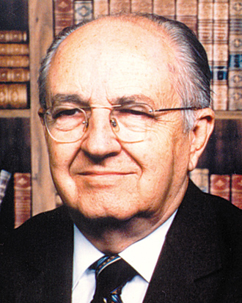

Not Established by Scientific Method
“Of all people, there is perhaps less reason for the scientists, than for any other, to accept evolution. By its very nature, evolutionary history is beyond the reach of his scientific method, having to do with origins, with events of the prehistoric past which are nonrepeatable and nonmeasureable.”
Henry Morris, Ph.D
Studies in the Bible and Science, 145

Slide 8
For Faith
Creation and Evolution
Evidence for Creation

Slide 9
Evidence for Creation
Based upon fact that God is
  Evidence presented in lessons # 1 & 2
  Means the Bible story is true
  Word of God says He created the world (75 references in OT & NT)
  Jesus (proven to be deity by resurrection – Rom 1:4) endorsed the Genesis account (Matt. 19:3-6)
  God governs and sustains all things (Col. 1:17; Heb 1:3; Acts 17:28)

Slide 10
Evidence for Creation
Based upon fact that God is
Created all things in six literal days

Slide 11
Genesis 1-2
“Day”
Ordinary Meaning
Nothing to demand otherwise
Day 1 - World Created - Light
Day 2 - Divided Waters From Firm.
Day 3 - Divided Waters From Land
Grass, Trees & Plants
“Day”
Evening & Morning
Day 4 - Stars, Sun & Moon
Day 5 - Birds & Sea Creatures
Day 6 - Cattle, Beast & Man

Slide 12

Genesis 5:1-5
1 This is the book of the genealogy of Adam. In the day that God created man, He made him in the likeness of God.
2 He created them male and female, and blessed them and called them Mankind in the day they were created.
3 And Adam lived one hundred and thirty years, and begot a son in his own likeness, after his image, and named him Seth.
4 After he begot Seth, the days of Adam were eight hundred years; and he had sons and daughters.
5 So all the days that Adam lived were nine hundred and thirty years; and he died.

Slide 13
Genesis 5:1-5
Adam & Eve were created same day
Two measures of time:
Day(s)
Years
Literal or non-literal?
Was Adam literally 930 years old?
How old was the creation when Adam died?

Slide 14
Exodus 20:9-11
9 Six days you shall labor and do all your work,
10 but the seventh day is the Sabbath of the LORD your God. In it you shall do no work: you, nor your son, nor your daughter, nor your male servant, nor your female servant, nor your cattle, nor your stranger who is within your gates.
11 For in six days the LORD made the heavens and the earth, the sea, and all that is in them, and rested the seventh day. Therefore the LORD blessed the Sabbath day and hallowed it.

Slide 15
Exodus 20:9-11
Not just the living things of the earth created in six days, but the heavens, earth and seas.
7 days of Creation - Parallel - to 7 days of a normal week for Israel.
Divine Commentary on Genesis 1-2
Creation - Six Literal Days

Slide 16
Exodus 31:15-17
15 Work shall be done for six days, but the seventh is the Sabbath of rest, holy to the LORD. Whoever does any work on the Sabbath day, he shall surely be put to death.
16 Therefore the children of Israel shall keep the Sabbath, to observe the Sabbath throughout their generations as a perpetual covenant.
17 It is a sign between Me and the children of Israel forever; for in six days the LORD made the heavens and the earth, and on the seventh day He rested and was refreshed.' "

Slide 17
Exodus 31:15-17
7 days of Creation - Parallel - to 7 days of a normal week for Israel.
In six days God created Heavens & Earth
Divine Commentary on Genesis 1-2
Creation - Six Literal Days

Slide 18
Psalms 33:6-9
6 By the word of the LORD the heavens were made, And all the host of them by the breath of His mouth.
7 He gathers the waters of the sea together as a heap; He lays up the deep in storehouses.
8 Let all the earth fear the LORD; Let all the inhabitants of the world stand in awe of Him.
9 For He spoke, and it was done; He commanded, and it stood fast.

Slide 19
Psalms 33:6-9
God: Spoke - Done - Stood Fast
Instantaneous - not - Billions of years to stabilize
“Done” does not mean “Begun”
Divine Commentary on Genesis 1-2
Creation - Instantaneous

Slide 20
Hebrews 4:3
3 For we who have believed do enter that rest, as He has said: "So I swore in My wrath, They shall not enter My rest," although the works were finished from the foundation of the world.

Slide 21
Hebrews 4:3
Work of creation - Finished at the foundation or world
IF God began His work at foundation - then finished it billions of years later - this passage is not so!
Divine Commentary on Genesis 1-2
Creation - Completed in Short Time

Slide 22
Matthew 19:4-6
Mark 10:6
4 And He answered and said to them, "Have you not read that He who made them at the beginning 'made them male and female,'
5 and said, 'For this reason a man shall leave his father and mother and be joined to his wife, and the two shall become one flesh'?
6 So then, they are no longer two but one flesh. Therefore what God has joined together, let not man separate."

Slide 23
Matthew 19:4-6
Mark 10:6
6 But from the beginning of the creation, God 'made them male and female.'

Slide 24
Matthew 19:4-6
Mark 10:6
God made male & female.
God made male & female at same time.
Man was created at the beginning of creation.
If billions of years -- man created closer to our time than beginning.

Slide 25
Matt. 19:4-6; Mark 10:6
“He who made them at the beginning ‘made them male and female,’”
Created Closer to us than begin.
Day 1
Day 2
Day 3
Day 4
Day 5
Day 6
Made
Man
Day 7
“Now”

Slide 26

Creation Account
Is It Literal or Non-Literal?
Genesis 1-2
Genesis 5:1-5
Exodus 20:9-11
Exodus 31:15-17
Psalm 33:6-9
Hebrews 4:3
Matt. 19:4-6
Mark 10:6

Slide 27
Evidence for Creation
Based upon fact that God is
Created all things in six literal days
Evidence of a relative young earth argues for creation
  If the earth is young (thousands not billions of years) there is not enough time for evolution

Slide 28

Time Makes All the Difference
“Both evolutionists and creationist believe evolution is an impossibility if the universe is only a few thousand years old. There is probably no statement that would be made on the topic of origins which would meet with so much agreement from both sides. Setting aside the question of whether vast time is competent to propel evolution, we must query if vast time is indeed available.”
(R. L. Wysong, The Creation-Evolution Controversy, 144)

Slide 29

Time Makes All the Difference
“It is interesting to observe how something on which both sides agree has caused so much disagreement. Aside from the basic issue of whether creation or evolution is correct, the most serious area of conflict between the biblical and the evolutionary scenarios is the chronological framework of history—in other words, the age of the Earth. …While a young Earth presents no problem whatsoever for a creationist, it is the death knell to each and every variety of the evolutionary scenario.”
(Bert Thompson, Ph.D, Reason & Revelation, Vol. 14, No. 7 [1994])
Notes:
https://www.apologeticspress.org/apPubPage.aspx?pub=1&issue=435&article=366

Slide 30
Evidence for Creation
Based upon fact that God is
Created all things in six literal days
Evidence of a relative young earth argues for creation
  If the earth is young (thousands not billions of years) there is not enough time for evolution
  Evidence that earth is not billions or even millions of years old

Slide 31

“Evidence That Implies a Young Earth and Solar System”
Institute for Creation Research, March 1981
Walter T. Brown, Jr., Ph.D
(Former Evolutionist)
“Actually most dating techniques show that the earth and solar system are young – usually less than 10,000 years old.”

Slide 32


“Evidence That Implies a Young Earth and Solar System”
Walter T. Brown, Ph.D
Atomic Clocks
Atomic clocks, which have measured the earth’s spin rate to the nearest billionth of a second, have consistently found that the earth is slowing down at the rate of almost one second a year (cf. Arthur Fisher, “The Riddle of the Leap Second,” Popular Science, Vol. 202, March 1973, 110‑113, 164‑166; Air Force Cambridge Research Laboratory, Earth Motions and Their Effect on Air Force Systems, November 1975, 6; Jack Fincher, “And Now, Atomic Clocks,” Readers’ Digest, Vol. III, November 1977, 34).
If the earth were billions of years old, its initial spin rate would have been fantastically rapid — so rapid that major distortions in the shape of the earth would have occurred.
As quoted by Daniel H. King, Ph.D. The Days of Creation, 23-31
Notes:
As quoted by Daniel King, Ph.D. The Days of Creation, 23-31
http://www.truthmagazine.com/archives/volume44/V4407060011.htm

Slide 33
“Evidence That Implies a Young Earth and Solar System”
Walter T. Brown, Ph.D
Earth’s Magnetic Field
Measurements of the earth’s magnetic field, since Karl Gauss first evaluated it in 1835, show a steady and rapid decline in its strength.
Physicists like Sir Horace Lamb and Dr. Thomas Barnes have examined the depletion of the earth’s magnetic field and shown that, given its rate of depletion, the earth cannot be older than about 10,000 years.
If this view is correct, then 25,000 years ago the electrical current would have been so vast that the earth’s structure could not have survived the heat produced. (Thomas G. Barnes, Origin and Destiny of the Earth’s Magnetic Field [San Diego: Institute for Creation Research, 1973]).
As quoted by Daniel H. King, Ph.D. The Days of Creation, 23-31
Notes:
As quoted by Daniel King, Ph.D. The Days of Creation, 23-31

Slide 34
“Evidence That Implies a Young Earth and Solar System”
Walter T. Brown, Ph.D
Helium Production
The atmosphere has less than 40,000 years worth of helium, based on the production of helium from the decay of uranium and thorium.
There is no known means by which large amounts of helium can escape from the atmosphere.
If the present rate of accumulation had been constant throughout four billion years of the earth’s history, there should be thirty times as much helium in our present atmosphere as is presently there.
The atmosphere therefore appears to be young (Melvin A. Cook, Prehistory and Earth Models [London: Max Parrish, 1966], 10‑14).
As quoted by Daniel H. King, Ph.D. The Days of Creation, 23-31
Notes:
As quoted by Daniel King, Ph.D. The Days of Creation, 23-31

Slide 35
“Evidence That Implies a Young Earth and Solar System”
Walter T. Brown, Ph.D
Cosmic Dust
The rate at which meteoritic dust is accumulating on the earth is such that after five billion years, the equivalent of 182 feet of this dust should have accumulated.
Because this dust is high in nickel, there should be an exceedingly large amount of nickel in the crustal rocks of the earth.
No such concentration has been found — on land or in the oceans. Consequently, the earth appears to be young (Henry M. Morris, Scientific Creationism [San Diego: Creation‑Life Publishers, 1974], 151‑153; Steveson, 23‑25; Hans Peterson, “Cosmic Spherules and Meteoritic Dust,” Scientific American, Vol. 202, February 1960, 132).
As quoted by Daniel H. King, Ph.D. The Days of Creation, 23-31
Notes:
As quoted by Daniel King, Ph.D. The Days of Creation, 23-31

Slide 36
“Evidence That Implies a Young Earth and Solar System”
Walter T. Brown, Ph.D
Comets “Boil Off”
Short period comets “boil off” some of their mass each time they pass the sun.
Nothing should remain of these comets after about 10,000 years. There are no known sources for replenishing comets.
If comets came into existence at the same time as the solar system, the solar system must be less than 10,000 years old (see Thomas D. Nicholson, “Comets, Studied for Many Years, Remain an Enigma to Scientists,” Natural History, March 1966, 44‑47; Harold Armstrong, “Comets and a Young Solar System,” Speak to the Earth, ed. George F. Howe [New Jersey: Presbyterian and Reformed Publishing Co., 1975], 327‑330; and Steidi, 58‑59).
As quoted by Daniel H. King, Ph.D. The Days of Creation, 23-31
Notes:
As quoted by Daniel King, Ph.D. The Days of Creation, 23-31

Slide 37
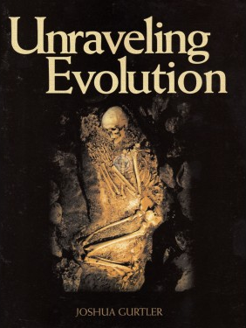

Evidence for a Young Earth
Contemporary Rapid
Sedimentation
Uniformitarianism says that millions of years are needed to produce the sedimentation we see in the geological column.
“Some sedimentary layers, that were supposedly created millions of years apart, are often interbedded within one another. One example of this shows Cambrian and Mississippian sedimentary layers interbedded one on top of the other. The only problem with this is that the Cambrian (Mauv limestone) layers were allegedly laid down over 150 million years before the Mississippian (Redwell limestone) layers! How did the Cambrian come out on top?”
Joshua Gurtler, Ph.D, Unraveling Evolution, 70-72

Slide 38
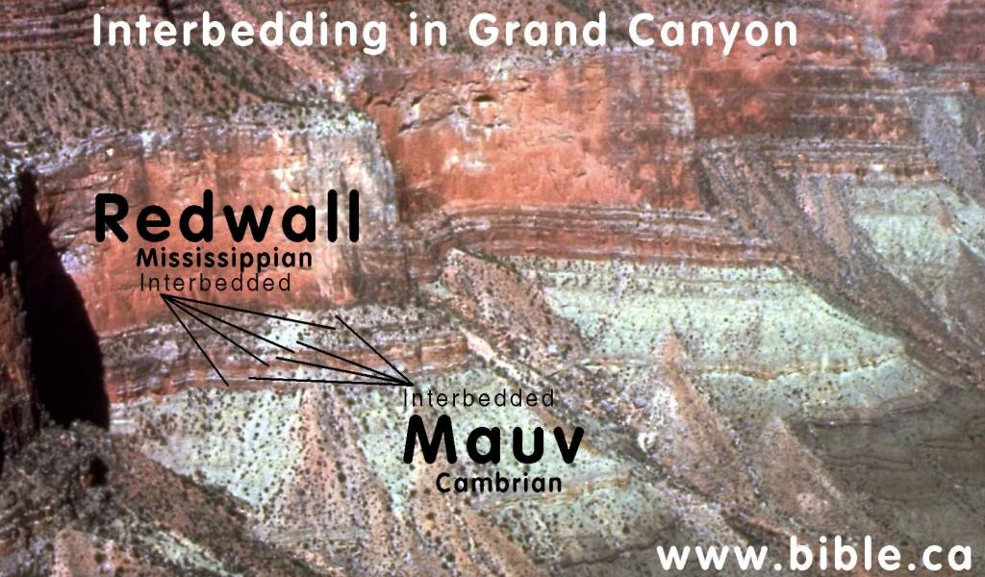
Photo credit: Don Patton & Steve Rudd

Slide 39
Evidence for a Young Earth
Rapid Sedimentation
“ Evidence shows that the sedimentary layers in the geologic column were formed rapidly rather than slowly.”(p. 71)
“..rocks hold dinosaur fossils contain only the dinosaurs and not the vegetation necessary to sustain life. But why?...Where is all of their food?! A full grown Apatosaurus would require over three tons of vegetation per day! Why are the dinosaurs buried absent of their surrounding ecosystem? Could this be evidence of a catastrophic burial? Yes.” (p. 71).
Trees set in several layers of sedimentation is evidence of rapid sedimentation
Joshua Gurtler, Ph.D, Unraveling Evolution, 70-72

Slide 40
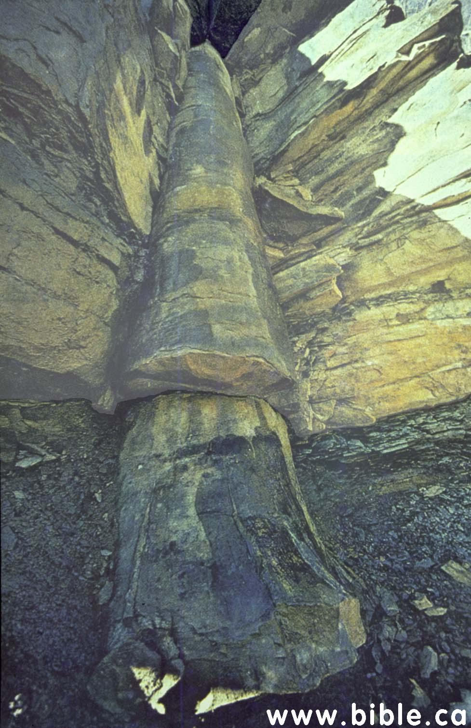
“A polystrate fossilized tree near Cookeville, TN in the Kettles coal mines. This tree was supposedly buried gradually amidst millions of years of sediment. Only a rapid catastrophic burial could create such pristine preservation.”
Joshua Gurtler, Ph.D, Unraveling Evolution, 70-72.
Photo: Don Patton & Steve Rudd
This tree begins in one coal seam, protrudes upward through numerous layers and finally into another layer of coal.

Slide 41
Evidence for a Young Earth
Distance of Moon
from The Earth
“The moon is receding from the earth at a rate of 1 ½ inches per year. However, if the earth is on the order of five billion years old, then the moon should be as least 3 ½ times further from the earth than it is presently (DeYoung, 1990, pp 79-84).
Joshua Gurtler, Ph.D, Unraveling Evolution, 70-72

Slide 42
Evidence for Creation
Based upon fact that God is
Created all things in six literal days
Evidence of a relative young earth argues for creation
Conclusions

Slide 43

From Evidence of Creation
Creation took place in a very short process of time
Creation was at the command of God – not a gradual thing
First plants, animals, and man were full grown
Animals & plants reproduce after their kind
There was ONE original man
Woman came from the rib of man
Man sinned and fell & needed redemption

Slide 44
For Faith
Creation and Evolution
Evidence for Creation
Problems with Evolution

