Slide 1

Is there real
evidence for believing?
For Faith
Evidence for God part 1 (11-15)
Evidence for God part 2 (11-22)
The Problem of Evil (11-29)
The Bible and Science (12-06)
Creation (12-13)
The Genesis Flood (12-20)
Archeology (01-03)
Historical Jesus (01-10)
The Resurrection of Christ (01-17)
Inspiration of Scripture (01-24)
Canon and the Apocrypha (02-07)
Sunday Evening
Studies
Designed to build and strengthen
real faith

Slide 2
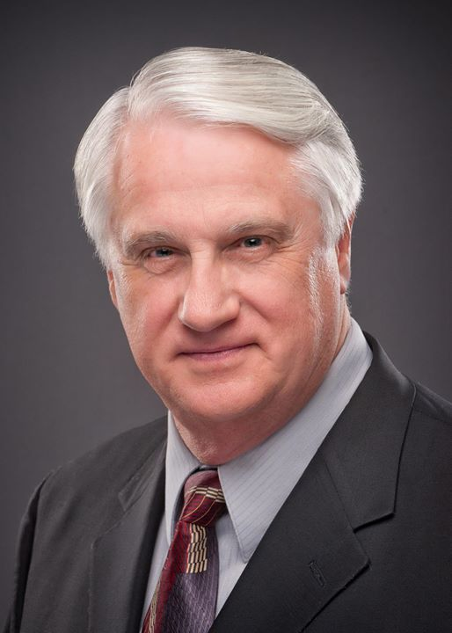
For Faith
Daniel H. King, Ph.D.
The Canon & The Apocrypha
Three Lessons (9:00 am; 9:50 am; 5:30 pm)
February 7, 2015

Slide 3

For Faith
The Bible and Science
The unbeliever thinks there is a conflict between the Bible & science
They believe the Bible is an antiquated book filled with scientific fallacies
Can science and the Bible be reconciled?

Slide 4
Is the Bible a Science Book?
Bible is not a science textbook, but it does not flee from science
“’Science’ is knowledge, and the Bible is a book of true and factual knowledge throughout, on every subject with which it deals. The Bible is a book of science” (Henry Morris, Many Infallible Proofs, 229).

Slide 5
Is the Bible a Science Book?
Genesis 1:1 – “In the beginning [TIME] God [LIFE] created [ENERGY] the heavens [SPACE] and the earth [MATTER].”
“In the very first statement of Holy Scripture is a statement which accurately identifies the five fundamental dimensions of science itself” (Larry Dickens, Ph.D. The Renewing of Your Mind, 245).

Slide 6
For Faith
The Bible and Science
The Conflict

Slide 7
The Conflict
Conflict Between the Bible & Science
The Real Problem
True | False
Religion | Religion
Science | Science
No Conflict
Conflict
Conflict

Slide 8
The Conflict
Conflict Between the Bible & Science
The Real Problem
Atheist: Bible is opposed to science (we all know to be true)
  “Although, therefore, fundamentalism is partly dependent upon the presuppositions that inform modern science, in its dogmatism it is irreconcilably opposed to science” (H. Holmes Hartshorne, as quoted by Roger Dickson, The Fall of Unbelief, 122).
  “The Party [Communist party] cannot be neutral towards religion, and it does conduct anti-religious propaganda against all and every religious prejudice because it stands for science, while religious prejudices run counter to science, because all religion is something opposite to science” (Joseph Stalin, as quoted by Roger Dickson, The Fall of unbelief, 122).

Slide 9
The Conflict
Conflict Between the Bible & Science
The Real Problem
Atheist: Bible is opposed to science (we all know to be true)
  Try to put the believer at a disadvantage: They spew out garbled scientific theory & expect you to accept it
    May not know the science well enough to be a critic
    They claim to know enough about the Bible to reject it
    Seems (at the moment) the “scientist” unbeliever has the upper hand!

Slide 10
The Conflict
Conflict Between the Bible & Science
The Real Problem
Atheist: Bible is opposed to science (we all know to be true)
True scientific facts will never overthrow your faith!
  There is false science (1 Tim. 6:20, KJV)
  Conflict comes as result of FALSE interpretations:
    Of the Bible
    Of scientific facts

Slide 11
“There can be no real conflict between natural science and true religion because their spheres are entirely distinct and separate. Natural science deals with physical entities by abstraction, experiment, and mathematical measurement: while religion is an attitude of trust and love toward and infinite God, which results in a vital experience constituting the essence of religion. Conflicts between these two are always the result of misinterpretation and misrepresentation of one or the other or both, and history abounds with illustrations of all these forms of confusing contradictions” (Thornton Whaling, Science and Religion Today, 21)

Slide 12
The Conflict
Conflict Between the Bible & Science
The Real Problem
Atheist: Bible is opposed to science (we all know to be true)
True scientific facts will never overthrow your faith!
The problem comes from a failure to distinguish fact and theory

Slide 13
For Faith
The Bible and Science
The Conflict
The Limitations

Slide 14
The Limitations
The Limitations of Science
“The basic conflict between science and Christian faith is not over the theory of evolution, but over the scientific method.”
Bolton Davidheiser, Evolution and the Christian Faith, 138

Slide 15
The Limitations
The Limitations of Science
Scientific method is limited in at least 5 areas
  Limited to the senses
    “Science is limited to the material world, to observable fact” (Jack Wood Sears, Conflict and Harmony in Science and the Bible, 93)
    “Facts can be observed or tested experimentally but theories are ideas about the facts” (Rita Rhodes Ward, In The Beginning, 10).
    Big difference in the facts and one’s interpretations of the facts!

Slide 16
Scientist’s
Communicated
Interpretation
Facts
Scientist
Public
Roger Dickson, The Fall of Unbelief, 131

Slide 17
The Limitations
The Limitations of Science
Scientific method is limited in at least 5 areas
  Limited to the senses
  Not capable of determining what is ethical or moral
    Science is non moral
    “It should be further be recognized that science is incapable of making value judgments about the things it measures. Many men on the frontiers of science are realizing that there is nothing inherent in science to guide them in the application of the discoveries they make. There is nothing in science itself which will determine whether nuclear energy will be used to destroy cities or destroy cancer. This is a judgment outside the scientific method to determine” (Paul Little, Know Why You Believe, 65).

Slide 18
The Limitations
The Limitations of Science
Scientific method is limited in at least 5 areas
  Limited to the senses
  Not capable of determining what is ethical or moral
  Limited to the present
    When science ventures into the past & future – it can only theorize
    Science cannot prove history (i.e. world is millions or billions of years old) for history is beyond the field of scientific method
    “The whole realm of science is the study of things as they are. Science can examine and analyze present processes and materials, but science is not in a position to say how things actually came into existence” (B.B. Baxter, I Believe Because…, 91)

Slide 19
“Approaching the matter fromm another way, science deals only with that which is timeless, repeatable at will, dependable, and universal. By this I mean that a scientist doing an experiment works only with those phenomena that are the same today as they were yesterday and as they will be tomorrow. He cannot deal with the unique, the thing that happens only once, for science relies for verification not upon one experiment but on repeated experiments.”
John Wood Sears, Conflict and Harmony in Science and the Bible, 22-23.

Slide 20
The Limitations
The Limitations of Science
Scientific method is limited in at least 5 areas
  Limited to the senses
  Not capable of determining what is ethical or moral
  Limited to the present
  Limited to telling us “how” a process functions, not “why”
    “Science can give us the ‘know-how,’ but it cannot give us the ‘know-why’.” (J.N. Hawthorne, Questions of Science and Faith, 4)
    Scientist can explain how many of the natural laws function, but cannot tell us WHY they so function
    “The more learned the man, the better he knows how little it is really possible to explain.” (F. Bettex, Science and Christianity, 138)

Slide 21
The Limitations
The Limitations of Science
Scientific method is limited in at least 5 areas
  Limited to the senses
  Not capable of determining what is ethical or moral
  Limited to the present
  Limited to telling us “how” a process functions, not “why”
  Limited by basic assumptions

Slide 22
Assumptions Stand Between the Scientist and the Physical World
Scientist
Assumptions
Physical World
Roger Dickson, The Fall of Unbelief, 135
Assumes his senses do not deceive him
  Limited to the sense of perception
  Assumes his perception is correct
Assumes uniformity
  Almost all scientific investigation follows uniformitarianism
  Idea: things have always happened in past as they are now
Assumes matter has always been constituted in same manner as we see it today
Assumes that theory of evolution is true
PROBLEM: ASSUMPTIONS ARE ALWAYS CHANGING!

Slide 23
An Evolutionist Admits Assumptions:
How Did Life On Earth Begin?
“The answer is that we do not know and probably never will. The origin of life occurred more than three billion years ago and was not the type of happening to leave a clear indication of its course of events in the fossil record. Why, then, do we discuss the question at all? The best we can do is to point out what might have happened.”
Paul Amos Moody, Ph.D., Introduction to Evolution, 115

Slide 24
The Limitations
The Limitations of Science
Scientific method is limited in at least 5 areas
“The science god”
  Some are lead to believe that “science” is our only source of truth.
  “Every age has its superstitions, and ours is the notion that science is an infallible and all-sufficient guide to truth” (Loius Cassels, The Reality of God, 6)
  “Because of the wonderful things it has done for society, we are tempted to place too high a value on science. We should remember that science exist only because there are people, and its concepts exist only in the minds of men. Behind these concepts lies the reality which is being revealed to us – but only by the grace of God.” (Wernher von Braun- 02-17-66)

Slide 25
For Faith
The Bible and Science
The Conflict
The Limitations
The Foreknowledge

Slide 26
The Foreknowledge
The Bible’s Scientific Foreknowledge
Defined
  “Scientific foreknowledge in the Bible is simply the statement of scientific facts not ‘scientifically’ accepted at the time of the inspired writing” (Larry Dickens, Ph.D., Renewing Your Mind, 245).
  Point: If Bible says things (scientific information) that man later has discovered to be true – conclusion is that God inspired those texts!
  “Furthermore, if the omniscient Ruler of the Universe actually did inspire these books, scientific and medical errors that fill the pages of other ancient, non-inspired texts should be entirely absent from the biblical record” (Kyle Butt, Surveying the Evidence,139).

Slide 27

Illustration of Proof of Ownership
Home stands unclaimed by anyone
No one can remember who owned it
One day a man came to town laid claim to it
Many disputed his claim
As proof – he told them of some secrets to its internal construction:
  Trowel that fell into cement
  Floor joist of odd size
  Things hid inside the walls
Tore into the house – found just as he said!

Slide 28
The Foreknowledge
The Bible’s Scientific Foreknowledge
Defined
Extremes
  Exploited:
    Used Joel 2:3 – to describe cars or jet planes
    Used Isa. 31:5 – to describe helicopters
    Used Isa. 11:12 – to show earth was flat
  Discarded
    Deny that it is there at all
    “I don’t know of any passage in the Bible that I could say is an example of scientific foreknowledge” (M. Pickup)

Slide 29
The Foreknowledge
The Bible’s Scientific Foreknowledge
Defined
Extremes
Examples

Slide 30
The Bible’s Scientific Foreknowledge
Rotundity of the Earth
Prov. 8:27 – “He inscribed a circle on the face of the deep”
Isa. 40:22 – “It is He that sitteth above the circle of the earth”
Many believed the earth was flat
Aristotle was one of the first to suggest a spherical earth – rejected by most (384-322 BC)
Magellan (1519-1520 AD) & Columbus demonstrated that earth was round

Slide 31
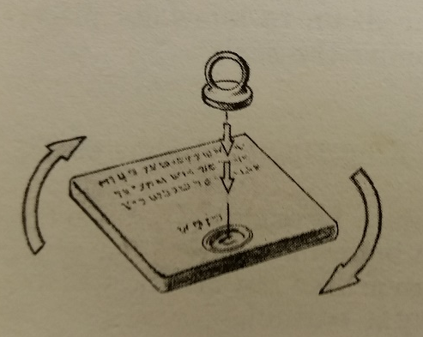
The Bible’s Scientific Foreknowledge
Rotation of the Earth
Job 38:12-14 – “It is changed like clay under the seal”
Early 1500’s generally accepted that was an immoveable earth (theory of Claudius Ptolemy)
1543 Nicolas Copernicus explained the apparent motion of the heavenly bodies due to earths daily rotation
1851 – earth’s rotation was demonstrated by Jean Leon Foucalt with a suspended pendulum in Paris

Slide 32
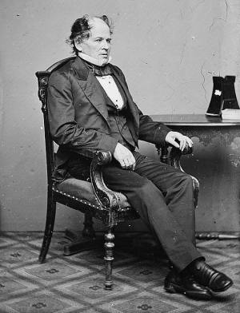
The Bible’s Scientific Foreknowledge
Paths of the Sea
Psa. 8:8 – “…paths of the sea”
Matthew Fontaine Maury (1850s) was known as founder of the science of Oceanography
One day while sick, he son read from Psa. 8:8
  Asked him to read it again
  “If the word of God says there are paths of the sea, they must be there. I will find them”
Used by our Navy and other sailing vessels today
Notes:
Raised in Franklin, TN

Slide 33
The Bible’s Scientific Foreknowledge
Circumcision 8th Day
Gen. 17:12-14 – Circumcise the male child on 8th day
Holt’s Pediatrics (first written 1896 by L. Emmet Holt, Jr.) warned of danger of excessive bleeding in children 2-5 days old because of lack of Vitamin K
On 8th day – show child has 110% prothrombin level (20% more than when born – 10% more than rest of life)

Slide 34

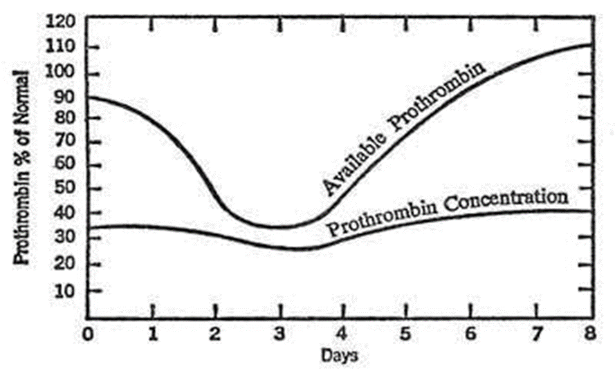
“We should commend the many hundreds of workers who labored at great expense over a number of years to discover that the safest day to perform circumcision is the eighth. Yet, as we congratulate medical science for this recent finding, we can almost hear the leaves of the Bible rustling. They would like to remind us that four thousand years ago, when God initiated circumcision with Abraham. Abraham did not pick the eighth day after many centuries of trial-and-error experiments. Neither he nor any of his company from the ancient city of Ur in the Chaldees ever had been circumcised. It was a day picked by the Creator of vitamin K.” (1984, p. 93)

Slide 35
The Bible’s Scientific Foreknowledge
Empty Space in the North
Job 26:7 – “Stretcheth out the North over the empty places and hangeth the earth upon nothing”
Not until the invention of the telescope that man discovered that empty space in north
In all other directions there planets

Slide 36
The Bible’s Scientific Foreknowledge
2nd Law of Thermodynamics
Heb. 1:10-11 – earth wears out like a garment
Psa. 102:26 – earth wears out like a garment
Isa. 51:6 – earth wears out like a garment
Law of increasing disorder
“Although mass-energy is not now being annihilated, it is running down, always becoming less ‘available’ for the ‘work’ of maintaining the processes of nature.” (H. Morris)

Slide 37
For Faith
The Bible and Science
The Conflict
The Limitations
The Foreknowledge

