Slide 1

Is there real
evidence for believing?
For Faith
Evidence for God part 1 (11-15)
Evidence for God part 2 (11-22)
The Problem of Evil (11-29)
The Bible and Science (12-06)
Creation (12-13)
The Genesis Flood (12-20)
Archeology (01-03)
Historical Jesus (01-10)
The Resurrection of Christ (01-17)
Inspiration of Scripture (01-24)
Cannon and the Apocrypha (02-17)
Sunday Evening
Studies
Designed to build and strengthen
real faith

Slide 2
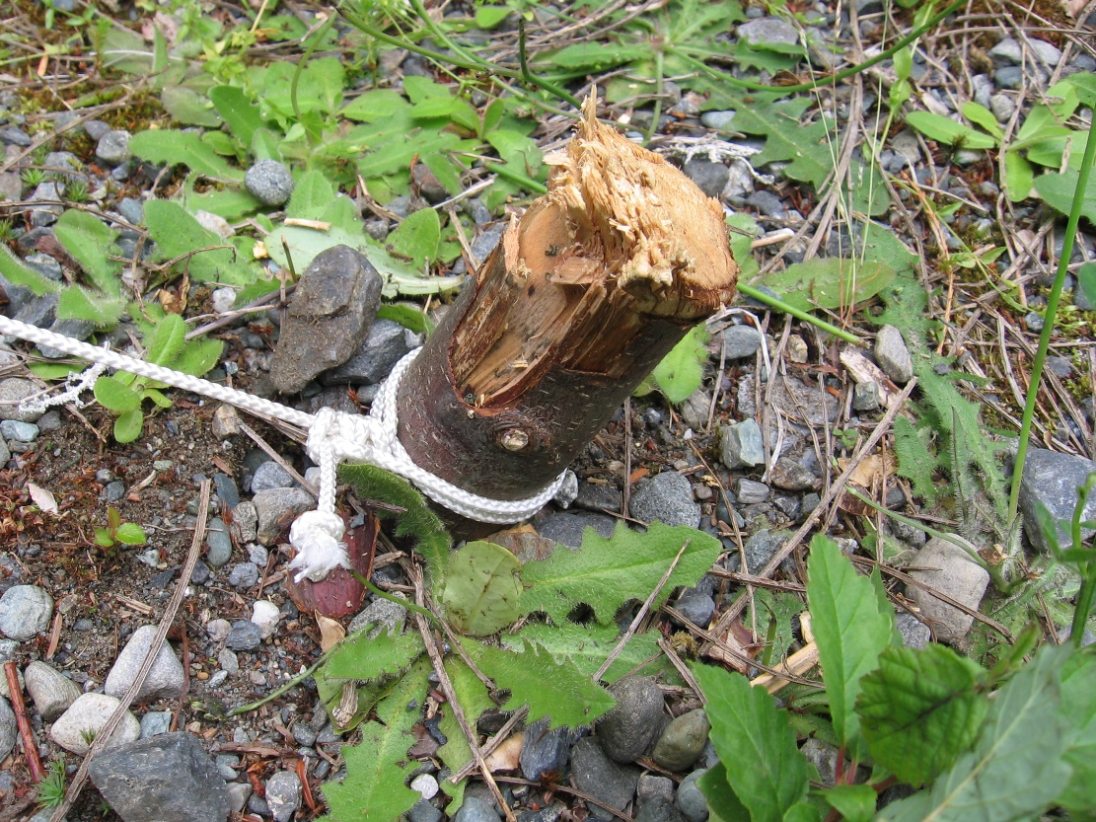
For Faith
The evidence we have presented becomes a “peg” we hold to
Always come back to my “peg”
May face questions / arguments – don’t know how to answer

Slide 3
Review
For Faith
Evidence for God (Part 1)
Passages that Argue From Creation
Argument for a Cause
Argument for a Designer

Slide 4
Review
For Faith
Evidence for God (Part 2)
Atheism’s “Non-Design” Response
Moral Argument
Universal Belief in God
Beliefs of Atheism

Slide 5
For Faith
“There is no evidence for God”
Answer:
Not so – we have given evidence
The absence of evidence is not the evidence of absence
Atheist needs to present more than “absence of evidence” – there must be positive proof that there is no God!

Slide 6
For Faith
The Problem of Evil
The Atheists’ Argument

Slide 7
The Atheists’ Argument
Contradiction for the Theist
If evil exist – there is no God
  If God is omnipotent (all powerful) he would be able to eliminate all evil (no limit to what he could do)
  If God is omnibenevolent (all good) would not desire that evil exist.
  A good, all powerful God would eliminate evil
  Evil exist (human suffering, animal cruelty, natural disasters, etc) Thus, there is no God!

Slide 8
The Atheists’ Argument
Contradiction for the Theist
If evil exist – there is no God
Epicurus (300 B.C.)
  Presented a logical contradiction between belief in God and presence of evil
  “The gods can either take away evil from the world and will not, or being willing to do so cannot; or they neither can nor will, or lastly, they are both able and willing. If they have the will to remove evil and cannot, then they are not omnipotent. If they can, but will not, then they are not benevolent. If they are neither able nor willing, then they are neither omnipotent or benevolent. Lastly, if they are both able and willing to annihilate evil, how does it exist?” (Quoted by Dickson, Fall of Unbelief, 101)

Slide 9
For Faith
The Problem of Evil
The Atheists’ Argument
The Apologists’ Assessment

Slide 10
The Apologists’ Assessment
A Major Argument
Point: this argument is one of their strongest arguments
  If it can be answered – their toughest argument can be answered
  If this is the best they have – they don’t have much argument

Slide 11
The Apologists’ Assessment
A Major Argument
Point: this argument is one of their strongest arguments
Assessment of argument from Apologists
  William Lane Craig, On Guard, 173.

Slide 12
“Paradoxically, then, even though the problem of suffering is the greatest objection to the existence of God, at the end of the day God, is the only solution to the problem of suffering.”
William Lane Craig, On Guard, 173

Slide 13
The Apologists’ Assessment
A Major Argument
Point: this argument is one of their strongest arguments
Assessment of argument from Apologists
  William Lane Craig, On Guard, 173.
  Batsell Barrett Baxter, I Believe Because, 273

Slide 14
“One of the most difficult is the question ‘How could a God of infinite goodness create a world with so much evil in it?’”
Batsell Barrett Baxter, I Believe Because…, 273

Slide 15
The Apologists’ Assessment
A Major Argument
Point: this argument is one of their strongest arguments
Assessment of argument from Apologists
  William Lane Craig, On Guard, 173.
  Batsell Barrett Baxter, I Believe Because, 273
  Paul E. Little, Know Why You Believe, 73

Slide 16
“This is one of the most pressing questions of our time. More pressing that the question of miracles or science and the Bible is the poignant problem of why innocent people suffer, why babies are born blind, or why a promising life is snuffed out as it is on the rise. Why are there wars in which thousands of innocent people killed, children burned beyond recognition, and many maimed for life?”
Paul E. Little, Know Why You Believe, 73

Slide 17
The Apologists’ Assessment
A Major Argument
Point: this argument is one of their strongest arguments
Assessment of argument from Apologists
  William Lane Craig, On Guard, 173.
  Batsell Barrett Baxter, I Believe Because, 273
  Paul E. Little, Know Why You Believe, 73
  Thomas B. Warren, Ph.D. Have the Atheists Prove There is no God? vii.

Slide 18
“It is likely the case that no charge has been made with greater frequency or with more telling force against theism of the Judeo-Christian (Biblical) tradition than that such theism is unable to explain adequately the occurrence or the existence of evil.”
Thomas B. Warren, Ph.D. Have the Atheists Proved There is No God?, vii

Slide 19
The Apologists’ Assessment
A Major Argument
Point: this argument is one of their strongest arguments
Assessment of argument from Apologists
For many the problem is emotional
  Some approach from an intellectual problem
  “I am convinced that for most people the terrible suffering in the world is really an emotional, not an intellectual, problem. Their unbelief is born, not out of refutation, but out of rejection. They just want nothing to do with a God who would allow them or others to suffer terribly” (William Lane Craig, On Guard, 153).

Slide 20
For Faith
The Problem of Evil
The Atheists’ Argument
The Apologists’ Assessment
A Reasonable Response

Slide 21
A Reasonable Response
No Dilemma for the Believer
Man is not in position to assess all the probabilities about suffering
  It is hopeless for finite beings to consider all the probabilities with confidence
  “No one would be so presumptuous as to assert that man can completely understand the problem of suffering.” (Wayne Jackson, Surveying the Evidence, 7)
  Will not and cannot answer all – but that doesn’t mean we have no answers or that any of that erases the existence of God!
  Man is limited in knowledge of what God is doing and why. Example: Joseph sold into Egypt was evil – but God’s plan and providence was at work!

Slide 22
A Reasonable Response
No Dilemma for the Believer
Man is not in position to assess all the probabilities about suffering
Burden of proof is on the atheist
  Must show and demonstrate his argument
  What proof is there that God and evil cannot co-exist?
  Must explain the evolution of the idea of a benevolent God from an environment of an all material (matter) universe.
  Assumes two things (hidden assumptions):
    If God is all powerful – He can create any world he wants
    If God is all loving – He prefers a world without suffering

Slide 23
A Reasonable Response
No Dilemma for the Believer
Man is not in position to assess all the probabilities about suffering
Burden of proof is on the atheist
If God created man with free will – cannot eliminate evil
  If man has free will – able to choose
  Cannot have free will and eliminate bad choices (evil)
  Must be consequences to choosing evil
  It is not possible to eliminate evil as long as there is free will
    Talking about impossible (round square, 4 sided triangle, ball all white and all black at same time, rock too heavy for God)
    An omnipotent God can do what is possible!
  Man misuses his freedom – thus suffers (woman marries a sorry man / drunk driver crosses the line)

Slide 24
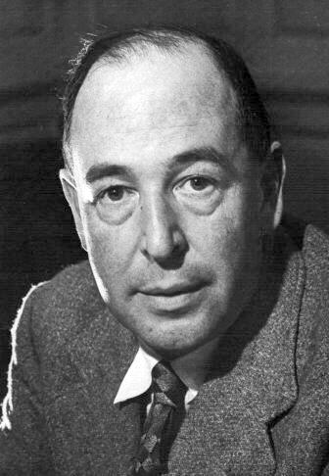
“Some people think they can imagine a creature which was free but had no possibility of going wrong; I cannot. If a thing is free to be good it is also free to be bad. And free will is what has made evil possible. Why, then did God give them free will? Because free will, though it makes evil possible, is also the only thing that makes possible any love or goodness or joy worth having.”
C. S. Lewis, Mere Christianity, 52

Slide 25
A Reasonable Response
No Dilemma for the Believer
Man is not in position to assess all the probabilities about suffering
Burden of proof is on the atheist
If God created man with free will – cannot eliminate evil
Why does God permit suffering?

Slide 26
Why Is There Suffering?
Some suffering is brought on by free will choices (self & others)
Suffering seems pointless and puzzling if we assume God’s purpose for happiness in life
God’s purpose is not limited to this life – spills over heavily into eternal life (2 Cor. 4:17; cf. his suffering 6:4-5)
  “The problem for the atheist becomes even more acute when we reflect that perhaps there wasn’t any earthly reason at all why God permitted those catastrophes. Maybe they serve no earthly good whatsoever.” (Craig, 169)
  To say they serve no purpose requires probability judgment way beyond our ability. May be a larger picture than we can see!

Slide 27
Why Is There Suffering?
Some suffering is brought on by free will choices (self & others)
Suffering seems pointless and puzzling if we assume God’s purpose for happiness in life
God’s purpose is not limited to this life – spills over heavily into eternal life (2 Cor. 4:17; cf. his suffering 6:4-5)
Good does come from suffering:
  Pain may send us to the doctor for treatment or cure
  Mother deer (or cow) charging to protect her young causes suffering – yet survival of young deer (or cow) provides food
  Bee sting – hurts – yet must have a way of protecting honey
  Makes us better – builds character, courage, patience (Rom. 5:3-4)
  Man needs a challenging environment to make moral and spiritual decisions

Slide 28
Why Is There Suffering?
Some suffering is brought on by free will choices (self & others)
Suffering seems pointless and puzzling if we assume God’s purpose for happiness in life
God’s purpose is not limited to this life – spills over heavily into eternal life (2 Cor. 4:17; cf. his suffering 6:4-5)
Good does come from suffering:
Pain of animals:
  Pain causes an animal to cease (or diminish) an activity after it is injured – necessary to control & preserve animal life
  Provides food and clothing for man
  Used as great instruments in the advancement of medical science

Slide 29
Why Is There Suffering?
Some suffering is brought on by free will choices (self & others)
Suffering seems pointless and puzzling if we assume God’s purpose for happiness in life
God’s purpose is not limited to this life – spills over heavily into eternal life (2 Cor. 4:17; cf. his suffering 6:4-5)
Good does come from suffering:
Pain of animals:
All suffering cannot be eliminated
  If have an axe or saw to cut a tree – possible to be used on an animal or man
  If have water to drink, cook and bath – possible to be used to drown

Slide 30
Why Is There Suffering?
Some suffering is brought on by free will choices (self & others)
Suffering seems pointless and puzzling if we assume God’s purpose for happiness in life
God’s purpose is not limited to this life – spills over heavily into eternal life (2 Cor. 4:17; cf. his suffering 6:4-5)
Good does come from suffering:
Pain of animals:
All suffering cannot be eliminated
What we learn from suffering: (from tragedy & calamities)
  Life on earth will be brief – will come to an end
  Time of death is uncertain
  Those should drive men to God!

Slide 31
Why Is There Suffering?
Some suffering is brought on by free will choices (self & others)
Suffering seems pointless and puzzling if we assume God’s purpose for happiness in life
God’s purpose is not limited to this life – spills over heavily into eternal life (2 Cor. 4:17; cf. his suffering 6:4-5)
Good does come from suffering:
Pain of animals:
All suffering cannot be eliminated
What we learn from suffering: (from tragedy & calamities)
Sin is the only evil in the world
  Nothing sub-human can do evil
  Animal suffering (at hand of other animals) & natural calamity are not evil

Slide 32
A Reasonable Response
No Dilemma for the Believer
Man is not in position to assess all the probabilities about suffering
Burden of proof is on the atheist
If God created man with free will – cannot eliminate evil
Why does God permit suffering?
World has underlying principle of regularity of law
  Everything produces after its kind (Gen. 1-2)
  Seasons (Gen. 8:22)
  The weather system (draws water from oceans – carries moisture to mainland sometimes create flood – tornados)
  Gravity – can cause death if fall
  Cannot have the advantages without the disadvantages

Slide 33
A Reasonable Response
No Dilemma for the Believer
Man is not in position to assess all the probabilities about suffering
Burden of proof is on the atheist
If God created man with free will – cannot eliminate evil
Why does God permit suffering?
World has underlying principle of regularity of law
Why doesn’t evil prove there is a God?
  If God does not exist, then objective moral values do not exist
  Evil exist
  Therefore, objective moral values exist (some things are evil)
  Therefore, God exist!

Slide 34
A Reasonable Response
No Dilemma for the Believer
Man is not in position to assess all the probabilities about suffering
Burden of proof is on the atheist
If God created man with free will – cannot eliminate evil
Why does God permit suffering?
World has underlying principle of regularity of law
Why doesn’t evil prove there is a God?
Must of what atheist say about this – deals with God’s character
  The question of the hour is not His character
  It is a question of the existence of God!

Slide 35
For Faith
The Problem of Evil
The Atheists’ Argument
The Apologists’ Assessment
A Reasonable Response

Slide 36
“Paradoxically, then, even though the problem of suffering is the greatest objection to the existence of God, at the end of the day God, is the only solution to the problem of suffering.”
William Lane Craig, On Guard, 173

