Slide 1

Is there real
evidence for believing?
For Faith
Evidence for God part 1 (11-15)
Evidence for God part 2 (11-22)
The Problem of Evil (11-29)
The Bible and Science (12-06)
Creation (12-13)
The Genesis Flood (12-20)
Archeology (01-03)
Historical Jesus (01-10)
The Resurrection of Christ (01-17)
Inspiration of Scripture (01-24)
Cannon and the Apocrypha (02-17)
Sunday Evening
Studies
Designed to build and strengthen
real faith

Slide 2
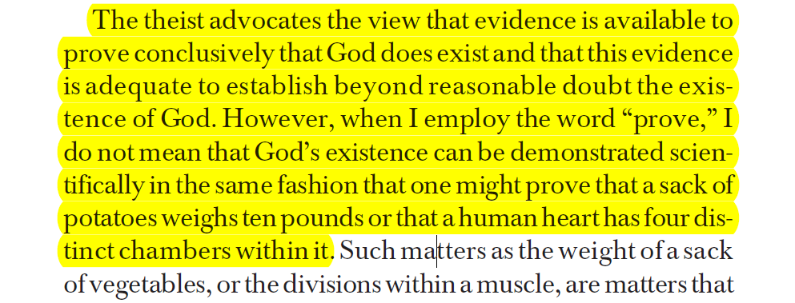
Proof & Evidence
Not demonstrative proof!
Can show it is more reasonable to believe than not believe
Bert Thompson, Ph.D.
The Case for the Existence of God, 2

Slide 3
Review
For Faith
Evidence for God (Part 1)
Passages that Argue From Creation
Argument for a Cause
Argument for a Designer

Slide 4
For Faith
Evidence for God (Part 2)
Atheism’s “Non-Design” Response

Slide 5
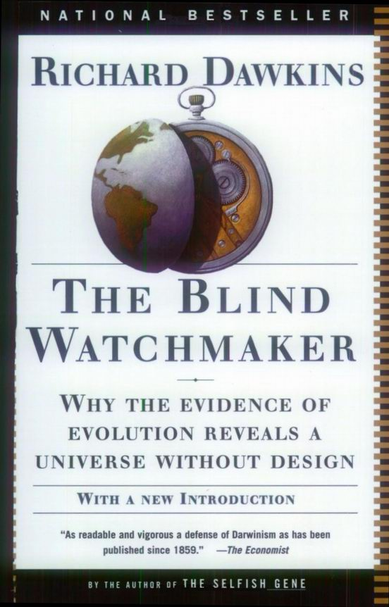
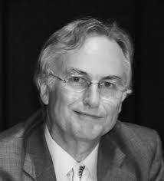
Atheism’s “Non-Design” Response

Slide 6
Atheism’s “Non-Design” Response
Their argument is a two pronged approach:
  “Design” is apparent – not actual
    What “appears” to be design can be explained on basis of adaptations, random chance operations over eons of time
  Poor design – would not be present if is an intelligent designer
    Argument: If design proves existence of God, then poor design disproves the same God!
  Argue from sub-optimality: If all design is perfect – everything will be optimal

Slide 7
Atheism’s “Non-Design” Response
Their argument is a two pronged approach:
Reasons “Non-Design” argument is flawed:
  Theist /Creationist is not obligated to show obvious design in every single feature of the Universe
  Possible that an object could possess purposeful design that we don’t yet recognize
    May not PRESENTLY know the design
    Further research – may cause design to be discovered

Slide 8
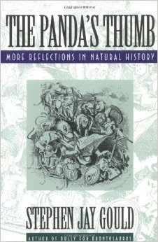

Argued that Panda’s thumb is very clumsy – not well designed
Would be more functional if like that of a human
Thus, proves that an all wise Creator did not design the Panda

Slide 9
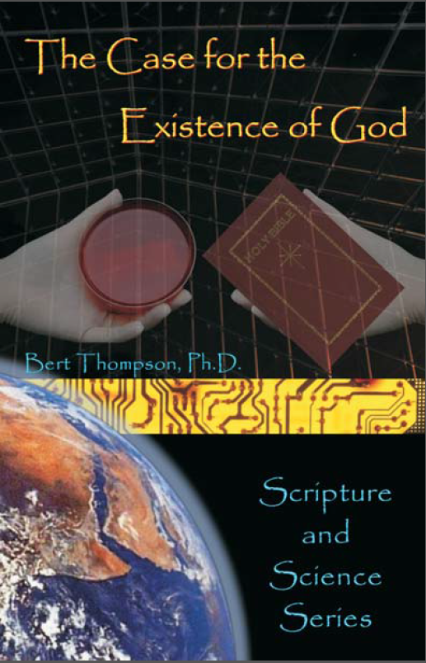
The Case for the Existence of God
Bert Thompson, Ph.D.
Page 147
“In fact, the giant panda is one of the few large animals that can grab things as tightly as a human can.” (San Diego Zoo’s Giant Panda Zoobook, 6)
“The panda can handle bamboo stems with great precision by holding them as if with forceps in the hairless groove connecting the pad of the first digit and pseudothumb” (The Giant Pandas of WoLong, Schaller (1985), 4)

Slide 10

“What Gould did not understand is that the panda’s thumb is perfectly designed to do the job it needs to do. Sure, the panda can’t use its thumb to write a letter or screw a lid on a peanut butter jar. But its thumb is ideal for holding bamboo. In fact, the ‘clumsy’ thumb of the panda can hold bamboo in a grip so tight it is like a vice. This allows the panda to strip the bamboo of its leaves and stem. That is good for the panda, because it spends about 12 hours every day eating about 50 pounds of food. In the wild, almost all of the food pandas eat is bamboo. They rarely eat anything else. We see then that their thumb is not an example of ‘bad design.’ Instead, God designed the panda to have the perfect tool it needed to eat bamboo all day long.”
The Panda’s Thumb
Kyle Butt, M.A.
Apologetics Press
apologeticspress.org
Notes:
https://www.apologeticspress.org/apPubPage.aspx?pub=2&issue=1074&article=1918

Slide 11
Atheism’s “Non-Design” Response
Their argument is a two pronged approach:
Reasons “Non-Design” argument is flawed:
  Theist /Creationist is not obligated to show obvious design in every single feature of the Universe
  Possible that an object could possess purposeful design that we don’t yet recognize
  Those who claim something is “sub-optimal” set selves up as the sole judge of what is and is not “optimal”
    Based on assumption – what they think!
    “The case for evolution then has two sides; positive evidence – that evolution has occurred; and negative evidence – that the natural world does not conform to our expectations of what an omnipotent, omniscient, truthful Creator would have created” (Douglas Futuyma, Science on Trial, 198.)
Notes:
Futuyma, Douglas (1983), Science on Trial (New York: Pantheon).

Slide 12
Atheism’s “Non-Design” Response
Their argument is a two pronged approach:
Reasons “Non-Design” argument is flawed:
  Theist /Creationist is not obligated to show obvious design in every single feature of the Universe
  Possible that an object could possess purposeful design that we don’t yet recognize
  Those who claim something is “sub-optimal” set selves up as the sole judge of what is and is not “optimal”
  What we see is degeneration

Slide 13
Degeneration
Illustrated: Suppose find an old book in pile of garden rubbish. Weathered – pages stuck together – type faded – practically illegible. Does current condition mean it was never legible?
Creation suffers (Rom 8:20-22)
World is wearing out (Heb. 1:10-11)
Death (thus disease) is a consequence to sin (Gen. 2:17)
Thus, heart disease, eye problems, cancer, etc. does not mean that we are not “fearfully and wonderfully made” (Psa. 139:14)
The atheist blames God for man’s mistakes!

Slide 14
For Faith
Evidence for God (Part 2)
Atheism’s “Non-Design” Response
Moral Argument

Slide 15
Moral Argument
Man’s moral nature argues for a moral architect – moral designer – moral governor
  Man has an innate capacity to know & choose right and wrong
  Universally man (even Atheist) appeal to a standard of morals:
    “That is mine, you can’t have it.”
    “How would you like it if someone did you that way?”
    “That is not fair”
    “You promised – you made a deal”

Slide 16
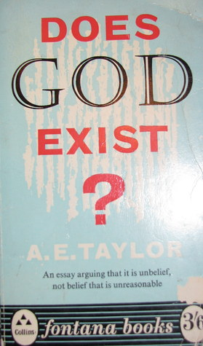
Man may draw “the line between right and wrong in a different place, but at least they all agree that there is such a line to be drawn” (84).

Slide 17
Moral Argument
Man’s moral nature argues for a moral architect – moral designer – moral governor
  Man has an innate capacity to know & choose right and wrong
  Universally man (even Atheist) appeal to a standard of morals:
  Why should man be concerned with the demands of the conscience if he is nothing more than a “chance combination of atoms”?
  Man is unique – no other creature has an inner moral sense
    Ox gores a man – no remorse – not arrested & tried
    Dog takes another dog’s bone – experiences no remorse
    Man has ability to make moral choices

Slide 18
Moral Argument
Man’s moral nature argues for a moral architect – moral designer – moral governor
  Man has an innate capacity to know & choose right and wrong
  Universally man (even Atheist) appeal to a standard of morals:
  Why should man be concerned with the demands of the conscience if he is nothing more than “chance combination of atoms”?
  Man is unique – no other creature has an inner moral sense
  From whence did the sense of morality come?
    Cannot come from matter – matter is neither moral or spiritual
    Intelligence is moral and spiritual
    Thus, it is more reasonable to believe it came from God – moral architect!

Slide 19
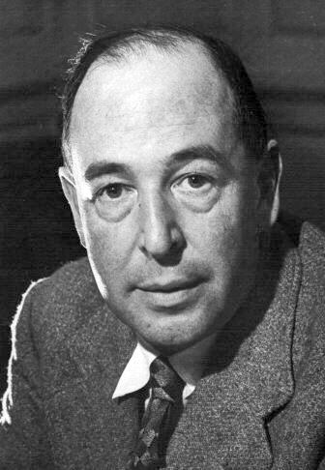
Moral Argument
Man’s moral nature argues for a moral architect – moral designer – moral governor
C.S. Lewis – Fellow of Magdalen College of Oxford University
  Once an atheist / agnostic – became an effective apologist
  In Mere Christianity gives moral law as evidence of existence of God.
  Argues that Moral Law is more than an instinct (ex: man standing on bank of swift water – sees a guy about to drown)
    First – desire to jump and save the man
    Second – desire to avoid danger – thus not help
    Third – Something that tells you to follow impulse to help – suppress the impulse to run away
    Often: act on the weaker impulse

Slide 20
Moral Argument
Man’s moral nature argues for a moral architect – moral designer – moral governor
C.S. Lewis – Fellow of Magdalen College of Oxford University
  Once an atheist / agnostic – became an effective apologist
  In Mere Christianity gives moral law as evidence of existence of God.
  Argues that Moral Law is more than an instinct (ex: man standing on bank of swift water – sees a guy about to drown)
  Lewis argues: the sense of ought within man – demonstrates that there is a moral /ethical Being behind the universe.

Slide 21
Moral Argument
Man’s moral nature argues for a moral architect – moral designer – moral governor
C.S. Lewis – Fellow of Magdalen College of Oxford University
Atheist have a severe burden of proof
  Must demonstrate how a morally responsible being could come from purely materialistic source!
  Must contend that raw, eternal, inorganic matter was able, by means of an extended evolutionary process, to concoct, promote and maintain morality!
  Fact is: infidelity (atheism) cannot explain the origin of morality or ethics!

Slide 22
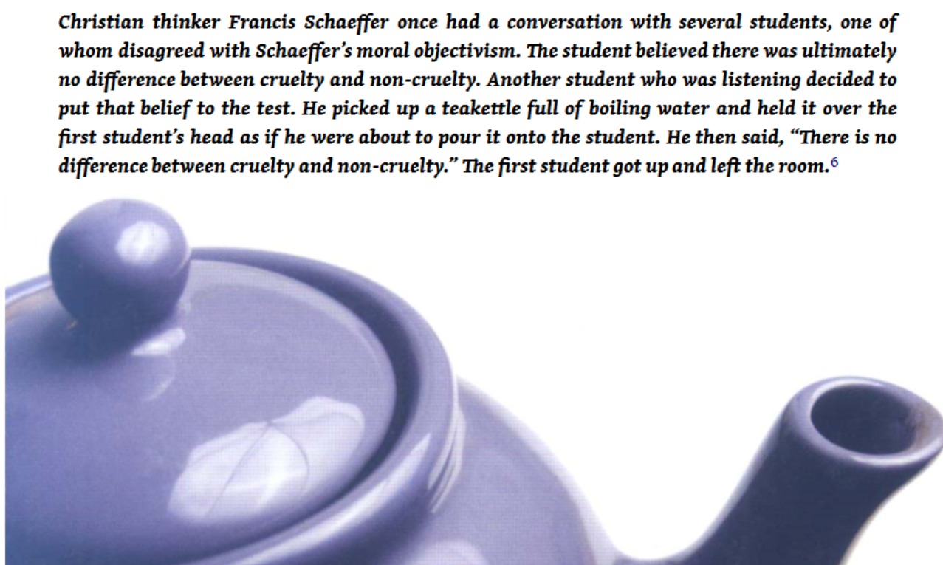

Slide 23
For Faith
Evidence for God (Part 2)
Atheism’s “Non-Design” Response
Moral Argument
Universal Belief in God

Slide 24
Universal Belief in God
All men / all nations – believe in a supreme being
  Believe in some deity – worship
  Religion dominates their thoughts and history
  The human heart has a craving for God
  “An impartial examination of the relevant facts, it appears to me, shows that religion is virtually universal” (Robert Flint, Quoted by Dickson, The Fall of Unbelief, 86)
  “As far as our present knowledge goes, religion appears to be universal among men” (C.H. Troy, Introduction to the History of Religion, 5)

Slide 25
Universal Belief in God
All men / all nations – believe in a supreme being
If God does not exist, then matter has produced a false idea that God does exist
  If God exists, we have an adequate cause for the effect
  If God does not exist, we do not have an adequate cause!

Slide 26
Universal Belief in God
All men / all nations – believe in a supreme being
If God does not exist, then matter has produced a false idea that God does exist
Conclusion:
  There is a Supreme being who created within man the attitudes of a higher being and worship
  Acts 17:26-28

Slide 27
For Faith
Evidence for God (Part 2)
Atheism’s “Non-Design” Response
Moral Argument
Universal Belief in God
Beliefs of Atheism

Slide 28
Beliefs of Atheism
An atheist is a believer
  Believes, but cannot prove that God does not exist
  Believes in the eternal existence of matter
  Believes in the spontaneous generation of life from non-life
  Believes that order evidence in nature is the result of chance
  Believes that consciousness arose out of non-conscious matter
  Believes that man is a machine without responsibility for his conduct
  Believes that man has no moral values

Slide 29
Beliefs of Atheism
An atheist is a believer
Contrasted views
Christian / Theist | Atheist / Skeptic
God involved in history | No God (referee or umpire)
Man is in God’s image | Man is a graduate beast
God is the authority | Man is the highest authority
God’s word is standard | Truth is relative (no right or wrong)
God created universe | Universe happened by chance
Man is a worshipping being | Desire to worship is sign of immaturity

Slide 30
For Faith
Evidence for God (Part 2)
Atheism’s “Non-Design” Response
Moral Argument
Universal Belief in God
Beliefs of Atheism

