Slide 1

Is there real
evidence for believing?
For Faith
Evidence for God part 1 (11-15)
Evidence for God part 2 (11-22)
The Problem of Evil (11-29)
The Bible and Science (12-06)
Creation (12-13)
Evolution (12-20)
The Genesis Flood (12-27)
Archaeology (01-03)
Historical Jesus (01-10)
The Resurrection of Christ (01-17)
Inspiration of Scripture (01-24)
Canon and the Apocrypha (02-07)
Sunday Evening
Studies
Designed to build and strengthen
real faith

Slide 2
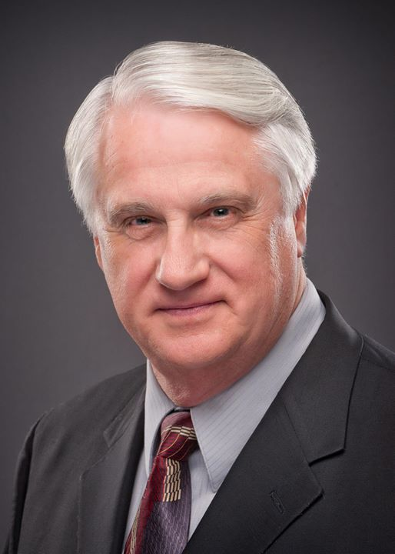
For Faith
February 7, 2015
Daniel H. King, Ph.D.
(Old Testament Studies & Biblical Languages)
9:00 AM: Plenary Inspiration of the Scriptures
9:50 AM: The Canonization of the Scriptures
5:30 PM: The Apocrypha
El Bethel Church of Christ ♦ 1801 Highway 41-A North ♦ Shelbyville, TN 37160

Slide 3
For Faith
Resurrection of Christ
God Is….
If Jesus was raised from the dead:
Jesus is Son of God
Word is True
“Hub” of Gospel

Slide 4
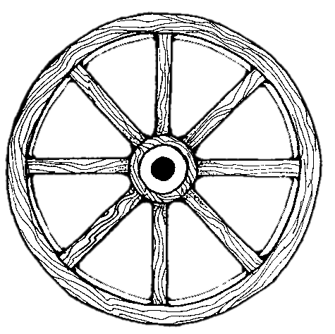
Resurrection
is at
the
Heart
and
Core
of all
We
Believe
Christ’s Work
Christ’s Deity
Preaching
Res. Of
Christ
Our Hope
Our Faith
Hope for Dead
Witnessing
Rem. of Sins
1 Cor. 15:14-18

Slide 5
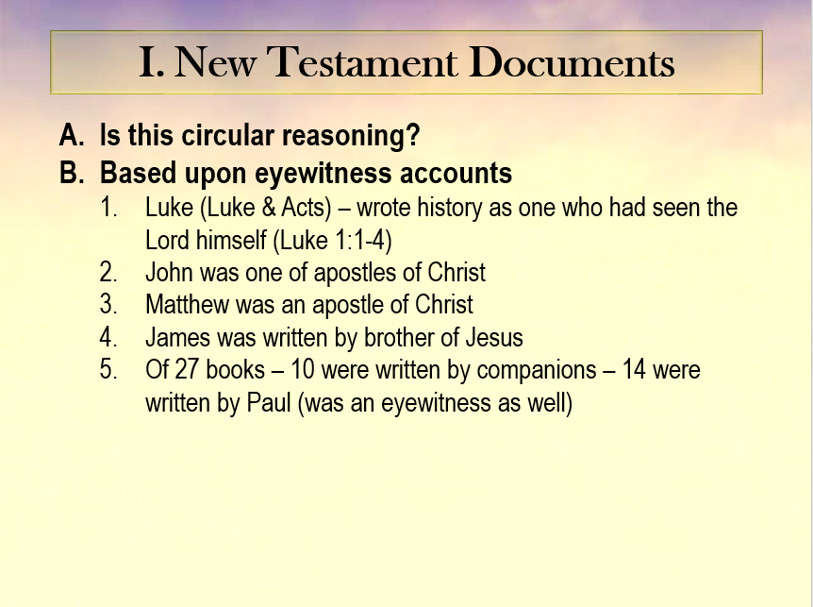
From Lesson 9
Historical
Accuracy
of NT
Documents

Slide 6
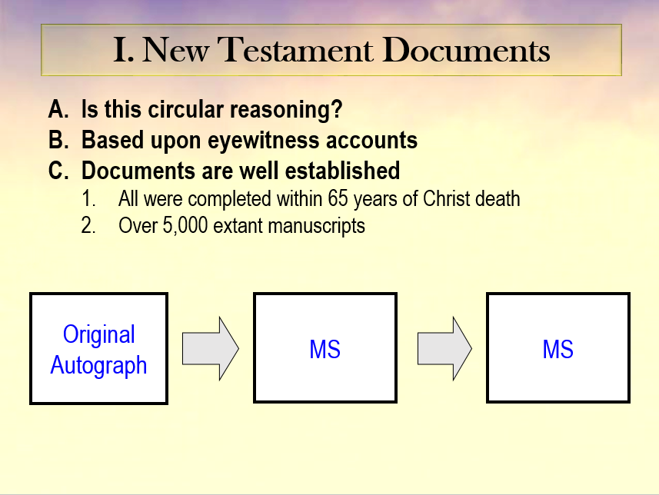
From Lesson 9
Historical
Accuracy
of NT
Documents

Slide 7
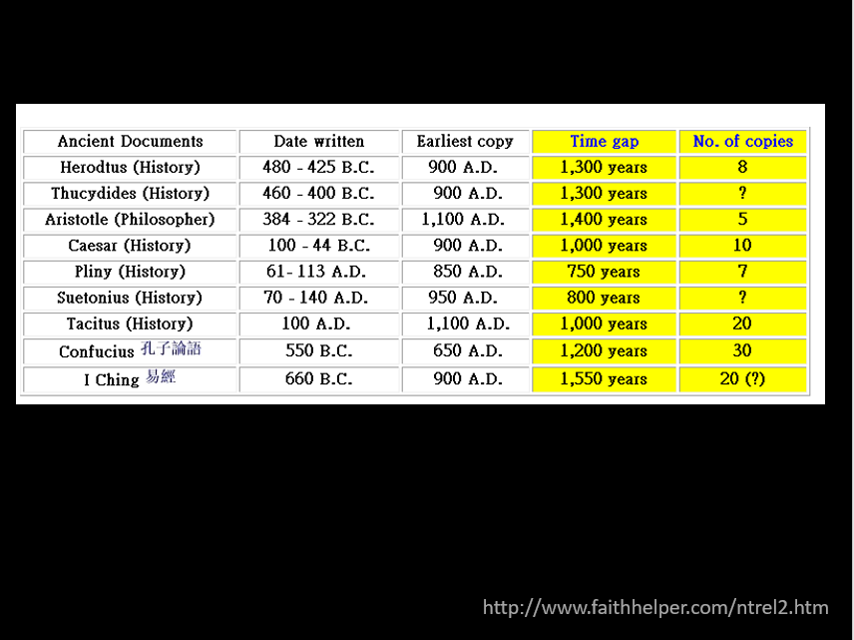
From Lesson 9
Historical
Accuracy
of NT
Documents

Slide 8
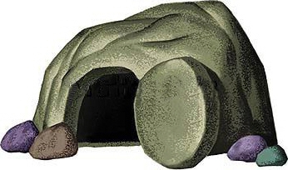
For Faith
Resurrection of Christ
The Empty Tomb

Slide 9
The Empty Tomb
Fact That the Tomb is Empty
  Matt. 28:6
  Luke 24:3
  Admitted by all

Slide 10
The Empty Tomb
Fact That the Tomb is Empty
How Did it Become Empty?
  “Swoon Theory” (didn’t really die)
    Stone 3 women could not move (Mark 16:3)
    Jesus in a weakened condition could not
      Blood he has lost
      He had not eaten in 3 days
    Those at the cross knew he was dead

Slide 11
The Tomb Itself
New Tomb (Luke 23:53; John 19:41)
Made of Solid Rock (Matt. 27:60; Mark 15:46)
Only Opening Sealed with a Great Stone (Mark 16:4; Matt. 27:62-66)
Found in the tomb: linen cloths & face cloth (John 20:6-7)

Slide 12
The Empty Tomb
Fact That Tomb is Empty
How Did It Become Empty
  “Swoon Theory”
  Disciples stole it
    Was the charge (Matt. 28:13)
    How could they without waking the guards?
    If disciples had the body – wouldn’t make the claim

Slide 13
The Empty Tomb
Fact That Tomb is Empty
How Did It Become Empty
  “Swoon Theory”
  Disciples stole it
  Enemies stole it
    If so could produce the dead body and destroyed “Christianity”
    What motive would they have?
    Proof for enemies would be to have the body still in grave!

Slide 14
The Empty Tomb
Fact That Tomb is Empty
How Did It Become Empty
  “Swoon Theory”
  Disciples stole it
  Enemies stole it
  Really was raised
    Was the conclusion of the angel (Matt. 28:7)
    Fulfilled prophecy (Psa. 16:10)

Slide 15
For Faith
Resurrection of Christ
The Empty Tomb
Transformation of Disciples

Slide 16
Transformation of Disciples
When Jesus Died – Disciples Were in Utter Despair
  Hearts troubled (John 14:1-3)
  Shortly after res. they are changed!
  They were not expecting a resurrection (Luke 24:11)

Slide 17
Transformation of Disciples
When Jesus Died – Disciples Were in Utter Despair
Peter As An Example
  Just prior to Christ’s death – denied the Lord (Matt. 26:69-75)
  At tomb he wondered… (Luke 24:12)
  Within few days – different man – boldness:
    Acts 4:10 – proclaims resurrection
    Acts 4:19-20 – cannot but speak
    Acts 5:29 – ought to obey God rather than men
Nothing but the resurrection could have done that!

Slide 18
For Faith
Resurrection of Christ
The Empty Tomb
Transformation of Disciples
Change in the Jews

Slide 19
Change in the Jews
The Jews Wanted to Kill Jesus
  “Crucify him” (Mark 15:13, 14)
  Very ones at Pentecost (Acts 2:22-23)

Slide 20
Change in the Jews
The Jews Wanted to Kill Jesus
What They Heard (Acts 2)
  Preaching about resurrection of Christ (vv. 24-36)
    Peter shows – fulfills Psa. 16:10
    Shows could not refer to David
  Concluded that Jesus is both Lord and Christ (v. 36)

Slide 21
Change in the Jews
The Jews Wanted to Kill Jesus
What They Heard (Acts 2)
They Changed!
  Pricked in hearts (v. 37)
  Asked what do to (v. 37)
  Did what told – submitted to the authority of Christ (v. 38, 41)
  They were convinced of a bodily resurrection of Christ!

Slide 22
For Faith
Resurrection of Christ
The Empty Tomb
Transformation of Disciples
Change in the Jews
Witnesses

Slide 23
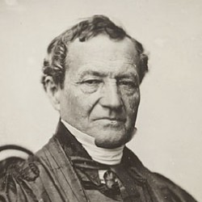
Witnesses
Criteria for Witnesses
  Honesty
  Ability
  Number (agreement)
“The credit due to the testimony of witnesses depends upon firstly, their honesty; secondly, their ability; thirdly, their number and the consistency of their testimony; fourthly, the conformity of their testimony with experience; and fifthly, the coincidence of their testimony with collateral circumstances” (p. 28)
Simon Greenleaf
Testimony of the Evangelist
Practiced law 1806-1853
Professor at Harvard Law School

Slide 24
Witnesses
Criteria for Witnesses
Witnesses Meet The Criteria
  Honest
    Suffered for cause (would they if knew it was a lie?)
    Tell of own faults:
      Peter’s denial (Matt. 26:69-75)
      Ambition (Matt. 20:20-28)
      Failure to understand (Jn. 20:9)
    Reasons for lying cannot be found:
      Fear – testified in face of death!
      Greed – had nothing to gain
      Ambition – no power was gained

Slide 25
Witnesses
Criteria for Witnesses
Witnesses Meet The Criteria
  Honest
  Competent (Ability)
    Been with Christ since his baptism (Acts 1:21-22)
    Matthew was a tax collector
    Luke was a doctor
    Peter, Andrew, James & John were business men
    John noted details (Jno. 20:7)
    Paul was highly educated

Slide 26
Witnesses
Criteria for Witnesses
Witnesses Meet The Criteria
  Honest
  Competent (Ability)
  Number (and agreement)
    Reach point need no more witness needed (cf. Lk. 22:71)
    All said the same thing
    Over 500 claimed they saw him (1 Cor. 15:6)

Slide 27
For Faith
Resurrection of Christ
The Empty Tomb
Transformation of Disciples
Change in the Jews
Witnesses
Appearances

Slide 28
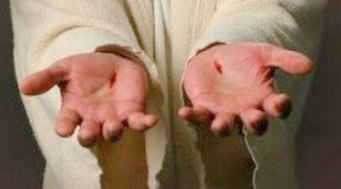
Appearances
When Jesus Appeared After Resurrection – That Proved He Was Raised
  Thomas would not believe until he saw the Lord (John 20:25)
  When he saw the Lord (vv. 27-28):
    Saw his hands and side
    Concluded “My Lord and my God”

Slide 29
Appearances
When Jesus Appeared After Resurrection – That Proved He Was Raised
Appeared to Many

Slide 30
Appearances
  Mary Magdalene (Jn. 20:14-18; Mk. 16:9)
  Two other women (Mt. 28:9)
  Simon –Cephas (Lk. 24:34; 1 Cor. 15:5)
  Two on road to Emmaus (Lk. 24:13)
  The eleven (Lk. 24:33-49; Mk. 16:14; Jn. 20:19-23)
  Over 500 at once (1 Cor. 15:6)
  James (1 Cor. 15:7)
  All apostles –including Thomas (1 Cor. 15:7; Jn. 20:26-29)
  Peter, Thomas, Nathanael, James, John, and others (Jn. 21:1-14)
  Eleven giving great comm. (Mt. 28:16-20)
  Eleven at Jerusalem (Lk. 24:44-49; Acts 1:3-8)
  Eleven at mount of Olives (Lk. 24:50-53: Acts 1:9-11)
  Paul (1 Cor. 15:8; Acts 9:1-9)

Slide 31
For Faith
Resurrection of Christ
The Empty Tomb
Transformation of Disciples
Change in the Jews
Witnesses
Appearances
Conversion of Saul

Slide 32
Conversion of Saul
Argument Presented by Lord George Lyttelton in 1747
  Gilbert West – Resurrection of Christ
  Lord Lyttelton – Conversion of Saul
  Set out to disprove the resurrection
  Changed – to believe in resurrection
  Lyttelton: “The conversion was of itself a demonstration sufficient to prove Christianity to be a divine revelation”

Slide 33
Conversion of Saul
Argument Presented by Lord George Lyttelton in 1747
Lyttelton’s Four Propositions:
  Paul was an imposter
  Paul was an enthusiast – imagination
  Paul was deceived (by others)
  What he said about his conversion – really happened

Slide 34
Conversion of Saul
Argument Presented by Lord George Lyttelton in 1747
Lyttelton’s Four Propositions:
Paul was not an imposter
  No motive for lying
    Money
    Reputation
    Power
  Placed his story on road to Damascus
  Miracles he worked shows he as not a fraud (Acts 13, 14, 16)

Slide 35
Conversion of Saul
Argument Presented by Lord George Lyttelton in 1747
Lyttelton’s Four Propositions:
Paul was not an imposter
Paul was not an enthusiast
  An enthusiast sees things he is looking for – Saul was not looking for resurrected Lord
  Were other witnesses (Acts 22, 26)
  No marks of an enthusiast
    Temper – wild and unreasonable
    Ignorance – (cf. Acts 26:24)
    Misguided zeal

Slide 36
Conversion of Saul
Argument Presented by Lord George Lyttelton in 1747
Lyttelton’s Four Propositions:
Paul was not an imposter
Paul was not an enthusiast
Paul was not deceived by others
  Impossible to produce a light brighter than noon sun
  Could not cause the voice to be heard
  Nor could they cause Saul to be blind for 3 days (and then return his sight)
Only Conclusion:
It Really Did Happen!

Slide 37
For Faith
Resurrection of Christ
The Empty Tomb
Transformation of Disciples
Change in the Jews
Witnesses
Appearances
Conversion of Saul

