Slide 1

Is there real
evidence for believing?
For Faith
Evidence for God part 1 (11-15)
Evidence for God part 2 (11-22)
The Problem of Evil (11-29)
The Bible and Science (12-06)
Creation (12-13)
The Genesis Flood (12-20)
Archeology (01-03)
Historical Jesus (01-10)
The Resurrection of Christ (01-17)
Inspiration of Scripture (01-24)
Cannon and the Apocrypha (02-17)
Sunday Evening
Studies
Designed to build and strengthen
real faith

Slide 2
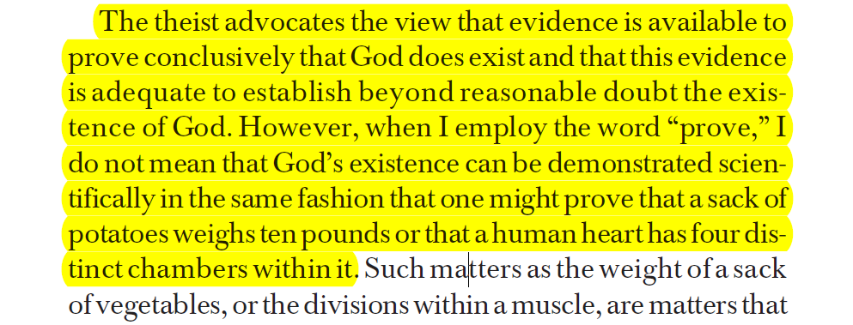
Proof & Evidence
Not demonstrative proof!
Can show it is more reasonable to believe than not believe
Bert Thompson, Ph.D.
The Case for the Existence of God, 2

Slide 3
God Has Always Given Proof
Faith is based on evidence (Rom. 10:17)
Many infallible proofs (Acts 1:3)
The heathen is without excuse (Rom. 1:20)
Word confirmed by wonders & signs (Heb. 2:4)
Witnesses give evidence of resurrection (Acts 2:32)

Slide 4
Faith Is Knowledge
Can Know there is a God (Psa. 46:10; 1 Jno. 5:13)
Faith is not:
  An unsubstantiated opinion
  A blind leap into the dark
  Wishful thinking
  Irrational anti-intellectualism
  Opposed to knowledge
  Opposed to reason

Slide 5
Faith Is Knowledge
Can Know there is a God (Psa. 46:10; 1 Jno. 5:13)
Faith is not:
How knowledge is acquired:
  Sense perception (certainty depends upon accurate senses & correct interpretation)
  Inference [reason] (certainty depends upon the truthfulness of the premises & validity of the inference) – Jno. 2:11; 3:2, 8; 20:8
  Testimony [revelation] (certainty depends upon the strength of evidence & credibility of witness) – Luke 1:1-4; Jno. 20:29-31

Slide 6
If Conditions for Accuracy Are Met:
  Sense perception
  Inference
  Testimony
Knowledge gained here
Knowledge gained here is no less certain than …

Slide 7
Same Way We Know :
  Sense perception
  Inference
  Testimony
George Washington was president
Was a Civil War
A builder built that building
Lincoln was shot

Slide 8
Faith is not opposed to Knowledge
Faith is opposed to sight
(2 Cor. 5:7)

Slide 9
If Don’t Believe = Atheist
Has the real “leap of faith”
All happened by time & chance

Slide 10
“The Bible makes no formal arguments for the existence of God; it assumes His being. However, it does make allusions to evidence for His existence.”
Homer Hailey, Internal Evidences of Christianity, 5

Slide 11
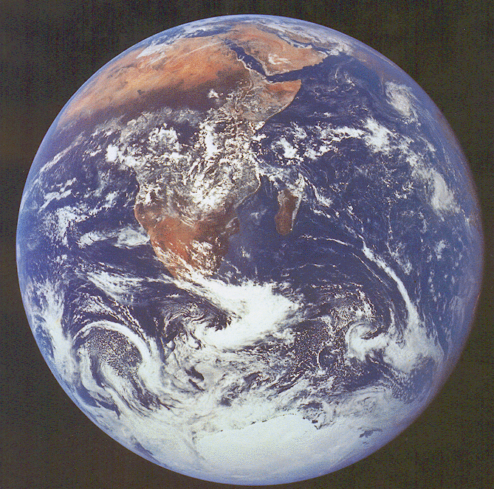
Bible Writers Point to Creation
The
World
That
Exist
Psa. 19:1-6
Rom. 1:20
Believe
There Is
A God

Slide 12
Cosmological & Teleological
Argument
“The Cosmological Argument is the argument that the cosmos is an effect produced by a Primal Cause, which, from the nature of the case, must be a Person. Sometimes it is call the argument from causality, or from cause and effect.”
L. S. Keyser, A System of Natural Theism, 46

Slide 13
Cosmological & Teleological
Argument
“The Teleological Argument is the argument for the divine existence which is based on the evidence of design, the purpose and adaptation in the creation. It is best known as the argument from design, purpose or final cause.”
L. S. Keyser, A System of Natural Theism, 30

Slide 14
Cosmological & Teleological
Argument
Cosmos – argues – Cause
Design – argues - Designer

Slide 15
For Faith
Evidence for God (Part 1)
Passages that Argue From Creation

Slide 16
Passages that Argue From Creation
Psalm 19:1-6

Slide 17
Psalm 19:1-6
1 The heavens declare the glory of God; And the firmament shows His handiwork.
2 Day unto day utters speech, And night unto night reveals knowledge.
3 There is no speech nor language Where their voice is not heard.
4 Their line has gone out through all the earth, And their words to the end of the world. In them He has set a tabernacle for the sun,
5 Which is like a bridegroom coming out of his chamber, And rejoices like a strong man to run its race.
6 Its rising is from one end of heaven, And its circuit to the other end; And there is nothing hidden from its heat.

Slide 18
Psalm 19:1-6
Heavens (vv.1-4a)
  Declare the glory of God (v. 1)
  Continual story – unfolds (v. 2)
  Speak an unspoken language – a can understand (vv. 3-4a)
The Sun (vv. 4b-6)
  Set a dwelling place for Sun (v. 4b)
  Like a Bridegroom –in radiance –imparts (v. 5a)
  Like a strong man ready for a race (vv. 5b-6)

Slide 19
Creation Cannot Tell Us The Character of God or His Will
“A look at creation impresses us with the fact of limitless, inexhaustible power in the universe. But, no one can determine by such observation, the character or attributes of God; indeed whether there is one God or a million. When we have had revealed to us the one God by the Bible, nature declares his glory. Nature does not tell us how to be saved or enable us to go to heaven. The Scriptures are the sole source of such information.”
Guy N. Woods,
Gospel Advocate Adult Quarterly (July 16, 1972)

Slide 20
Passages that Argue From Creation
Psalm 19:1-6
Psalm 139:14

Slide 21
Psalm 139:14
14 I will praise You, for I am fearfully and wonderfully made; Marvelous are Your works, And that my soul knows very well.

Slide 22
Passages that Argue From Creation
Psalm 19:1-6
Psalm 139:14
Acts 14:15-17

Slide 23
Acts 14:15-17
15 and saying, "Men, why are you doing these things? We also are men with the same nature as you, and preach to you that you should turn from these useless things to the living God, who made the heaven, the earth, the sea, and all things that are in them,
16 who in bygone generations allowed all nations to walk in their own ways.
17 Nevertheless He did not leave Himself without witness, in that He did good, gave us rain from heaven and fruitful seasons, filling our hearts with food and gladness."

Slide 24
Passages that Argue From Creation
Psalm 19:1-6
Psalm 139:14
Acts 14:15-17
Acts 17:22-31

Slide 25
Acts 17:22-31
22 Then Paul stood in the midst of the Areopagus and said, "Men of Athens, I perceive that in all things you are very religious;
23 for as I was passing through and considering the objects of your worship, I even found an altar with this inscription: TO THE UNKNOWN GOD. Therefore, the One whom you worship without knowing, Him I proclaim to you:
24 God, who made the world and everything in it, since He is Lord of heaven and earth, does not dwell in temples made with hands.

Slide 26
Acts 17:22-31
25 Nor is He worshiped with men's hands, as though He needed anything, since He gives to all life, breath, and all things.
26 And He has made from one blood every nation of men to dwell on all the face of the earth, and has determined their preappointed times and the boundaries of their dwellings,
27 so that they should seek the Lord, in the hope that they might grope for Him and find Him, though He is not far from each one of us;
28 for in Him we live and move and have our being, as also some of your own poets have said, 'For we are also His offspring.'

Slide 27
Acts 17:22-31
29 "Therefore, since we are the offspring of God, we ought not to think that the Divine Nature is like gold or silver or stone, something shaped by art and man's devising.
30 Truly, these times of ignorance God overlooked, but now commands all men everywhere to repent,
31 because He has appointed a day on which He will judge the world in righteousness by the Man whom He has ordained. He has given assurance of this to all by raising Him from the dead."

Slide 28
Passages that Argue From Creation
Psalm 19:1-6
Psalm 139:14
Acts 14:15-17
Acts 17:22-31
Romans 1:20

Slide 29
Romans 1:20
20 For since the creation of the world His invisible attributes are clearly seen, being understood by the things that are made, even His eternal power and Godhead, so that they are without excuse,
Invisible Attributes:
Eternal Power
Godhead
Things that
are made:
The World
Clearly
Seen

Slide 30
For Faith
Evidence for God (Part 1)
Passages that Argue From Creation
Argument for a Cause

Slide 31
Argument for a Cause
A. Something Is – Therefore something always was
“We do not say ‘everything must have a cause,’ but that every effect must have an adequate cause. Hence we get back to that which is not an effect, but the uncaused cause of all: God”
Homer Hailey, Internal Evidences of Christianity, 8)
Something cannot come from nothing. The fact that the world is – means something always was!

Slide 32
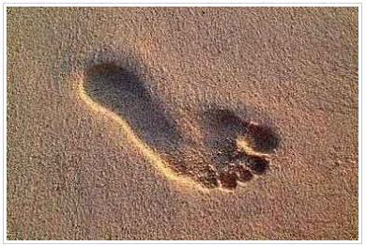
Argument for a Cause
Something Is – Therefore something always was
Only two possible choices
Principle of Cause & Effect
To see the effect – is evidence of an unseen cause
Footprint in Earth
Know Someone
Has Walked
There Before
Effect

Slide 33
Mind
Matter
One of the two is eternal & the origin of all
Impossible that both are cause & effect
It is more reasonable to believe Mind acted upon Matter
“It is reasonable to believe that mind acted upon matter, that mind was the cause and matter the effect. To reverse this order twists the harmony of the universe out of shape. A nest does not create the bird to sit on it. A mighty telescope does not create the astronomer to peer through it into outer space, and an automobile does not create the driver to sit in it and determine its course.”
(Stanley E. Sayers, For This Cause, 7-8)

Slide 34
Argument for a Cause
Something Is – Therefore something always was
Only two possible choices
Hebrews 3:4
“For every house is built by someone, but He who built all things is God.”

Slide 35
For Faith
Evidence for God (Part 1)
Passages that Argue From Creation
Argument for a Cause
Argument for a Designer

Slide 36
Argument for a Designer
Chance Does Not Explain – Universe As We Know It
Matter is not eternal
Impersonal Matter + Time + Chance = Zero

Slide 37

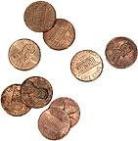
A. Cressy Morrison
Man Does Not Stand Alone
Earth rotates on its axes
at 1,000 MPH
If at 100 MPH days &
Night 10 times as long
Hot day would burn vegetation – Long Night would freeze any sprout
Ten Pennies
Number 1-10
Chance of drawing out
1-10 in succession
1 in 10 billion
Sun’s surface is 12,000 Degrees F.
If half that – freeze!
If half more roast!
Slant of the earth
23 degrees
(gives us our seasons)
If not so tilted vapors
From ocean would pile up continents of ice
If crust of earth were ten feet thicker
Would be no oxygen

Slide 38
Argument for a Designer
Chance Does Not Explain – Universe As We Know It
Design & Complexity Argues For A Designer

Slide 39
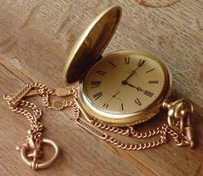
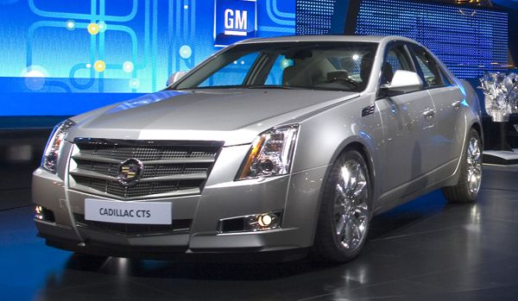
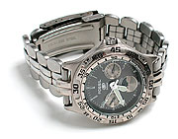

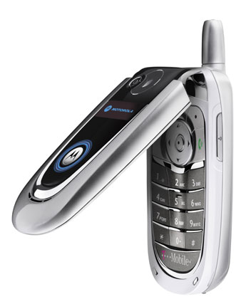
Design & Complexity

Slide 40
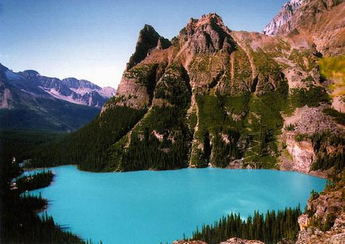
Design & Complexity

Slide 41
Argument for a Designer
Chance Does Not Explain – Universe As We Know It
Design & Complexity Argues For A Designer
Design & Complexity In Creation

Slide 42
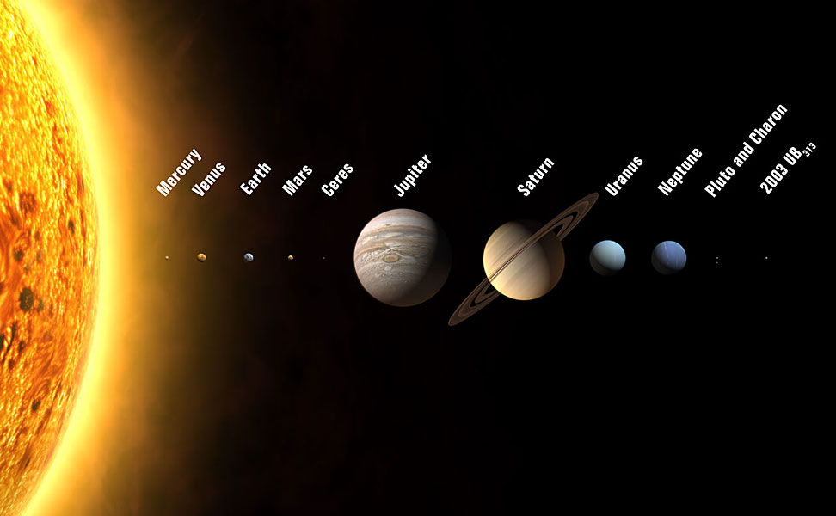
Design & Complexity
In Creation
Solar System

Slide 43
Design & Complexity
In Creation
Insects & Animals
Salmon return to place where born – many years after being at sea
Starlings fly by day using the sun as a compass
Old World Warblers migrate using the stars (stop if fog hinders sight)
Bees & pollination of flowers & fruit trees

Slide 44
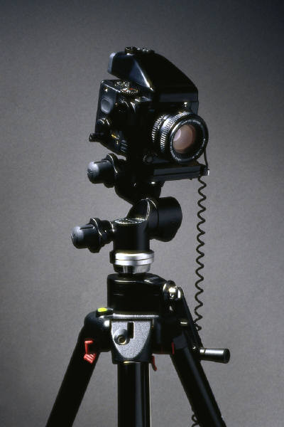
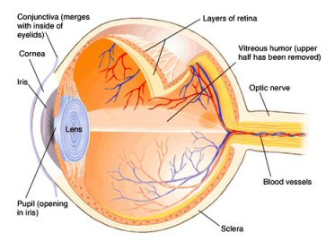
Design & Complexity
In Creation
Human Body

Slide 45
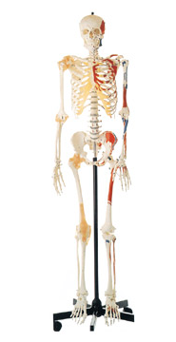
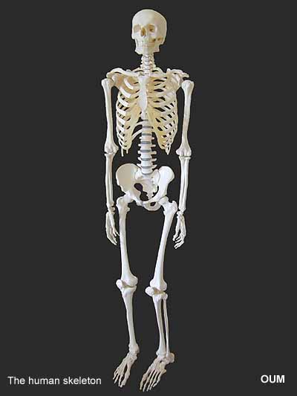
Design & Complexity
In Creation
Human Body

Slide 46
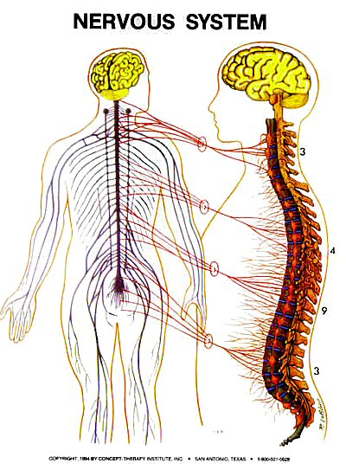
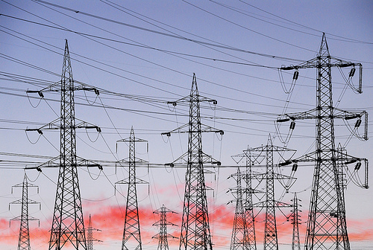
Design & Complexity
In Creation
Human Body

Slide 47
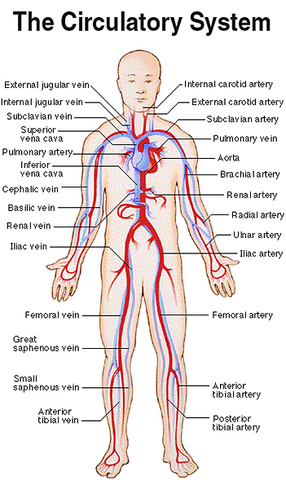
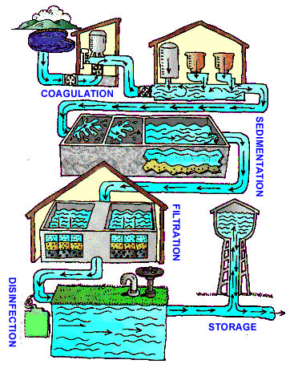
Design & Complexity
In Creation
Human Body

Slide 48
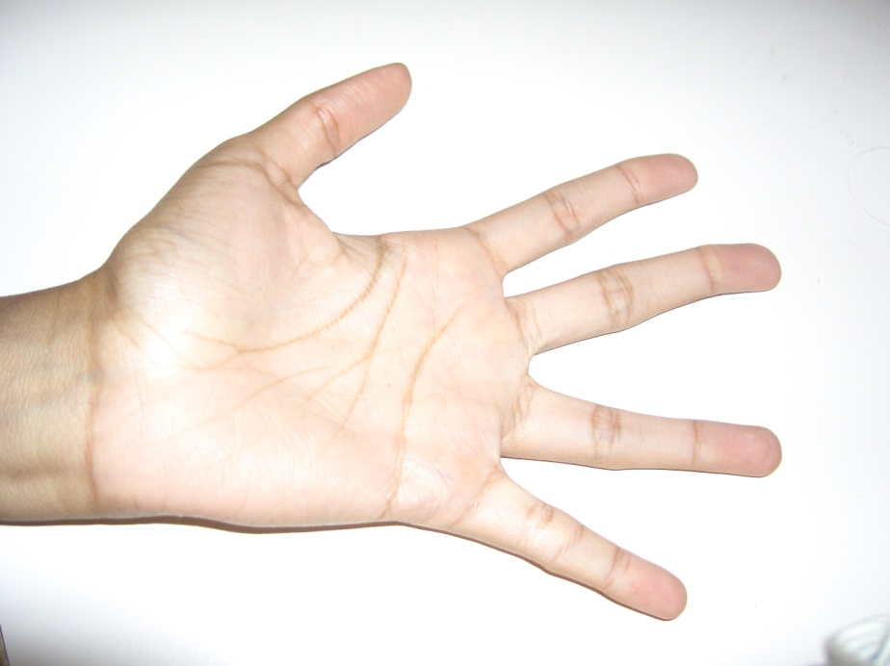
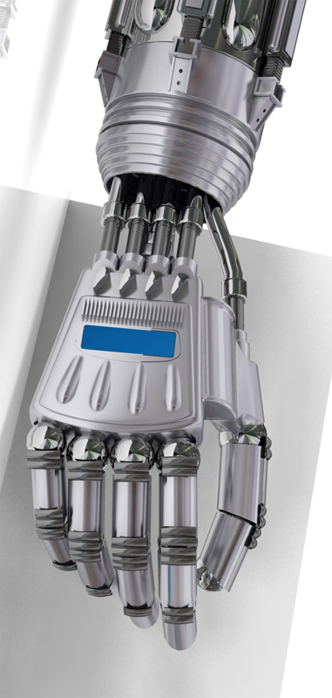
Design & Complexity
In Creation
Human Body

Slide 49
For Faith
Evidence for God (Part 1)
Passages that Argue From Creation
Argument for a Cause
Argument for a Designer

