Slide 1

The Christian’s
Day-to-Day Sin
1. Christians Do Sin
2. Consequences To Sin
3. Justification And The Christian
4. Preventing Day to Day Sin

Slide 2
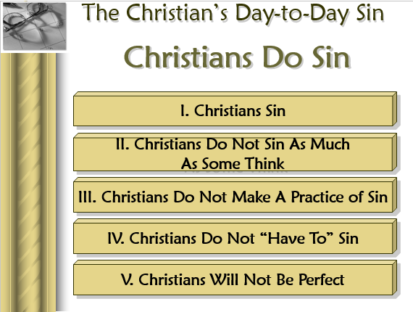
Review
Lesson 1

Slide 3
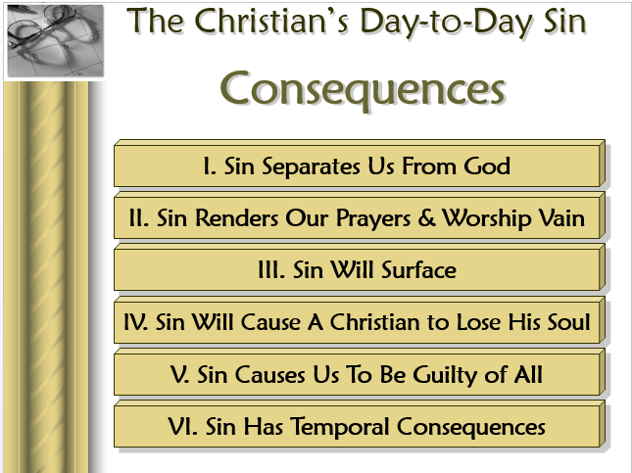
Review
Lesson 2

Slide 4
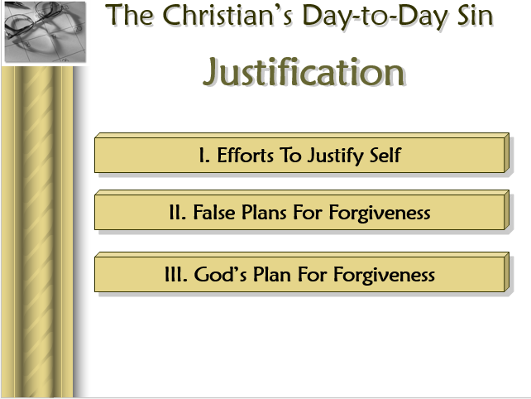
Review
Lesson 3

Slide 5
The Christian’s
Day-to-Day Sin
Preventing Sin

Slide 6
How can I deter sin in my life?
Can I actually prevent sin?
Can I take steps to sin less than I have?
Do I control whether I sin or not?
Yes!
“I write unto you that you might not sin” (1 John 2:1)

Slide 7

What Can I Do?

Slide 8
The Christian’s Day-to-Day Sin
Preventing Sin
I. Self Examination

Slide 9
I. Self Examination
A. Passages
1. 1 Cor. 11:31
2. 2 Cor. 13:5
3. Jas. 1:22-25

Slide 10
I. Self Examination
A. Passages
B. Questions:
1. What can I do to improve?
2. What are my weaknesses?
3. Wherein do I yield to temptation?
4. What sins do I need to overcome?
5. What am I doing that God forbids?
6. What does God require that I am not doing?
7. How does this passage apply to me?

Slide 11
The Christian’s Day-to-Day Sin
Preventing Sin
I. Self Examination
II. Flee Temptation

Slide 12
II. Flee Temptation
A. Pray that not be led into it (Matt. 6:13)
B. Watch about getting familiar (Psa. 1:1-3)
C. Stay clear of tempting situations
1. Prov. 5:8
2. Prov. 7:25
3. Joshua 23:7-13
D. Point: Don’t toy with sin – Don’t see how close can get
1. Don’t put self in tempting situations
2. Don’t tempt self
3. Don’t get into situations – know will tempt

Slide 13
The Christian’s Day-to-Day Sin
Preventing Sin
I. Self Examination
II. Flee Temptation
III. Take The Word To Heart

Slide 14
III. Take The Word To Heart
Word discourages sin (Psa. 119:11, 61)
Remembrance combats temptation (Matt. 4:1-11)
Is opposite of gradual influence of the world (Psa. 1:1-3)
Involves a full consent of the mind & complete implementation of the will (Deut. 6:6)

Slide 15
The Christian’s Day-to-Day Sin
Preventing Sin
I. Self Examination
II. Flee Temptation
III. Take The Word To Heart
IV. Clean Up Your Mind

Slide 16
IV. Clean Up Your Mind
A. Actions are based on our thinking
1. Prov. 4:23
2. Prov. 23:7
3. Matt. 15:19
B. Dismiss Thoughts – Before Become Action
1. 1 John 3:15 – hatred – becomes murder
2. Matt. 5:28 – lust –becomes adultery

Slide 17
The Christian’s Day-to-Day Sin
Preventing Sin
I. Self Examination
II. Flee Temptation
III. Take The Word To Heart
IV. Clean Up Your Mind
V. Develop Hatred For Sin

Slide 18
V. Develop Hatred For Sin
A. Sin should be disgusting
1. Psa. 119:104 – hate every false way
2. 2 Pet. 2:7-8 – sick and tired of sin
3. Matt. 6:24 – cannot serve two masters
4. Prov. 6:16-19 – God hates sin
5. Psa. 97:10 – You who love the Lord hate evil
B. Too often sin doesn’t bother us
1. Not real bothered at Corinth (1 Cor. 5)
2. Even enjoy those who do sin (Rom. 1:32)

Slide 19
The Christian’s Day-to-Day Sin
Preventing Sin
I. Self Examination
II. Flee Temptation
III. Take The Word To Heart
IV. Clean Up Your Mind
V. Develop Hatred For Sin
VI. Watch Your Associations

Slide 20
VI. Watch Your Associations
A. Our friends influence us
1. Prov. 1:10-17
2. 1 Cor. 15:33
3. Gal. 2:11-13 – Peter influenced by those he was with; Barnabas influenced by Peter
B. We become like our associates (Prov. 22:24-25)

Slide 21
VI. Watch Your Associations
A. Our friends influence us
B. We become like our associates (Prov. 22:24-25)
C. What Could Happen: (Psa. 1:1-3)
  Become indifferent toward sin – not bothered
  A little participation in sin (drink, smoke, drugs, language, filth watch, etc.)
  Hypocrisy – (still try to “serve God” & hold world’s hand)
  More participation in sin – less bothered….
  Less concern about God, his church or doing right

Slide 22
The Christian’s Day-to-Day Sin
Preventing Sin
I. Self Examination
II. Flee Temptation
III. Take The Word To Heart
IV. Clean Up Your Mind
V. Develop Hatred For Sin
VI. Watch Your Associations
VII. Use Every Opportunity For Strength

Slide 23
VII. Use Every Opportunity For Strength
A. Your faith is your standing ground (Heb. 11:1)
B. Stronger faith = stronger resistance
C. Opportunities to grow abound:
1. Read & study the word (Rom. 10:17)
2. Pray daily (Dan. 6:10; 1 Thess. 5:17)
3. Don’t miss a class (some miss ½ to ¾)
4. Attend all the services (Heb. 10:24-25)
5. Associate with people who are godly (Phil. 3:17)
6. Attend meetings, read good material, etc.

Slide 24
The Christian’s Day-to-Day Sin
Preventing Sin
I. Self Examination
II. Flee Temptation
III. Take The Word To Heart
IV. Clean Up Your Mind
V. Develop Hatred For Sin
VI. Watch Your Associations
VII. Use Every Opportunity For Strength
VIII. Remember Who You Were

Slide 25
VIII. Remember Who You Were
A. Don’t forget what it was like to be in sin
1. Were in bondage (Rom. 6:17)
2. Were children of wrath (Eph. 2:1-ff)
3. Were without God, Christ & Hope (Eph. 2:12)
B. Don’t forget consequences faced (Rom. 6:23)
C. Why go back?

Slide 26
The Christian’s Day-to-Day Sin
Preventing Sin
I. Self Examination
II. Flee Temptation
III. Take The Word To Heart
IV. Clean Up Your Mind
V. Develop Hatred For Sin
VI. Watch Your Associations
VII. Use Every Opportunity For Strength
VIII. Remember Who You Were

