Slide 1

The Christian’s
Day-to-Day Sin
1. Christians Do Sin
2. Consequences To Sin
3. Justification And The Christian
4. Preventing Day to Day Sin

Slide 2
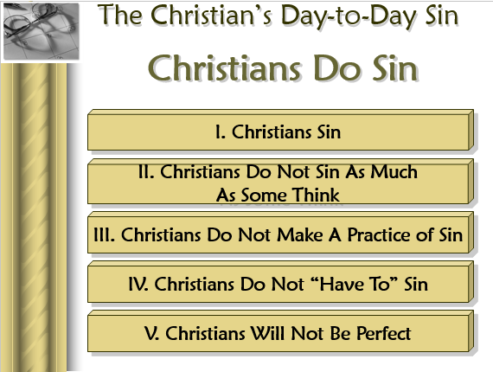
Review
Lesson 1

Slide 3
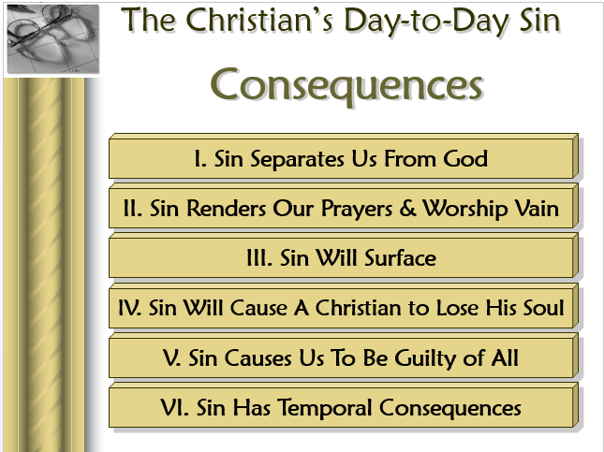
Review
Lesson 2

Slide 4
The Christian’s
Day-to-Day Sin
Justification

Slide 5
Once A Christian Realizes He Has Sinned
Must Ask What To Do About It
Often we seek to justify what we have done
Or, console ourselves – with false plans
Only way – seek forgiveness God’s way

Slide 6
The Christian’s Day-to-Day Sin
Justification
I. Efforts To Justify Self

Slide 7
I. Efforts To Justify Self
“We all sin”
“We are just human”
“You think you are perfect”
“Bunch of hypocrites in the church”

Slide 8
The Christian’s Day-to-Day Sin
Justification
I. Efforts To Justify Self
II. False Plans For Forgiveness

Slide 9
II. False Plans For Forgiveness
Automatic cleansing
  Cleansed “even as we sin”
  Illustrated with wipers on windshield
  No repentance – no confession, etc.

Slide 10
II. False Plans For Forgiveness
Automatic cleansing
Imputed Righteousness

Slide 11
Imputed Righteousness
Calvinism:
Christ
R. of Christ
transferred
Us

Slide 12


God Sees
Perfect
Righteousness
of Christ
Sin
Inst. Music
Adultery
Error

Slide 13
Imputed Righteousness
Calvinism:
Bible:
Christ
Nothing in Rom. 4 about
the righteousness of Christ
Righteousness imputed = own
Sin imputed = own
If Righteousness = R. of Christ – then sin = sin of Christ
R. of Christ
transferred
Us

Slide 14
II. False Plans For Forgiveness
Automatic cleansing
Imputed Righteousness
Time
Time doesn’t change anything
2 Pet. 2:4
Jude 6
If so, then all sinners under OT will surely be saved

Slide 15
II. False Plans For Forgiveness
Automatic cleansing
Imputed Righteousness
Time
Self – Purification
Somehow handle the sin myself (my way)
Balance the sin with good deeds

Slide 16
The Christian’s Day-to-Day Sin
Justification
I. Efforts To Justify Self
II. False Plans For Forgiveness
III. God’s Plan For Forgiveness

Slide 17
A. Repentance - (Acts 8:22)
1. Change of mind
a. Literally: to perceive afterwards
b. Gen. 6:6; Exo. 32:14 –
c. Matt. 21:29 – regret
- Context: Changed his mind
- NIV – “but later changed his mind and went”
d. Acts 8:22 – demanding a change of mind

Slide 18
A. Repentance - (Acts 8:22)
1. Change of mind
2. Godly sorrow
a. 2 Cor. 7:10 – sorrow according to God
b. NKJV clarifies what the KJV confuses: a distinction in sorrow, regret, & repentance.
c. Sorrow toward God that produces a change of mind

Slide 19
A. Repentance - (Acts 8:22)
1. Change of mind
2. Godly sorrow
3. Change of life
a. Rev. 2:5 –
b. Matt. 3:8 –
c. Compare: Matt. 12:41 & Jonah 3:10
d. Rom. 6 – not to continue in sin

Slide 20
Repentance
Godly
Sorrow
A Change
of Life
A Change
of Mind
Produces
Produces

Slide 21
A. Repentance - (Acts 8:22)
B. Confession - (1 John 1:9)
1. To God
a. As often as we confess – that often he forgives
b. Implied all sin (public & private) confessed to God
c. Must we specify every sin?
Confess
Every Sin
Confess
Every Instance
of Sin
A Difference

Slide 22
A. Repentance - (Acts 8:22)
B. Confession - (1 John 1:9)
1. To God
2. What we are to confess – Our sins
a. 1 John 1:9
b. Jas. 5:16
c. Not just:
- that we are sinners
- could do better

Slide 23
A. Repentance - (Acts 8:22)
B. Confession – (1 John 1:9)
C. Prayer – (Acts 8:22)
1. Asking God for forgiveness
2. Others pray with us & for us
a. Acts 8:24
b. Jas. 5:16

Slide 24

What About Public
Correction?

Slide 25
Public Correction
A. There is a time – confess before others
Jas. 5:16
“Confess your trespasses to one another, and pray for one another, that you may be healed. The effective, fervent prayer of a righteous man avails much.”

Slide 26
Jas. 5:16
“Confess your trespasses to one another, and pray for one another, that you may be healed. The effective, fervent prayer of a righteous man avails much.”
Only passage on the subject of “public confession”
What ever conclusions we draw must be in harmony with this verse.
Demand no more or less

Slide 27
Jas. 5:16
“Confess your trespasses to one another, and pray for one another, that you may be healed. The effective, fervent prayer of a righteous man avails much.”
Only have three choices:
Publicly confess all sin
Publicly confess no sin
Publicly confess some sin

Slide 28
Jas. 5:16
“Confess your trespasses to one another, and pray for one another, that you may be healed. The effective, fervent prayer of a righteous man avails much.”
Implied that confession be as public as the sin
Private Sin
(You Alone)
Sin Before
Five People
(You & Five)
Sin Between
Two
(You & One
Other)
Public Sin
(Before many)

Slide 29




Class & Teacher Illustration
Student
Makes
A Mistake
Working
Alone
Student
Makes
A Mistake
Before
Teacher
Student
Makes
A Mistake
Working
In A Group
Student
Makes
A Mistake
Before
The Class

Slide 30
Public Correction
A. There is a time – confess before others
B. What is to be confessed?
Jas. 5:16
“Confess your trespasses to one another, and pray for one another, that you may be healed. The effective, fervent prayer of a righteous man avails much.”

Slide 31
Public Correction
A. There is a time – confess before others
B. What is to be confessed?
C. What is not in the text

Slide 32
Jas. 5:16
“Confess your trespasses to one another, and pray for one another, that you may be healed. The effective, fervent prayer of a righteous man avails much.”
“Going forward” –vs- another way
Public confession of every sin
Public confession of private sin
That it all has to be in an assembly

Slide 33
Applying Correction
A. Situation: Feel weak, had bad thoughts, not praying as should.
B. Situation: Sin before wife / or before children / done a brother wrong
C. Situation: Sin publicly – drinking, curse before customers, forsaking assembly….
D. Situation: “Wholesale apostasy” – just quit for weeks, years – ready to correct

Slide 34
The Christian’s Day-to-Day Sin
Justification
I. Efforts To Justify Self
II. False Plans For Forgiveness
III. God’s Plan For Forgiveness

Slide 35
Mutual Confession?
Practice of: encourage others to tell what they have done – their struggles – weaknesses, etc.
Practiced by Boston – Crossroads movement (Prayer Partners)
House church movement

Slide 36
Mutual Confession?
Driven by desire to see all have weakness – so feel comfortable around others – can talk to them
Case of: “I’m broken – show me you are too”
Some have used it for control (Crossroads)

Slide 37
Mutual Confession?
No command, example or inference of such a practice
Difference in voluntary & pressured (forced)
Mean that all need to confess all sins
If this is good – better before all congregation so all could pray
David confessed (Psa. 51) & Simon confessed (Acts 8) no evidence encouraged others to do same
Jas. 5:16 does not invite us to go looking for sin – but a case of sin has found us
Confession is not revealing, but an acknowledgement.

