Slide 1

The Christian’s
Day-to-Day Sin
1. Christians Do Sin
2. Consequences To Sin
3. Justification And The Christian
4. Preventing Day to Day Sin

Slide 2
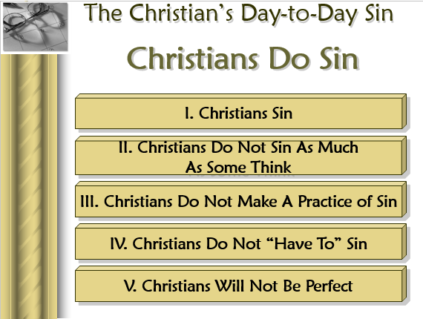
Review
Lesson 1

Slide 3
The Christian’s
Day-to-Day Sin
Consequences

Slide 4
Knowing The Consequences:
Discourage sin – lest we face…
Cause us not to want to stay in sin
Cause us to correct our sin
Cause us to conclude – “not worth it”

Slide 5
The Christian’s Day-to-Day Sin
Consequences
I. Sin Separates Us From God

Slide 6
I. Sin Separates Us From God
Isa. 59:1-2 2 John 9 Jas. 1:15
What about sins of weakness?
  Still sin – Still separates
  Case in point – Gal. 2:11-ff
  What if weakness is lying, stealing, fornication?

Slide 7
I. Sin Separates Us From God
Isa. 59:1-2 2 John 9 Jas. 1:15
What about sins of weakness?
What about sins of ignorance?
  Still sin – Still separates
  Case in point – Acts 8:20-22
  What if ignorance is adultery, denominationalism?

Slide 8
I. Sin Separates Us From God
Isa. 59:1-2 2 John 9 Jas. 1:15
What about sins of weakness?
What about sins of ignorance?
Do all sins separate?
  Jas. 1:15 – applies to all sins
  If not – which are excluded?
  Which sin does not separate?

Slide 9
I. Sin Separates Us From God
Isa. 59:1-2 2 John 9 Jas. 1:15
What about sins of weakness?
What about sins of ignorance?
Do all sins separate?
What about “little” sins?
  1 Thess. 5:22 – every kind
  Bible makes no distinction

Slide 10
The Christian’s Day-to-Day Sin
Consequences
I. Sin Separates Us From God
II. Sin Renders Our Prayers & Worship Vain

Slide 11
II. Sin Renders Our Prayers & Worship Vain
John 9:31
Prov. 28:9
1 Pet. 3:7, 12
Point: wasting our time as long as we continue in sin – All the same as if didn’t even try to worship!

Slide 12
The Christian’s Day-to-Day Sin
Consequences
I. Sin Separates Us From God
II. Sin Renders Our Prayers & Worship Vain
III. Sin Will Surface

Slide 13
III. Sin Will Surface
Numbers 32:23
We will eventually expose ourselves
  May be by inconsistency
  May be by being too bold – get caught
Consequences Come Home to Roost!
“You can’t act like a skunk without someone’s getting wind of it” (Lorence Workman)

Slide 14
The Christian’s Day-to-Day Sin
Consequences
I. Sin Separates Us From God
II. Sin Renders Our Prayers & Worship Vain
III. Sin Will Surface
IV. Sin Will Cause A Christian to Lose His Soul

Slide 15
IV. Sin Will Cause A Christian to Lose His Soul
Rom. 6:23
Rev. 21:8
Gal. 5:19-21
John 8:21
1 Cor. 6:9-11
Possible for a Child of God
to so sin as to lose his soul in Hell!

Slide 16
The Christian’s Day-to-Day Sin
Consequences
I. Sin Separates Us From God
II. Sin Renders Our Prayers & Worship Vain
III. Sin Will Surface
IV. Sin Will Cause A Christian to Lose His Soul
V. Sin Causes Us To Be Guilty of All

Slide 17
V. Sin Causes Us To Be Guilty of All
Jas. 2:10
Doesn’t mean – committed every sin in the book
Context: (vv. 10-13) faith requires obedience to whole law
  If offend in one point – guilty of all (v. 10)
  One part is just as binding as other (v. 11)
  Judged by the whole law (vv. 12-13)

Slide 18
V. Sin Causes Us To Be Guilty of All
Jas. 2:10
Doesn’t mean – committed every sin in the book
Context: (vv. 10-13) faith requires obedience to whole law
Point: Whole law stands against an infraction of one point
If obey every part but one – all same as if
disobey every part (Matt. 19:16-22)

Slide 19
The Christian’s Day-to-Day Sin
Consequences
I. Sin Separates Us From God
II. Sin Renders Our Prayers & Worship Vain
III. Sin Will Surface
IV. Sin Will Cause A Christian to Lose His Soul
V. Sin Causes Us To Be Guilty of All
VI. Sin Has Temporal Consequences

Slide 20
VI. Sin Has Temporal Consequences
Prov 13:15
Good understanding giveth favour: but the way of transgressor is hard” (ASV).
Shame (Prov. 6:33)
Cost Family (Matt. 19:9)
Destroy Life (Drugs, Drinking)
Cost Job – Financially (Stealing)
Pay a Price with Law (Jail)

Slide 21
The Christian’s Day-to-Day Sin
Consequences
I. Sin Separates Us From God
II. Sin Renders Our Prayers & Worship Vain
III. Sin Will Surface
IV. Sin Will Cause A Christian to Lose His Soul
V. Sin Causes Us To Be Guilty of All
VI. Sin Has Temporal Consequences

