Slide 1
A Local Church is Only As Strong
as the Bible Classes it Has
A Local Church is Only As Strong
as the Bible Classes it Has
Christianity is a taught religion (John 6:45)
Understanding is gained by instruction (Acts 8:30-35)
Our Lord was a teacher (Matt. 5:2; 7:29; John 13:13)

Slide 2

Acts 2
4 And they were all filled with the Holy Spirit and began to speak with other tongues, as the Spirit gave them utterance.
5 And there were dwelling in Jerusalem Jews, devout men, from every nation under heaven.
6 And when this sound occurred, the multitude came together, and were confused, because everyone heard them speak in his own language.
7 Then they were all amazed and marveled, saying to one another, "Look, are not all these who speak Galileans?
8 And how is it that we hear, each in our own language in which we were born?
Times When
Divided into Groups
For Instruction

Slide 3
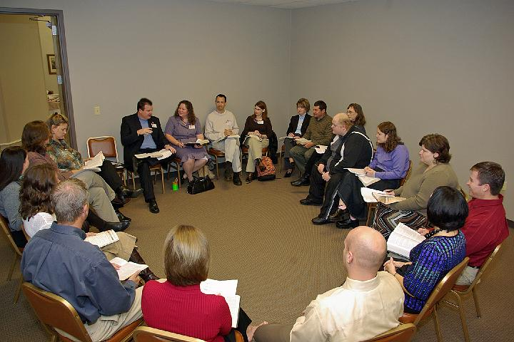
Not All Classes Are Quality Bible Classes
Pooling of ignorance
Discussion of opinion
Little discussion of the text
Read the workbook to class
Teacher unprepared to truly instruct
Students not ready for lesson
Fail to learn the point of the text
Clueless on Bible periods
Read a few verses: “Means what it says”

Slide 4


Better Bible Classes
Improve our Bible class program
Encourage more to be teachers
Provide any needed help to our teachers
Solicit input for ALL for improvements

Slide 5
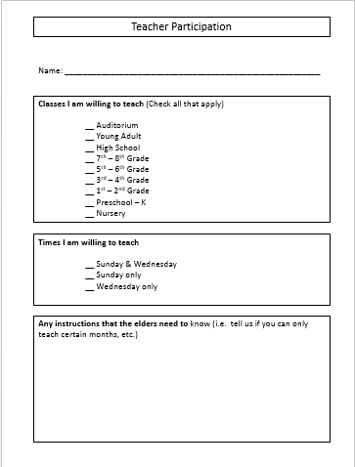

Two Things Planned
Teacher’s Meeting
Sunday Night
March 16
After Services

Slide 6
Better Bible Classes
Quality Material

Slide 7
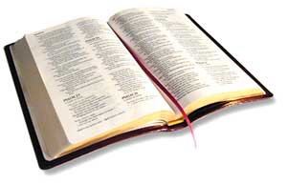
Quality Material
Purpose: teach the Bible
  “The Sunday school is a part – not apart from – the church. The church’s purpose, therefore, is the purpose of the Sunday school.” (Guy P. Leavitt, Teach with Success, 25)
  Church is spread the truth (1 Tim. 3:15)
  Two fold:
    Teach all nations – Evangelism
    Teach them to observe - Nurturing
  Are, after all, BIBLE classes

Slide 8
Quality Material
Purpose: teach the Bible
Principal Subject: Bible Text
  Any passage – tells what is to be preached or taught – applies to Bible classes
    Sound doctrine (Titus 2:1)
    Word (2 Tim. 4:2)
    Gospel (1 Cor. 1:17)
    Forbidden to preach any other (Gal. 1:6-9)

Slide 9
Quality Material
Purpose: teach the Bible
Principal Subject: Bible Text
  Any passage – tells what is to be preached or taught – applies to Bible classes
  Not:
    Opinions / personal convictions (Rom. 14)
    Words of men (workbooks, comments)

Slide 10






Workbooks - Should Be Used As Aids
Drive Student To:

Slide 11
Quality Material
Purpose: teach the Bible
Principal Subject: Bible Text
Props: help learn the Text
  Aids / activities / props/ illustrations should not be the focus of the class
  Focus – learning the Bible
  Ill: Study about flood, Noah & ark
    Have drawing of ark
    Talk about size of ark
    Model would be helpful
    Main point: learn story & use of it!

Slide 12
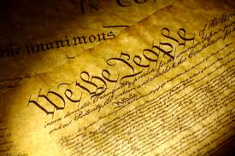
Quality Material
Purpose: teach the Bible
Principal Subject: Bible Text
Props: help learn the Text
Parallel: Class on constitution
  Goal: learn and know constitution
  Any study aid (books, workbooks, articles, videos, drawings, etc.) should drive student to constitution
  Reading & studying ABOUT it – not same as reading and studying IT!

Slide 13
Quality Material
Purpose: teach the Bible
Principal Subject: Bible Text
Props: help learn the Text
Parallel: Class on constitution
Summary:
Teach the Bible!

Slide 14
Better Bible Classes
Quality Material
Quality Teachers

Slide 15

Quality Teachers
Teaching is serious business (Jas. 3:1)
  Not everyone should be teaching
  Not everyone is qualified (2 Tim. 2:2)
  Guiding souls destined for eternity
  Success or failure of class – relies heavily on teacher
    “No matter what material is being used, no matter what system of teaching a congregation is using, each individual teacher makes the system either succeed or fail in his classroom, based upon his degree of preparedness” (Bob Waldron)
    May have to add “meat”
    May have to add scripture
    May have to develop thought

Slide 16

Quality Teachers
Teaching is serious business (Jas. 3:1)
Christians are to be teachers
  Great commission to individuals (Matt. 28:18-20)
  Those scattered spread work (Acts 8:4)
  Time grow and develop skills (Heb. 5:12-14)
Take Your Turn
Give Other Teachers a Break
Who Want to be in Class
(Matt. 7:12)

Slide 17
Quality Teachers
Teaching is serious business (Jas. 3:1)
Christians are to be teachers
Teachers should strive to improve skills
  Should be “able to teach” (2 Tim. 2:24)
    Same as qual. for elders (1 Tim. 3:2)
    Means “skillful in teaching” (Thayer)
  “Determining who needs the milk and who needs the meat in their spiritual diet and presenting it in an appealing manner requires some skill.” (Binkley and Broadwell, Success at Bible Teaching, 5)

Slide 18
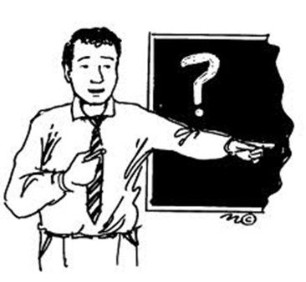
Quality Teachers
Teaching is serious business (Jas. 3:1)
Christians are to be teachers
Teachers should strive to improve skills
Teacher’s job:
  Explain – give the sense (Neh. 8:8)
  Instruct – teach (2 Tim. 2:2, 24)
  Help student to see application (Deut. 31:12-13; Lk. 10:26-28, 37)
  Not:
    Merely to moderate / referee
    Merely to guide discussion / start it
    Merely to fill time / cover all questions
  Help student see how all fits together

Slide 19
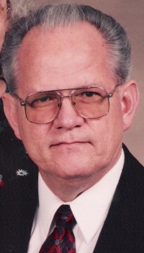

Waldron’s Illustration of Bible Study
Bible Stories, Books, Chapters & Verses
Are like pieces of a jigsaw puzzle

Slide 20



Waldron’s Illustration of Bible Study
Bible Stories, Books, Chapters & Verses
Are like pieces of a jigsaw puzzle
Start with one piece – analyze it
State the obvious: “blue piece”
Others may repeat obvious “Has a blue tint”
Go to next: “This one seems to be red”
Go to next: “This one different from rest”

Slide 21

Waldron’s Illustration of Bible Study
Bible Stories, Books, Chapters & Verses
Are like pieces of a jigsaw puzzle
When we get through
Still have a pile of pieces
Still don’t see picture
Know a lot about parts

Slide 22
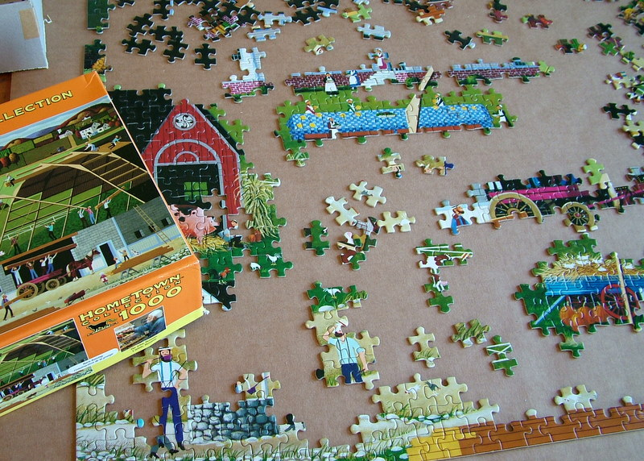
Waldron’s Illustration of Bible Study
See how each piece fits into the larger picture
See how each fits together
Comparison to big picture
See how verse fits into chapter
See how chapter fits into book
See how book fits into theme of Bible
Bible Stories, Books, Chapters & Verses
Are like pieces of a jigsaw puzzle

Slide 23
Better Bible Classes
Quality Material
Quality Teachers
Quality Students

Slide 24
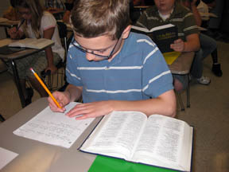
Quality Students
Present
  Bible classes DOUBLE your opportunity to learn & grow
  Any passage on growing in knowledge – encourages going to class (2 Pet. 1:5-10; 3:18)
  Those that don’t come:
    Missing chance for greater knowledge
    Denying selves greater faith
    Depriving children of understanding, faith – perhaps salvation

Slide 25
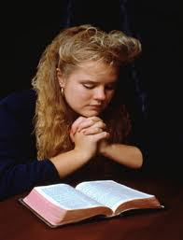
Quality Students
Present
Prepare
  Proper preparation prevents poor performance
  Study the lesson before class – to enhance your learning
  The careful reading, learning and study – will be outside of class (Acts 17:11)

Slide 26

Quality Students
Present
Prepare
Participate
  Study with us – with open Bible
  Answer questions
  Ask questions that generate study and thought
  Add comments to enhance understanding & application

Slide 27
Better Bible Classes
Quality Material
Quality Teachers
Quality Students
Quality Parents

Slide 28

Quality Parents
Most of success /failure (for a particular child) starts in the home
  Whether they come to class at all
  Whether they come regularly (seldom miss)
  Whether they have lesson prepared
  Discussion of lesson learned
  Application of lesson in daily events

Slide 29
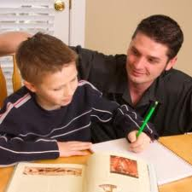
Quality Parents
Most of success /failure (for a particular child) starts in the home
Responsibility lies upon family
  In OT (Deut. 6:5-9)
  In NT (Eph. 6:4)
  No passage in NT gives specific obligation to the church to teach our children – thus classes are “icing on the cake”

Slide 30

Quality Parents
Most of success /failure (for a particular child) starts in the home
Responsibility lies upon family
What can parents do?
  Get them to class
  Get them to class on time (sends a signal – message)
  Help with their lesson
  Give teachers / elders feedback

Slide 31
Better Bible Classes
Quality Material
Quality Teachers
Quality Students
Quality Parents

