Slide 2
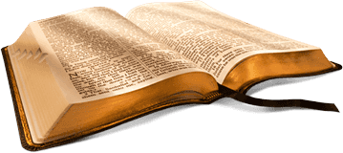
Back to the Bible
A Five Lesson Home Bible Study
The Bible is God’s Word
Applying the Bible Today
The Theme of the Bible
What the Bible Says about Salvation
The Church in the Bible
Foundation
Each Lesson Last One Hour Or Less

Slide 3
Back to the Bible – Lesson One
Review
The Bible Is God’s Word
The Resurrection of Christ from the Dead
  Why begin here?
  Evidence of the resurrection
God Is and His Word is True
  God is…
  His Word is True
Inspiration of the Bible
  Plenary (Complete)
  Verbal (Every word)

Slide 4
Review
If Jesus was raised from the dead:
God Is….
Jesus is the
Son of God
Why Begin Here?
Word is True
“Hub” of Gospel

Slide 5
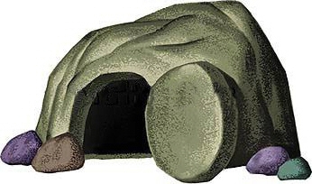
Review
The Resurrection of Christ
The Empty Tomb
Transformation of Disciples
Change in the Jews
Witnesses
Appearances (John 20:25-28)
Conversion of Saul
Manuscript Evidence

Slide 6
Review
Therefore
God is….
We can know there is a God!
We can know there is evidence
My faith is not a blind leap
Word of God is True
Agreement with science
Prophecy Fulfilled
Historically Accurate
Unity of writers
Archaeology

Slide 7
Inspiration of The Bible
Review
Verbal
Verbal
Plenary
Plenary
All The Bible
“All Scripture is given by inspiration of God, and is profitable for doctrine, for reproof, for correction, for instruction in righteousness,”
(2 Tim. 3:16)
Every Word
“These things we also speak, not in words which man’s wisdom teaches but which the Holy Spirit teaches, comparing spiritual things with spiritual.
(1 Cor. 2:13)

Slide 8
Review
Accept it as God’s word (1 Thess. 2:13)
Believe what it says (Rom. 10:17)
Seek to know and understand it (John 8:32)
Want to do what it says (Matt. 7:21; John 12:48)
If The Bible Is God’s Word, Then I Should:

Slide 9
Back to the Bible – Lesson Two
Review
Applying The Bible Today
Can We Understand the Bible?
  The Bible can be understood
  We can understand it alike
Does it Make a Difference What One Believes?
  A popular concept
  It makes a difference what one – believes
  It makes a difference what one – practices
  Consequences

Slide 10
Review
The Two Covenants
  The two covenants are different
  The Old Covenant has been taken away
  We are under the New Covenant
The Authority of the Word
  From the mind of God to the written word
  The Bible has the power and authority of God behind it
    To accept it is to accept God
    To reject it is to reject God

Slide 11

Review
Can We Understand the Bible?
If not, it is God’s fault
Bible is written on 5th grade level
Average word is 5 letters
Can and must be understood
  John 8:32
  Eph. 3:3-5
  Eph. 5:17

Slide 12
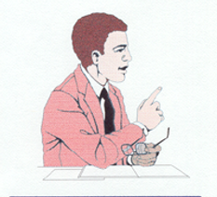
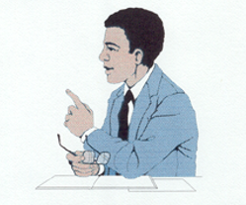
Can We Understand The Bible Alike?
Review
4 Understands | 2+2= | 4 Understands
6 Does Not Understand | 2+2= | 4 Understands
Son of God Understands | Who is Jesus? | Son of God Understands
Son of God Understands | Who is Jesus? | A Son Does not Understand
If they understand, it will be alike!

Slide 13
2 Thess. 2:10-12
Review
Lie Truth
Deceived (v.10)
Not love truth (v. 10)
Deluded (v. 11)
Believe lie (v. 11)
Not believe truth (v. 12)
Pleasure in unright. (v. 12)
Love truth (v. 10)
Believe truth (v. 12)
Saved (v. 10)
Perish (v. 10)
Condemned (v. 12)

Slide 14
Review
Old Testament
New Testament
Israel
(Exo. 20:2; 31:13, 16, 17; Deut. 5:1-3)
Added – Trans.
Bring Men to Christ
(Gal. 3:17-25)
Till Seed Come
(Gal. 3:19; Rom. 7:1-4; Gal. 3:24-25)
All Men
(Mark 16:15-16; Mt. 28:29-20)
Salvation
(Rom. 1:16-17; 8:1-2)
Till End
(Matt. 28:19-20)
To Whom Given
Purpose
Duration
Different

Slide 15
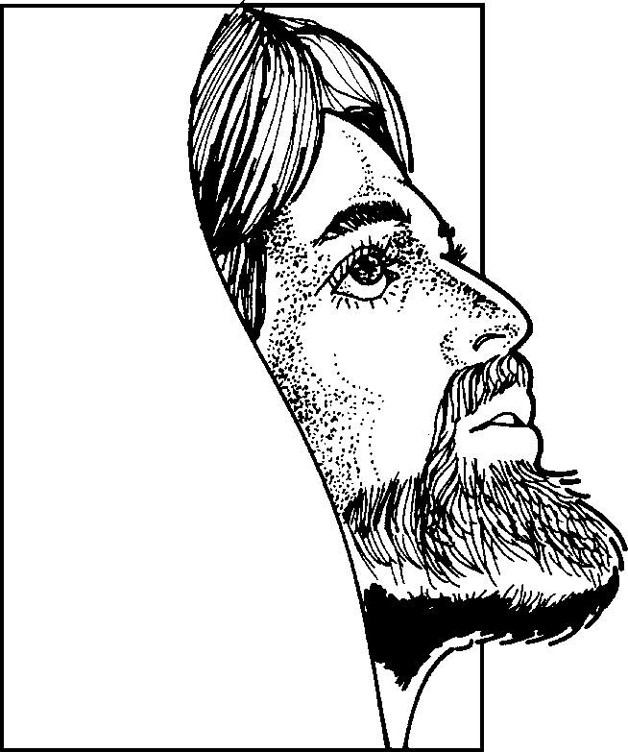
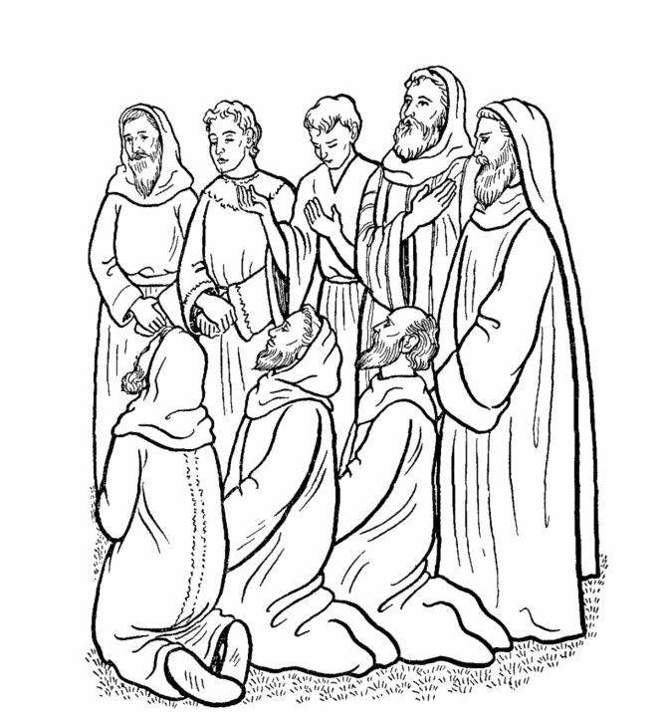
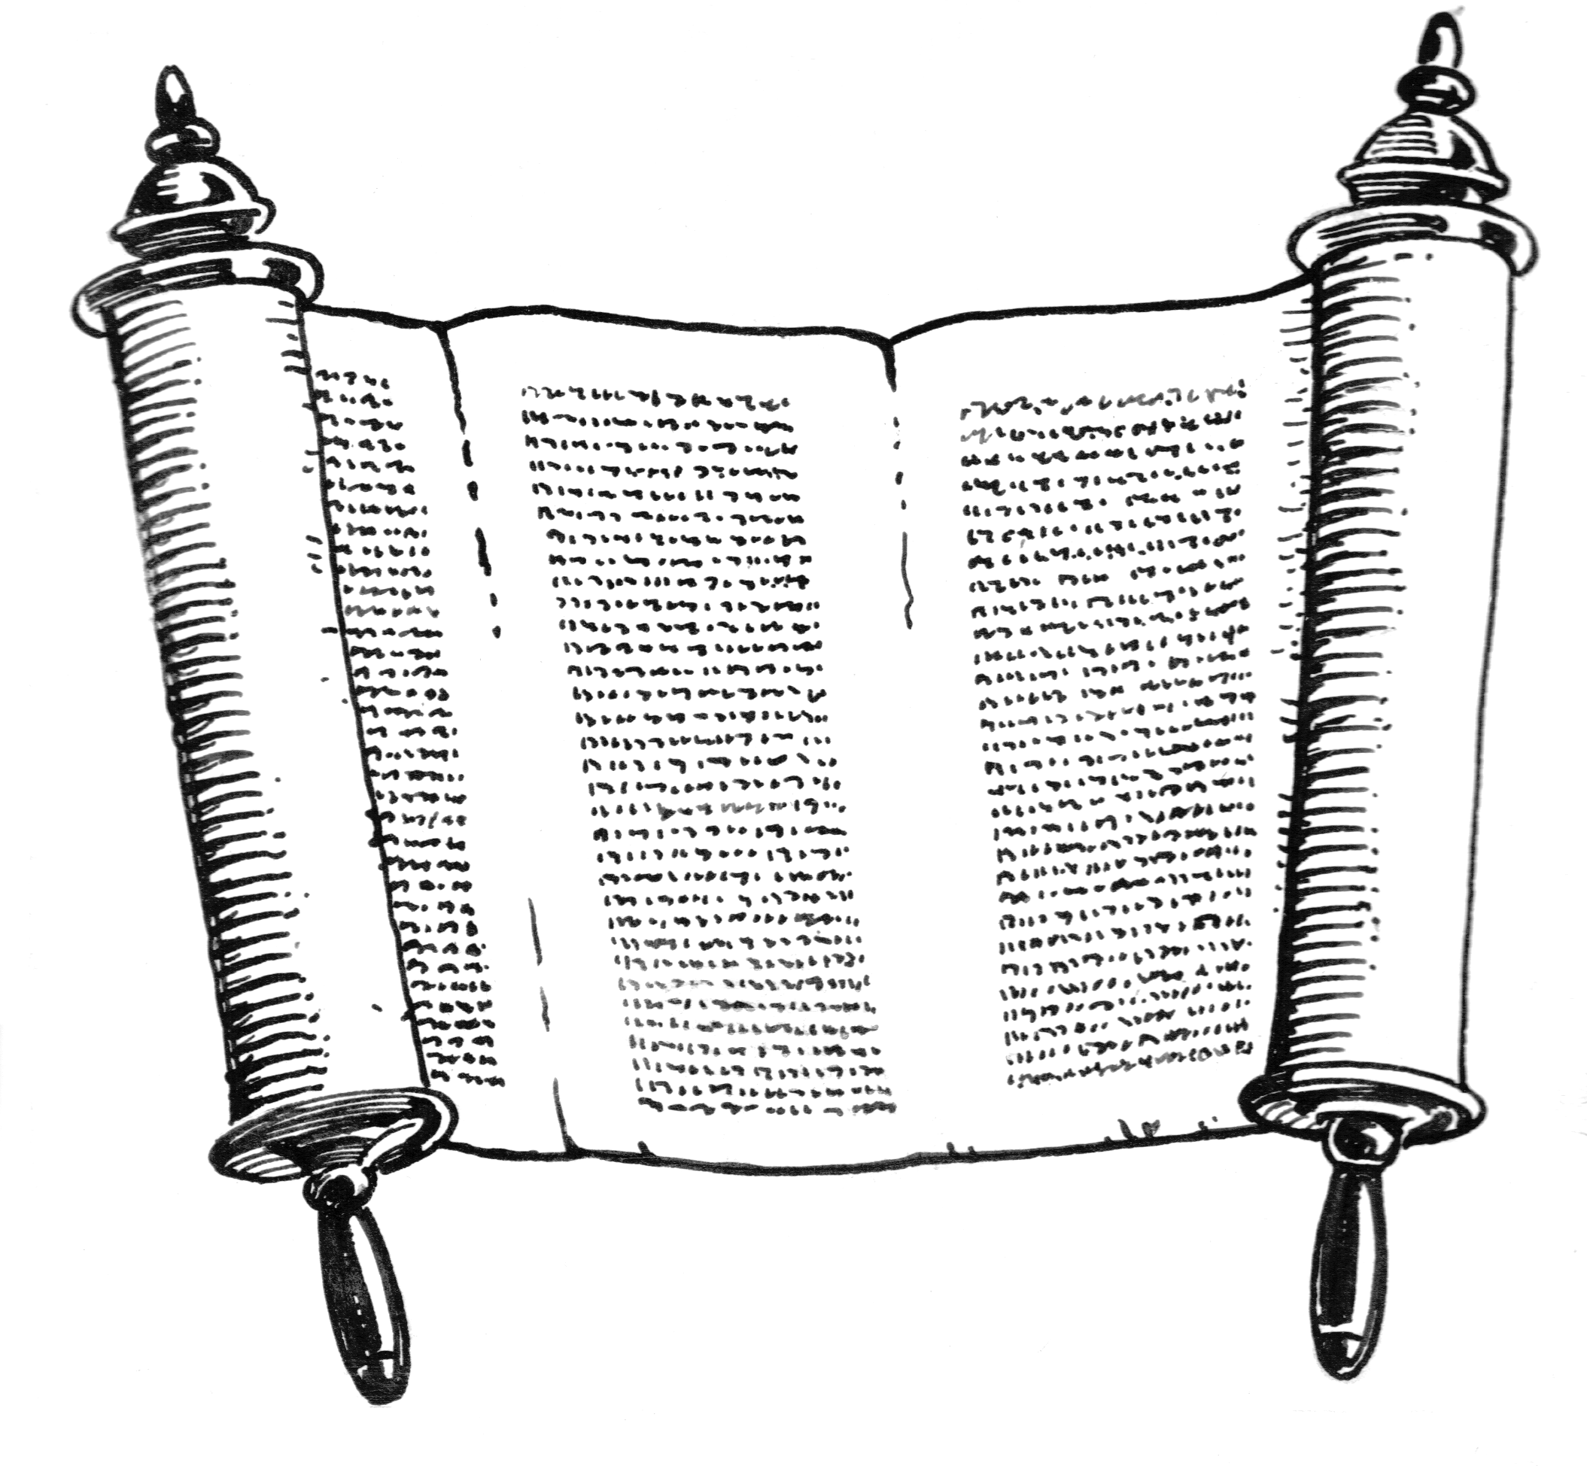
From the Mind of God to the Written Word
Review
God
Holy
Spirit
John 14:26; 15:26; 16:13
Matt. 10:19
Heb. 1:1-2
Matt. 28:18
John 16:13; 1 Cor. 14:37
The word has the power and authority of God behind it!
Original Writings
Eph. 3:3-5
Apostles & Prophets
Eph.3:3-5; 1 Cor. 2:9-13

Slide 16
Back to the Bible – Lesson Three
Review
The Theme of the Bible
Sin: Man Has a Problem
  What sin is
  The first sin
  All sin – individual responsibility
  A remedy is needed
Christ is the Answer
  Gen. 3:15 – the first promise
  Who is Jesus Christ?
  Died as a sacrifice for our sins

Slide 17
Review
A Common Theme
  A golden thread through the Bible
  The coming of Jesus Christ
The Bible Library
Periods of the Bible

Slide 18
Sin
1. What Sin Is: Transgression of the law
“Whosoever committeth sin transgresseth also the law: for sin is the transgression of the law” (1 John 3:4)
Sin
2. The First Sin: Adam & Eve (Gen. 2:17; 3:1-6)
3. All Sin – Individual Responsibility (Rom. 3:9, 23; 1 John 5:19)
4. Consequences of Sin
- Death = Separation from God
- Rom. 5:12; 6:23; 7:9; Jas. 1:15
5. A Remedy is Needed (Rom. 7:24-25)
Sin
Sin

Slide 19
Who
is
Jesus
Christ?
Born of a virgin (Matt. 1:23)
Messiah (John 4:25-26)
Son of God –Deity (John 9:35; 5:17-18)
Died on the cross (1 Cor. 2:2)
Raised from the dead (Rom. 1:4)
Review
Evidence of His Claim
The Miracles
“And truly Jesus did many other signs in the presence of His disciples, which are not written in this book; but these are written that you may believe that Jesus is the Christ, the Son of God, and that believing you may have life in His name.”
(John 20:30-31)

Slide 20
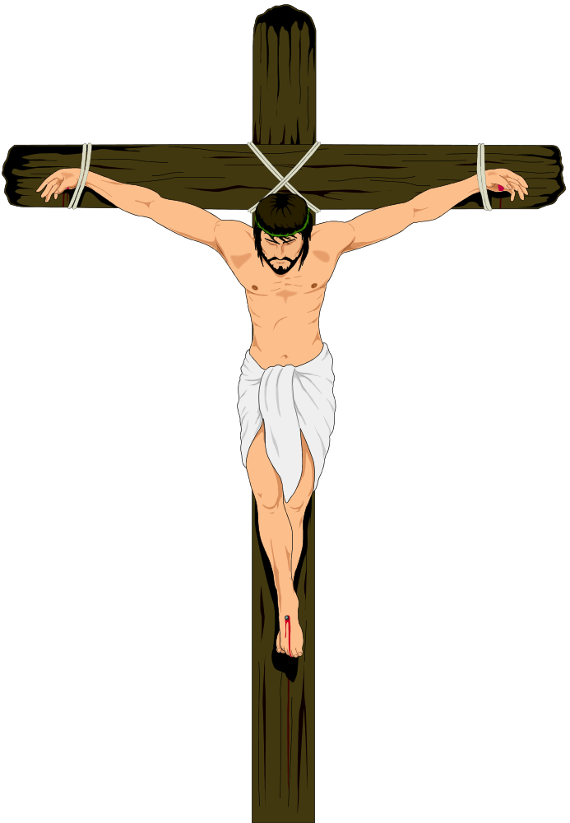
Review
The Crucifixion
Crown of thorns (Matt. 27:29)
Nails in his hands (John 20:25)
Nails in his feet
Shame – as a criminal (Matt. 27:38)
Can’t breathe – suffocates
Pierced his side (John 19:34)

Slide 21

Review
The Golden Thread Running Through the Bible:
Christ the Redeemer
Genesis
Preserving a Nation
Leviticus -
Deut.
Kings & Chronicles
Isaiah
Joshua - Judges
Building a Nation
Exodus
Ruth
A Nation Departs
Jesus is the Messiah
Jeremiah
Matthew –
Luke
A Remnant Returns
The Messiah is Coming
John
Daniel
Ezra
Nehemiah
Acts
Live for Christ, Our Redeemer
Ezekiel
Epistles
Revelation

Slide 22
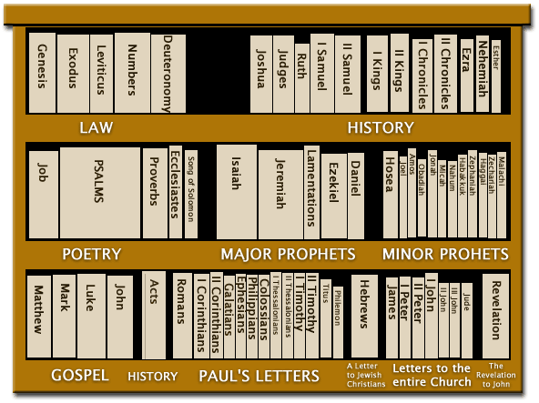
Review
5
12
Old Testament
Bible Library
5
5
12
New Testament
4
1
14
7
1

Slide 23
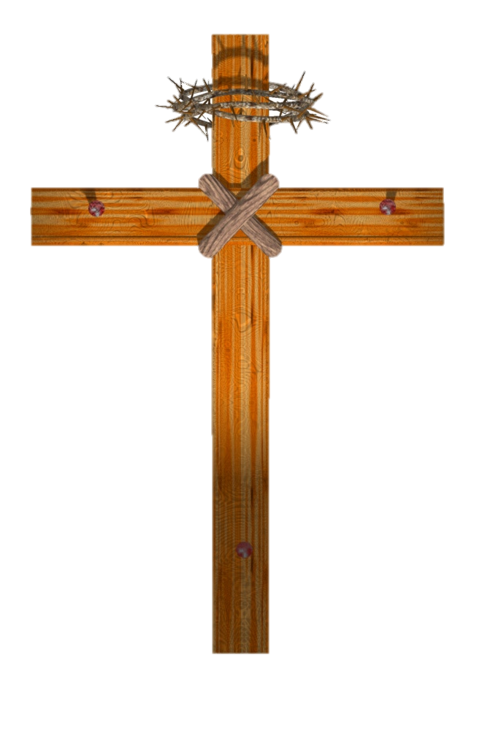


Review
End
of
World
Patriarchal Age
Gospel Age
For All Men
Mosaic Age
For Jews Only
Patriarchal Age
Began at Creation
God spoke to family head
Mosaic Age
For Abraham’s decendants (Deut. 5:1-3)
Law was temporary (Jer. 31:31-34)
To bring men to Christ (Gal. 3:19-29)
Gospel Age
Began at the cross
New Testament effective by the death of Christ (Heb. 9:16-17)

Slide 24
Back to the Bible – Lesson Four
Review
What the Bible Says about Salvation
Sin
  We sin when we become accountable
  Sin causes death: we need salvation
  The gospel makes us aware of sin
Saved by Grace – Eph. 2:8
  “Good News”: Can be saved / God will forgive
  Grace defined
  Grace provided a sacrifice for our sins
  Grace includes….

Slide 25
Review
Grace is Conditional
  A gift can be conditional
  Must obey to receive the grace
Saved by Faith – Eph. 2:8
  Not by faith alone
  The conditions
When Should One Obey?
  Examples in Acts
  Now – because of the urgency

Slide 26
Review
The Need of Salvation
God
Man
Isa. 59:1-2
Sin
Makes Us
Aware
James 1:15
Romans 5:12
Gospel
John 16:8; Rom. 3:20; Acts 2:23, 37

Slide 27
Review
“Good News”:
  We can be saved!
  God will forgive!
  Acts 13:32; Heb. 8:12
Grace Defined:
  Undeserved favor from God (cf. 1 Cor. 15:10)
  Titus 3:4-7 (kindness, love, not our own righteousness & mercy = grace)
Grace Provided a Sacrifice (Heb. 2:9)
Grace Includes: Love, blood, word, work of the Father, Son & Holy Spirit
Saved by Grace
Ephesians 2:8

Slide 28
Review
Faith is Essential:
  John 3:16
  John 8:24
Not Faith Alone:
  Some who believed – yet not saved (Jas. 2:19; John 8:31, 44)
  James 2:24 – “not by faith only”
  Repentance is required (Acts 17:30)
  “Faith” = obedience (Rom. 10:16)
Faith Includes: belief, love, obedience, all that God requires & faithfulness
Saved by Faith
Ephesians 2:8

Slide 29
Review
Jews (Acts 2)
Hear (Rom. 10:17)
V. 22
Believe (John 8:24)
V. 36
The Conditions
Repent (Acts 17:30-31)
V. 38
Confess – that believe (Rom. 10:9-10)
Be Baptized (Mark 16:16)
V. 38

Slide 30
Back to the Bible – Lesson Five
The Church in the Bible
What the Church Is
  What it is not
  It is people
  It is those who are saved
There is But One
  The Lord only built one church
  The term “church” used in two senses
  The idea of denominationalism

Slide 31
Identifying the Church in the Bible
  Illustration of finding a lost boy
  The identifying characteristics of the Lord’s church
Departures
  Departures foretold
  Departures came gradual and slowly
  Departures formed the denominations
Life in the Church
  Assemble and worship
  Walk in the fear of God

Slide 32
Back to the Bible – Lesson Five
The Church in the Bible
What the Church Is
  What it is not
  It is people
  It is those who are saved
There is But One
  The Lord only built one church
  The term “church” used in two senses
  The idea of denominationalism

Slide 33

What Is The Church?
Is Not
Building
A Social Club
A Human Institution
People
Paul made havoc of the church (Acts 8:3)
By persecuting men and women (Acts 8:3)
People Who
Are Saved
Acts 2:47
Eph. 5:23
Eph. 2:16
Ekklesia = “called out”
Church = those who turn to the Lord, disciples, Christians
(Acts 11:20-26)

Slide 34
Back to the Bible – Lesson Five
The Church in the Bible
What the Church Is
  What it is not
  It is people
  It is those who are saved
There is But One
  The Lord only built one church
  The term “church” used in two senses
  The idea of denominationalism

Slide 35

The Lord Only Built One Church
“There is one body”
(Eph. 4:4)
Body = Church
(Eph. 1:22-23)
Thus: One Church
“I will build my church” [singular]
(Matt. 16:18)

Slide 36
The Term “Church” is Used in Two Senses
Universal
Local
All of God’s people (the saved) all over the world
Individual Christians are members – not local churches
Involves a relationship to Jesus Christ as head (Col. 1:18)
Matt. 16:18
Acts 2:47
God’s people (the saved) in a certain place
Has organization and work to do
1 Cor. 1:2
Rom. 16:16
Rev. 2, 3
1 Cor. 16:1
Corinth
Thess.
Ephesus
Rome
Antioch

Slide 37
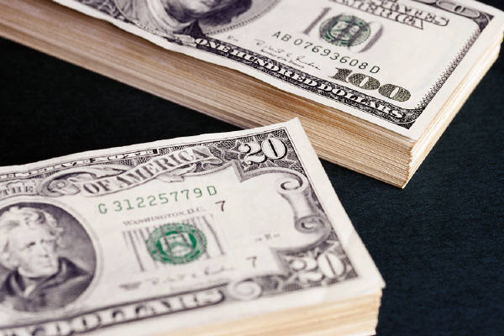
Denominationalism
“The act of naming. 2. A name; designation. 3. The name of a class of group; classificaton” (AHD, 381)
Defined:
Illustrated:
$ 1
$ 5
$ 10
$ 20
$ 50
$ 100
Division
One is as good as another
No wrong choices

Slide 38

Denominationalism
Division
One is as good as another
No wrong choices
God’s People
(The Saved)
Adventist
Presb.
Catholic
Nazarene
Ch. Of
Christ
Ch. Of God
Methodist
Baptist

Slide 39
Identifying the Church in the Bible
  Illustration of finding a lost boy
  The identifying characteristics of the Lord’s church
Departures
  Departures foretold
  Departures came gradual and slowly
  Departures formed the denominations
Life in the Church
  Assemble and worship
  Walk in the fear of God

Slide 40

Identifying the Church in the Bible
“One boy is as good as another”
Find a boy that I like
Most popular boy

Slide 41
Identifying the Church in the Bible
10 Years old
70 lbs
50” tall
Name is Tommy
Hair: Brown
Eyes: Green

Slide 42
Identifying the Church in the Bible
Founder: Christ (Matt. 16:18)
Began: 33 AD in Jerusalem (Acts 2)
Name: Church of God (1 Cor. 1:2)
Church of Christ (Rom. 16:16)
Organization:
  Universally: None
  Locally: elders, deacons (Phil. 1:1)
Work: Preach (1 Tim. 3:15); Edify (Eph. 4:16); Relieve (1 Tim. 5:16)
Worship: Sing (Eph. 5:19); Pray (Acts 2:42); Lord’s Supper (Acts 20:7); Giving (1 Cor. 16:1-2); Study (Acts 20:7)

Slide 43
Identifying the Church in the Bible
  Illustration of finding a lost boy
  The identifying characteristics of the Lord’s church
Departures
  Departures foretold
  Departures came gradual and slowly
  Departures formed the denominations
Life in the Church
  Assemble and worship
  Walk in the fear of God

Slide 44
2 Thessalonians 2:3
Let no one deceive you by any means; for that Day will not come unless the falling away comes first, and the man of sin is revealed, the son of perdition,
1 Timothy 4:1
Now the Spirit expressly says that in latter times some will depart from the faith, giving heed to deceiving spirits and doctrines of demons,
Departure Foretold
Acts 20:29–30
For I know this, that after my departure savage wolves will come in among you, not sparing the flock. Also from among yourselves men will rise up, speaking perverse things, to draw away the disciples after themselves.

Slide 45

Gradually & Slowly
Heb. 2:1
Presiding Elder
(Bishop)
Presiding Cardinal
(POPE)
Elders
Elders
Cardinals
Bishops
Presiding Bishop
(Cardinal)

Slide 46
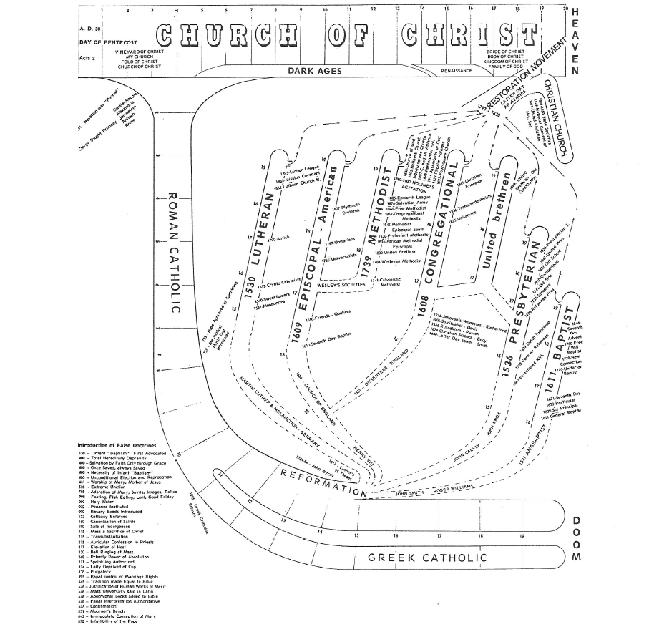

Slide 49
Identifying the Church in the Bible
  Illustration of finding a lost boy
  The identifying characteristics of the Lord’s church
Departures
  Departures foretold
  Departures came gradual and slowly
  Departures formed the denominations
Life in the Church
  Assemble and worship
  Walk in the fear of God

Slide 50
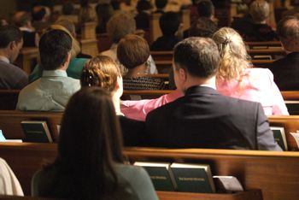
Assemble & Worship
Purpose: Honor & Praise God (John 4:24; 1 Cor. 10:31; Rev. 22:9)
Important: Less important things should not hinder (Heb. 10:25)
Acts: Sing (Eph. 5:19); Pray (Acts 2:42); Study (Acts 20:7); Lord’s Supper (Acts 20:7); Give (1 Cor. 16:1-2)
Attitude: Sincere & from heart (John 4:24; Col. 3:23)
Accomplishes: Edify and are edified (Eph. 5:19; Rom. 10:17)

Slide 51
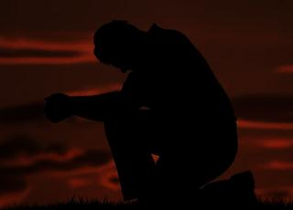
Walking in the Fear of God
Those who fear God – Please God (Acts 10:35; Psa. 34:9, 15)
What it means:
  Respect & awe (Luke 7:16; Heb. 12:28)
  Afraid (1 Sam. 11:7; Psa. 119:120)
Causes us to do:
  Do what God says (Deut. 13:4)
  Be dedicated (Deut. 10:12, 20)
  Hate sin (Prov. 3:7; 8:13; 16:6)
  Honor God (Neh. 1:5, 11; 4:14)
  Respect God’s word (Neh. 8:2, 3, 5, 7)

Slide 52
Back to the Bible
A Five Lesson Home Bible Study
The Bible is God’s Word
Applying the Bible Today
The Theme of the Bible
What the Bible Says about Salvation
The Church in the Bible
Each Lesson Last One Hour Or Less

