Slide 2

Back to the Bible
A Five Lesson Home Bible Study
The Bible is God’s Word
Applying the Bible Today
The Theme of the Bible
What the Bible Says about Salvation
The Church in the Bible
Foundation
Each Lesson Last One Hour Or Less

Slide 3
Back to the Bible – Lesson One
Review
The Bible Is God’s Word
The Resurrection of Christ from the Dead
  Why begin here?
  Evidence of the resurrection
God Is and His Word is True
  God is…
  His Word is True
Inspiration of the Bible
  Plenary (Complete)
  Verbal (Every word)

Slide 4
Review
If Jesus was raised from the dead:
God Is….
Jesus is the
Son of God
Why Begin Here?
Word is True
“Hub” of Gospel

Slide 5
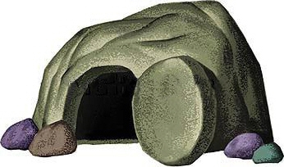
Review
The Resurrection of Christ
The Empty Tomb
Transformation of Disciples
Change in the Jews
Witnesses
Appearances (John 20:25-28)
Conversion of Saul
Manuscript Evidence

Slide 6
Review
Therefore
God is….
We can know there is a God!
We can know there is evidence
My faith is not a blind leap
Word of God is True
Agreement with science
Prophecy Fulfilled
Historically Accurate
Unity of writers
Archaeology

Slide 7
Inspiration of The Bible
Review
Verbal
Verbal
Plenary
Plenary
All The Bible
“All Scripture is given by inspiration of God, and is profitable for doctrine, for reproof, for correction, for instruction in righteousness,”
(2 Tim. 3:16)
Every Word
“These things we also speak, not in words which man’s wisdom teaches but which the Holy Spirit teaches, comparing spiritual things with spiritual.
(1 Cor. 2:13)

Slide 8
Review
Accept it as God’s word (1 Thess. 2:13)
Believe what it says (Rom. 10:17)
Seek to know and understand it (John 8:32)
Want to do what it says (Matt. 7:21; John 12:48)
If The Bible Is God’s Word, Then I Should:

Slide 9
Back to the Bible – Lesson Two
Review
Applying The Bible Today
Can We Understand the Bible?
  The Bible can be understood
  We can understand it alike
Does it Make a Difference What One Believes?
  A popular concept
  It makes a difference what one – believes
  It makes a difference what one – practices
  Consequences

Slide 10
Review
The Two Covenants
  The two covenants are different
  The Old Covenant has been taken away
  We are under the New Covenant
The Authority of the Word
  From the mind of God to the written word
  The Bible has the power and authority of God behind it
    To accept it is to accept God
    To reject it is to reject God

Slide 11

Review
Can We Understand the Bible?
If not, it is God’s fault
Bible is written on 5th grade level
Average word is 5 letters
Can and must be understood
  John 8:32
  Eph. 3:3-5
  Eph. 5:17

Slide 12
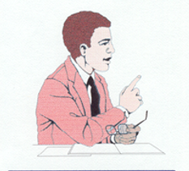
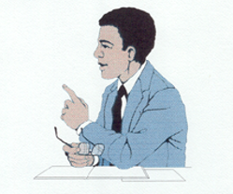
Can We Understand The Bible Alike?
Review
4 Understands | 2+2= | 4 Understands
6 Does Not Understand | 2+2= | 4 Understands
Son of God Understands | Who is Jesus? | Son of God Understands
Son of God Understands | Who is Jesus? | A Son Does not Understand
If they understand, it will be alike!

Slide 13
2 Thess. 2:10-12
Review
Lie Truth
Deceived (v.10)
Not love truth (v. 10)
Deluded (v. 11)
Believe lie (v. 11)
Not believe truth (v. 12)
Pleasure in unright. (v. 12)
Love truth (v. 10)
Believe truth (v. 12)
Saved (v. 10)
Perish (v. 10)
Condemned (v. 12)

Slide 14
Review
Old Testament
New Testament
Israel
(Exo. 20:2; 31:13, 16, 17; Deut. 5:1-3)
Added – Trans.
Bring Men to Christ
(Gal. 3:17-25)
Till Seed Come
(Gal. 3:19; Rom. 7:1-4; Gal. 3:24-25)
All Men
(Mark 16:15-16; Mt. 28:29-20)
Salvation
(Rom. 1:16-17; 8:1-2)
Till End
(Matt. 28:19-20)
To Whom Given
Purpose
Duration
Different

Slide 15
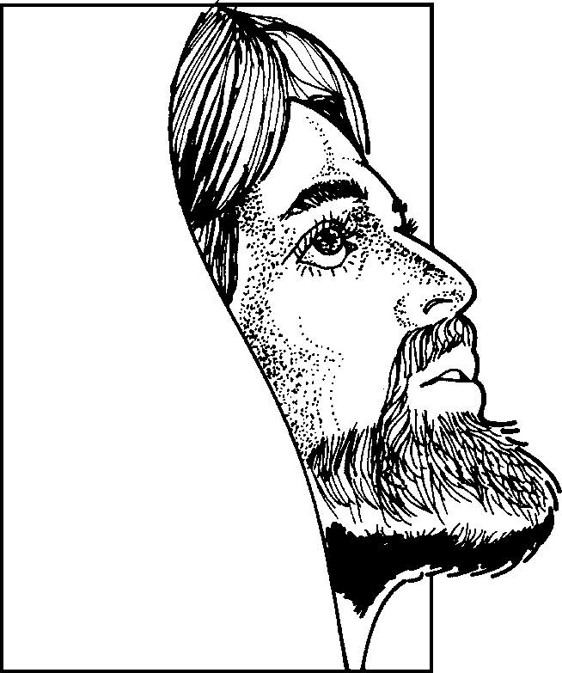
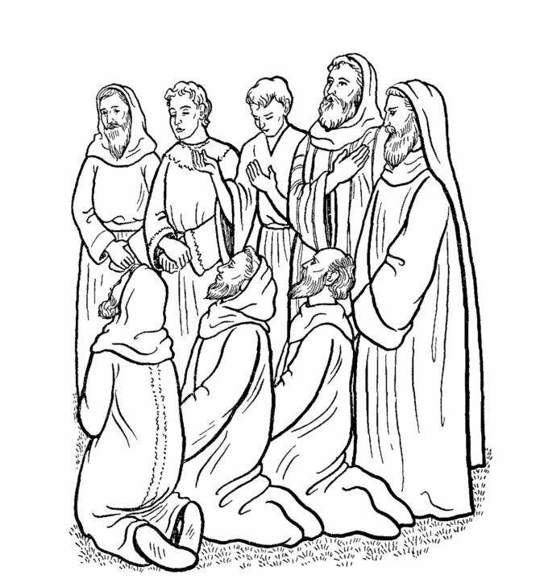
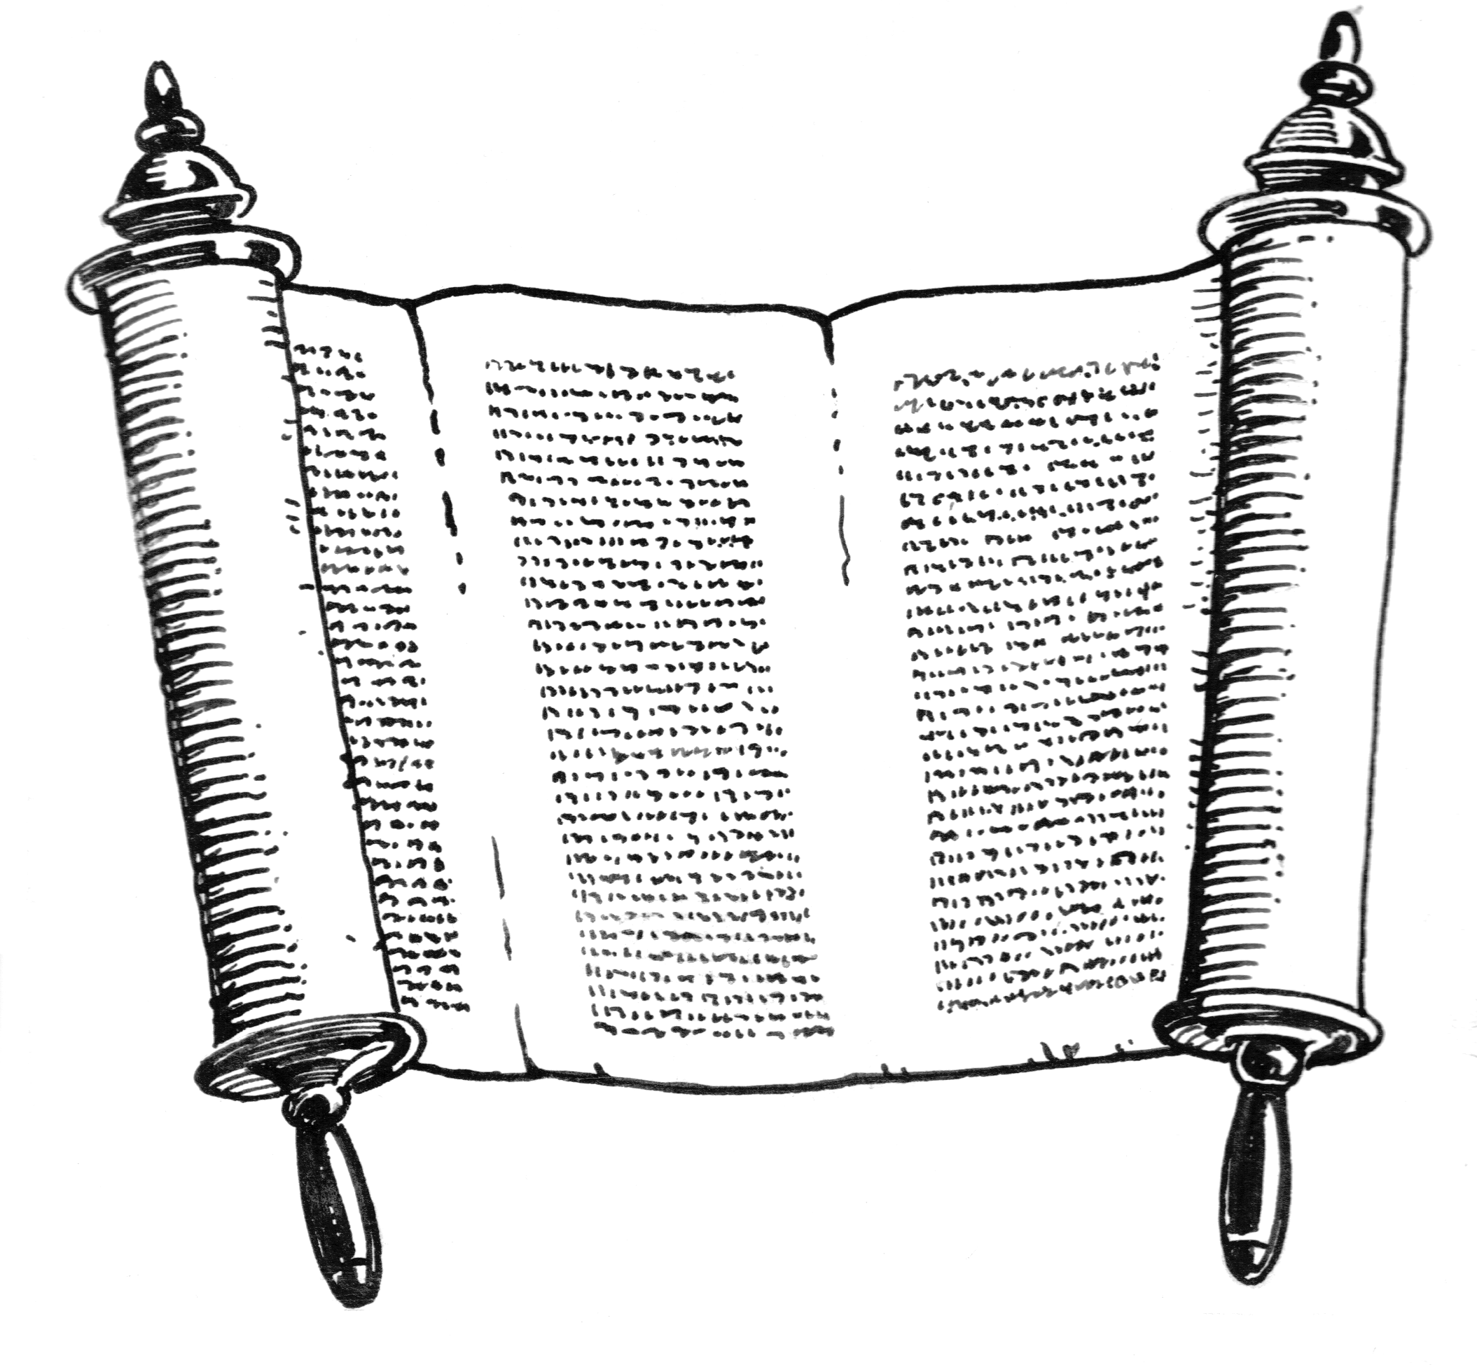
From the Mind of God to the Written Word
Review
God
Holy
Spirit
John 14:26; 15:26; 16:13
Matt. 10:19
Heb. 1:1-2
Matt. 28:18
John 16:13; 1 Cor. 14:37
The word has the power and authority of God behind it!
Original Writings
Eph. 3:3-5
Apostles & Prophets
Eph.3:3-5; 1 Cor. 2:9-13

Slide 16
Back to the Bible – Lesson Three
Review
The Theme of the Bible
Sin: Man Has a Problem
  What sin is
  The first sin
  All sin – individual responsibility
  A remedy is needed
Christ is the Answer
  Gen. 3:15 – the first promise
  Who is Jesus Christ?
  Died as a sacrifice for our sins

Slide 17
Review
A Common Theme
  A golden thread through the Bible
  The coming of Jesus Christ
The Bible Library
Periods of the Bible

Slide 18
Sin
1. What Sin Is: Transgression of the law
“Whosoever committeth sin transgresseth also the law: for sin is the transgression of the law” (1 John 3:4)
Sin
2. The First Sin: Adam & Eve (Gen. 2:17; 3:1-6)
3. All Sin – Individual Responsibility (Rom. 3:9, 23; 1 John 5:19)
4. Consequences of Sin
- Death = Separation from God
- Rom. 5:12; 6:23; 7:9; Jas. 1:15
5. A Remedy is Needed (Rom. 7:24-25)
Sin
Sin

Slide 19
Who
is
Jesus
Christ?
Born of a virgin (Matt. 1:23)
Messiah (John 4:25-26)
Son of God –Deity (John 9:35; 5:17-18)
Died on the cross (1 Cor. 2:2)
Raised from the dead (Rom. 1:4)
Review
Evidence of His Claim
The Miracles
“And truly Jesus did many other signs in the presence of His disciples, which are not written in this book; but these are written that you may believe that Jesus is the Christ, the Son of God, and that believing you may have life in His name.”
(John 20:30-31)

Slide 20
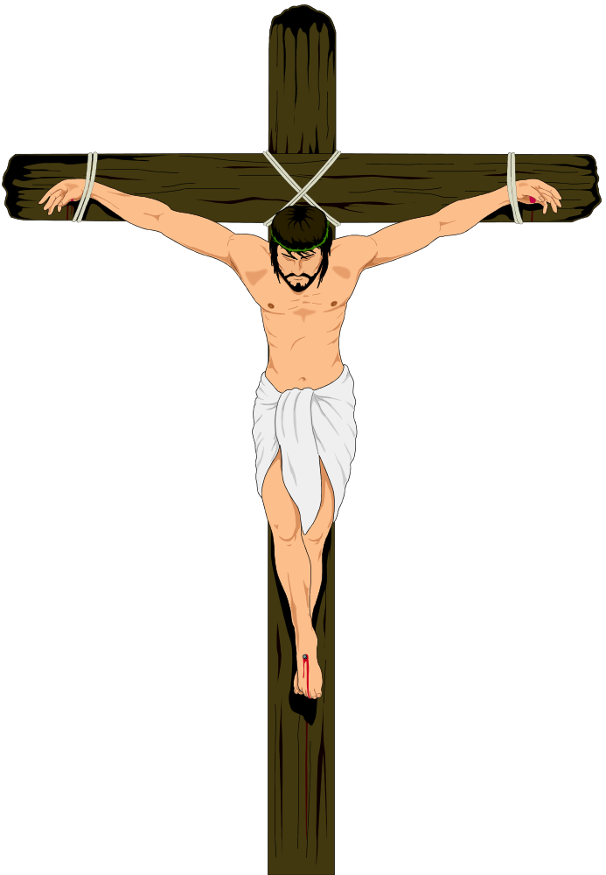
Review
The Crucifixion
Crown of thorns (Matt. 27:29)
Nails in his hands (John 20:25)
Nails in his feet
Shame – as a criminal (Matt. 27:38)
Can’t breathe – suffocates
Pierced his side (John 19:34)

Slide 21

Review
The Golden Thread Running Through the Bible:
Christ the Redeemer
Genesis
Preserving a Nation
Leviticus -
Deut.
Kings & Chronicles
Isaiah
Joshua - Judges
Building a Nation
Exodus
Ruth
A Nation Departs
Jesus is the Messiah
Jeremiah
Matthew –
Luke
A Remnant Returns
The Messiah is Coming
John
Daniel
Ezra
Nehemiah
Acts
Live for Christ, Our Redeemer
Ezekiel
Epistles
Revelation

Slide 22
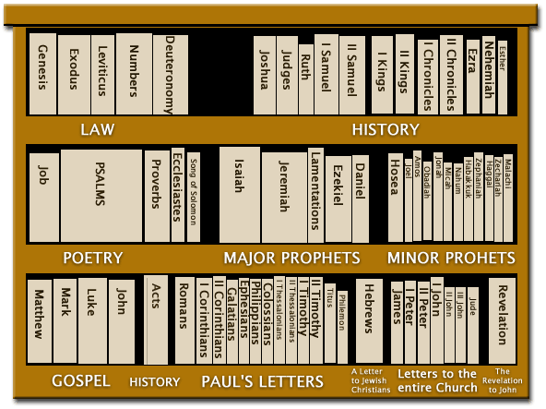
Review
5
12
Old Testament
Bible Library
5
5
12
New Testament
4
1
14
7
1

Slide 23



Review
End
of
World
Patriarchal Age
Gospel Age
For All Men
Mosaic Age
For Jews Only
Patriarchal Age
Began at Creation
God spoke to family head
Mosaic Age
For Abraham’s decendants (Deut. 5:1-3)
Law was temporary (Jer. 31:31-34)
To bring men to Christ (Gal. 3:19-29)
Gospel Age
Began at the cross
New Testament effective by the death of Christ (Heb. 9:16-17)

Slide 24
Back to the Bible – Lesson Four
What the Bible Says about Salvation
Sin
  We sin when we become accountable
  Sin causes death: we need salvation
  The gospel makes us aware of sin
Saved by Grace – Eph. 2:8
  “Good News”: Can be saved / God will forgive
  Grace defined
  Grace provided a sacrifice for our sins
  Grace includes….

Slide 25
Grace is Conditional
  A gift can be conditional
  Must obey to receive the grace
Saved by Faith – Eph. 2:8
  Not by faith alone
  The conditions
When Should One Obey?
  Examples in Acts
  Now – because of the urgency

Slide 26
Back to the Bible – Lesson Four
What the Bible Says about Salvation
Sin
  We sin when we become accountable
  Sin causes death: we need salvation
  The gospel makes us aware of sin
Saved by Grace – Eph. 2:8
  “Good News”: Can be saved / God will forgive
  Grace defined
  Grace provided a sacrifice for our sins
  Grace includes….

Slide 27
We Sin When We Become Accountable
Rom 7:9
I was alive once without the law, but when the commandment came, sin revived and I died.
Before He Was Accountable
After He Was Accountable
Without Law
No Sin
Alive
Commandment Came
Sin Revived
Died
Point of Accountability

Slide 28
The Need of Salvation
God
Man
Isa. 59:1-2
Sin
Makes Us
Aware
James 1:15
Romans 5:12
Gospel
John 16:8; Rom. 3:20; Acts 2:23, 37

Slide 29
Back to the Bible – Lesson Four
What the Bible Says about Salvation
Sin
  We sin when we become accountable
  Sin causes death: we need salvation
  The gospel makes us aware of sin
Saved by Grace – Eph. 2:8
  “Good News”: Can be saved / God will forgive
  Grace defined
  Grace provided a sacrifice for our sins
  Grace includes….

Slide 30
“Good News”:
  We can be saved!
  God will forgive!
  Acts 13:32; Heb. 8:12
Grace Defined:
  Undeserved favor from God (cf. 1 Cor. 15:10)
  Titus 3:4-7 (kindness, love, not our own righteousness & mercy = grace)
Saved by Grace
Ephesians 2:8

Slide 31
Titus 3:4–7
⁴ But when the kindness and the love of God our Savior toward man appeared,
⁵ not by works of righteousness which we have done, but according to His mercy He saved us, through the washing of regeneration and renewing of the Holy Spirit,
⁶ whom He poured out on us abundantly through Jesus Christ our Savior,
⁷ that having been justified by His grace we should become heirs according to the hope of eternal life.

Slide 32
“Good News”:
  We can be saved!
  God will forgive!
  Acts 13:32; Heb. 8:12
Grace Defined:
  Undeserved favor from God (cf. 1 Cor. 15:10)
  Titus 3:4-7 (kindness, love, not our own righteousness & mercy = grace)
Grace Provided a Sacrifice (Heb. 2:9)
Grace Includes: Love, blood, word, work of the Father, Son & Holy Spirit
Saved by Grace
Ephesians 2:8

Slide 33
Grace is Conditional
  A gift can be conditional
  Must obey to receive the grace
Saved by Faith – Eph. 2:8
  Not by faith alone
  The conditions
When Should One Obey?
  Examples in Acts
  Now – because of the urgency

Slide 34
By Grace – Yet Conditional
“Therefore it is of faith, that it might be by grace…”
(Rom. 4:16)
Grace
“I will give you my watch…”
“I have given into thy hand Jericho…”
(Joshua 6:2)
Faith
“…if you come and get it.”
March around the city for
Seven days
(Joshua 6:3-7)

Slide 35
We Must Obey to Receive Grace
Matthew 7:21
“Not everyone who says to Me, ‘Lord, Lord,’ shall enter the kingdom of heaven, but he who does the will of My Father in heaven.
Hebrews 5:8–9
“though He was a Son, yet He learned obedience by the things which He suffered. And having been perfected, He became the author of eternal salvation to all who obey Him,”
1 Peter 1:22
“Since you have purified your souls in obeying the truth through the Spirit in sincere love of the brethren, love one another fervently with a pure heart,”

Slide 36
Grace is Conditional
  A gift can be conditional
  Must obey to receive the grace
Saved by Faith – Eph. 2:8
  Not by faith alone
  The conditions
When Should One Obey?
  Examples in Acts
  Now – because of the urgency

Slide 37
Faith is Essential:
  John 3:16
  John 8:24
Not Faith Alone:
  Some who believed – yet not saved (Jas. 2:19; John 8:31, 44)
  James 2:24 – “not by faith only”
  Repentance is required (Acts 17:30)
  “Faith” = obedience (Rom. 10:16)
Saved by Faith
Ephesians 2:8

Slide 38
Romans 10:16
But they have not all obeyed the gospel. For Isaiah says, “Lord, who has believed our report?”

Slide 39
Faith is Essential:
  John 3:16
  John 8:24
Not Faith Alone:
  Some who believed – yet not saved (Jas. 2:19; John 8:31, 44)
  James 2:24 – “not by faith only”
  Repentance is required (Acts 17:30)
  “Faith” = obedience (Rom. 10:16)
Faith Includes: belief, love, obedience, all that God requires & faithfulness
Saved by Faith
Ephesians 2:8

Slide 40
Jews (Acts 2)
Hear (Rom. 10:17)
V. 22
Believe (John 8:24)
V. 36
The Conditions
Repent (Acts 17:30-31)
V. 38
Confess – that believe (Rom. 10:9-10)
Be Baptized (Mark 16:16)
V. 38

Slide 41
Grace is Conditional
  A gift can be conditional
  Must obey to receive the grace
Saved by Faith – Eph. 2:8
  Not by faith alone
  The conditions
When Should One Obey?
  Examples in Acts
  Now – because of the urgency

Slide 42
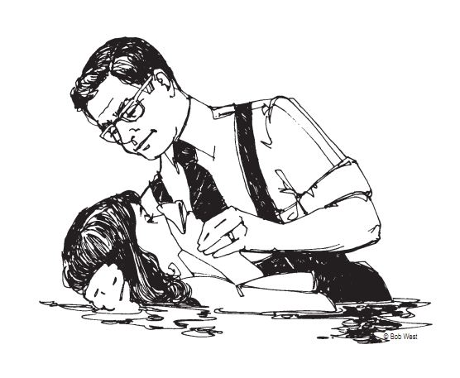
When
Should
One
Obey?
Examples in Acts
Same day (Acts 2:41)
Immediately (Acts 8:12, 38)
Same hour (Acts 16:33)

Slide 43
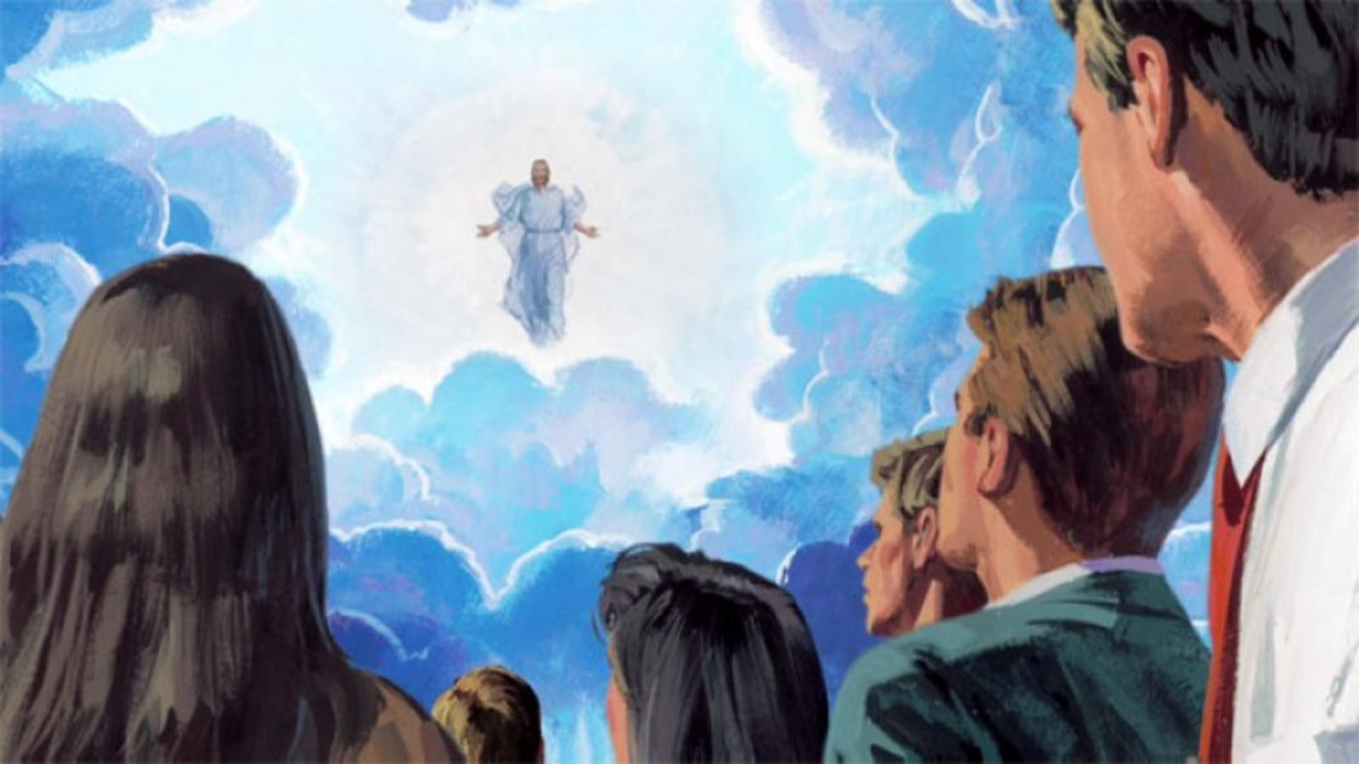
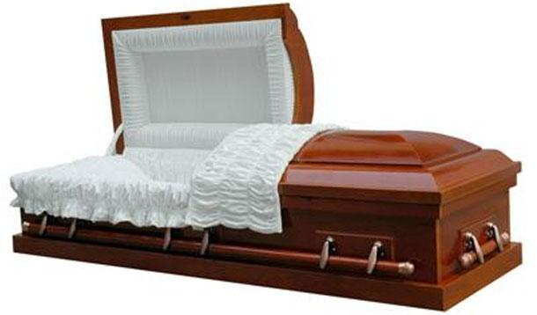
What is the Urgency?
Christ Could Come
You Could Die
Matt. 24:36-ff
1 Thess. 5:2
Jas. 4:13-14
Heb. 9:27

Slide 44
Back to the Bible
A Five Lesson Home Bible Study
The Bible is God’s Word
Applying the Bible Today
The Theme of the Bible
What the Bible Says about Salvation
The Church in the Bible
Each Lesson Last One Hour Or Less

Slide 46
Repent (Acts 8:22)
Confess (1 John 1:9)
The Conditions
Before God (1 John 1:9) – all our sins
Before others (Jas. 5:16) – Those sins of a public nature
For the Erring Child of God
Pray (Acts 8:22)

Slide 47
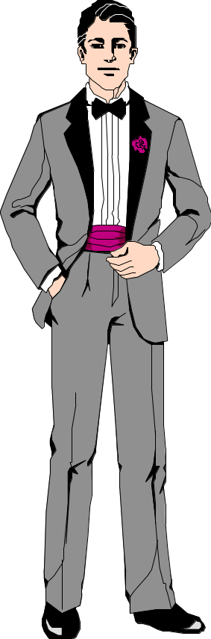
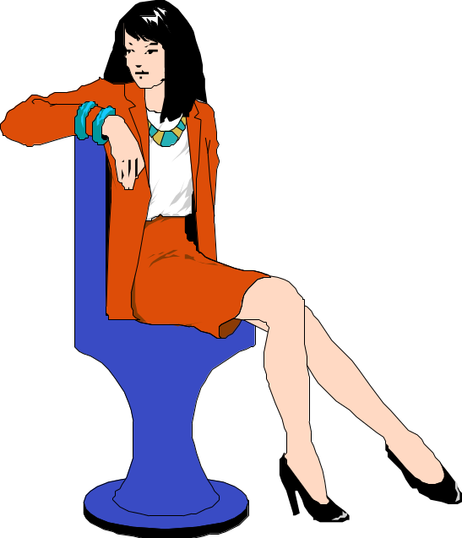
Matt. 19:9
And I say unto you, Whosoever shall put away his wife, except it be for fornication, and shall marry another, committeth adultery:
and whoso marrieth her which
is put away doth commit adultery.

Slide 48
Matt. 19:9
And I say unto you, Whosoever shall put away his wife, except it be for fornication, and shall marry another, committeth adultery:
A
B
and whoso marrieth her which
is put away doth commit adultery.

Slide 49
Matt. 19:9
Put Away (for forn.) - Remarry - No Adultery
Put Away (no forn.) - Remarry - Adultery
A
B
Is Put Away - Remarry - Adultery

Slide 50
Person
believer / repents
(Mark 16:16; Acts 2:38)
Person
unbeliever / infant
Action
immersion / burial
(Rom. 6:3-4; Col. 2:12)
Action
sprinkle / pour
The Right Baptism
Authority
Christ
(Acts 2:38; 19:5)
Authority
Pope / church vote
“There is one baptism” (Eph. 4:5)
Purpose
saved / remission
(Mark 16:16; Acts 2:38)
Purpose
are saved / outward sign
Direction
into one body
(1 Cor. 12:13)
Direction
into a denomination

