Slide 2

Back to the Bible
A Five Lesson Home Bible Study
The Bible is God’s Word
Applying the Bible Today
The Theme of the Bible
What the Bible Says about Salvation
The Church in the Bible
Each Lesson Last One Hour Or Less

Slide 3
Back to the Bible – Lesson One
Review
The Bible Is God’s Word
The Resurrection of Christ from the Dead
  Why begin here?
  Evidence of the resurrection
God Is and His Word is True
  God is…
  His Word is True
Inspiration of the Bible
  Plenary (Complete)
  Verbal (Every word)

Slide 4
Review
If Jesus was raised from the dead:
God Is….
Jesus is the
Son of God
Why Begin Here?
Word is True
“Hub” of Gospel

Slide 5
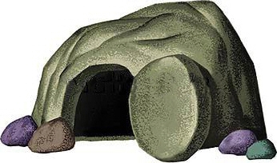
Review
The Resurrection of Christ
The Empty Tomb
Transformation of Disciples
Change in the Jews
Witnesses
Appearances (John 20:25-28)
Conversion of Saul
Manuscript Evidence

Slide 6
Review
Therefore
God is….
We can know there is a God!
We can know there is evidence
My faith is not a blind leap
Word of God is True
Agreement with science
Prophecy Fulfilled
Historically Accurate
Unity of writers
Archaeology

Slide 7
Inspiration of The Bible
Review
Verbal
Verbal
Plenary
Plenary
All The Bible
“All Scripture is given by inspiration of God, and is profitable for doctrine, for reproof, for correction, for instruction in righteousness,”
(2 Tim. 3:16)
Every Word
“These things we also speak, not in words which man’s wisdom teaches but which the Holy Spirit teaches, comparing spiritual things with spiritual.
(1 Cor. 2:13)

Slide 8
Review
Accept it as God’s word (1 Thess. 2:13)
Believe what it says (Rom. 10:17)
Seek to know and understand it (John 8:32)
Want to do what it says (Matt. 7:21; John 12:48)
If The Bible Is God’s Word, Then I Should:

Slide 9
Back to the Bible – Lesson Two
Review
Applying The Bible Today
Can We Understand the Bible?
  The Bible can be understood
  We can understand it alike
Does it Make a Difference What One Believes?
  A popular concept
  It makes a difference what one – believes
  It makes a difference what one – practices
  Consequences

Slide 10
Review
The Two Covenants
  The two covenants are different
  The Old Covenant has been taken away
  We are under the New Covenant
The Authority of the Word
  From the mind of God to the written word
  The Bible has the power and authority of God behind it
    To accept it is to accept God
    To reject it is to reject God

Slide 11

Review
Can We Understand the Bible?
If not, it is God’s fault
Bible is written on 5th grade level
Average word is 5 letters
Can and must be understood
  John 8:32
  Eph. 3:3-5
  Eph. 5:17

Slide 12
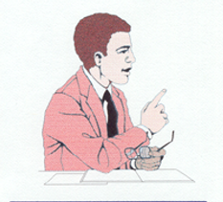

Can We Understand The Bible Alike?
Review
4 Understands | 2+2= | 4 Understands
6 Does Not Understand | 2+2= | 4 Understands
Son of God Understands | Who is Jesus? | Son of God Understands
Son of God Understands | Who is Jesus? | A Son Does not Understand
If they understand, it will be alike!

Slide 13
2 Thess. 2:10-12
Review
Lie Truth
Deceived (v.10)
Not love truth (v. 10)
Deluded (v. 11)
Believe lie (v. 11)
Not believe truth (v. 12)
Pleasure in unright. (v. 12)
Love truth (v. 10)
Believe truth (v. 12)
Saved (v. 10)
Perish (v. 10)
Condemned (v. 12)

Slide 14
Review
Old Testament
New Testament
Israel
(Exo. 20:2; 31:13, 16, 17; Deut. 5:1-3)
Added – Trans.
Bring Men to Christ
(Gal. 3:17-25)
Till Seed Come
(Gal. 3:19; Rom. 7:1-4; Gal. 3:24-25)
All Men
(Mark 16:15-16; Mt. 28:29-20)
Salvation
(Rom. 1:16-17; 8:1-2)
Till End
(Matt. 28:19-20)
To Whom Given
Purpose
Duration
Different

Slide 15
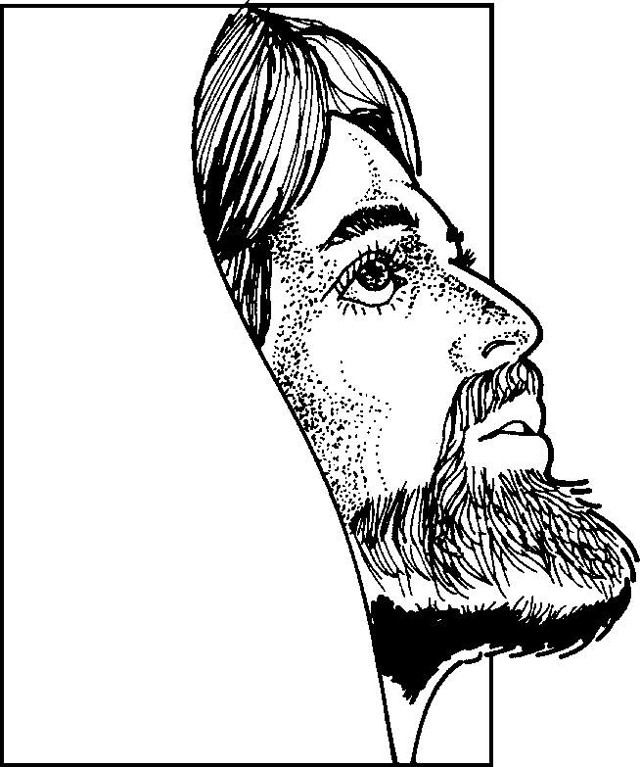
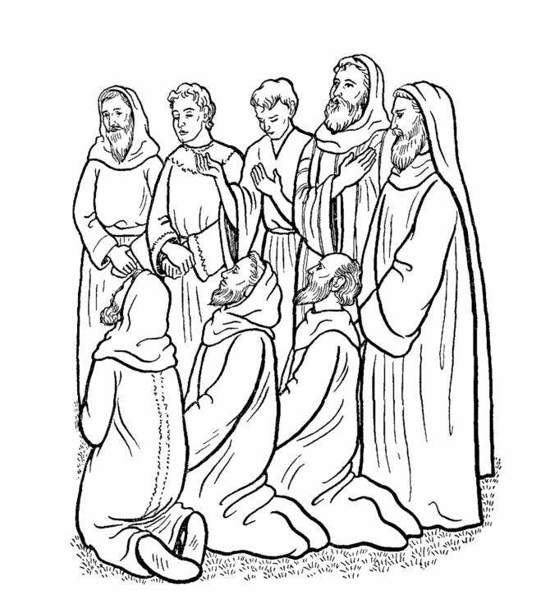
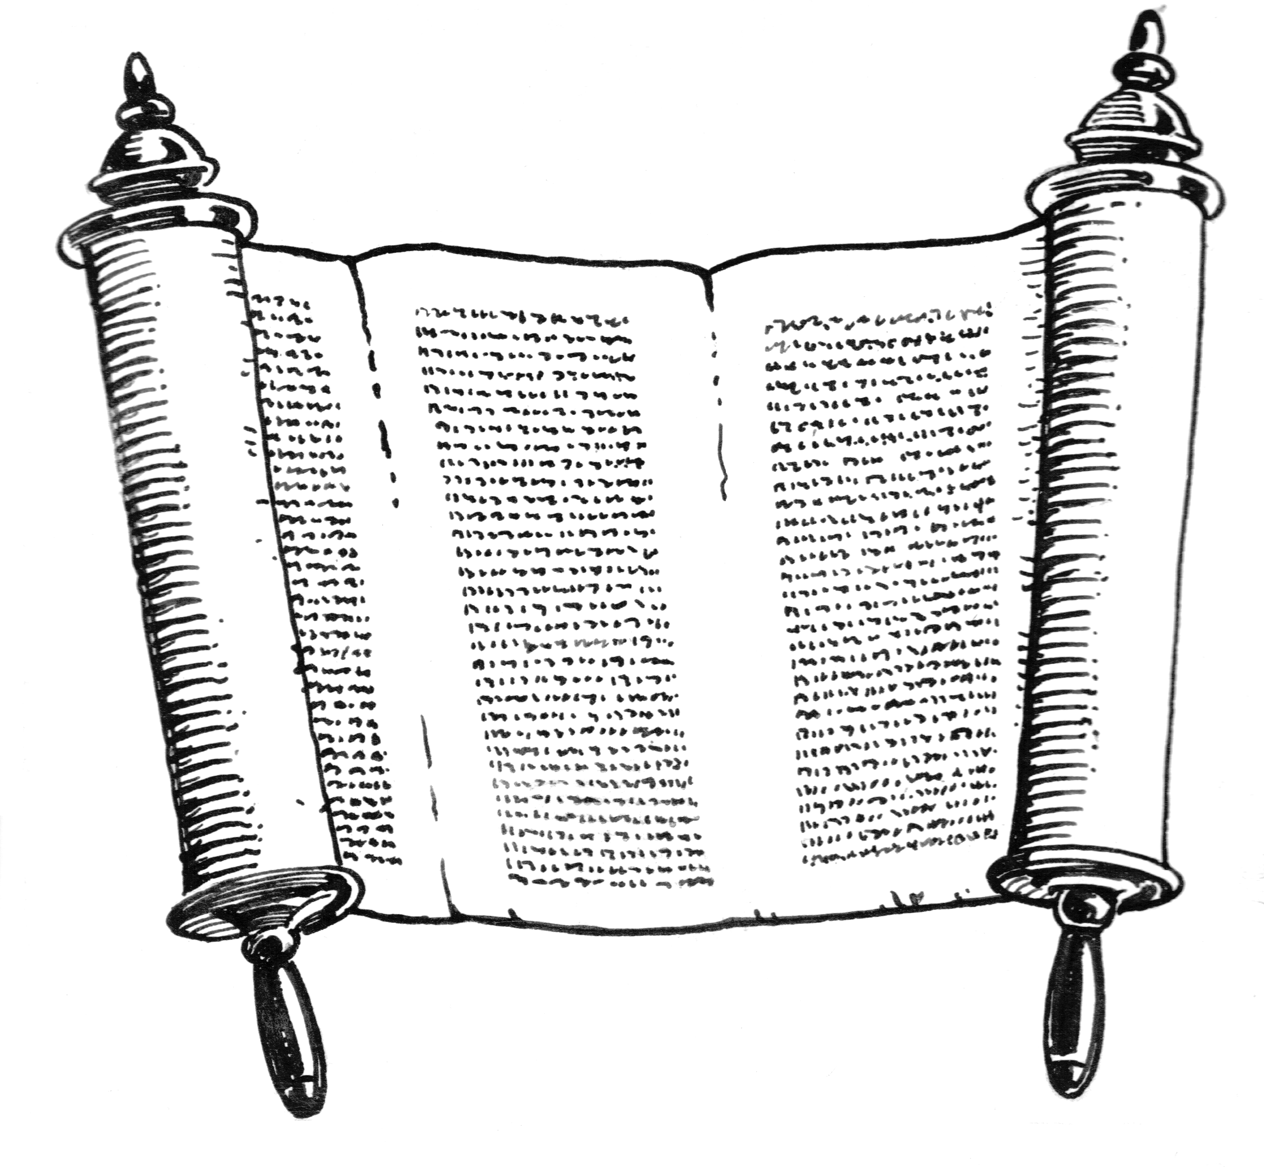
From the Mind of God to the Written Word
Review
God
Holy
Spirit
John 14:26; 15:26; 16:13
Matt. 10:19
Heb. 1:1-2
Matt. 28:18
John 16:13; 1 Cor. 14:37
The word has the power and authority of God behind it!
Original Writings
Eph. 3:3-5
Apostles & Prophets
Eph.3:3-5; 1 Cor. 2:9-13

Slide 16
Back to the Bible – Lesson Three
The Theme of the Bible
Sin: Man Has a Problem
  What sin is
  The first sin
  All sin – individual responsibility
  A remedy is needed
Christ is the Answer
  Gen. 3:15 – the first promise
  Who is Jesus Christ?
  Died as a sacrifice for our sins

Slide 17
A Common Theme
  A golden thread through the Bible
  The coming of Jesus Christ
The Bible Library
Periods of the Bible

Slide 18
Back to the Bible – Lesson Three
The Theme of the Bible
Sin: Man Has a Problem
  What sin is
  The first sin
  All sin – individual responsibility
  A remedy is needed
Christ is the Answer
  Gen. 3:15 – the first promise
  Who is Jesus Christ?
  Died as a sacrifice for our sins

Slide 19
Sin
1. What Sin Is: Transgression of the law
“Whosoever committeth sin transgresseth also the law: for sin is the transgression of the law” (1 John 3:4)
Sin
2. The First Sin: Adam & Eve (Gen. 2:17; 3:1-6)
3. All Sin – Individual Responsibility (Rom. 3:9, 23; 1 John 5:19)
4. Consequences of Sin
- Death = Separation from God
- Rom. 5:12; 6:23; 7:9; Jas. 1:15
5. A Remedy is Needed (Rom. 7:24-25)
Sin
Sin

Slide 20
Back to the Bible – Lesson Three
The Theme of the Bible
Sin: Man Has a Problem
  What sin is
  The first sin
  All sin – individual responsibility
  A remedy is needed
Christ is the Answer
  Gen. 3:15 – the first promise
  Who is Jesus Christ?
  Died as a sacrifice for our sins

Slide 21
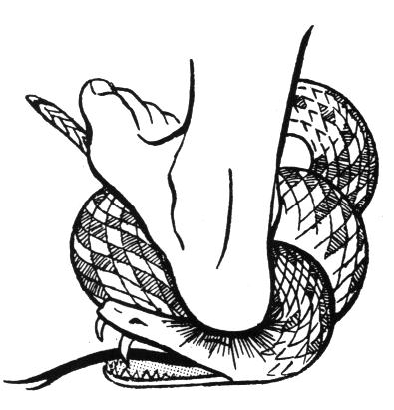
Genesis 3:15
“And I will put enmity Between you and the woman, And between your seed and her Seed; He shall bruise your head, And you shall bruise His heel.”
A Promise of
a Redeemer
Christ
“bruise His heel”
(Death)
Satan
“bruise your head”
(Resurrection)

Slide 22
Who
is
Jesus
Christ?
Born of a virgin (Matt. 1:23)
Messiah (John 4:25-26)
Son of God –Deity (John 9:35; 5:17-18)
Died on the cross (1 Cor. 2:2)
Raised from the dead (Rom. 1:4)
Evidence of His Claim
The Miracles
“And truly Jesus did many other signs in the presence of His disciples, which are not written in this book; but these are written that you may believe that Jesus is the Christ, the Son of God, and that believing you may have life in His name.”
(John 20:30-31)

Slide 23

Christ Died as a Sacrifice
Sin (violation of law) Demands that a Penalty be Paid
Man Can’t Pay – Has Nothing to Pay
  Cannot be cleared
  Can only face the consequence (Rom. 6:23)
God Demands Blood Sacrifice
  Life is in the blood (Gen.9:4; Lev. 17:1-14; Deut. 12:23)
  Animal sacrifice could not pay the price (Heb. 10:4)
  Perfect sacrifice: Blood of Christ (1 Pet. 1:19)
He died so that we could be saved!
Matt. 26:28; Heb. 2:9; 9:22

Slide 24
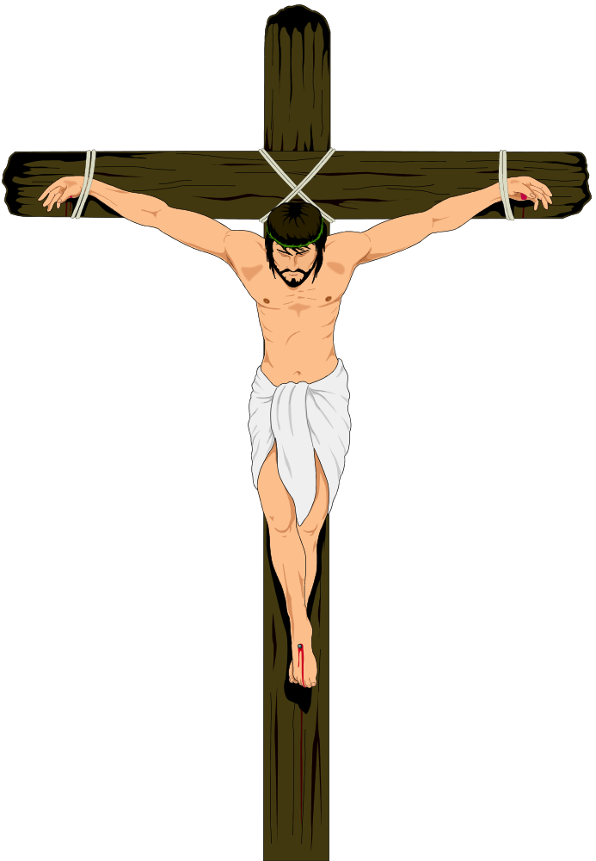
The Crucifixion
Crown of thorns (Matt. 27:29)
Nails in his hands (John 20:25)
Nails in his feet

Slide 25
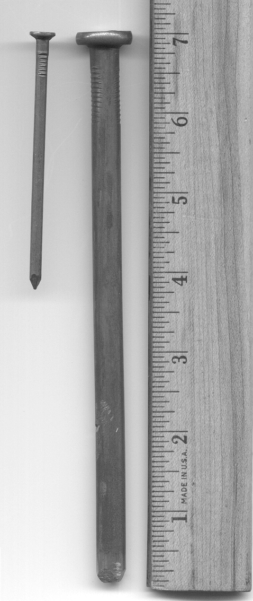
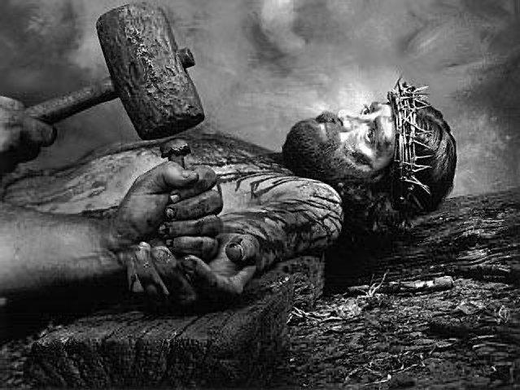

Slide 26
The Crucifixion
Crown of thorns (Matt. 27:29)
Nails in his hands (John 20:25)
Nails in his feet
Shame – as a criminal (Matt. 27:38)
Can’t breathe – suffocates
Pierced his side (John 19:34)

Slide 27
A Common Theme
  A golden thread through the Bible
  The coming of Jesus Christ
The Bible Library
Periods of the Bible

Slide 28

The Golden Thread Running Through the Bible:
Christ the Redeemer
Genesis
Preserving a Nation
Leviticus -
Deut.
Kings & Chronicles
Isaiah
Joshua - Judges
Building a Nation
Exodus
Ruth
A Nation Departs
Jesus is the Messiah
Jeremiah
Matthew –
Luke
A Remnant Returns
The Messiah is Coming
John
Daniel
Ezra
Nehemiah
Acts
Live for Christ, Our Redeemer
Ezekiel
Epistles
Revelation

Slide 29
The Coming of Christ
Christ is Coming
Christ has Come
Christ is Coming Again
Genesis – Malachi
Preaching of John the Baptist
Matthew - John
Acts
Acts
Romans – Revelation

Slide 30
A Common Theme
  A golden thread through the Bible
  The coming of Jesus Christ
The Bible Library
Periods of the Bible

Slide 31
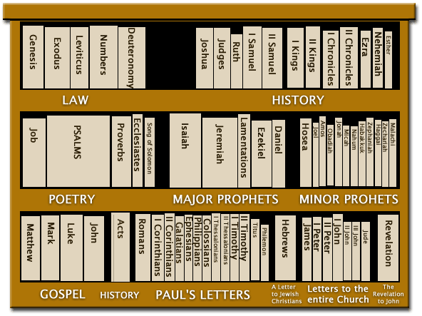
5
12
Old Testament
Bible Library
5
5
12
New Testament
4
1
14
7
1

Slide 32
A Common Theme
  A golden thread through the Bible
  The coming of Jesus Christ
The Bible Library
Periods of the Bible

Slide 33



End
of
World
Patriarchal Age
Gospel Age
For All Men
Mosaic Age
For Jews Only
Patriarchal Age
Began at Creation
God spoke to family head
Mosaic Age
For Abraham’s decendants (Deut. 5:1-3)
Law was temporary (Jer. 31:31-34)
To bring men to Christ (Gal. 3:19-29)
Gospel Age
Began at the cross
New Testament effective by the death of Christ (Heb. 9:16-17)

Slide 34
Back to the Bible
A Five Lesson Home Bible Study
The Bible is God’s Word
Applying the Bible Today
The Theme of the Bible
What the Bible Says about Salvation
The Church in the Bible
Each Lesson Last One Hour Or Less

