Slide 2
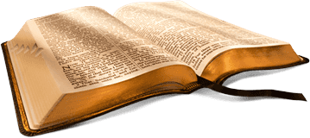
Back to the Bible
A Five Lesson Home Bible Study
The Bible is God’s Word
Applying the Bible Today
The Theme of the Bible
What the Bible Says about Salvation
The Church in the Bible
Each Lesson Last One Hour Or Less

Slide 3
Back to the Bible – Lesson One
Review
The Bible Is God’s Word
The Resurrection of Christ from the Dead
  Why begin here?
  Evidence of the resurrection
God Is and His Word is True
  God is…
  His Word is True
Inspiration of the Bible
  Plenary (Complete)
  Verbal (Every word)

Slide 4
Review
If Jesus was raised from the dead:
God Is….
Jesus is the
Son of God
Why Begin Here?
Word is True
“Hub” of Gospel

Slide 5
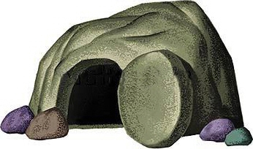
Review
The Resurrection of Christ
The Empty Tomb
Transformation of Disciples
Change in the Jews
Witnesses
Appearances (John 20:25-28)
Conversion of Saul
Manuscript Evidence

Slide 6
Review
Therefore
God is….
We can know there is a God!
We can know there is evidence
My faith is not a blind leap
Word of God is True
Agreement with science
Prophecy Fulfilled
Historically Accurate
Unity of writers
Archaeology

Slide 7
Inspiration of The Bible
Review
Verbal
Verbal
Plenary
Plenary
All The Bible
“All Scripture is given by inspiration of God, and is profitable for doctrine, for reproof, for correction, for instruction in righteousness,”
(2 Tim. 3:16)
Every Word
“These things we also speak, not in words which man’s wisdom teaches but which the Holy Spirit teaches, comparing spiritual things with spiritual.
(1 Cor. 2:13)

Slide 8
Review
Accept it as God’s word (1 Thess. 2:13)
Believe what it says (Rom. 10:17)
Seek to know and understand it (John 8:32)
Want to do what it says (Matt. 7:21; John 12:48)
If The Bible Is God’s Word, Then I Should:

Slide 9
Back to the Bible – Lesson Two
Applying The Bible Today
Can We Understand the Bible?
  The Bible can be understood
  We can understand it alike
Does it Make a Difference What One Believes?
  A popular concept
  It makes a difference what one – believes
  It makes a difference what one – practices
  Consequences

Slide 10
The Two Covenants
  The two covenants are different
  The Old Covenant has been taken away
  We are under the New Covenant
The Authority of the Word
  From the mind of God to the written word
  The Bible has the power and authority of God behind it
    To accept it is to accept God
    To reject it is to reject God

Slide 11
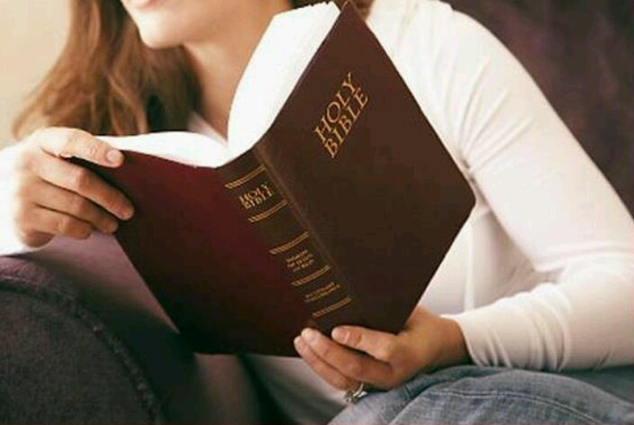
Can We Understand the Bible?
If not, it is God’s fault
Bible is written on 5th grade level
Average word is 5 letters
Can and must be understood
  John 8:32
  Eph. 3:3-5
  Eph. 5:17

Slide 12
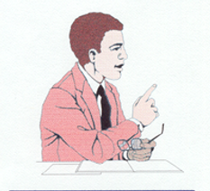
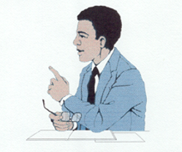
Can We Understand The Bible Alike?
4 Understands | 2+2= | 4 Understands
6 Does Not Understand | 2+2= | 4 Understands
Son of God Understands | Who is Jesus? | Son of God Understands
Son of God Understands | Who is Jesus? | A Son Does not Understand
If they understand, it will be alike!

Slide 13
Back to the Bible – Lesson Two
Applying The Bible Today
Can We Understand the Bible?
  The Bible can be understood
  We can understand it alike
Does it Make a Difference What One Believes?
  A popular concept
  It makes a difference what one – believes
  It makes a difference what one – practices
  Consequences

Slide 14

A Very Popular Concept
Faith alone - “Just believe in the Lord”
“Sincerity is all that matters”
“Join the church of your choice”
Good moral people = Christians
“We are all wrong about something”

Slide 15



An Objective Standard
Fixed
Standard
Makes A
Difference
What - Believe
What is written (2 Cor. 4:13)
Oracles of God (1 Pet. 4:11)
Commandments (1 Cor. 14:37)
Word of God (1 Thess. 2:13)
Inspired Scriptures (2 Tim. 3:16-17)
Words chosen by the Holy Spirit (1 Cor. 2:9-13)

Slide 16
2 Thess. 2:10-12
Lie Truth
Deceived (v.10)
Not love truth (v. 10)
Deluded (v. 11)
Believe lie (v. 11)
Not believe truth (v. 12)
Pleasure in unright. (v. 12)
Love truth (v. 10)
Believe truth (v. 12)
Saved (v. 10)
Perish (v. 10)
Condemned (v. 12)

Slide 17
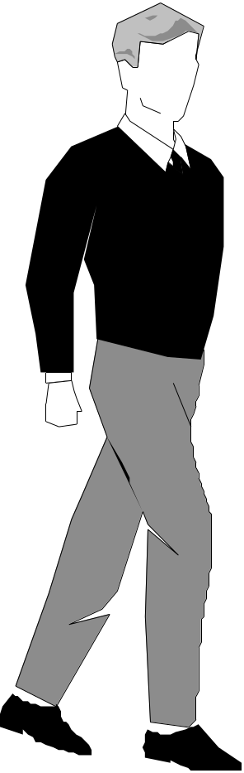
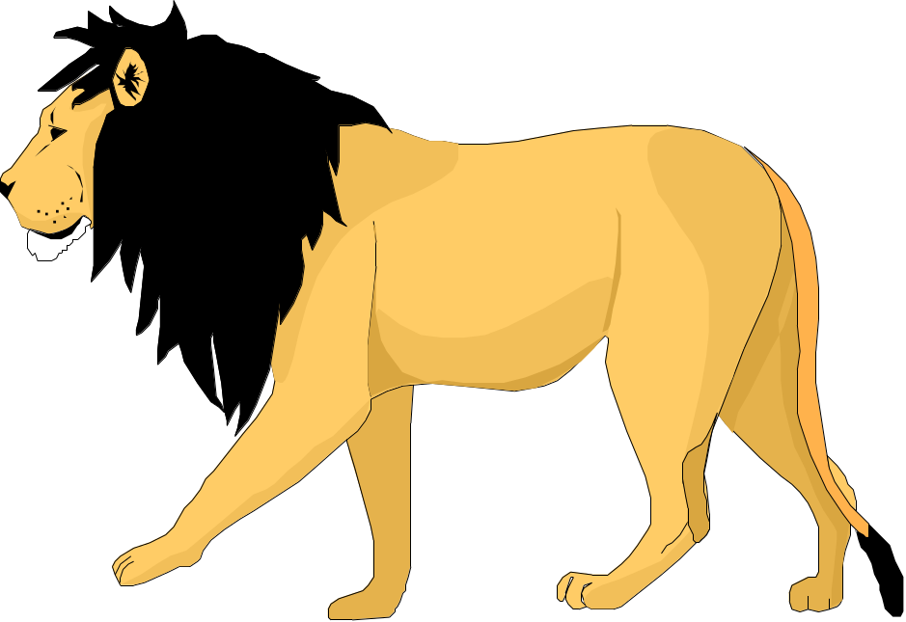
Believing A Lie
1 Kings 13
Truth:
Do not eat bread
Do not drink water
Do not return
by the same way
Lie:
“Bring him back to your
house, that he
may eat bread
and drink water.”

Slide 18
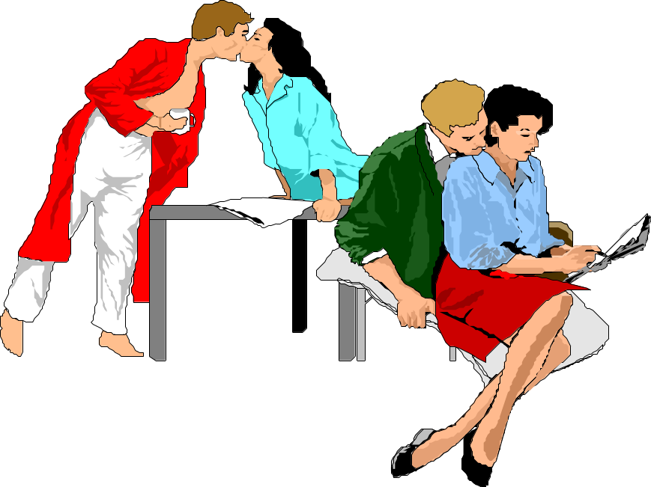
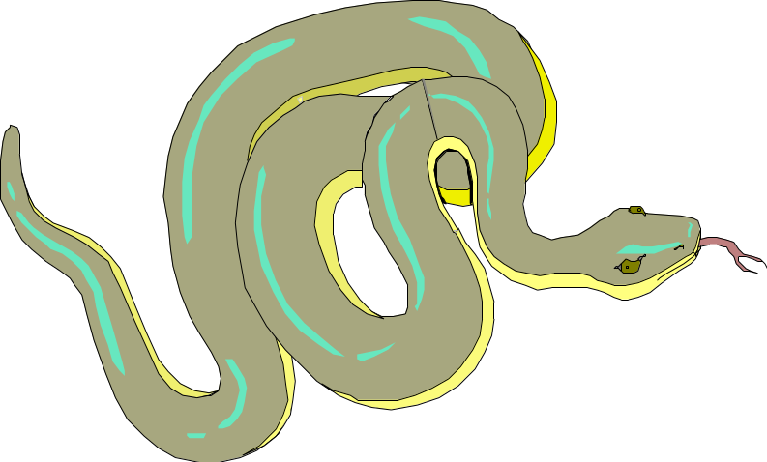
It Makes a Difference What One Practices in Religion
If not – Can do anything!
  Handle snakes
  Immoral acts

Slide 19
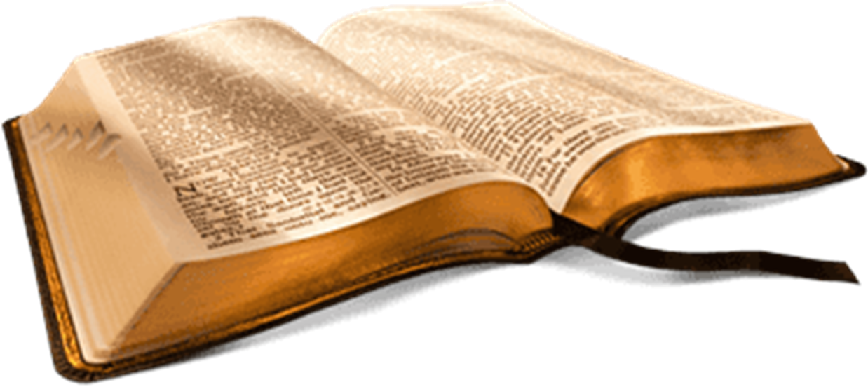
Our Practice
Must Be
Authorized
By Word of God
It Makes a Difference What One Practices in Religion
According to the pattern (Heb. 8:5)
In the name of the Lord (Col. 3:17)
Within the doctrine of Christ (2 John 9)
By the rule (Phil. 3:16)

Slide 20
The Difference It Makes
Our Practice Affects Our:
Eternal Salvation
(Matt. 7:22-23)
Fellowship with God
(2 John 9)

Slide 21
Consequences
If It Doesn’t
Make Any Difference
If It Does
Make A Difference
Doesn’t matter whether one believes or not
Doesn’t make any difference whether one believes the Bible
What Bible says - unimportant
What God says - unimportant
I need to know the truth (John 8:32)
I need to study & examine what I am taught (Acts 17:11)
I need to obey truth (1 Pet. 1:22)
I need to be careful (Eph. 5:15)

Slide 22
The Two Covenants
  The two covenants are different
  The Old Covenant has been taken away
  We are under the New Covenant
The Authority of the Word
  From the mind of God to the written word
  The Bible has the power and authority of God behind it
    To accept it is to accept God
    To reject it is to reject God

Slide 23
Old Testament
New Testament
Israel
(Exo. 20:2; 31:13, 16, 17; Deut. 5:1-3)
Added – Trans.
Bring Men to Christ
(Gal. 3:17-25)
Till Seed Come
(Gal. 3:19; Rom. 7:1-4; Gal. 3:24-25)
All Men
(Mark 16:15-16; Mt. 28:29-20)
Salvation
(Rom. 1:16-17; 8:1-2)
Till End
(Matt. 28:19-20)
To Whom Given
Purpose
Duration
Different

Slide 24

The Old Covenant
Has Been Taken Away
Dead to the law (Rom. 7:1-4)
Nailed to the cross (Col. 2:14)
No longer under it (Gal. 3:24-25)

Slide 25

Today We Are Under The New Covenant
Old
New
Jer. 31
God Promised A New Covenant Would Come

Slide 26
Jeremiah 31:31-34
31 "Behold, the days are coming, says the LORD, when I will make a new covenant with the house of Israel and with the house of Judah-
32 not according to the covenant that I made with their fathers in the day that I took them by the hand to lead them out of the land of Egypt, My covenant which they broke, though I was a husband to them, says the LORD.
33 But this is the covenant that I will make with the house of Israel after those days, says the LORD: I will put My law in their minds, and write it on their hearts; and I will be their God, and they shall be My people.
34 No more shall every man teach his neighbor, and every man his brother, saying, 'Know the LORD,' for they all shall know Me, from the least of them to the greatest of them, says the LORD. For I will forgive their iniquity, and their sin I will remember no more."

Slide 27
Heb 8:7-13
7 For if that first covenant had been faultless, then no place would have been sought for a second.
8 Because finding fault with them, He says: "Behold, the days are coming, says the LORD, when I will make a new covenant with the house of Israel and with the house of Judah–
9 not according to the covenant that I made with their fathers in the day when I took them by the hand to lead them out of the land of Egypt; because they did not continue in My covenant, and I disregarded them, says the LORD.
10 For this is the covenant that I will make with the house of Israel after those days, says the LORD: I will put My laws in their mind and write them on their hearts; and I will be their God, and they shall be My people.

Slide 28
Heb 8:7-13
11 None of them shall teach his neighbor, and none his brother, saying, 'Know the LORD,' for all shall know Me, from the least of them to the greatest of them.
12 For I will be merciful to their unrighteousness, and their sins and their lawless deeds I will remember no more."
13 In that He says, "A new covenant," He has made the first obsolete. Now what is becoming obsolete and growing old is ready to vanish away.

Slide 29
Two Conclusions:
There would be a NEW covenant
The New would be different than the Old

Slide 30
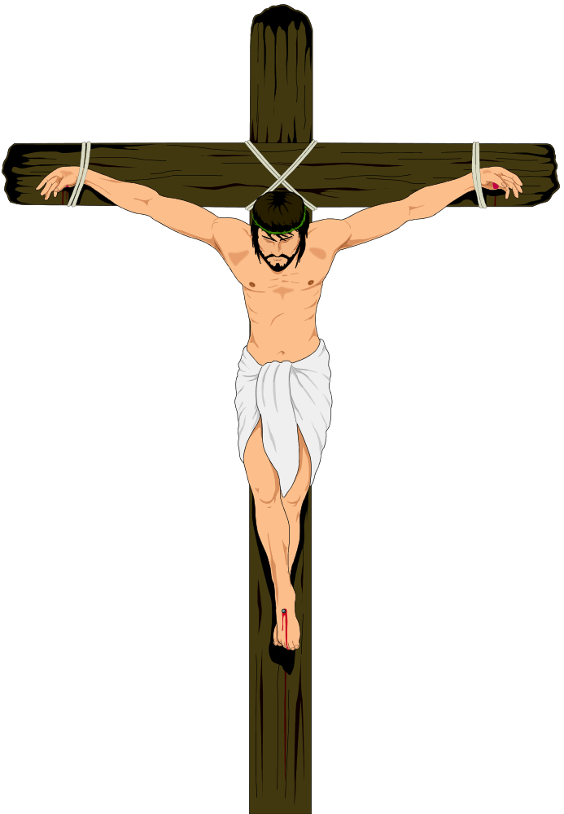
The New Covenant Became Law Upon the Death of Christ
Heb. 9:16-17
¹⁶ For where there is a testament, there must also of necessity be the death of the testator.
¹⁷ For a testament is in force after men are dead, since it has no power at all while the testator lives.

Slide 31
The Two Covenants
  The two covenants are different
  The Old Covenant has been taken away
  We are under the New Covenant
The Authority of the Word
  From the mind of God to the written word
  The Bible has the power and authority of God behind it
    To accept it is to accept God
    To reject it is to reject God

Slide 32
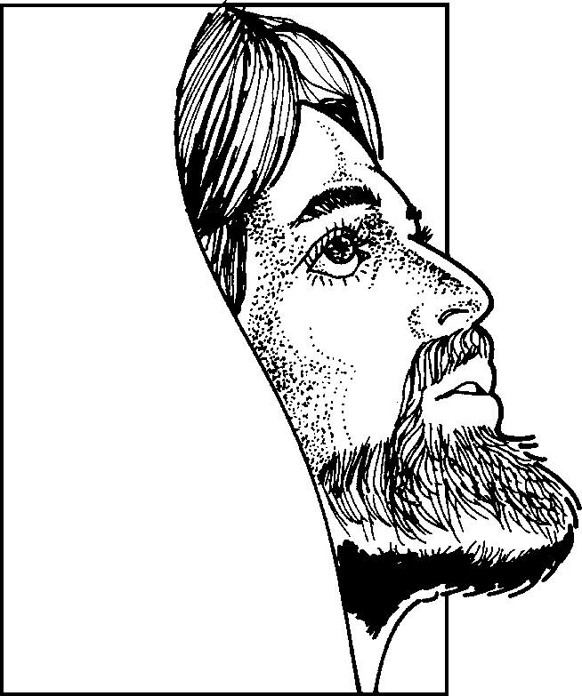
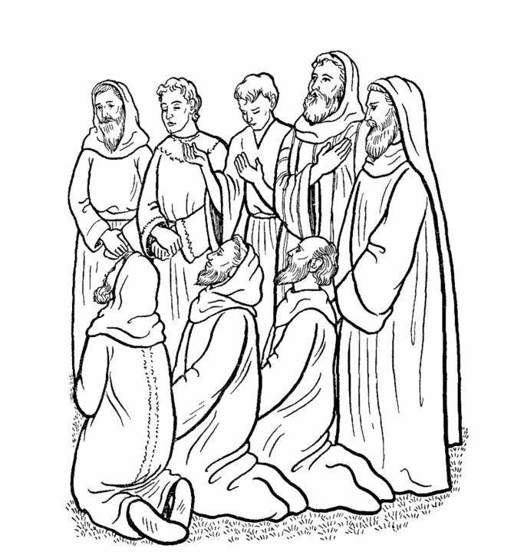
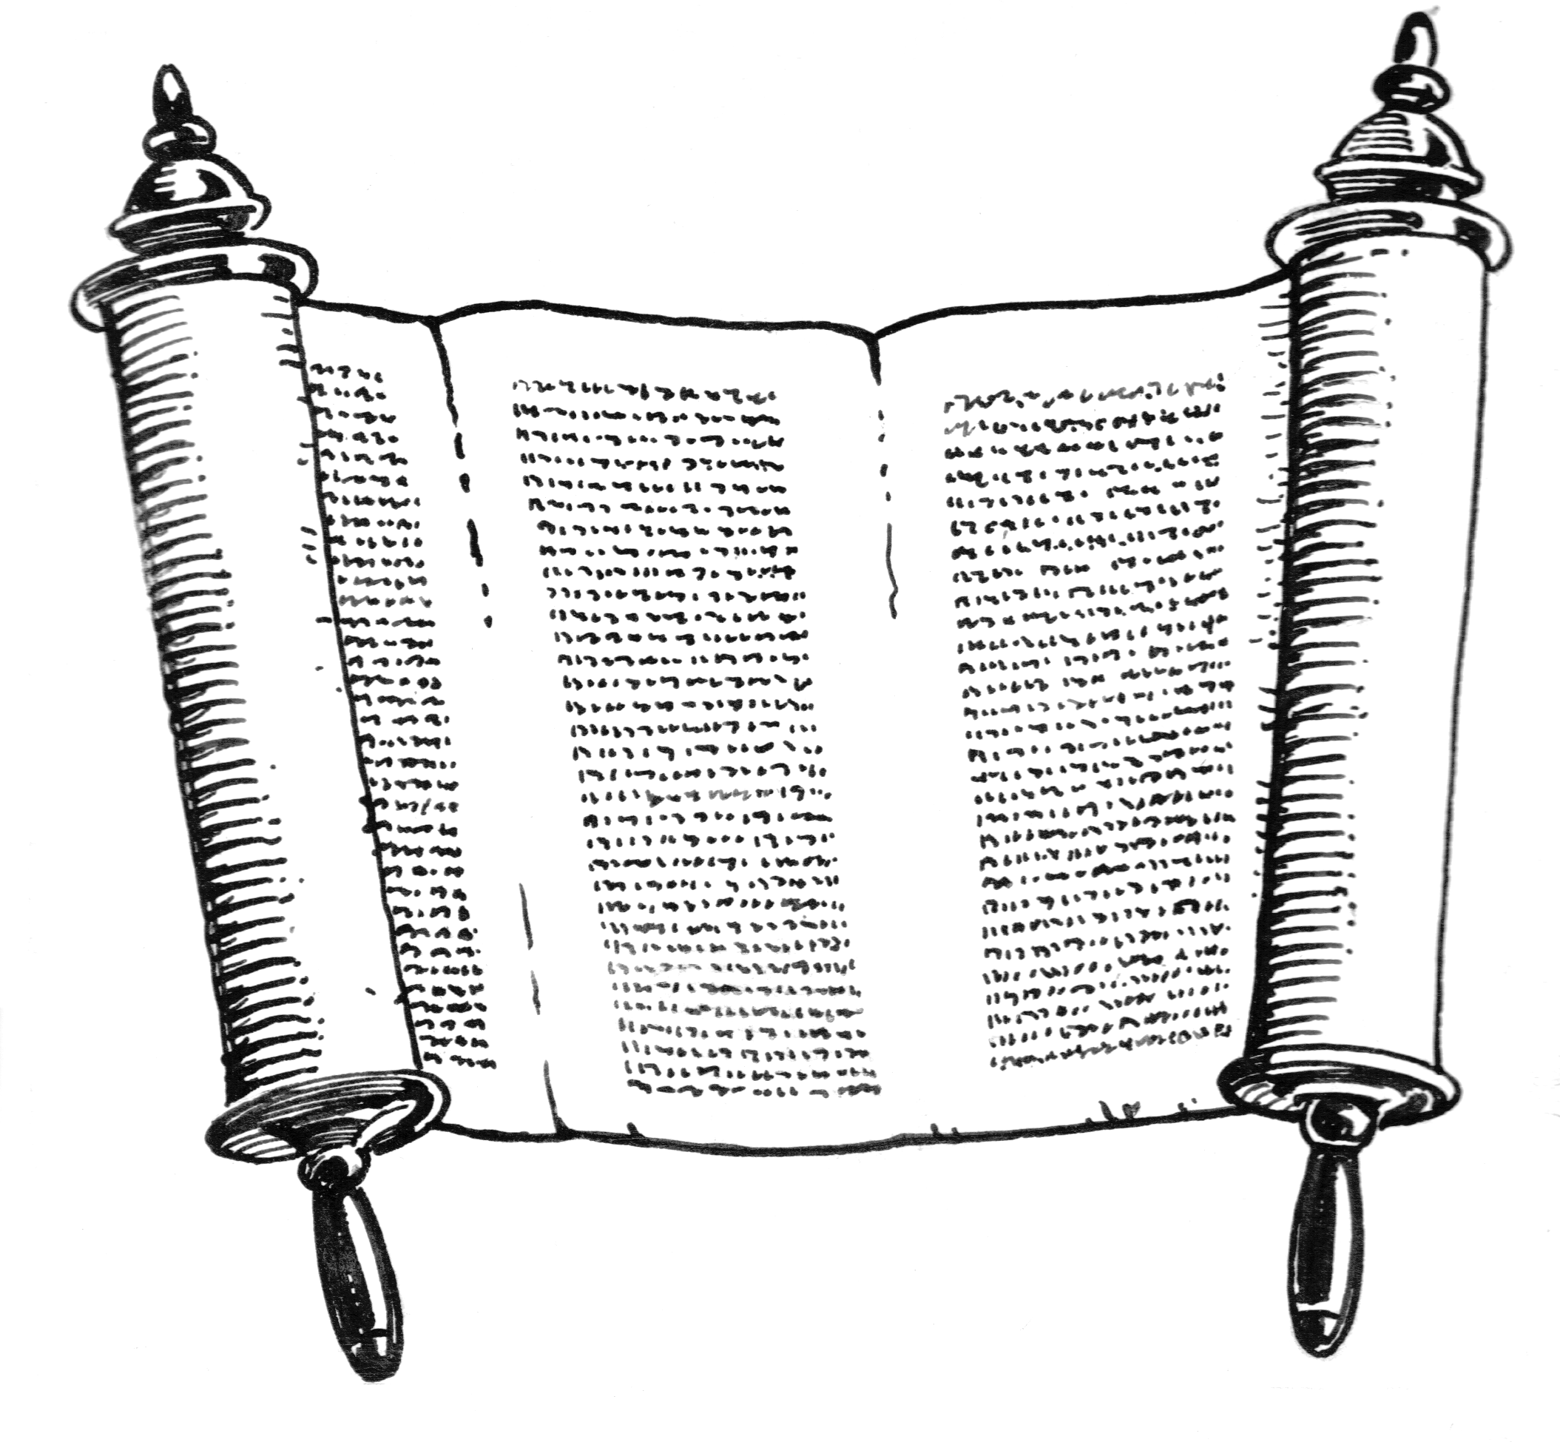
From the Mind of God to the Written Word
God
Holy
Spirit
John 14:26; 15:26; 16:13
Matt. 10:19
Heb. 1:1-2
Matt. 28:18
John 16:13; 1 Cor. 14:37
The word has the power and authority of God behind it!
Original Writings
Eph. 3:3-5
Apostles & Prophets
Eph.3:3-5; 1 Cor. 2:9-13

Slide 33
How God Teaches & Authorizes
John 13:34-35
34 A new commandment I give to you, that you love one another; as I have loved you, that you also love one another.
35 By this all will know that you are My disciples, if you have love for one another."
1. Command /
Direct Statement
2. Approved Example
3. Necessary Inference

Slide 34
Establishing Bible Authority
Acts 15
Command / Statement
VV. 13-21 – James appealed to direct statement from Amos 9
Approved Example
V. 12 – Paul & Barnabas appealed to example of their work & miracles
Necessary Inference
VV. 7-11 – Peter appealed to events at Cornelius’ house – infers…

Slide 35
Back to the Bible
A Five Lesson Home Bible Study
The Bible is God’s Word
Applying the Bible Today
The Theme of the Bible
What the Bible Says about Salvation
The Church in the Bible
Each Lesson Last One Hour Or Less

