Slide 2

Back to the Bible
A Five Lesson Home Bible Study
The Bible is God’s Word
Applying the Bible Today
The Theme of the Bible
What the Bible Says about Salvation
The Church in the Bible
Each Lesson Last One Hour Or Less

Slide 3
Back to the Bible – Lesson One
The Bible Is God’s Word
The Resurrection of Christ from the Dead
  Why begin here?
  Evidence of the resurrection
God Is and His Word is True
  God is…
  His Word is True
Inspiration of the Bible
  Plenary (Complete)
  Verbal (Every word)

Slide 4
If Jesus was raised from the dead:
God Is….
Jesus is the
Son of God
Why Begin Here?
Word is True
“Hub” of Gospel

Slide 5
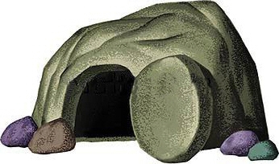
The Resurrection of Christ
The Empty Tomb

Slide 6
The Tomb Itself
New Tomb (Luke 23:53; John 19:41)
Made of Solid Rock (Matt. 27:60; Mark 15:46)
Only Opening Sealed with a Great Stone (Mark 16:4; Matt. 27:62-66)
Found in the tomb: linen cloths & face cloth (John 20:6-7)

Slide 7
The Resurrection of Christ
The Empty Tomb
  Tomb was empty (Matt. 28:6)
  How did it become empty?
    “Swoon” Theory
    Disciples stole it
    Enemies stole it
    Really raised from dead!

Slide 8
The Resurrection of Christ
The Empty Tomb
Transformation of Disciples
  Hearts were troubled (John 14:1-3)
  Shortly after – Changed!
  Peter is an example:
    Prior to death (Matt. 26:69-75)
    At tomb (Luke 24:12)
    Within days he was bold:
      Acts 4:19-20
      Acts 5:29

Slide 9
The Resurrection of Christ
The Empty Tomb
Transformation of Disciples
Change in the Jews
  They wanted to kill Jesus (Mk. 15:13-14)
  Heard sermon about resurrection (Acts 2:21-36)
  Convinced & obeyed (Acts 2:37-41)

Slide 10
The Resurrection of Christ
The Empty Tomb
Transformation of Disciples
Change in the Jews
Witnesses

Slide 11
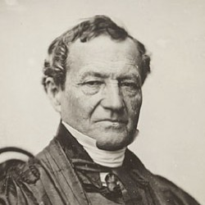
Criteria for Witnesses
“The credit due to the testimony of witnesses depends upon firstly, their honesty; secondly, their ability; thirdly, their number and the consistency of their testimony; fourthly, the conformity of their testimony with experience; and fifthly, the coincidence of their testimony with collateral circumstances” (p. 28)
Simon Greenleaf
Testimony of the Evangelist
Practiced law 1806-1853
Professor at Harvard Law School
Honesty
Ability
Number (agreement)

Slide 12
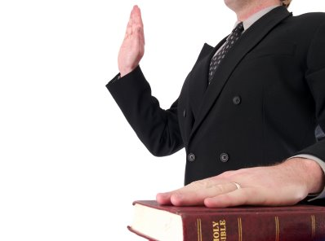
  Honest
    Suffered for cause (would they if knew it was a lie?)
    Tell of own faults:
      Peter’s denial (Matt. 26:69-75)
      Ambition (Matt. 20:20-28)
      Failure to understand (Jn. 20:9)
    Reasons for lying cannot be found:
      Fear – testified in face of death!
      Greed – had nothing to gain
      Ambition – no power was gained
Witnesses

Slide 13
  Honest
  Competent (Ability)
    Been with Christ since his baptism (Acts 1:21-22)
    Matthew was a tax collector
    Luke was a doctor
    Peter, Andrew, James & John were business men
    John noted details (Jno. 20:7)
    Paul was highly educated
Witnesses

Slide 14
  Honest
  Competent (Ability)
  Number (and agreement)
    Reach point need no more witness needed (cf. Lk. 22:71)
    All said the same thing
    Over 500 claimed they saw him (1 Cor. 15:6)
Witnesses

Slide 15
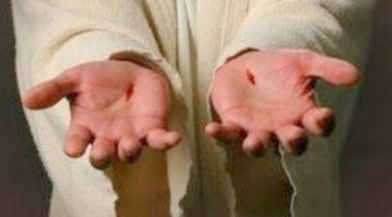
The Resurrection of Christ
The Empty Tomb
Transformation of Disciples
Change in the Jews
Witnesses
Appearances (John 20:25-28)

Slide 16
Appeared to Many
  Mary Magdalene (Jn. 20:14-18; Mk. 16:9)
  Two other women (Mt. 28:9)
  Simon –Cephas (Lk. 24:34; 1 Cor. 15:5)
  Two on road to Emmaus (Lk. 24:13)
  The eleven (Lk. 24:33-49; Mk. 16:14; Jn. 20:19-23)
  Over 500 at once (1 Cor. 15:6)
  James (1 Cor. 15:7)
  All apostles –including Thomas (1 Cor. 15:7; Jn. 20:26-29)
  Peter, Thomas, Nathanael, James, John, and others (Jn. 21:1-14)
  Eleven giving great comm. (Mt. 28:16-20)
  Eleven at Jerusalem (Lk. 24:44-49; Acts 1:3-8)
  Eleven at mount of Olives (Lk. 24:50-53: Acts 1:9-11)
  Paul (1 Cor. 15:8; Acts 9:1-9)

Slide 17
The Resurrection of Christ
The Empty Tomb
Transformation of Disciples
Change in the Jews
Witnesses
Appearances (John 20:25-28)
Conversion of Saul

Slide 18
Conversion of Saul
Argument Presented by Lord George Lyttelton in 1747
  Gilbert West – Resurrection of Christ
  Lord Lyttelton – Conversion of Saul
  Set out to disprove the resurrection
  Changed – to believe in resurrection
  Lyttelton: “The conversion was of itself a demonstration sufficient to prove Christianity to be a divine revelation”

Slide 19
Conversion of Saul
Argument Presented by Lord George Lyttelton in 1747
Lyttelton’s Four Propositions:
  Paul was an imposter
  Paul was an enthusiast – imagination
  Paul was deceived (by others)
  What he said about his conversion – really happened

Slide 20
Conversion of Saul
Argument Presented by Lord George Lyttelton in 1747
Lyttelton’s Four Propositions:
Paul was not an imposter
  No motive for lying
    Money
    Reputation
    Power
  Placed his story on road to Damascus
  Miracles he worked shows he as not a fraud (Acts 13, 14, 16)

Slide 21
Conversion of Saul
Argument Presented by Lord George Lyttelton in 1747
Lyttelton’s Four Propositions:
Paul was not an imposter
Paul was not an enthusiast
  An enthusiast sees things he is looking for – Saul was not looking for resurrected Lord
  Were other witnesses (Acts 22, 26)
  No marks of an enthusiast
    Temper – wild and unreasonable
    Ignorance – (cf. Acts 26:24)
    Misguided zeal

Slide 22
Conversion of Saul
Argument Presented by Lord George Lyttelton in 1747
Lyttelton’s Four Propositions:
Paul was not an imposter
Paul was not an enthusiast
Paul was not deceived by others
  Impossible to produce a light brighter than noon sun
  Could not cause the voice to be heard
  Nor could they cause Saul to be blind for 3 days (and then return his sight)
Only Conclusion:
It Really Did Happen!

Slide 23
The Resurrection of Christ
The Empty Tomb
Transformation of Disciples
Change in the Jews
Witnesses
Appearances (John 20:25-28)
Conversion of Saul
Manuscript Evidence

Slide 24
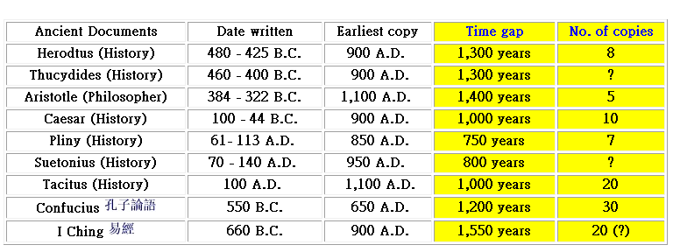
Original
Autograph
MS
MS
5,000+
http://www.faithhelper.com/ntrel2.htm
Notes:
http://www.faithhelper.com/ntrel2.htm

Slide 25
Back to the Bible – Lesson One
The Bible Is God’s Word
The Resurrection of Christ from the Dead
  Why begin here?
  Evidence of the resurrection
God Is and His Word is True
  God is…
  His Word is True
Inspiration of the Bible
  Plenary (Complete)
  Verbal (Every word)

Slide 26
Therefore
God is….
We can know there is a God!
We can know there is evidence
My faith is not a blind leap
Word of God is True
Agreement with science
Prophecy Fulfilled
Historically Accurate
Unity of writers
Archaeology

Slide 27
Back to the Bible – Lesson One
The Bible Is God’s Word
The Resurrection of Christ from the Dead
  Why begin here?
  Evidence of the resurrection
God Is and His Word is True
  God is…
  His Word is True
Inspiration of the Bible
  Plenary (Complete)
  Verbal (Every word)

Slide 28
Inspiration of The Bible
Verbal
Verbal
Plenary
Plenary
All The Bible
“All Scripture is given by inspiration of God, and is profitable for doctrine, for reproof, for correction, for instruction in righteousness,”
(2 Tim. 3:16)
Every Word
“These things we also speak, not in words which man’s wisdom teaches but which the Holy Spirit teaches, comparing spiritual things with spiritual.
(1 Cor. 2:13)

Slide 29
Accept it as God’s word (1 Thess. 2:13)
Believe what it says (Rom. 10:17)
Seek to know and understand it (John 8:32)
Want to do what it says (Matt. 7:21; John 12:48)
If The Bible Is God’s Word, Then I Should:

Slide 30
Back to the Bible
A Five Lesson Home Bible Study
The Bible is God’s Word
Applying the Bible Today
The Theme of the Bible
What the Bible Says about Salvation
The Church in the Bible
Each Lesson Last One Hour Or Less

