Slide 2
The Importance of Fellowship
Refuse to fellowship those we should
Extend fellowship to those we should not
(3 John 9-11)
(2 John 9-11)

Slide 3
What Is
Biblical Fellowship?
Review
The Meaning of Fellowship
The Direction of Fellowship
The Use of Fellowship
The Conclusions about Fellowship

Slide 4
2 Corinthians 6:14–17
¹⁴ Do not be unequally yoked together with unbelievers. For what fellowship has righteousness with lawlessness? And what communion has light with darkness?
¹⁵ And what accord has Christ with Belial? Or what part has a believer with an unbeliever?
¹⁶ And what agreement has the temple of God with idols? For you are the temple of the living God. As God has said: “I will dwell in them And walk among them. I will be their God, And they shall be My people.”
¹⁷ Therefore “Come out from among them And be separate, says the Lord. Do not touch what is unclean, And I will receive you.”
Review
Common Work
Share in Action
koinonia
Harmony of thought
A part together with
others
A union of purpose
Thus:
Agreement in principle
leading to joint or common action in spiritual work

Slide 5
Review
Fellowship
In The Truth
The Basis
The Objections
The Application

Slide 6
Review
The Basis
Truth is the basis for unity
Truth is the basis for fellowship
Truth is the basis for rejecting
Truth includes the whole revelation
Unity & Fellowship is Dear & Precious
But Should Not be Maintained at the Expense of Truth!

Slide 7
Review
Receive Him
(Rom. 14)
The Context
The Point
The Chapter
The Abuse
The Application

Slide 8

Review
The Point
Continue in Fellowship
In Spite of Differences
Receive him (v. 1)
Don’t dispute (v. 1)
Pursue things that make for peace (v. 19)
Don’t bind your opinion on others (v. 22)

Slide 9
Romans 14
Review
Doctrine
Faith
Morals
Indifference
Liberty
?
God received him (v. 3)
To the Lord (v. 6)
Not to judge (condemn) him (v. 13)
Not wrong within itself (v. 14)
Keep it to self (v. 22)

Slide 10
Do Not Receive Him
(2 John 9-11)
Review

Slide 11
Do Not Receive Him
(2 John 9-11)
Review
The Context
The Doctrine
The Condemned

Slide 12
Review
The Condemned
One who practices sin / error (v. 9)
One who teacher error (v. 10)
One who receives the false teacher (v. 11)

Slide 13
Applications to
Controversy
We must learn how to take Bible principles and apply them properly to current and future issues

Slide 14

Possible to Learn One
Without the Other
Learned
Principle
Not Learned
Application
Learned
Application
Not Learned
Principle

Slide 15
Applications to
Controversy
Principles that Must be Applied
Instructions that Must be Followed
Efforts that Must be Resisted
Warnings that Must be Heeded

Slide 16
Applications to
Controversy
Principles that Must be Applied

Slide 17
Principles that Must be Applied
Actions Based upon Authority
  Principle: We must respect Bible authority

Slide 18



We Must Have Bible Authority
God Has A Pattern
Hebrews 8:5
Then This
If This
Pattern
Model
Real

Slide 19
We Must Have Bible Authority
Do all in the name of the Lord
(Col. 3:17)
Abide within the doctrine of Christ
(2 John 9)

Slide 20
Principles that Must be Applied
Actions Based upon Authority
  Principle: We must respect Bible authority
  Question: What does the word say on this issue (cf. Jer. 37:17)?
  Question: What is the Bible pattern for fellowship in this type of issue?
    Is this a matter of liberty / indifference?
    Is this a matter of doctrine, faith, or morals?
    Respecting the Bible pattern for fellowship – is just as important as respecting it for worship!

Slide 21
Principles that Must be Applied
Actions Based upon Authority
Unity Based upon the Truth
  Principle:
    Truth is the basis for unity (John 17:6, 17, 20-21)
    Truth is the basis for fellowship (1 John 1:7; 2 Jno. 9)
  Applied:
    Question: Are we teaching and practicing the same things?
    Question: Is our unity / fellowship based upon truth or ignoring our differences?

Slide 22
Principles that Must be Applied
Actions Based upon Authority
Unity Based upon the Truth
Reaction Based upon the Pattern

Slide 23
Two Different Patterns
Romans 14
“Receive Him”
Matters of
Indifference
God receives him
We should too
2 John 9-11
“Do Not Receive Him”
Matters of
Faith / Doctrine
God rejects him
We should too

Slide 24
Principles that Must be Applied
Actions Based upon Authority
Unity Based upon the Truth
Reaction Based upon the Pattern
Forgotten / Ignored
Disregarded
When it is a friend / family
When it is a brother we like
When it is a brother in my “group”

Slide 25
Applications to
Controversy
Principles that Must be Applied
Instructions that Must be Followed
What instructions were given in OT & NT concerning dealing with sin and error? Accept it? Tolerate it? Correct it?

Slide 26
Instructions that Must be Followed
Old Testament – Sin & Error was not to be Accepted
  They committed idolatry (Jer. 2:11; 3:1; 5:7)
  Efforts made to justify (Jer. 2:29)
  False prophets preached acceptance (Jer. 5:12-13; 6:14; 8:11)
  ANSWER: Not accept it! But, correct it! (Jer. 7:3; 36:3, 7)

Slide 27
Instructions that Must be Followed
Old Testament – Sin & Error was not to be Accepted
New Testament – Sin & Error was not to be Accepted
  Case at Corinth
    Tolerating an adulterer (1 Cor. 5)
    Perversion of the Lord’s Supper (1 Cor. 11)
    Misuse of spiritual gifts (1 Cor. 12-14)
    Error taught on resurrection (1 Cor. 15)
    ANSWER: Not accept it! But, correct it! (1 Cor. 5:13; 11:33-34; 14:26-33; 15:33)

Slide 28
Instructions that Must be Followed
Old Testament – Sin & Error was not to be Accepted
New Testament – Sin & Error was not to be Accepted
  Case at Corinth
  Case at Rome
    Error (Judaism) is addressed in the book (3:20-21)
    ANSWER: Not accept it! But, correct it! (Rom. 16:17-18)

Slide 29
Instructions that Must be Followed
Old Testament – Sin & Error was not to be Accepted
New Testament – Sin & Error was not to be Accepted
  Case at Corinth
  Case at Rome
  Case in Asia
    Doctrinal error tolerated (Rev. 2:14, 20)
    Moral sins accepted (2:14)
    ANSWER: Not accept it! But, correct it! (2:16, 22; 3:3, 19)

Slide 30
Instructions that Must be Followed
Old Testament – Sin & Error was not to be Accepted
New Testament – Sin & Error was not to be Accepted
No Instructions in Old or New Testaments:
  To receive or accept the practice of sin!
  To receive or accept doctrinal diversity!
  To receive or accept diversity of morals!
  To receive or accept teachers of error!

Slide 31
Applications to
Controversy
Principles that Must be Applied
Instructions that Must be Followed
Efforts that Must be Resisted
Efforts to broaden the scope of fellowship

Slide 32
Efforts that Must be Resisted
Redefine “Fellowship”

Slide 33
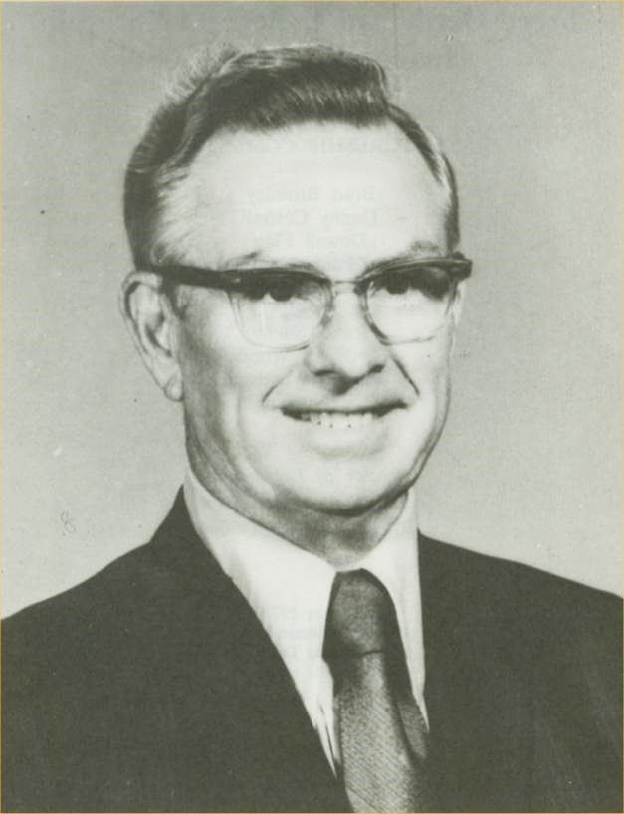
“If you allow a false teacher to create his own vocabulary, his arguments will be unanswerable.”
G. K. Wallace
1903-1988
Alan Highers, How Do You Spell (F)(f)ELLOWSHIP?, 17

Slide 34
Efforts that Must be Resisted
Redefine “Fellowship”
  Can have fellowship in matters wherein we agree, but not fellowship the error taught (cf. 2 John 9-11)
  Fellowship is merely a local church matter. There is no fellowship beyond a local church (cf. 2 Cor. 8:4; Phil. 1:5; 4:14-16)
  Some use the terms “associate” or “reach out” for fellowship.

Slide 35
2 Corinthians 6:14–17
¹⁴ Do not be unequally yoked together with unbelievers. For what fellowship has righteousness with lawlessness? And what communion has light with darkness?
¹⁵ And what accord has Christ with Belial? Or what part has a believer with an unbeliever?
¹⁶ And what agreement has the temple of God with idols? For you are the temple of the living God. As God has said: “I will dwell in them And walk among them. I will be their God, And they shall be My people.”
¹⁷ Therefore “Come out from among them And be separate, says the Lord. Do not touch what is unclean, And I will receive you.”
Common Work
Share in Action
koinonia
Harmony of thought
A part together with
others
A union of purpose
Thus:
Agreement in principle
leading to joint or common action in spiritual work

Slide 36
Efforts that Must be Resisted
Redefine “Fellowship”
Redefine “False Teacher”

Slide 37
“False Teacher”
Teaches
error /
false doc.
Dishonest
?
Consequence: honest man could not be a false teacher
Consequence: Teacher’s attitude makes the difference:

Slide 38





Doctrine:
Guilty Party
Can
Remarry
--------------
Error / False
Teaches
Teaches
Dishonest
Honest
Marry
Marry
Which Couple
Is In Adultery?

Slide 39
“False Teacher”
Teaches
error /
false doc.
Dishonest
?
Consequence: honest man could not be a false teacher
Consequence: Teacher’s attitude makes the difference:
How do we know if one is a false teacher?
By what he teaches (1 John 4:1, 6)

Slide 40
2 Peter 2:1 – “False Teachers”
Argument: “False Teachers” = Dishonest (vv. 3, 10)
Before and after – emphasis on adherence to the word
  Before: 2 Pet. 1:12
  After: 2 Pet. 3:1-2
“False teacher” paralleled to “false prophet” (v. 1)
  Reference to “false prophets” of OT
  Taught false doctrine (Jer. 5:31)
Teach destructive heresies (2 Pet. 2:1)

Slide 41
Efforts that Must be Resisted
Redefine “Fellowship”
Redefine “False Teacher”
Historical Consistency
  Argued that brethren in years past had unity in spite of differences over such issues as MDR
  Makes brethren the standard – not the word (1 Pet. 4:11; 1 Cor. 4:6)
  Some brethren had fellowship in spite of inst. Music
  History does not change 2 John 9-11

Slide 42
Efforts that Must be Resisted
Redefine “Fellowship”
Redefine “False Teacher”
Historical Consistency
Local Church Autonomy
  Argued that when we refuse fellowship & warn about teachers of error – violation of local church autonomy
  Makes the local church the standard (subjective standard) rather than the truth (objective standard)
  Paul warned churches where he was not a member (Gal. 1:7; 5:12)

Slide 43

Tolerant of error and its teachers
Broaden the scope of Romans 14
Narrow the scope of “false teacher”
Point of All This:
“Don’t call me a ‘false teacher’ or cut off
fellowship because you think my doctrine
is wrong. Allow me to teach what I want!”

Slide 44
Applications to
Controversy
Principles that Must be Applied
Instructions that Must be Followed
Efforts that Must be Resisted
Warnings that Must be Heeded

Slide 45
Warnings that Must be Heeded
Beware of drifting
  The winds of change are blowing
  Departure of the present day – differs from the past -now many symptoms:
    Softer preacher
    Loose on worldliness
    Blurring lines of individual and church
    Confusing cordiality / excitement with spirituality
    Divorce & remarriage
    Cast doubts on credibility of Genesis account
    Claims that we are not under law

Slide 46
Warnings that Must be Heeded
Beware of drifting
  The winds of change are blowing
  Departure of the present day – differs from the past -now many symptoms:
  Danger: the changes are gradual.

Slide 47

Hebrews 2:1
“Therefore we must give the more earnest heed to the things we have heard, lest we drift away” (NKJV)
Therefore we ought to give the more earnest heed to the things which we have heard, lest at any time we should let them slip. (KJV)
Footnote KJV “run out as leaking vessels”

Slide 48
Gradually & Slowly
Heb. 2:1
5
10
15
20
25
30
35
40
45
50
55

Slide 49
Gradually & Slowly
Heb. 2:1
55
60
65
70
75
80
85
90
95
100
105
110

Slide 50
Warnings that Must be Heeded
Beware of drifting
Understand there can be false teachers among us
  Acts 20:30
  2 Pet. 2:1

Slide 51
Warnings that Must be Heeded
Beware of drifting
Understand there can be false teachers among us
Know the text in context
  2 Pet. 3:16-18
  A well informed church – insulated against apostasy

Slide 52
Warnings that Must be Heeded
Beware of drifting
Understand there can be false teachers among us
Know the text in context
Realize that compromise will not work
  Common idea: I can teach against a doctrine while fellowshipping those who teach and practice it
  Contrary to 2 John 9-11
  Those who have tried – have failed

Slide 53
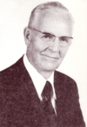
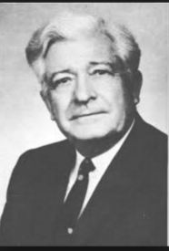
Churches That Would Not Tolerate Preaching Against Premillennialism
1930’s & 1940’s
During / shortly after the “Premillennialism” controversy
Many churches (rejected the false doctrine)
Also didn’t tolerate the preaching against it
Not one of them stood – 50’s /60’s
Roy E. Cogdill
Foy E. Wallace, Jr.

Slide 54
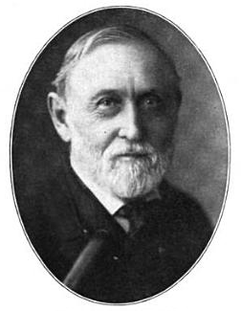
McGarvey Taught Against The Instrument
But Fellowshipped Those Who Used It
Brother McGarvey said to me: "Brother Sewell I want to say something to you, if you'll accept it in the spirit in which I mean it." I told him I'd appreciate anything he had to say to me. He said about these words, "You are or the right road, and whatever you do, don't ever let anybody persuade you that you can successfully combat error by fellowshipping it and going along with it. I have tried. I believed at the start that was the only way to do it. I've never held membership in a congregation that uses instrumental music. I have, however, accepted invitations to preach without distinction between churches that used it and churches that didn't. I've gone along with their papers and magazines and things of that sort. During all these years I have taught the truth as the New Testament teaches it to every young preacher who has passed through the College of the Bible. Yet, I do not know of more than six of those men who are preaching the truth today." He said, "It won't work.“
- J. P. Sewell
J. W. McGarvey
1829-1911
Doctrine of Christ and Unity of the Saints, 129-130

Slide 55
McGarvey Taught Against The Instrument
But Fellowshipped Those Who Used It
And as someone said, “while he preached against the organ he went where they used it and his influence went with his fellowship instead of with his teaching.” Someone wrote to me from Indiana and said, “Do you remember when you were there whether any of the students were influenced by McGarvey and his talk position on the organ?”
I said, “No I can’t remember a single man – a single one that was changed.”
It was because he didn’t teach it as consistently as he ought to and didn’t back it up by his presence.
Henry S. Ficklin, Reminiscing With McGarvey, Florida College Lectures, 1967
Lesson:
Can’t combat error by fellowshipping it
Influence will go with your fellowship!
J. W. McGarvey
1829-1911

Slide 56
Applications to
Controversy
Principles that Must be Applied
Instructions that Must be Followed
Efforts that Must be Resisted
Warnings that Must be Heeded

